Slide 3
Productivity and Quality Management
Lecture 11

Slide 4
Summary Last Lecture
Many of the perceived threats are result of problems in the organization that need to be understood and resolved.
Managing the introduction of a productivity measurement process involves managing resistance to change.

Slide 5
Summary Last Lecture
Quick Productivity Appraisal
Integrated audit approach
Includes diagnosis and monitoring of a productivity improvement program covering a whole organization
Steps in Company Performance Appraisal (CPA)
Problems of Productivity Analysis
Misunderstanding of Productivity measurement
Sound Productivity measurement system

Slide 6
Total Productive Maintenance

Slide 7
Objectives of This Lecture
Answers of the following questions are able to tell what role TPM can play within a company:
Does TPM replace traditional maintenance techniques ?
Why is it so popular and important ?
What are its policies and objectives ?
How does it fit in with TQM ?
What are its steps, activities and components?
What are its benefits and results ?

Slide 8
What is Maintenance?
Any Idea?
Maintenance, repair and operations (MRO) or maintenance, repair, and overhaul involves fixing any sort of mechanical, plumbing or electrical device should it become out of order or broken (known as repair, unscheduled, or casualty maintenance).
Notes:
Maintenance, repair and operations (MRO) or maintenance, repair, and overhaul involves fixing any sort of mechanical, plumbing or electrical device should it become out of order or broken (known as repair, unscheduled, or casualty maintenance).

Slide 9
TPM
TPM is a productive maintenance implemented by all employees in an organization.
TPM involves everyone in the organization from operators to senior management in equipment improvement.

Slide 10
What is TPM?
Total Productive Maintenance (TPM) is both
a philosophy to permeate throughout an operating company touching people of all levels
a collection of techniques and practices
aimed at maximizing the effectiveness (best possible return) of business facilities and processes

Slide 11
The TPM Philosophy

Slide 12
The TPM Philosophy
It is a Japanese approach for
Creating company culture for maximum efficiency
Striving to prevent losses with minimum cost
Zero breakdowns and failures, Zero accident, and Zero defects etc
The essence of team work (small group activity) focused on condition and performance of facilities to achieve zero loss for improvement
Involvement of all people from top management to operator

Slide 13
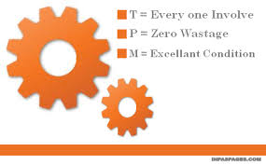
TPM in three words:
Total = All individuals in the organization working together.
Productive = production of goods that meet or exceed customer’s expectations.
Maintenance = keeping equipment and plant in good condition at all times.

Slide 14
Total Productive Management
Total Productive Maintenance transforms maintenance into a crucial part of the business structure instead of being merely a non-profit activity.
The crucial tenet is to keep unscheduled and emergency maintenance to a minimum.
This lecture will discuss the different aspects of TPM including the following:
• TPM targets: zero defects, zero breakdowns and zero accidents
• Aligning the maintenance team to priorities
• Implementing TPM: where to begin
• Measuring TPM performance: the key to effective asset management
• Communicating TPM

Slide 15
Total Productive Management
TPM is a management process developed for improving productivity by making processes more reliable and less wasteful.
TPM is an extension of TQM (Total Quality Management).
The objective of TPM is to maintain the plant or equipment in good condition without interfering with the daily process.
To achieve this objective, preventive and predictive maintenance is required.
By following the philosophy of TPM we can minimize the unexpected failure of the equipment.
To implement TPM the production unit and maintenance unit should work jointly.

Slide 16
Original Goal of TPM
“Continuously improve all operational conditions, within a production system; by stimulating the daily awareness of all employees” (by Seiichi Nakajima, Japan, JIPM)
TPM focuses primarily on manufacturing (although its benefits are applicable to virtually any "process") and is the first methodology Toyota used to improve its global position (1950s).
After TPM, the focus was stretched, and also suppliers and customers were involved (Supply Chain), this next methodology was called lean manufacturing.
This following gives an overview of TPM in its original form.

Slide 17
Positive Results of TPM
An accurate and practical implementation of TPM will increase productivity within the total organization, where:
A clear business culture is designed to continuously improve the efficiency of the total production system.
A standardized and systematic approach is used, where all losses are prevented and/or known.
All departments, influencing productivity, will be involved to move from a reactive- to a predictive mindset.
Transparent multidisciplinary organization in reaching zero losses.
Steps are taken as a journey, not as a quick menu.
Finally TPM will provide practical and transparent ingredients to reach operational excellence.

Slide 18
History of Tpm

Slide 19
History
An innovative Japanese concept.
Developed in 1951.
TPM is an evolving process, starting from a Japanese idea that can be traced back to 1952, when preventive maintenance was introduced into Japan from the USA (Deming).
Nippondenso was the 1st company that implemented TPM in 1960.
Based on these developments Nippondenso was awarded the distinguished plant prize for developing and implementing TPM, by the Japanese Institute of Plant Engineers ( JIPE ).
This Nippondenso became the first company to obtain the TPM certifications.

Slide 20
History
In preventive maintenance, operators produced goods using machines and the maintenance group was dedicated to the work of maintaining those machines.
However, with the high level of automation of Nippondenso, maintenance became a problem as so many more maintenance personnel were now required.
So the management decided that much of the routine maintenance of equipment would now be carried out by the operators themselves.

Slide 21
Autonomous Maintenance
Autonomous Maintenance, one of the features of TPM, is more cost-effective as the operator (compared to a highly skilled engineer) is on a lower pay rate.
This is not to reduce costs however; the operator has a better understanding of the how the equipment works daily, can tell if an issue is appearing, can tell if quality is decreasing, and, through constant learning, is allowed to follow a career path to a better job.
The maintenance group then focused only on more complex problems and project work for long term upgrades.

Slide 22
The Role of Maintenance Group
The maintenance group performed equipment modification that would improve its reliability.
These modifications were then made or incorporated into new equipment. The work of the maintenance group, with the support and input from operators and production engineers, is then to make changes that lead to maintenance prevention and increased quality through fewer defects and a reduction in scrap levels.
Thus preventive maintenance along with maintenance prevention and maintainability improvement were grouped as productive maintenance.
The aim of productive maintenance was to maximize plant and equipment effectiveness to achieve the optimum life cycle cost of production equipment.

Slide 23
Adoption of TPM by Nippondenso
Nippondenso already had quality circles which involved the employees in changes.
Therefore, now, all employees took part in implementing Productive maintenance.
Based on these developments Nippondenso was awarded the distinguished plant prize for developing and implementing TPM, by the Japanese Institute of Plant Engineers (JIPE).
Thus Nippondenso of the Toyota group became the first company to obtain the TPM certifications.

Slide 24
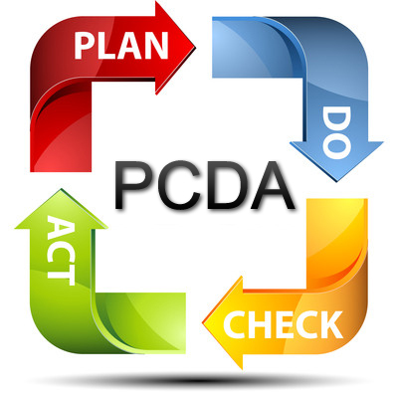
GOALS :
Increase production quality.
Increase job satisfaction.
Using teams for continuous improvement.
Improve the state of maintenance
Empower employees
CONTINUOUS PROCESS IMPROVEMENT

Slide 25
Why TPM:
Avoid wastages
Producing with good product quality.
Reducing cost
Produce a low batch quantity at the earliest time.
Non-defective finished goods

Slide 26
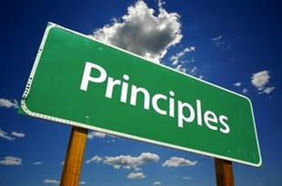
Principles of TPM
Use Overall Equipment Effectiveness (OEE) as a compass for success.
Improve existing planned maintenance systems
Work toward zero losses
Providing training to upgrade operations and maintenance skills
Involve everyone and utilize cross-functional teamwork

Slide 27
types of maintenance

Slide 28
TPM and Traditional Maintenance
Reactive maintenance inherently wasteful and ineffective with following disadvantages:
No warning of failure
Possible safety risk
Unscheduled downtime of machinery
Production loss or delay
Possible secondary damage

Slide 29
TPM and Traditional Maintenance
Need for:
Stand-by machinery
A stand-by maintenance team
A stock of spare parts
Costs include:
Post production
Disrupted schedule
Repair cost
Stand-by machinery
Spare parts

Slide 30
TPM and Traditional Maintenance
Real cost of reactive maintenance is more than the cost of maintenance resources and spare parts
Pro-active maintenance (planned, preventive and predictive) more desirable than reactive maintenance

Slide 31
TPM and Traditional Maintenance
TPM enables or provides:
The traditional maintenance practices to change from reactive to pro-active
A number of mechanisms whereby
Breakdowns are analyzed
Causes investigated
Actions taken to prevent further breakdowns
Preventive maintenance schedule to be made more meaningful

Slide 32
TPM and Traditional Maintenance
To ‘free up’ maintenance professionals to:
Carry out scheduled and preventive maintenance
Gather relevant information as important input to the maintenance system
Keep the system up to date
To review cost effectiveness
To develop and operate a very effective maintenance system an integral part of manufacturing

Slide 33
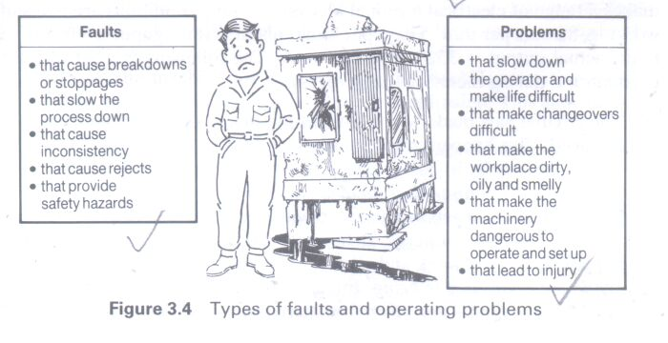
Faults and Problems

Slide 34
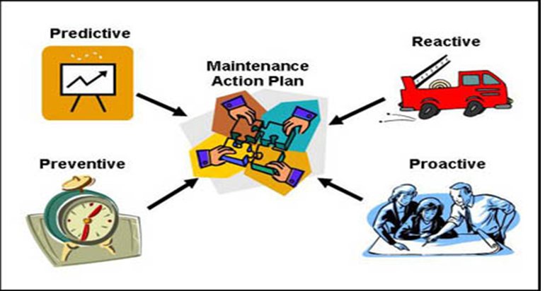
Types of maintenance
Breakdown maintenance
Preventive maintenance
.periodic maintenance( time based maintenance)
.Predictive maintenance
Corrective maintenance
Maintenance prevention

Slide 35
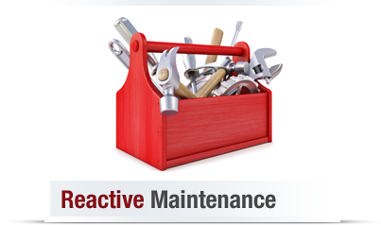
Breakdown/Reactive maintenance
Repairs or replacements performed after a machine has failed to return to its functional state following a malfunction or shutdown.
e.g., an electric motor of a machine tool will not start, a belt is broken, etc.
Under such conditions, production department calls on the maintenance department to rectify the defect.
After removing the fault, maintenance engineers do not attend the equipment again until another failure or breakdown occurs.

Slide 36
Preventive maintenance(1951)
The primary goal of preventive maintenance is to prevent the failure of equipment before it actually occurs.
It is designed to preserve and enhance equipment reliability by replacing worn components before they actually fail.
It is a daily maintenance which includes cleaning, inspection, oiling and re-tightening of equipments.

Slide 37
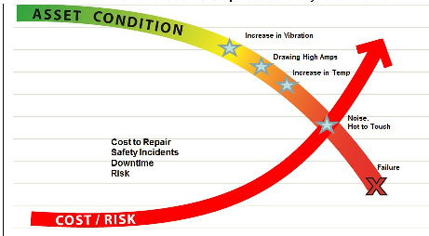
Long-term benefits of preventive maintenance:
Improved system reliability.
Decreased cost of replacement.
Decreased system downtime.
Better spares inventory management.

Slide 38
Benefits

Slide 39
Periodic maintenance (TBM)
Time based maintenance consists of periodically inspecting, servicing and cleaning equipment and replacing parts to prevent sudden failure and process problems.
Benefits:
Extended life and use of the equipment.
Reliable production at the times when machine is needed most.

Slide 40
Predictive maintenance
This is a method in which the service life of important part is expected based on inspection or diagnosis, in order to use the parts to the limit of their service life.
Compared to periodic maintenance, predictive maintenance is condition based maintenance.

Slide 41
Benefits of predictive maintenance
Increased plant readiness due to greater reliability of the equipment.
Many industries report from two to ten percent productivity increases due to predictive maintenance practices.
Reduced expenditures for spare parts and labor.
Reduces the probability of a machine experiencing a disastrous failure, and this results in an improvement in worker safety.

Slide 42
Corrective maintenance ( 1957 )
Maintenance actions carried out to restore a defective item to a specified condition
Corrective maintenance is probably the most commonly used approach, but it is easy to see its limitations.
When equipment fails, it often leads to downtime in production.
In most cases this is costly business. Also, if the equipment needs to be replaced, the cost of replacing it alone can be important.
It is also important to consider health, safety and environment (HSE) issues related to malfunctioning equipment.

Slide 43
Maintenance prevention (1960 )
It indicates the design of a new equipment.
Weakness of current machines are sufficiently studied ( on site information leading to failure prevention, easier maintenance and prevents of defects, safety and ease of manufacturing ) and are incorporated before commissioning a new equipment.

Slide 44
TPM Policy and objectives

Slide 45
Policy and objectives
To maximize overall equipment effectiveness (Zero breakdowns and failures, Zero accident, and Zero defects etc) through total employee involvement
To improve equipment reliability and maintainability as contributors to quality and to raise productivity

Slide 46
Policy and objectives
To aim for maximum economy in equipment for its entire life
To cultivate equipment-related expertise and skills among operators
To create a vigorous and enthusiastic work environment

Slide 47
TPM Corporate policy
To aim for world-class maintenance, manufacturing performance and quality
To plan for corporate growth through business leadership
To promote greater efficiency through greater flexibility
Revitalize the workshop and make the most of employee talents

Slide 48
Similarities and differences of tpm and tqm

Slide 49
Similarities b/w TQM & TPM
Total commitment to the program by upper level management is required in both programs.
Employees must be empowered to initiate corrective action, and
A long range outlook must be accepted, as TPM may take a year or more to implement.
It is an on-going process which is a continuous process improvement.

Slide 50
Differences between TQM and TPM
Category | TQM | TPM
Object | Quality ( Output and effects ) | Equipment ( Input and cause )
Mains of attaining goal | Systematize the management. It is software oriented | Employees participation and it is hardware oriented
Target | Quality for PPM | Elimination of losses and wastes.

Slide 51
Summary
Philosophy of Total Productive Maintenance (TPM)
History of TPM
Types of Maintenance
TPM Policies and Objectives
Similarities and Differences between TPM and TQM

Slide 53
Improving Productivity

