Slide 1
Corporate Governance
By: 1. Kenneth A. Kim
John R. Nofsinger
And
2. A. C. Fernando

Slide 2
Creditors and Credit Rating Agencies
Lesson 15

Slide 3
Shareholders & Shareholder Activism
Last Lecture Review
Shareholders are innocent and helpless victims when scandals occur.
Two categories of investors
Individual investors
Institutional investors
Institutional investors are more effective and influential than the individual investors

Slide 4
Shareholders & Shareholder Activism
Benefits of Mutual Funds
The advantage of professional investment management.
Funds managers have real access and information about the market.
Diversification in the investment.
Low cost and high quality investing.
Convenience and flexible.

Slide 5
Shareholders & Shareholder Activism
Mutual funds investment funds are liquid and easy to withdraw.
Costs of Mutual Funds
Hidden fee charges
What is Shareholders activism?
The goal of activists ranges from financial as well as non-financial matters.
Individual shareholders activism
Monitoring by large shareholders
Institutional Shareholders: An Overview
Does Institution Shareholders activism works?

Slide 6
Shareholders & Shareholder Activism
Potential Roadblocks to effective Shareholders activism.
Limited desire to be activists
Many other options for investments
Mgt don’t hire pension fund advisors who are trouble makers for management
Private/public funds normally go with management activities.

Slide 7
Shareholders & Shareholder Activism
Law restricts them to become major OWNER of the firm.
Long paperwork.
International Perspective
In west, we can see company discourages one investor to become the significant owner
In east, we can see greater owners i.e. family owner as well as state owner.

Slide 8
Creditors and Credit Rating Agencies
Lecture Outlines
Introduction
Who care about the firm 1. stock holders 2. Creditors
Two types of lenders
Commercial Banks
Individual (bondholders)
Credit Rating Agencies (CRAs)
Analysis of the situation having different credit ratings by different CRAs

Slide 9
Creditors and Credit Rating Agencies
Introduction
Who really cares about the firm?
Stock holders
Lenders (Creditors)
We will discuss about the lenders attitude toward corporate governance.
There are basically two types of lenders
Commercial banks
Individual investors (bondholders)

Slide 10
Creditors and Credit Rating Agencies
1. Commercial banks as lender
Almost all banks have commercial lending departments that loan money to companies to purchase equipment and inventory to start or expand their businesses.
One of the main revenue sources for banks is the interest made on loans they lend.
Firms financial position is taken into account before issuing loans.

Slide 11
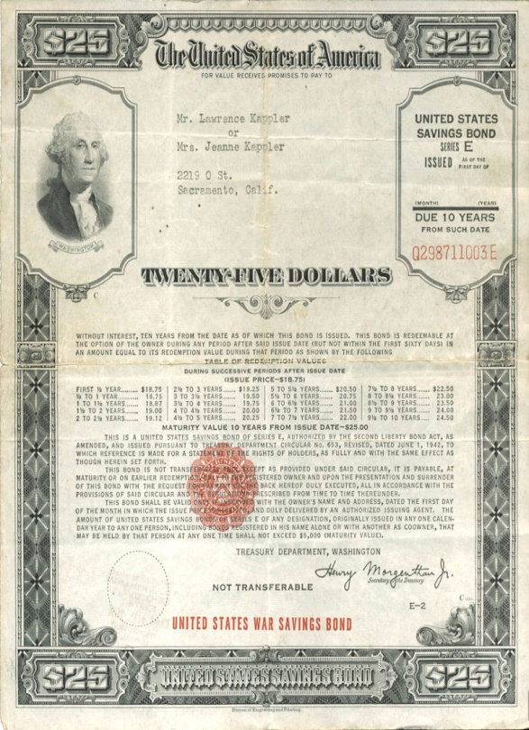
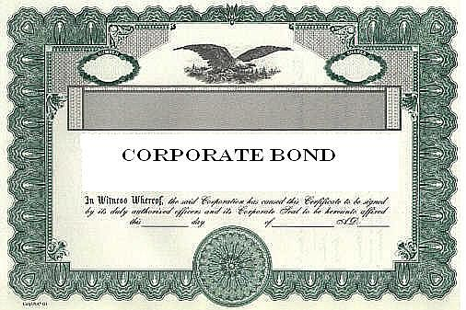
Creditors and Credit Rating Agencies
Individual Investors as lenders (bondholders)
Individual investors can become creditors of a firm by purchasing that firms bonds.

Slide 12
Creditors and Credit Rating Agencies
Creditors can trade their claims just as stockholders
Bond holders can also sell their bonds to other investors (and banks can also sell their loans too but primarily to other institutions).

Slide 13
Creditors and Credit Rating Agencies
If firms suffer from poor corporate governance, then the value of their bonds might decline just like the value of stocks.
If a firm collapses from poor corporate governances then lenders may get back only pennies on the amount of their loan.

Slide 14
Creditors and Credit Rating Agencies
While a bank may find it worthwhile to monitor the firm that they lend to (because millions, even billions could be at stake), individual bondholders may not have the resources to do so.
Debt, in and of itself, could be a governance mechanism.

Slide 15
Creditors and Credit Rating Agencies
Credit Rating agencies (CRA)- Government/Private
(all bonds need to be rated to attract the investors/creditors)
CRA assesses the credit worthiness of an individual, corporation, or even a country.
Analysts rate stocks and CRA rate bonds for bond investors (Creditors).
Credit ratings are calculated from the financial history and current assets and liabilities.

Slide 16
Creditors and Credit Rating Agencies
CRA tells a lender or investors the probability of the subject being able to pay back a loan.
A poor credit rating indicates a high risk of defaulting on a loan, and thus leads to high interest rates.
Basically, CRA analyse the element of risk involved with the bonds by having some grades which determine the level of risk associated with.

Slide 17
Creditors and Credit Rating Agencies
Analysis of the situation where a firm has different credit ratings by different CRAs.
CRAs Perspective
Moody rating for a firm=AAA
PACRA rating for a firm=AA
Private rating for a firm=A
Private as well as PACRA must have to evaluate their expertise for credit rating purposes because Moody CRA is having international image and a firm is always single financial position which means having same credit rating if evaluated by different CRAs.

Slide 18
Creditors and Credit Rating Agencies
Firm’s perspective
Firm must go for those CRAs whose reputation is good because this will increase their bond value.
So instead of going for private CRAs for, so called, good and cheap ratings, it would be in the firm’s best interest to have ratings from reputable CRAs, what if they charge more for their services.
It all depends upon firm’s financial position.

Slide 19
Creditors and Credit Rating Agencies
Summary
Introduction
Who care about the firm 1. stock holders 2. Creditors
Two types of lenders
Commercial Banks
Individual (bondholders)
Credit Rating Agencies (CRAs)
Analysis of the situation having different credit ratings by different CRAs

