Slide 1
Corporate Governance
By: 1. Kenneth A. Kim
John R. Nofsinger
And
2. A. C. Fernando

Slide 2
Accountants and Auditors
5th Lesson

Slide 3
Last Lecture Review
Main problem in the corporations are separation of ownership and control.
Managers are supposed to work for the best interest of the shareholders.
Managers try to take the advantage of their control power.
Stocks and options benefits can’t guaranteed to reduce the conflict.

Slide 4
Accountants and Auditors
Lecture Outlines
Difference between Accountants and Auditors (A &A).
Importance of Accountants and Auditors (A & A).
Accounting for Inside use.
Accountants answers for inside users Qs.
Accounting for outside use.
Difference between Financial Accounting and Managerial Accounting.
Advantages & Disadvantages of Financial Accounting.
Advantages & Disadvantages of Managerial Accounting
Summary

Slide 5
Accountants and Auditors
Difference between Accountants and Auditors
Accountants
An accountant is a practitioner of accountancy or accounting, which is the measurement, disclosure or provision of assurance about financial information that helps managers, investors, tax authorities and others make decisions about allocating resources.
Auditors
An auditor is a professional who is responsible for evaluating some aspect of a project, business, or individual. The term most commonly refers to audits in accounting.

Slide 6
Accountants and Auditors
Difference between accounting and auditing
Scope:
· Accounting is related with preparing financial statements.
· Auditing is concerned with checking financial statements.
Data:
· Accounting is related with current data.
· Auditing is concerned with past data.
Purpose:
· The purpose of accounting is to show performance and financial position of a business.
· The purpose of auditing is to certify true and fair view of financial statements.

Slide 7
Accountants and Auditors
Time:
· The time period of accounting is usually twelve months (one year). It takes twelve months (one year) to complete records.
· The time period of auditing is less than one year. It may be completed within one month or may be more than one month.
Start:
· When the work of bookkeeper ends then the accountant work starts.
· when the work of accountants ends Then the auditor work starts.

Slide 8
Accountants and Auditors
Necessity:
· Accounting is necessity of every entity having any size.
· Auditing is not the necessity of every business.
Report:
· Accounting work involves no report to any party.
· Auditing work requires separate report to owners.

Slide 9
Accountants and Auditors
A & A are important part of any corporate monitoring system.
Accountants keep tracks of financial information and auditors make a review and monitor.
Information can only be obtained by auditors.
Banks, creditors and other rely on these statement to the firm’s accurate picture and financial health.
Good for the investors to assess the value of the company.

Slide 10
Accountants and Auditors
Accounting Functions
Gathering, compiling, reporting, and archiving a firm’s business activities.
Accounting information helps making decision
either for insiders
or outsiders.

Slide 11
Accountants and Auditors
Accounting for Inside Use
Managers use these information to measure the progress toward their goals and highlight any potential problems in advance
E.g. Managers wants to know their product’s sales situation.
How to manage the inventory.
Inventory comprises of work in process, stores and spares etc.
What about cash?
Have the firm enough cash to pay its upcoming debt payments?

Slide 12
Accountants and Auditors
Accountants answer these Qs with;
Budgets
An estimation of the revenue and expenses over a specified future period of time. A budget can be made for a person, family, group of people, business, government, country, multinational organization or just about anything else that makes and spends money. It may be either surplus budget or deficit budget
Surplus Budget
A situation in which income exceeds expenditures.
Deficit Budget
A financial situation that occurs when an entity has more money going out than coming in

Slide 13
Accountants and Auditors
Variance reports
In business, a variance report is prepared to evaluate the operating efficiency of different aspects of (usually) a manufacturing company.
Three main sections with two subsections each: 1. Materials price variance & materials quantity variance
If the company is paying too much for materials or using too much materials for a product, that is an unfavorable variance. If the company is getting materials for less than the standard cost or is using less than the standard materials for a product, that would be favorable. 2. Labor rate variance & labor efficiency variance.
Labor rate variance measures deviation from standard in the average hourly rate paid to direct labor workers. Labor efficiency variance attempts to measure the productivity of direct labor. 3. Variable overhead spending variance & variable overhead efficiency variance.

Slide 14
Accountants and Auditors
Sensitivity analyses
A technique used to determine how different values of an independent variable will impact a particular dependent variable under a given set of assumptions. The sensitivity analysis can answer the following questions:
"WHAT" would be my forecasted net income, "IF" my sales forecast is 30%, 20%, or 10% toohigh?
"WHAT" would be my forecasted net income, "IF" my sales forecast is 30%, 20% or 10% too low?

Slide 15
RESUME SERVICES FORECASTED SENSITIVITY ANALYSIS FOR YEAR ENDING DECEMBER 31, 200X
 | 15% Decline in Sales | 10% Decline in Sales | 200X Original Forecasted Figures | 10% Incline in Sales
Sales | $88,400 | $93,600 | $104,000 | $114,400
Cost of Goods Sold | $10,200 | $10,800 | $ 12,000 | $ 13,200
GROSS PROFIT | $78,200 | $82,800 | $ 92,000 | $101,200

Slide 16
Accountants and Auditors
Revenue reports
Daily
Monthly
Cost projections and
Cost estimates (five years, less or more)
Even analysis of competitors
The assessment of SWOT analysis of potential competitors.
SWOT stands for Strength, Weakness, Opportunities, and Threads.

Slide 17
Accountants and Auditors
Accounting for Outside Use
Who are outsiders for a firm
Investors
Banks
The government
Other stakeholders

Slide 18
Accountants and Auditors
Most companies have a corporate website with a section entitled "Investor Relations", which should have a wide range of company documentation, including quarterly and annual reports.

Slide 19
Accountants and Auditors
Difference between financial accounting and managerial accounting
provide information to two different user groups.
Financial accounting primarily provides information for external users of accounting data, such as investors and creditors.
On the other hand, management accounting provides information for internal users of accounting data. Internal users include employees, managers, and executives of the company.

Slide 20
Accountants and Auditors
Advantages of Financial Accounting
Access to Information
Important information for all stakeholders
Preview of a company
Help to decide about the investment in a company or not.
Compliance
Financial accounting information is an element of transparency and business ethics, requiring honest and accurate information for investors, competitors and market analysts to review.

Slide 21
Accountants and Auditors
Disadvantages of Financial Accounting
Cost
Expensive part of doing business, especially for large businesses in shape of having professionals who earn handsome salaries and require benefits.
Timing Problems
Accurate accounting can benefit the business but selecting wrong accounting type can be just a time wasting activity.
E.g simple cash methods can’t handle large businesses outstanding payments and accounts receivable.

Slide 22
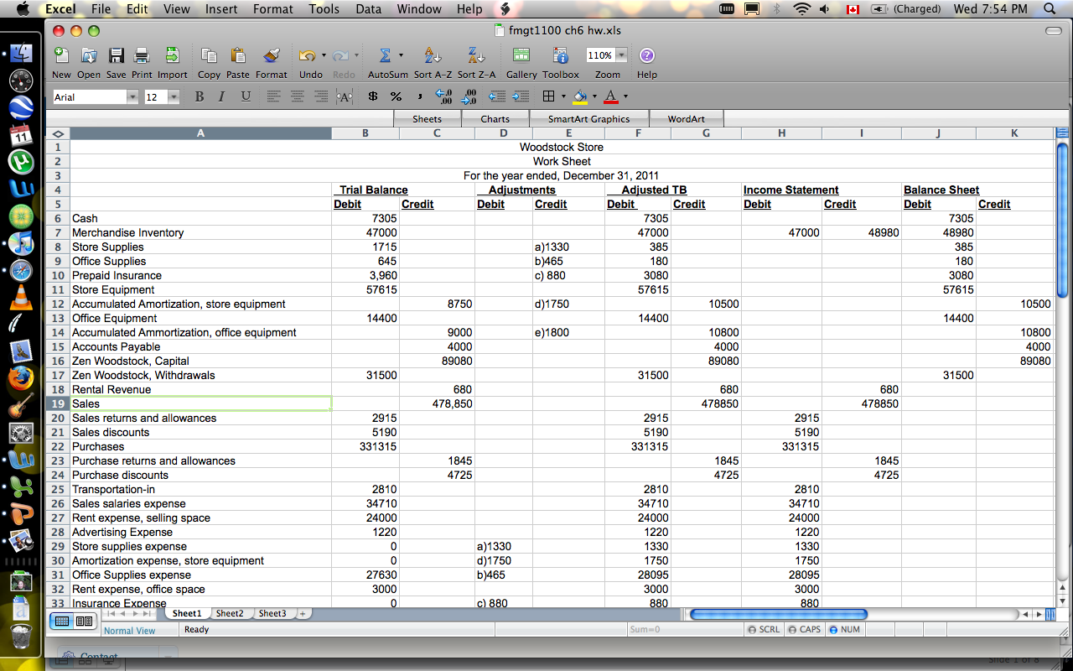

Slide 23
Accountants and Auditors
Advantages of Managerial Accounting
Since it is focused on making future decisions with the help of past financial data, it is forward looking and therefore progressive in nature.
It is meant for internal users like top management and therefore it is not necessary that it is made by following strict guidelines which is the case with financial accounting.

Slide 24
Accountants and Auditors
It is flexible in nature and therefore it can be prepared anytime and they are not required to be made yearly they can be made monthly or on weekly basis.
It takes all the data and then present it in such a way that a proper analysis about the feasibility and profitability of any business decision can be made.

Slide 25
Accountants and Auditors
Disadvantages of Managerial Accounting
It is dependent on cost accounting and financial accounts and therefore the accuracy of it is also dependent on how accurate that data is, hence it is one of the limitations as far as its usability is concerned.
It is affected by the bias of top management and therefore it is likely that they may tweak it in such a way so as to benefit themselves rather than shareholders.

Slide 26
Accountants and Auditors
Since it does not follow accounting principles, it cannot be compared with other company’s and hence proper evaluation about the management may not be possible on the basis of management accountancy.

Slide 27
Accountants and Auditors
Summary
A & A play very important role in corporations.
Companies are legally bound to hire A & A to have crystal clear financial position of a company because its not their money.
Companies face two types of interactions as far as accounting practices are concerned. Accounting for management and for outside world.
Normally company keeps two types of records in the shape of Financial Accounting and Managerial accounting- which normally do not match.

Slide 28
Accountants and Auditors
A single company always must have single financial position, so how is it possible to have two different accounting records.
Lastly, different accounting records means the element of frauds in the company
THE END

