Slide 1
Virtual COMSATS Inferential Statistics Lecture-10
Ossam Chohan
Assistant Professor
CIIT Abbottabad

Slide 2
Recap of previous lecture
We discussed confidence intervals
How to calculate critical value using z table
How to understand problem with respect to the cases.

Slide 3
Objective of this lecture
We will discuss more problems
Understanding t distribution and degrees of freedom
Precision of interval estimate
Sample size estimation.
Understanding 1-α

Slide 4
Problem-8
A sample poll of 100 voters chosen at random from all voters in a given district indicated that 55% of them were in favor of a particular candidate. Find the
95% CI for the proportion of all the voters in favor of this candidate.
99% CI for the proportion of all the voters in favor of this candidate.
99.73% confidence limits for the proportion of all the voters in favor of this candidate.

Slide 5
Problem-8 Solution

Slide 6
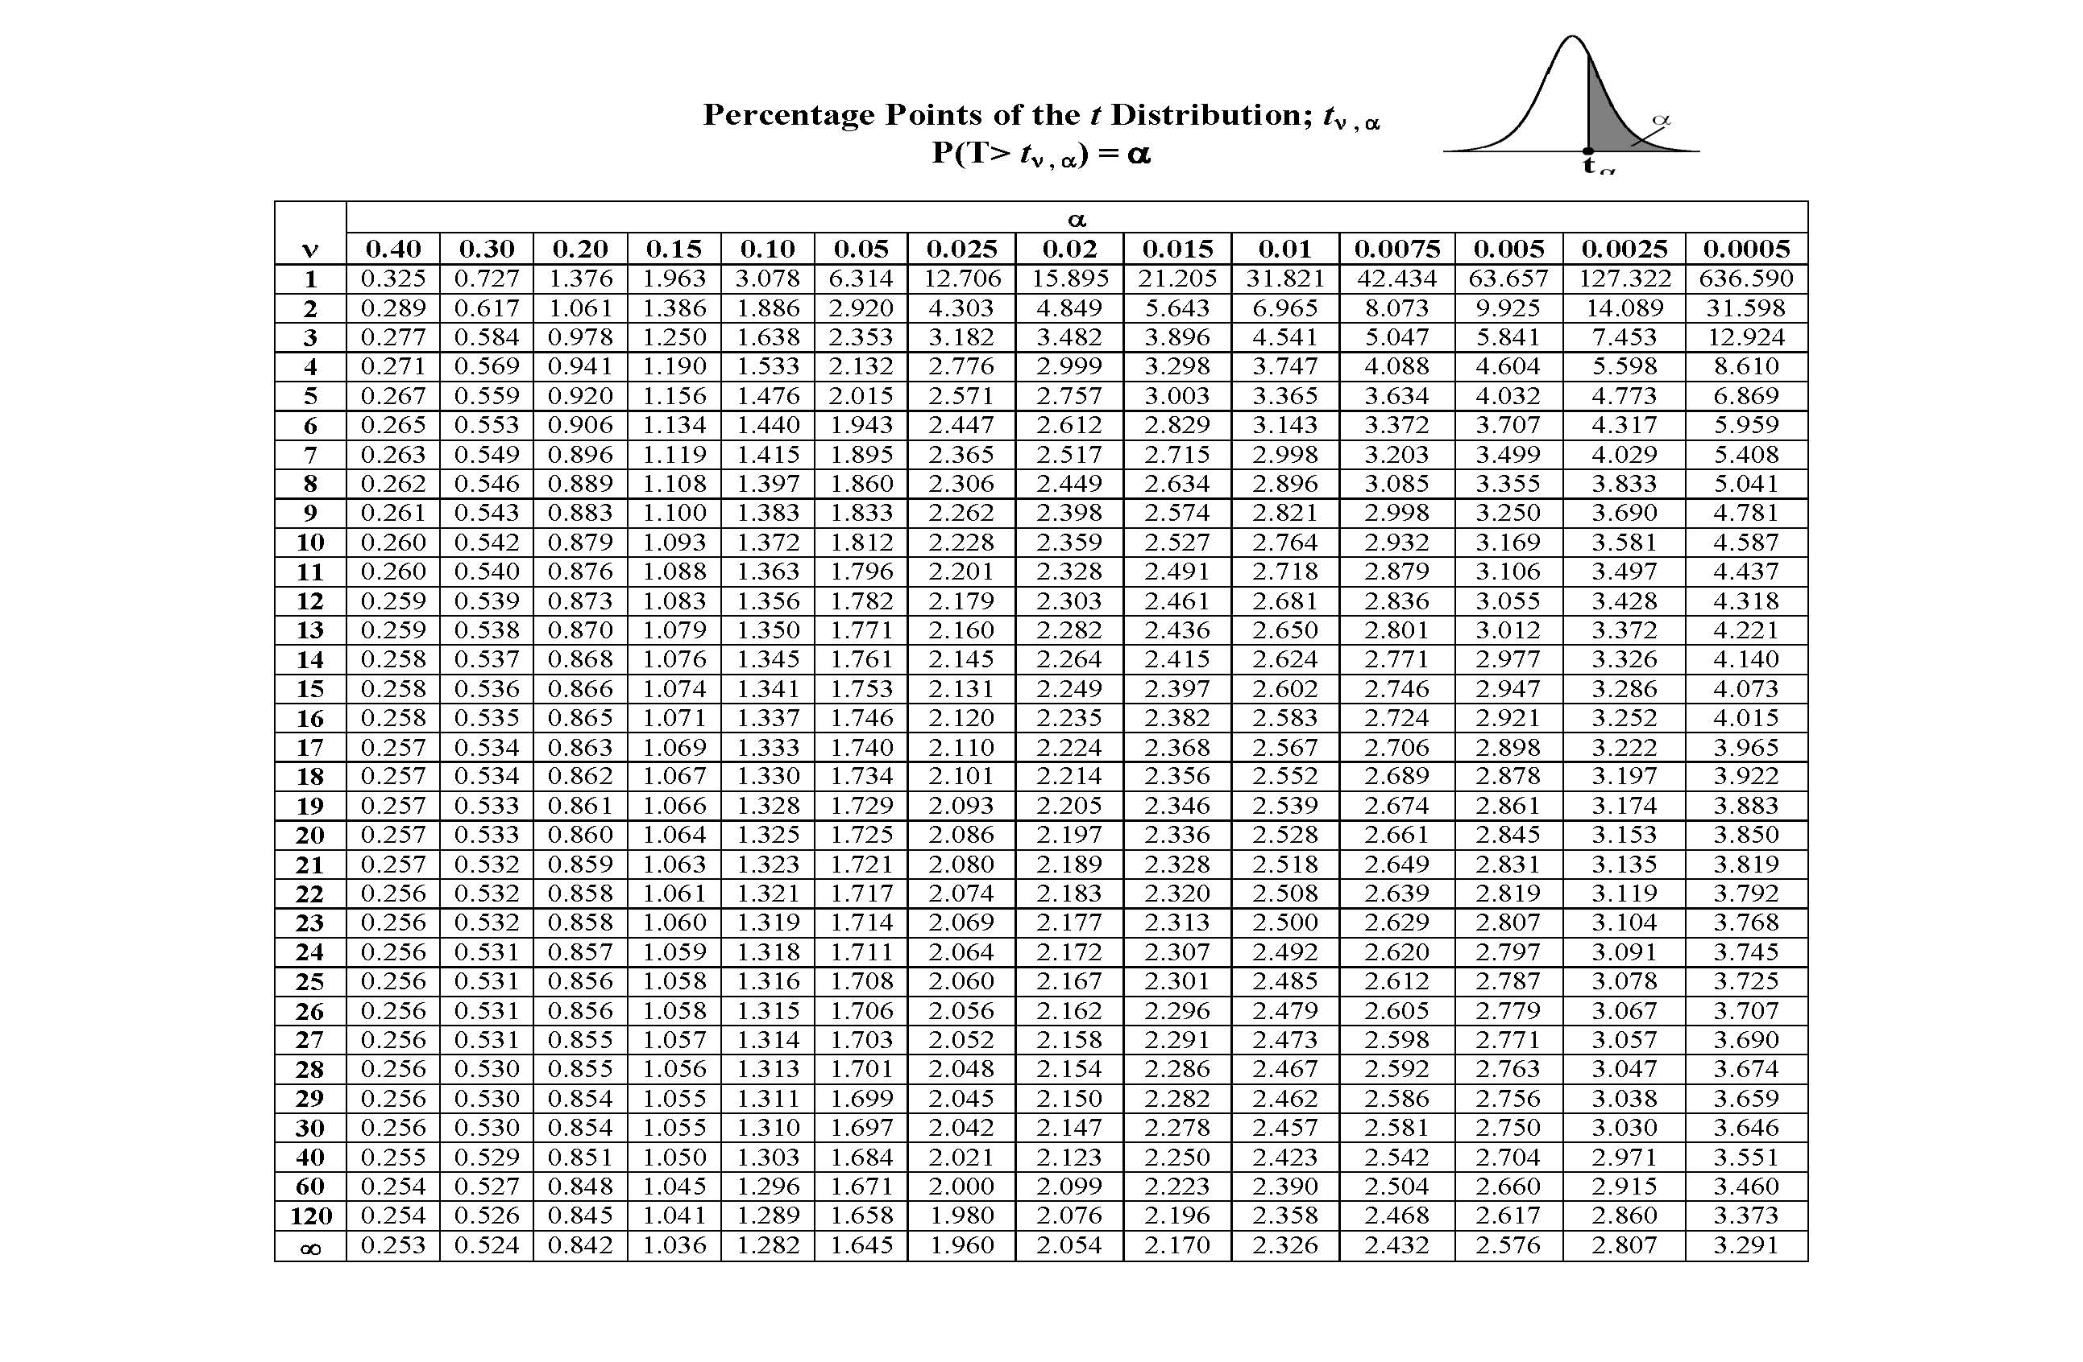
t-distribution table

Slide 7
Problem-9
For the following sample sizes and confidence levels, find the appropriate t values for constructing intervals:
n=28; 95% t_{α/2}=?, t_{α}
n=8; 98%
n=13; 90%
n=10; 95%
n=25; 99%
n=10; 99%

Slide 8
Problem-9 Solution

Slide 9
Problem-10
The masses, in grams, of thirteen ball bearings taken at random from a batch are
21.4, 23.1, 25.9, 24.7, 23.4, 24.5, 25.0, 22.5, 26.9, 26.4, 25.8, 23.2, 21.9
Calculate a 95% CI for the mean mass of the population, supposed normal, from which these masses were drawn:

Slide 10
Problem-10 Solution
Sample mean= 314.7/13= 24.21
s= √[Σ(xi- )²]/n-1
s= √ 3.12= 1.77
v=n-1, degree of freedom
1-α=0.95, α=0.05
t_{α/2(v)}= t_{0.025(12)}=2.179

Slide 11
Problem-10 Solution

Slide 12
Problem-11
The following sample of eight observations is from an infinite population with normal distribution:
75.3, 76.4, 83.2, 91.0, 80.1, 77.5, 84.8, 81
Find the sample mean.
Estimate the population standard deviation and standard error.
Construct a 98% CI for the population mean.

Slide 13
Problem-11 Solution
Sample mean=81.1625
Estimated standard deviation= 5.1517
Estimated standard error=1.8214
1-α=0.98

Slide 14
Problem-11 Solution

Slide 15
Problem-12
Twelve bank tellers were randomly sampled and it was determined they made an average of 3.6 errors per day with a sample of standard deviation of 0.42 error. Construct a 90% CI for population mean of errors per day.

Slide 16
Problme-12 Solution

Slide 17
Problem-13
In a certain large city, a random sample of 400 families contacted by a local TV station showed that 275 owned color TV sets. Find an approximate 90% confidence interval on that true proportion of all families living in the city who
Own color TV sets
Don’t have color TV sets

Slide 18
Problem-13 Solution

Slide 19
Problem-14
The average monthly electricity consumption for a sample of 100 families is 1250 units. Assuming the standard deviation of electric consumption of all families is 150 units, construct a 95% Confidence Interval estimate of the actual mean electric consumption.

Slide 20
Problem-14 Solution

Slide 21
Problem-15
A random sample of 50 sales invoices was taken from a large population of sales invoices. The average value was found to be Rs. 2000 with a standard deviation of Rs 540. Find a 90% confidence interval for the true mean of all the sales

Slide 22
Problem-15 Solution

Slide 23
Problem-16
Suppose we want to estimate the proportion of families in a town which have two or more children. A random sample 144 families shows that 48 families have two or more children. Setup a 95% confidence interval estimate of the population proportion of families having two or more children.

Slide 24
Problem-16 Solution

Slide 25
Problem-17
A show manufacturing company is producing 50,000 pairs of shoes daily. From a sample of 500 pairs, 2 % are found to be substandard quality. Estimate at 95% level of confidence the number of pairs of shoes that are reasonably expected to be spoiled in the daily production.

Slide 26
Problem-17 Solution

Slide 27
Estimating Sample Size
Estimation of sample size is important to infer about population parameter.
Standard errors are generally inversely proportional to sample size.
It means that n is also related to width of confidence interval.

Slide 28
Precision of confidence interval
The precision with which a confidence interval estimates the true population parameters is determined by the width of the confidence interval.
Narrow the CI, more precise the estimate and vice versa.
Width of CI depends upon
Specified level of confidence
Sample size
Population standard deviation

Slide 29
More precision can be achieved by increasing sample size.
But cost of increasing sample size, sometimes not possible.
Therefore to achieve desired precision, lower the confidence.
Lets have a look on some problems.

Slide 30
Problem-18
Suppose the sample standard deviation of P/E rations for stocks listed on KSE is s=7.8. Assume that we are interested in estimating the population mean of P/E ration for all stocks listed on KSE with 95% confidence. How many stocks should be included in the sample if we desire a margin of error of 2.

Slide 31
Problem-18 Solution

Slide 32
Problem-19
A car manufacturing company received a shipment of petrol filters. These filter are to be sampled to estimate the proportion that is unusable. From past experience, the proportion of unusable filter is estimated to be 10%. How large a random sample should be taken to estimate the true proportion of unusable filter to within 0.07 with 99% confidence

Slide 33
Problem-19 Solution

Slide 34
Home Work
Variable | 1-α | Sample mean | n | S.D | Confident interval
Systolic BP | 0.95 | 122 | 61 | s= 11
Weight (kg) | 0.99 | 75 | 46 | δ= 8.4
Serum cholesterol | 0.95 | 177 | 51 | δ= 21
Age | 0.95 | 45 | 25 | s= 6.2
Age | 0.95 | 45 | 51 | s= 6.2
Income | 0.95 | 48 | 91 | δ= 12.8
Income | 0.99 | 48 | 91 | δ= 12.8

Slide 35
Understanding 1-α
1-α is confidence coefficient.
It means that α is risk or tolerance level.
You may want to change the confidence coefficient from a certain value to another confidence, that will effect critical values (z or t).

Slide 36
Confidence Intervals for the Difference between Two Population Means µ₁ - µ₂: Independent Samples
36

Slide 37
Confidence Intervals for the Difference between Two Population Means µ₁ - µ₂: Independent Samples
Two random samples are drawn from the two populations of interest.
Because we compare two population means, we use the statistic .
37

Slide 38
Estimating the Difference Between Two Population Means
The estimates of the population parameters are calculated from the sample data.
Properties of the Sampling Distribution of , the Difference Between Two Sample Means:
When independent random sample of n₁ and n ₂ have been selected from populations with means μ ₁ and μ ₂ and variances, respectively, the sampling distribution of the differences has the following properties:
1. The mean and the standard error of are
and

Slide 39
2. If the sampled populations are normally distributed, then the sampling distribution of is exactly normally distributed, regardless of the sample size.
3. If the sampled populations are not normally distributed, then the sampling distribution of is approximately normally distributed when n₁ and n ₂ are large, due to the CLT.
Since μ ₁ − μ ₂ is the mean of the sampling distribution,
is an unbiased estimator of (μ ₁ − μ ₂ ) with an approximately normal distribution.
The statistic
has an approximately standard normal z distribution.
©1998 Brooks/Cole Publishing/ITP

Slide 40
Point Estimation of (μ ₁ − μ ₂ ) :
Point estimator:
Margin of error:
If are unknown, but both n₁ and n ₂ are 30 or more, you can use the sample variances to estimate
A (1−α )100% Confidence Interval for (μ ₁ − μ ₂ ) :
©1998 Brooks/Cole Publishing/ITP

Slide 41
If are unknown, they can be approximated by the sample variances and the approximate confidence interval is
The calculation of confidence intervals.
©1998 Brooks/Cole Publishing/ITP

Slide 42
Population 1 Population 2
Parameters: µ₁ and σ₁² Parameters: µ₂ and σ₂²
(values are unknown) (values are unknown)
Sample size: n₁ Sample size: n₂
Statistics: x₁ and s₁² Statistics: x₂ and s₂²
Estimate µ₁− µ₂ with x₁− x₂
42

Slide 44
Confidence Interval for μ₁ – μ₂
What about the conditions?
What if unknown variances are equal???
44

Slide 45
Problem-20
A research team is interested in the difference between serum uric acid levels in patients with and without Down's syndrome. In a large hospital for the treatment of the mentally retarded, a sample of 12 individuals with Down's syndrome yielded a mean of = 4.5 mg/100 ml. In a general hospital a sample of 15 normal individuals of the same age and sex were found to have a mean value of = 3.4 mg/100 ml. If it is reasonable to assume that the two populations of values are normally distributed with variances equal to 1 and 1.5, find the 95 percent confidence interval for -

Slide 46
Problem-20 Solution

Slide 47
Population variances are unknown but can be assumed to be equal (t is used)
If it can be assumed that the population variances are equal then each sample variance is actually a point estimate of the same quantity. Therefore, we can combine the sample variances to form a pooled estimate.
Weighted averages The pooled estimated of the common variance is made using weighted averages. This means that each sample variance is weighted by its degrees of freedom.

Slide 48
Pooled estimate of the variance The pooled estimate of the variance comes from the formula: Standard error of the estimate The standard error of the estimate is

Slide 49
Confidence interval
The 100(1- ) confidence interval for µ₁-µ₂ is

Slide 50
Problem-21
Given n₁ = 13, = 21.0, s₁= 4.9
n₂ = 17, = 12.1, s₂= 5.6
We have to find 95% confidence for difference between population means

Slide 53
Problem-22
Suppose that simple random samples of college freshman are selected from two universities - 15 students from school A and 20 students from school B. On a standardized test, the sample from school A has an average score of 1000 with a standard deviation of 100. The sample from school B has an average score of 950 with a standard deviation of 90.
What is the 90% confidence interval for the difference in test scores at the two schools, assuming that test scores came from normal distributions in both schools?

Slide 54
Problem-22 Solution

Slide 55
Problem-23
Suppose the Cartoon Network conducts a nation-wide survey to assess viewer attitudes toward Superman. Using a simple random sample, they select 400 boys and 300 girls to participate in the study. Forty percent of the boys say that Superman is their favorite character, compared to thirty percent of the girls. What is the 90% confidence interval for the true difference in attitudes toward Superman?

Slide 56
Problem-23 Discussion
The sampling method must be simple random sampling. This condition is satisfied; the problem statement says that we used simple random sampling.
Both samples should be independent. This condition is satisfied since neither sample was affected by responses of the other sample.
The sampling distribution should be approximately normally distributed. Because each sample size is large, we know from the central limit theorem that the sampling distribution of the difference between sample proportions will be normal or nearly normal; so this condition is satisfied.

Slide 57
Problem-23 Solution

Slide 58
Confidence Interval for difference between proportion

Slide 59
Problem-24
To study the effectiveness of a drug for arthritis, two samples of patients were randomly selected. One sample of 100 was injected with the drug, the other sample of 60 receiving a placebo injection. After a period of time the patients were asked if their arthritic condition had improved. Results were:

Slide 60
Problem-24
 | Drug | Placebo
Improved | 59 | 22
Not Improved | 41 | 38
total | 100 | 60

Slide 61
Problem-24 Solution

Slide 62
Practice Problem-1
In order to ensure efficient usage of a server, it is necessary to estimate the mean number of concurrent users. According to records, the sample mean and sample standard deviation of number of concurrent users at 100 randomly selected times is 37.7 and 9.2, respectively.
Construct a 90% confidence interval for the mean number of concurrent users.

Slide 63
Practice Problem-2
To assess the accuracy of a laboratory scale, a standard weight that is known to weigh 1 gram is repeatedly weighed 4 times. The resulting measurements (in grams) are: 0.95, 1.02, 1.01, 0.98. Assume that the weighing by the scale when the true weight is 1 gram are normally distributed with mean.
Use these data to compute a 95% confidence interval for µ.

Slide 64
Practice Problem-3
A sample of size n = 100 produced the sample mean of X = 16. Assuming the population standard deviation = 3, compute a 95% confidence interval for the population mean.

Slide 65
Practice Problem-4
Installation of a certain hardware takes a random amount of time with a standard deviation of 5 minutes. A computer technician installs this hardware on 64 different computers, with the average installation time of 42 minutes. Compute a 95% confidence interval for the mean installation time.

Slide 66
Practice Problem-25

Slide 67
Example: confidence interval for μ₁ – μ₂
Example
Do people who eat high-fiber cereal for breakfast consume, on average, fewer calories for lunch than people who do not eat high-fiber cereal for breakfast?
A sample of 150 people was randomly drawn. Each person was identified as a consumer or a non-consumer of high-fiber cereal.
For each person the number of calories consumed at lunch was recorded.
67

Slide 68
Common Mistake !!!
A common mistake is to calculate a one-sample
confidence interval for μ₁, a one-sample confidence interval for μ₂, and to then conclude that μ₁ and μ₂ are equal if the confidence intervals overlap.
This is WRONG because the variability in the sampling distribution for from two independent samples is more complex and must take into account variability coming from both samples. Hence the more complex formula for the standard error.

Slide 69
Confidence Interval on the Variance and Standard Deviation of a Normal Distribution
Definition
Test Statistics

Slide 70
Probability density functions of several χ² distributions.

