Slide 1
Virtual COMSATS Inferential Statistics Lecture-8
Ossam Chohan
Assistant Professor
CIIT Abbottabad

Slide 2
Recap of previous lecture
Introduction to Statistical Inference
Approaches to draw inferences
Estimation
Hypothesis Testing
Types of Estimation
Point Estimation
Degree of Confidence
Margin of Error
Interval Estimation
Confidence Interval Estimation

Slide 3
Objectives of this lecture
After completing this unit, student will be able to:
Construct 100(1-α)% confidence interval for different statistics.
Understanding application of sample statistics in precise way.
Multiple problems regarding confidence interval construction.
Z and t distribution

Slide 4
Recap of confidence interval construction

Slide 5
Guidelines
Guidelines for constructing 100(1-α)% confidence interval for population mean µ, when:
Variation not known but n≥30.
Variation not known and n<30.
Confidence interval for population proportion p.

Slide 6
Confidence interval for mean
Based on the information regarding population standard deviation or variance (in general population variation), we can be 95% sure that population mean is in the range:
What is the relation of 95% with 1.96????
Wait for a while then we will bring it in discussion.

Slide 7
Sampling Distribution of Mean σ unknown
If population standard deviation is unknown then it can be shown that sample means from samples of size n are t-distributed with n-1 degrees of freedom
As an estimate for standard error we can use is

Slide 8
Confidence interval for mean σ unkown
Based on the previous slide, we can be 95% sure that population mean is in the range:
Here we did not put 1.96 for 95% confidence. Why so?

Slide 9
T-distribution
T-distribution is quite similar to normal distribution, but the exact shape of t-distribution depends on sample size
When sample size increases then t-distribution approaches normal distribution
T-distribution’s critical values can be calculated with Excel
=TINV(probability;degrees of freedom)
In the case of error margin for mean degrees of freedom equals n – 1 (n=sample size)
Ex. Critical value for 95% confidence level when sample size is 50:
=TINV(0,05;49) results 2,00957

Slide 10
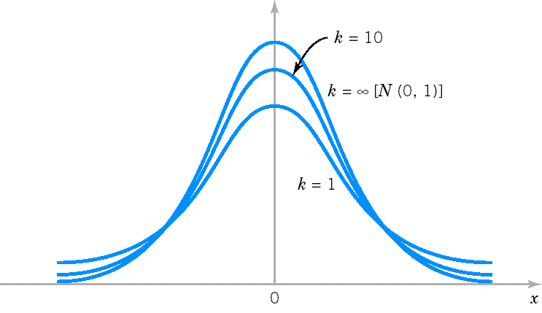
Probability density function for different df

Slide 11
Sampling Distribution of Proportion
Proportion calculated from a sample is usually the best guess for population proportion. But different samples give different sample proportions!
It can be shown that proportions from samples of size n are normally distributed
Standard error (standard deviation of sample proportions) is
As an estimate for standard error we use

Slide 12
Error margin for proportion
Based on the sampling distribution of proportion we can be 95% sure that population proportion is (95% confidence interval)

Slide 13
Error margin
A value calculated from the sample is the best guess when estimating corresponding population value
Estimate is still uncertain due to sampling error
Error margin is a measure of uncertainty
Using error margin you can state confidence interval: estimate + error margin

Slide 14
Error margin for mean - σ known
If population standard deviation σ is known then error margin for population mean is
We can be 95% sure that population mean is (95% confidence interval):

Slide 15
Error margin for mean - σ unknown
If population standard deviation is unknown then error margin for population mean is
We can be 95% sure that population mean is (95% confidence interval):

Slide 16
Error margin for proportion
Error margin for proportion is
We can be 95% sure that population proportion is (95% confidence interval)

Slide 17
Problem-4
For a population with a known variance of 185, a sample of 64 individuals leads to 217 as an estimate of the mean.
Find the standard error of the mean.
Establish an interval estimate that should include the population mean 68.3% of the time.
Remember no confidence attached…Is that so?

Slide 18
Problem-4 Solution
To solve this problem, first we need to understand normal curve and standard areas.
This is important concept to understand
µ±δ
µ±2δ
µ±3δ
This concept will help us to understand 6δ quality standard on later stages of this course.

Slide 19
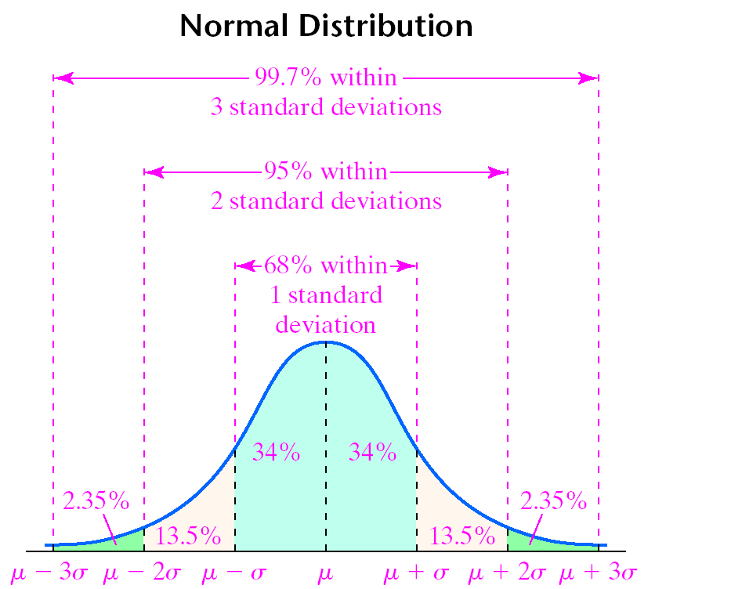

Slide 20
Understanding normal curve

Slide 21
Problem-4 Solution

Slide 22
Problem-5
Ms Shaheena is interested in purchasing a used car. She randomly selected 125 want ads and found that the average price of car in this sample was Rs. 312500. she knows that the standard deviation of used-car prices in this city is 65000.
Establish an interval estimate for the average price of a car so that Shaheena can 68.3% certain that the population mean lies within this interval.
Establish interval for 95.5% certainty.

Slide 23
Problem-5 Solution

