Slide 1
Lecture No. 10
Types of Insurers and Marketing Systems

Slide 2
Objectives
Overview of Private Insurance in the Financial Services Industry
Types of Private Insurers
Agents and Brokers
Types of Marketing Systems
Group Insurance Marketing

Slide 3
Risk Avoidance
A conscious decision not to expose oneself or one’s firm to a particular risk
Can be said to decrease one’s chance of loss to zero
A doctor may decide to leave the practice of medicine rather than contend with the risk of malpractice liability losses
Risk avoidance is common
Particularly among those with a strong aversion to risk
However, avoidance is not always feasible
Or may not even be desirable if it is possible
When risk is avoided, the potential benefits, as well as costs, are given up

Slide 4
Loss Control
When particular risks cannot be avoided
Actions may often be taken to reduce the losses associated with them
Known as loss control
The firm or individual is still engaging in operations that give rise to particular risks
Involves making conscious decisions regarding the manner in which those activities will be conducted

Slide 5
Focus of Loss Control
Some loss control measures are designed primarily to reduce loss frequency
Called frequency reduction
Some firms spend considerable funds in an effort to reduce the frequency of injuries to its workers
Useful to consider the classic domino theory originally stated by H. W. Heinrich

Slide 6
Domino Theory
Employee accidents can be viewed in light of the following steps
Heredity and social environment, which cause persons to act a particular way
Personal fault, which is the failure of individuals to respond appropriately in a given situation
An unsafe act or the existence of a physical hazard
Accident
Injury
Each step can be thought of as a domino that falls, which in turn causes the next domino to fall
If any of the dominos prior to the final one are removed
The injury will not occur
Often argued that the emphasis of loss control should be on the third domino

Slide 7
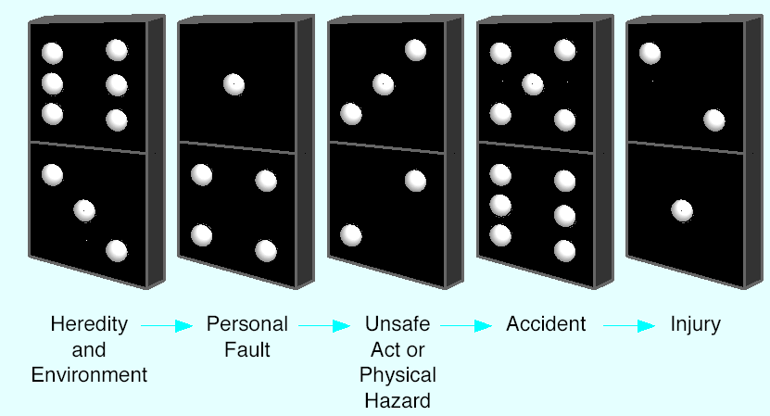
Figure 5-1: Heinrich’s Domino Theory

Slide 8
Types of Loss Control
Severity reduction
For example, an auto manufacturer having airbags installed in the company fleet of automobiles
The air bags will not prevent accidents from occurring, but they will reduce the probable injuries that employees will suffer if an accident does happen
Separation
Involves the reduction of the maximum probable loss associated with some kinds of risks
Duplication
Spare parts or supplies are maintained to replace immediately damaged equipment and/or inventories

Slide 9
Timing of Loss Control
Pre-loss activities
Implemented before any losses occur
Concurrent loss control
Activities that take place concurrently with losses
Post-loss activities
Always have a severity-reduction focus
One example is trying to salvage damaged property rather than discard it

Slide 10
Decisions Regarding Loss Control
A major issue for risk managers
The decision about how much money to spend on the various forms of loss control
In some cases it may be possible to significantly reduce the exposure to some types of risk
But if the cost of doing so is very high relative to the firm’s financial situation
The loss control investment may not be money well spent
The general rule is that to justify the expenditure
The expected gains from an investment in loss control should be at least equal to the expected costs

Slide 11
Potential Benefits of Loss Control
Many of the benefits are either readily quantifiable or can be reasonably estimated
These may include the reduction or elimination of expenses associated with the following
Repair or replacement of damaged property
Income losses due to destruction of property
Extra costs to maintain operations following a loss
Adverse liability judgments
Medical costs to treat injuries
Income losses due to death or disabilities

Slide 12
Potential Benefits of Loss Control
Another potential quantifiable benefit of loss control
A reduction in the cost of other risk management techniques used in conjunction with the loss control
An example is the decrease in insurance premiums that often accompanies a loss control investment
There may be loss control benefits for which a dollar value cannot be easily estimated
Examples include
The reduction in subjective risk that may accompany lower expected loss frequency and severity
Improved public and employee relations associated with fewer and less severe losses

Slide 13
Potential Costs of Loss Control
It is usually easier to estimate the potential costs
Two obvious cost components are installation and maintenance expenses
For example, a sprinkler system will have an initial cost to install and also will have ongoing expenses necessary to maintain it in proper working order
The challenge of cost estimation is often identifying all of the ongoing expenses
Also, some of the ongoing cost may merely be increases in other expenses

Slide 14
Risk Retention
Involves the assumption of risk
If a loss occurs, an individual or firm will pay for it out of whatever funds are available at the time

Slide 15
Planned Versus Unplanned Retention
Planned retention
Involves a conscious and deliberate assumption of recognized risk
Sometimes occurs because it is the most convenient risk treatment technique
Or because there are simply no alternatives available short of ceasing operations
Unplanned retention
When a firm or individual does not recognize that a risk exists and unwittingly believes that no loss could occur
Sometimes occurs even when the existence of a risk is acknowledged
If the maximum possible loss associated with a recognized risk is significantly underestimated

Slide 16
Funded Versus Unfunded Retention
Many risk retention strategies involve the intention to pay for losses as they occur
Without making any funding arrangements in advance of a loss
Known as unfunded retention
Funded retention
Preloss arrangements are made to ensure that money is readily available to pay for losses that occur

Slide 17
Funded Retention
Credit
May provide some limited opportunities to fund losses that result from retained risks
Usually not a viable source of funds for the payment of large losses
Unless the risk manager has already established a line of credit prior to the loss
The very fact that the loss has occurred may make it impossible to obtain credit when needed
Reserve funds
Sometimes established to pay for losses arising out of risks a firm has decided to retain
When the maximum possible loss is quite large
A reserve fund may not be appropriate

Slide 18
Funded Retention
Self-insurance
If the firm has a group of exposure units large enough to reduce risk and thereby predict losses
The establishment of a fund to pay for those losses is a special form of planned, funded retention
Will not involve a transfer of risk
Necessary elements of self-insurance
Existence of a group of exposure units that is sufficiently large to enable accurate loss prediction
Prefunding of expected losses through a fund specifically designed for that purpose
Captive insurers
Combines the techniques of risk retention and risk transfer

Slide 19
Decisions Regarding Retention: Financial Resources
A large business can often use risk retention to a greater extent than can a small firm
In part because of the large firm’s greater financial resources
Thus, losses due to many risks may merely be absorbed as losses occur, without much advance planning
Examples may include pilferage of office supplies, breakage of windows, burglary of vending machines
The following elements from a firm’s financial statements should be considered when choosing possible retention levels
Total assets, total revenues, asset liquidity, cash flows, working capital, ratio of revenues to net worth, retained earnings, ratio of total debt to net worth

Slide 20
Decisions Regarding Retention
Ability to predict losses
Although a firm may be able to retain the maximum probable loss associated with a particular risk
Problems may result if there is considerable variability in the range of possible losses
Feasibility of the retention program
If the decision to retain losses involves advance funding
Administrative issues may need to be considered
If the risk is likely to result in several losses over time
There will be administrative expenses associated with investigating and paying for those losses
Administrative issues are of particular concern when a firm decides to set up a self-insurance or captive insurer arrangement

Slide 21
Risk Transfer
Involves payment by one party (the transferor) to another (the transferee, or risk bearer)
Transferee agrees to assume a risk that the transferor desires to escape

Slide 22
Hold-Harmless Agreements
Provisions inserted into many different kinds of contracts
Can transfer responsibility for some types of losses to a party different than the one that would otherwise bear it
Also known as indemnity agreements
Intent of these contractual clauses
To specify the party that will be responsible for paying for various losses
Usually, no dollar limit is stated

Slide 23
Hold-Harmless Agreements
Forms of hold-harmless agreements
Limited form
Clarifies that all parties are responsible for liabilities arising from their own actions
Intermediate form
Transferee agrees to pay for any losses in which both the transferee and transferor are jointly liable
Broad form
Requires the transferee to be responsible for all losses arising out of a particular situation
Regardless of fault

Slide 24
Hold-Harmless Agreements
Enforcement of hold harmless agreements
Are not always legally enforceable
If the transferor is in a superior position to the transferee with respect to either bargaining power or knowledge of the factual situation
Attempt to transfer risk through a hold-harmless agreement may not be upheld by the courts
Particularly true of broad-form hold-harmless agreements

Slide 25
Incorporation
The most that an incorporated firm can ever lose is the total amount of its assets
Personal assets of the owners cannot be attached to help pay for business losses
As can be the case with sole proprietorships and partnerships

Slide 26
Diversification, Hedging, and Insurance
Diversification
Results in the transfer of risk across business units
Combining businesses or geographic locations in one firm can even result in a reduction in total risk
Through the portfolio effect of pooling individual risks that have different correlations
Hedging
Involves the transfer of a speculative risk
A business transaction in which the risk of price fluctuations is transferred to a third party
Which can be either a speculator or another hedger
Insurance
The most widely used form of risk transfer

Slide 27
The Value of Risk Management
Some elements of risk management can be viewed as positive net present value projects
If the expected gains from an investment in loss control exceed the expected costs associated with that investment
The project should increase the value of the firm
However, shareholders in a publicly traded corporation can eliminate firm-specific risk
By holding a diversified portfolio of different company stocks
Therefore, the shareholder would appear to care little about the management of nonsystematic or firm-specific risk
This would appear to make many risk management activities negative net present value projects
However, many corporations engage in a number of activities directed at managing firm-specific risk
Why is this economically justified?

Slide 28
The Value of Risk Management
Mayers and Smith suggest reasons for the transfer of risk by the corporation
Insurance contracts and other forms of risk transfer can allocate risk to those of the firm’s claim holders who have a comparative advantage in risk bearing
Risk transfer can provide benefits by lowering the expected costs of bankruptcy
Risk transfer increases the likelihood that the firm will meet its obligations to its debtholders and assures that funds will be available for future investment in valuable projects
The comparative advantage of insurers in providing services related to risks can be an advantage of risk transfer through insurance
When the tax system is progressive
The additional tax from increases and earnings is greater than the reduction in taxes associated with decreases in earnings

Slide 29
The Value of Risk Management
A broader view of risk underpins the movement toward enterprise risk management
Reflects the realization that appropriate risk management must consider the fact that the corporation faces a portfolio of risks
Diversification within the portfolio of risks facing the corporation can alter the firm’s risk profile
Ignoring these diversification effects by managing the firm’s many risks independently
Can lead to an inefficient use of the corporation’s resources

Slide 30
Integrated Risk Management
The enterprise view of risk management
Encompasses building a structure and a systematic process for managing all the corporation’s risks
Considers financial, commodity, credit, legal, environmental, reputation, and other intangible exposures that could adversely impact the value of the corporation
The formation by some firms of the new position of chief risk officer (CRO)
Reflects a realization of the importance of identifying all risks that could negatively impact the firm
Suggested responsibilities of the CRO include
Implementation of a consistent risk management framework across the organization’s business areas
Implementation and management of an integrated risk management program
With particular emphasis on operational risk
Communication of risk and the integrated risk management program to stakeholders
Mitigation and financing of risks

Slide 31
End of Lecture No. 10

