Slide 1
Lecture No. 11
Insurance Company Operations

Slide 2
Objectives
Rating and Ratemaking
Underwriting
Production
Claim settlement
Reinsurance
Investments

Slide 3
Rating and Ratemaking
Ratemaking refers to the pricing of insurance and the calculation of insurance premiums
A rate is the price per unit of insurance
An exposure unit is the unit of measurement used in insurance pricing
Total premiums charged must be adequate for paying all claims and expenses during the policy period
Rates and premiums are determined by an actuary, using the company’s past loss experience and industry statistics

Slide 4
Underwriting
Underwriting refers to the process of selecting, classifying, and pricing applicants for insurance
A statement of underwriting policy establishes policies that are consistent with the company’s objectives, such as
Acceptable classes of business
Amounts of insurance that can be written
A line underwriter makes daily decisions concerning the acceptance or rejection of business

Slide 5
Underwriting
Important principles of underwriting:
The primary objective of underwriting is to attain an underwriting profit
The second principle is to select prospective insureds according to the company’s underwriting standards
The purpose of underwriting standards is to reduce adverse selection against the insurer
Adverse selection is the tendency of people with a higher-than-average chance of loss to seek insurance at standard rates. If not controlled by underwriting, this will result in higher-than-expected loss levels.
Underwriting should also maintain equity among the policyholders
One group of policyholders should not unduly subsidize another group

Slide 6
Underwriting
Underwriting starts with the agent in the field
Information for underwriting comes from:
The application
The agent’s report
An inspection report
Physical inspection
A physical examination and attending physician’s report
MIB report
After reviewing the information, the underwriter can:
Accept the application
Accept the application subject to restrictions or modifications
Reject the application

Slide 7
Production
Production refers to the sales and marketing activities of insurers
Agents are often referred to as producers
Life insurers have an agency or sales department
Property and liability insurers have marketing departments
An agent should be a competent professional with a high degree of technical knowledge in a particular area of insurance and who also places the needs of his or her clients first

Slide 8
Claim Settlement
The objectives of claims settlement include:
Verification of a covered loss
Fair and prompt payment of claims
Personal assistance to the insured
Some laws prohibit unfair claims practices, such as:
Refusing to pay claims without conducting a reasonable investigation
Not attempting to provide prompt, fair, and equitable settlements
Offering lower settlements to compel insureds to institute lawsuits to recover amounts due

Slide 9
Claim Settlement
The claim process begins with a notice of loss
Next, the claim is investigated
A claims adjustor determines if a covered loss has occurred and the amount of the loss
The adjustor may require a proof of loss before the claim is paid
The adjustor decides if the claim should be paid or denied
Policy provisions address how disputes may be resolved

Slide 10
Reinsurance
Reinsurance is an arrangement by which the primary insurer that initially writes the insurance transfers to another insurer part or all of the potential losses associated with such insurance
The primary insurer is the ceding company
The insurer that accepts the insurance from the ceding company is the reinsurer
The retention limit is the amount of insurance retained by the ceding company
The amount of insurance ceded to the reinsurer is known as a cession

Slide 11
Reinsurance
Reinsurance is used to:
Increase underwriting capacity
Stabilize profits
Reduce the unearned premium reserve
The unearned premium reserve represents the unearned portion of gross premiums on all outstanding policies at the time of valuation
Provide protection against a catastrophic loss
Retire from business or from a line of insurance or territory
Obtain underwriting advice on a line for which the insurer has little experience

Slide 12
Types of Reinsurance Agreements
There are two principal forms of reinsurance:
Facultative reinsurance is an optional, case-by-case method that is used when the ceding company receives an application for insurance that exceeds its retention limit
Facultative reinsurance is often used when the primary insurer has an application for a large amount of insurance
Treaty reinsurance means the primary insurer has agreed to cede insurance to the reinsurer, and the reinsurer has agreed to accept the business
All business that falls within the scope of the agreement is automatically reinsured according to the terms of the treaty

Slide 13
Methods for Sharing Losses
There are two basic methods for sharing losses:
Under the Pro rata method, where the ceding company and reinsurer agree to share losses and premiums based on some proportion
Under the Excess method, where the reinsurer pays only when covered losses exceed aa certain level
Under a quota-share treaty, the ceding insurer and the reinsurer agree to share premiums and losses based on some proportion
Under a surplus-share treaty, the reinsurer agrees to accept insurance in excess of the ceding insurer’s retention limit, up to some maximum amount
An excess-of-loss treaty is designed for catastrophic protection
A reinsurance pool is an organization of insurers that underwrites insurance on a joint basis

Slide 14
Reinsurance Alternatives
Some insurers use the capital markets as an alternative to traditional reinsurance
Securitization of risk means that an insurable risk is transferred to the capital markets through the creation of a financial instrument, such as a futures contract
Catastrophe bonds are corporate bonds that permit the issuer of the bond to skip or reduce the interest payments if a catastrophic loss occurs
Catastrophe bonds are growing in importance and are now considered by many to be a standard supplement to traditional reinsurance.

Slide 15
Investments
Because premiums are paid in advance, they can be invested until needed to pay claims and expenses
Investment income is extremely important in reducing the cost of insurance to policyowners and offsetting unfavorable underwriting experience
Life insurance contracts are long-term; thus, safety of principal is a primary consideration
In contrast to life insurance, property insurance contracts are short-term in nature, and claim payments can vary widely depending on catastrophic losses, inflation, medical costs, etc

Slide 16
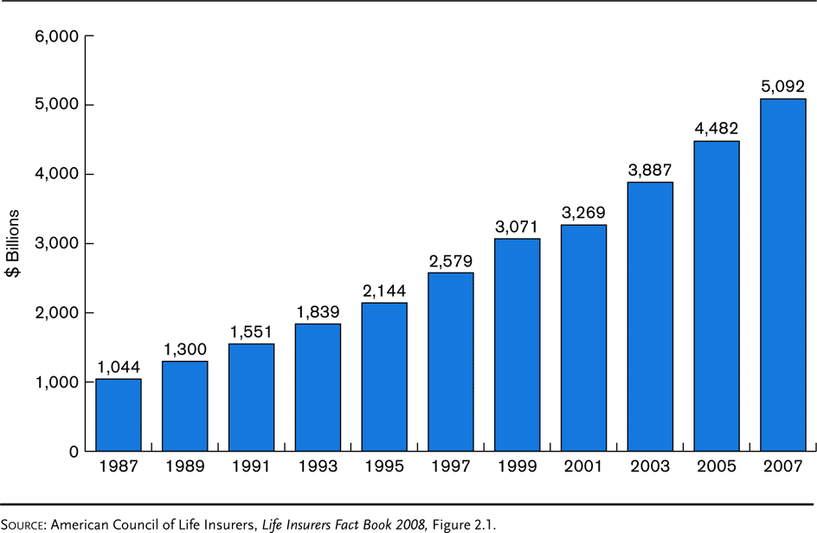
Exhibit 6.1 Growth of Life Insurers’ Assets

Slide 17
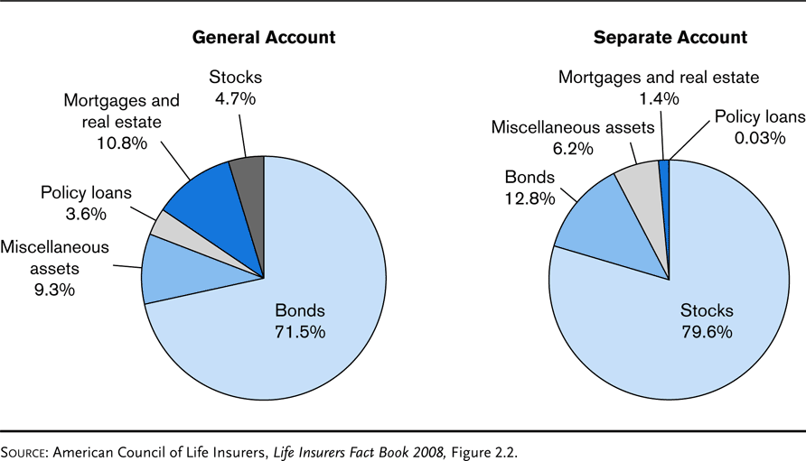
Exhibit 6.2 Asset Distribution of Life Insurers 2007

Slide 18
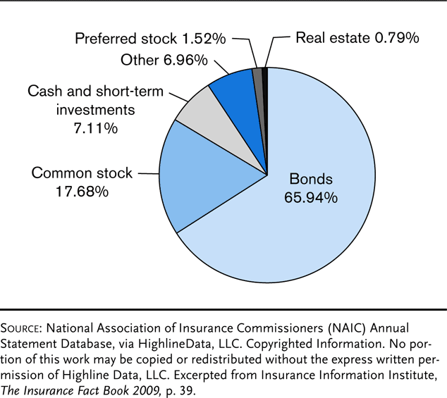
Exhibit 6.3 Investments, Property/Casualty Insurers, 2007 Investments by Type

Slide 19
Other Insurance Company Functions
The electronic data processing area maintains information on premiums, claims, loss ratios, investments, and underwriting results
The accounting department prepares financial statements and develops budgets
In the legal department, attorneys are used in advanced underwriting and estate planning
Property and liability insurers provide numerous loss control services

Slide 20
The Nature of Insurance
Insurance involves not only risk transfer but also pooling and risk reduction
Pooling: The sharing of total losses among a group
Risk reduction: A decrease in the total amount of uncertainty present in a particular situation
Insurers accomplish this by combining a group of objects situated so that the aggregate losses become predictable within narrow limits
Overall risk for the group is reduced, and losses that result are pooled
Usually through the payment of an insurance premium
Insureds transfer various risks to the group and exchange a potentially large uncertain loss for a relatively smaller certain payment (the premium)

Slide 21
The Nature of Insurance
Gambling and insurance are exact opposites
Gambling creates a new risk where none existed before
Insurance is a method of eliminating or greatly reducing an already existing risk
Insurance is usually implemented through legal contracts, or policies
Insurer promises to reimburse the insured for losses suffered during the term of the agreement
Implicit is the assumption that the insurer will be able to pay whatever losses may occur
Important to consider the financial condition of the insurer

Slide 22
Principle of Indemnity
One of the most important precepts for many types of insurance
Particularly property insurance
The insured may not collect more than the actual loss in the event of damage caused by an insured peril
Serves to control moral hazards that might otherwise exist
Indemnify
To restore insureds to the situations that existed prior to a loss
Likelihood of intentional loss is greatly reduced

Slide 23
Principle of Indemnity
Typically contained within property insurance contracts are clauses regarding the existence of other insurance
Such causes provide that all policies covering the same loss will share losses that occur
Some exceptions to the application of the principle of indemnity and property insurance
Appropriate way to measure losses
Replacement value or current value
Valued policy laws
An insurer must pay the entire face amount of the fire insurance policy in the event of total loss
Usually not applicable in the field of life insurance
No attempt is made to measure the amount of the loss when the insured dies
The full amount of life insurance policy is paid

Slide 24
Principle of Insurable Interest
Holds that an insured must demonstrate a personal loss or else be unable to collect amounts due when a loss caused by an insured peril occurs
If insureds could collect without having an insurable interest a moral hazard would exist
Necessary to prevent insurance from becoming a gambling contract
Necessary to remove a possible incentive for murder

Slide 25
What Constitutes Insurable Interest
The legal owner of property having its value diminished by loss
Other rights exist that are sufficient to establish an insurable interest in addition to ownership
The holder of a contract to receive royalties
Legal liability resulting from contracts
Secured creditors
Building contractors, etc.

Slide 26
What Constitutes Insurable Interest
Always presumed to exist in life insurance for persons who voluntarily insure their own lives
However someone who purchases life insurance on another’s life must have an insurable interest in that person’s life
For instance, a business firm may insure the life of a key employee
A husband may insure the life of his wife
There are practical limits as to the amount of life insurance an individual may obtain

Slide 27
When the Insurable Interest Must Exist
In property and liability insurance it is possible to effect coverage on property in which the insured does not have an insurable interest at the time the policy is written
However such an interest is expected in the future
Courts generally hold that in property insurance, insurable interest need exist only at the time of the loss and not at the inception of the policy
However, if at the time of the loss the insured no longer has an interest in the property
There is no liability under the policy

Slide 28
When the Insurable Interest Must Exist
In life insurance, the general rule is that insurable interest must exist at the inception of the policy
It is not necessary at the time of the loss
Courts view life insurance as an investment contract

Slide 29
Principle of Subrogation
Grows out of the principle of indemnity
One who has indemnified another’s loss is entitled to recovery from reliable third parties who are responsible
Reasons for subrogation
To reinforce the principle of indemnity
To prevent the insured from collecting more than the actual amount of the loss
Keeps insurance premiums below what they would otherwise be
The burden of loss is more nearly placed on the shoulders of those responsible
The party that caused the loss is held financially accountable for its actions

Slide 30
Exceptions to the Principle of Subrogation
Subrogation normally does not exist in such lines as life insurance and most types of health insurance
Subrogation does not give the insurer the right to collect against the insured
Even if the insured is negligent
It is not uncommon for an insurer to waive rights of subrogation under certain circumstances
Where, by doing so, there is no violation of the principle of indemnity

Slide 31
Exceptions to the Principle of Subrogation
A waiver can be performed by inserting a waiver-of-subrogation clause
Such clauses are common
An insured who acts in such a way as to destroy or reduce the value of the insurer’s right of subrogation violates the provisions of most subrogation clauses
Forfeits all rights under the policy
Insurer’s subrogation rights also cannot be avoided by a settlement between the primary parties after the insurer has paid under the policy
The insurer is entitled to subrogation only after the insured has been fully indemnified
If the insured has borne part of the loss, the insurer may claim recovery only after these costs have been repaid
Exception: The insurer is entitled to legal expenses incurred in pursuing the subrogation process against a negligent third party

Slide 32
End of Lecture 11

