Slide 1
Lecture No. 15
Government Regulation of Insurance

Slide 2
Objectives
Reasons for Insurance Regulation
Historical Development of Insurance Regulation
Methods for Regulating Insurers
What Areas are Regulated?
State versus Federal Regulation
Current Problems and Issues in Insurance Regulation

Slide 3
Reasons for Insurance Regulation
Maintain insurer solvency
Compensate for inadequate consumer knowledge
Ensure reasonable rates
Make insurance available
Notes:
Transparency Master 1.2

Slide 4
Historical Development of Insurance Regulation
Insurers were initially subject to few regulatory controls
Paul v. Virginia (1868) affirmed the right of the states to regulate insurance
  The court ruled that insurance was not interstate commerce
In U.S. v. South-Eastern Underwriters Association (1944) the court ruled that insurance was interstate commerce when conducted across state lines and was subject to federal regulation
  The legality of rating bureaus was questioned

Slide 5
Historical Development of Insurance Regulation
The McCarran-Ferguson Act (1945) states that continued regulation and taxation of the insurance industry by the states are in the public interest
  Federal antitrust laws apply to insurance only to the extent that the insurance industry is not regulated by state law
    e.g., insurers are not exempt from the Sherman Act provisions
The Financial Modernization Act (1999) changed federal law that earlier prevented banks, insurers, and investment firms from competing outside their core area

Slide 6
Methods of Regulating Insurers
The three principal methods of regulating insurers are:
  Legislation, through both state and federal laws
  Court decisions, e.g., interpreting policy provisions
  State insurance departments
    Every state has an insurance commissioner, who administers state insurance laws
    The National Association of Insurance Commissioners meets periodically to discuss industry problems and draft model laws

Slide 7
What Areas Are Regulated?
All states have requirements for the formation and licensing of insurers
  Licensing includes minimum capital and surplus requirements
  A domestic insurer is domiciled in the state
  A foreign insurer is an out-of-state insurer that is chartered by another state, but licensed to operate in the state
  An alien insurer is an insurer that is chartered by a foreign country, but is licensed to operate in the state

Slide 8
What Areas Are Regulated?
Insurers are subject to financial regulations designed to maintain solvency
  Assets must be sufficient to offset liabilities
    Admitted assets are assets that an insurer can show on its statutory balance sheet in determining its financial condition
  States have regulations that address the calculation of reserves
  An insurer’s surplus position is carefully monitored by state regulators

Slide 9
What Areas Are Regulated?
  Life and health insurers must meet certain risk-based capital standards
    A risk-based capital (RBC) standard means that insurers must have a certain amount of capital, depending on the riskiness of their investments and insurance operations
    An insurer’s RBC depends on:
      Asset risk
      Underwriting risk
      Interest rate risk
      Business risk
    A comparison of the company’s total adjusted capital to the amount of required risk-based capital determines whether company or regulatory action is required

Slide 10
What Areas Are Regulated?
  The purpose of investment regulations is to prevent insurers from making unsound investments that could threaten the company’s solvency and harm the policyowners
    Laws generally place a limit on the proportion of assets in a specific asset category, such as real estate
  Many states limit the amount of surplus a participating life insurer can accumulate, rather than pay as dividends

Slide 11
What Areas Are Regulated?
  Each insurer must file an annual report with the state insurance department in the states where it does business
  The state insurance department assumes control of insurance companies that they determine to be financially impaired
    All states have guaranty funds that provide for the payment of unpaid claims of insolvent property and casualty insurers
    States have guaranty laws and guaranty associations that pay the claims of policyowners of insolvent life and health insurers
    The assessment method is the major method used to raise the necessary funds to pay unpaid claims

Slide 12
What Areas Are Regulated?
Rate regulation takes a variety of forms across states
  Forms of rate regulation for property and casualty insurance include:
    Prior approval law
    Modified prior approval law
    File-and-use law
    Use-and-file law
    Flex-rating law
    State-made rates
    No filing required
  Many states exempt insurers from filing rates for large commercial accounts
  Life insurance rates are not directly regulated by the states

Slide 13
What Areas Are Regulated?
State insurance commissioners have the authority to approve or disapprove new policy forms before the contracts are sold to the public
Sales practices are regulated by the laws concerning the licensing of agents and brokers
  All states require agents and brokers to be licensed
  Insurance laws prohibit a variety of unfair trade practices, such as misrepresentation, twisting, and rebating
    Twisting is the inducement of a policyowner to drop an existing policy and replace it with a new one that provides little or no economic benefit to the client
    Rebating is the practice of giving an individual a premium reduction or some other financial advantage not stated in the policy as an inducement to purchase the policy

Slide 14
What Areas Are Regulated?
State insurance departments typically have a complaint division for handling consumer complaints
  Most complaints involve claims
Information is provided to consumers on insurance department websites and in brochures
Insurers pay numerous local, state, and federal taxes

Slide 15
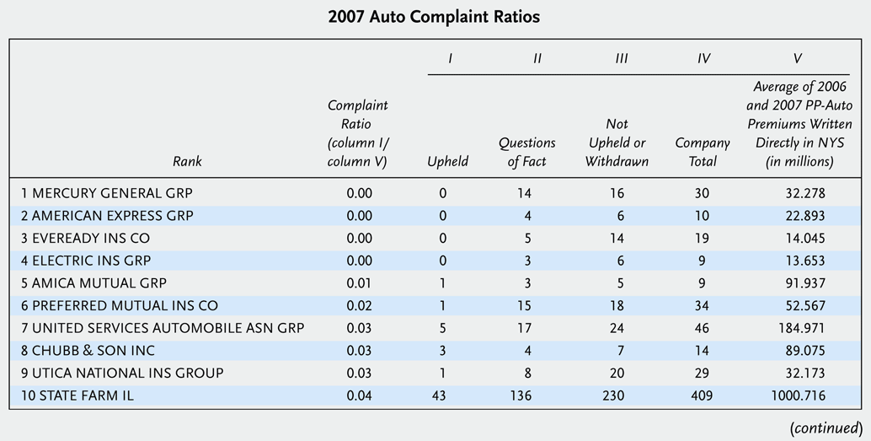
Insight 8.2 2008 Annual Ranking of Automobile Insurance Complaints in New York State (based on 2007 data) (cont.)

Slide 16
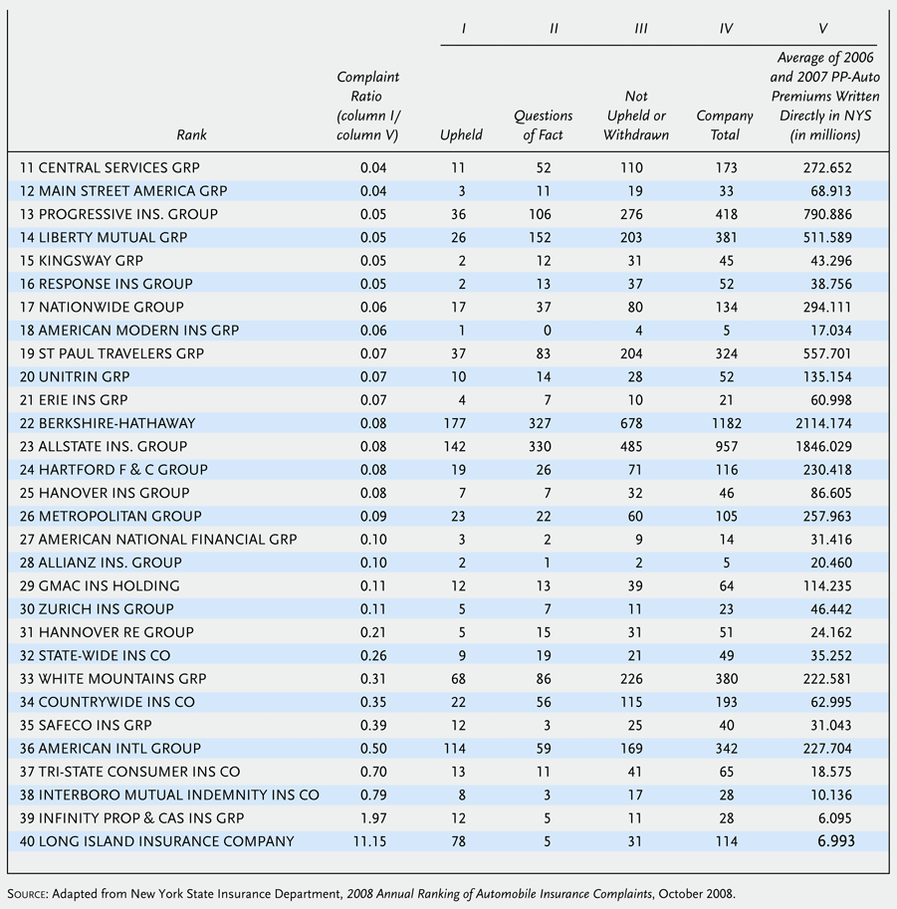
Insight 8.2 2008 Annual Ranking of Automobile Insurance Complaints in New York State (based on 2007 data)
Notes:
16

Slide 17
State versus Federal Regulation
Should the McCarran-Ferguson Act be repealed?
Arguments for federal regulation include:
  Uniformity of laws and standards
  Greater efficiency
  More competent regulators

Slide 18
State versus Federal Regulation
Advantages of state regulation include:
  Greater responsiveness to local needs
  Promotion of uniform laws by the NAIC
  Greater opportunity for innovation
  Unknown consequences of federal regulation
  Decentralization of political power

Slide 19
State versus Federal Regulation
Shortcomings of state regulation include:
  Inadequate protection against insolvency
  Inadequate protection of consumers
  Inadequate market conduct examinations
  Insurance availability
  Regulators may be overly responsive to the insurance industry

Slide 20
Current Problems and Issues in Insurance Regulation
Crisis in Insurance Regulation
  Critics believe that lax regulatory oversight at both the state and federal levels contributed to the current financial meltdown
  The federal government bailout of AIG limited the worldwide repercussions of the crisis
Modernizing Insurance Regulation
  Critics believe the current regulatory system is broken
  Proposals for reform are moving in two directions:
    A dual system of regulation that would allow insurers to choose either a state or federal system
      An optional federal charter proposal would allow life insurers to choose a federal or state charter
    Modernization of regulation at the state level

Slide 21
Current Problems and Issues in Insurance Regulation
Insolvency of insurers continues to be an important regulatory concern
  Reasons for insolvencies include:
    Inadequate rates
    Inadequate reserves for claims
    Rapid growth and inadequate surplus
    Problems with affiliates
    Overstatement of assets
    Alleged fraud
    Failure of reinsurers to pay claims
    Mismanagement
    Catastrophic losses

Slide 22
Current Problems and Issues in Insurance Regulation
The principal methods of ensuring insolvency are:
  Minimum capital and surplus requirements
  Risk-based capital standards
  Review of annual financial statements
  Field examinations
  Early warning system (IRIS ratios)
  FAST system analysis

Slide 23
Current Problems and Issues in Insurance Regulation
An increasing number of insurers are using a credit-based insurance score for underwriting
  Proponents argue:
    There is a high correlation between an applicant’s credit record and future claims experience
    Insurance scores benefit consumers
      Underwriting and rating can be more objective and consistent
      Most consumers have good credit scores
  Critics argue:
    The use of credit data in underwriting or rating discriminates against minorities and other groups
    Credit reports often contain errors that can harm insurance applicants
    Credit-based insurance scores may penalize consumers unfairly during business recessions

Slide 24
Avoid Risks if Possible
Risks that can be eliminated without an adverse effect on the goals of an individual or business probably should be avoided
Without a systematic identification of pure risk exposures
  Some risks that easily could be avoided may inadvertently be retained

Slide 25
Implement Appropriate Loss Control Measures
For risks that a business or individual cannot or does not wish to avoid
  Consideration should be given to available loss control measures
In analyzing the likely costs and benefits of loss control alternatives
  Should recognize that loss control will always be used in conjunction with either risk retention or risk transfer
Therefore, part of the cost/benefit analysis regarding potential loss control is recognition of the likely effects on the transfer or retention of the risk existing after loss control measures are implemented
The selection between risk retention and risk transfer as the optimal risk management technique may change after loss control expenditures are made

Slide 26
Analyzing Loss Control Decisions
Capital budgeting techniques from finance and accounting can be applied to risk management decisions regarding loss control
For example, Cole Department Store has been experiencing substantial shoplifting losses and occasional vandalism to its building
  The company is considering hiring 24-hour security guards to decrease the frequency and severity of these losses
    Its estimated annual cost of the protection is $60,000
      Covers salaries and employee benefits for the guards
  Cole estimates that the presence of security guards will decrease shoplifting losses by $30,000 and vandalism losses by $20,000
    Additionally its insurance premiums are expected to decrease by $5,000
      Should Cole hire the guards?

Slide 27
Analyzing Loss Control Decisions
After examining only the financial considerations
  Since the estimated $55,000 in savings is less than the estimated $60,000 cost of hiring the guards
    The firm should not hire the guards
However the company should consider whether there are any additional relevant factors that may have been overlooked
  For instance, will the presence of the security guards make employees feel safer?
  Will the firm be able to hire better employees?
  Will customer relations be enhanced by the presence of a guard?

Slide 28
Analyzing Loss Control Decisions
In the Cole Department Store example all the benefits and costs were expected to happen in the same year
When a longer period of time is involved the calculations become more complicated

Slide 29
End of Lecture 15

