Slide 1
Lecture No. 19
Analysis of Insurance Contracts

Slide 2
Agenda
Basic parts of an insurance contract
Definition of the “Insured”
Endorsements and Riders
Deductibles
Coinsurance
Other-insurance provisions

Slide 3
Basic Parts of an Insurance Contract
Declarations are statements that provide information about the particular property or activity to be insured
Usually the first page of the policy
In property insurance, it contains name of the insured, location of property, period of protection, amount of insurance, premium and deductible information
Insurance contracts typically contain a page or section of definitions
For example, the insured is referred to as “you”
Notes:
Transparency Master 1.2

Slide 4
Basic Parts of an Insurance Contract
The insuring agreement summarizes the major promises of the insurer
The two basic forms of an insuring agreement in property insurance are:
Named perils policy, where only those perils specifically named in the policy are covered
“All-risks” policy, where all losses are covered except those losses specifically excluded
May also be called an open-perils policy or special coverage policy
Insurers have generally deleted the word “all” from policies
“All-risks” coverage has fewer gaps, and the burden of proof is placed on the insurer to deny a claim

Slide 5
Basic Parts of an Insurance Contract
Insurance contracts contain three major types of exclusions
Excluded perils, e.g., flood, intentional act
Excluded losses, e.g., a professional liability loss is excluded in the homeowners policy
Excluded property, e.g., pets are not covered as personal property in the homeowners policy

Slide 6
Why are Exclusions Necessary?
Some perils are not commercially insurable
e.g., catastrophic losses due to war
Extraordinary hazards are present
e.g., using the automobile for a taxi
Coverage is provided by other contracts
e.g., use of auto excluded on homeowners policy
Moral hazard problems
e.g., coverage of money limited to $200 in homeowners policy
Attitudinal hazard problems
e.g., individuals are forced to bear losses that result from their own carelessness
Coverage not needed by typical insureds
e.g., homeowners policy does not cover aircraft
Notes:
Transparency Master 1.2

Slide 7
Basic Parts of an Insurance Contract
Conditions are provisions in the policy that qualify or place limitations on the insurer’s promise to perform
If policy conditions are not met, insurer can refuse to pay the claim
Insurance policies contain a variety of miscellaneous provisions
e.g., cancellation, subrogation, grace period, misstatement of age

Slide 8
Definition of an “Insured”
An insurance contract must identify the persons or parties who are insured under the policy
The named insured is the person or persons named in the declarations section of the policy
The first named insured has certain additional rights and responsibilities that do not apply to other named insureds
A policy may cover other parties even though they are not specifically named
e.g., the homeowners policy covers resident relatives under age 24 who are full-time students away from home
Additional insureds may be added using an endorsement

Slide 9
Endorsements and Riders
In property and liability insurance, an endorsement is a written provision that adds to, deletes from, or modifies the provisions in the original contract
e.g., an earthquake endorsement to a homeowners policy
In life and health insurance, a rider is a provision that amends or changes the original policy
e.g., a waiver-of-premium rider on a life insurance policy

Slide 10
Deductibles
A deductible is a provision by which a specified amount is subtracted from the total loss payment that otherwise would be payable
The purpose of a deductible is to:
Eliminate small claims that are expensive to handle and process
Reduce premiums paid by the insured
Under the large loss principle, insurance should pay for high severity losses; small losses can be budgeted out of the person’s income
Reduce moral hazard and attitudinal hazard

Slide 11
Deductibles
With a straight deductible, the insured must pay a certain amount before the insurer makes a loss payment
e.g., an auto insurance deductible
An aggregate deductible means that all losses that occur during a specified time period are accumulated to satisfy the deductible amount

Slide 12
Deductibles in Health Insurance
A calendar-year deductible is a type of aggregate deductible that is found in basic medical expense and major medical insurance contracts
A corridor deductible is a deductible that can be used to integrate a basic medical expense plan with a supplemental major medical expense plan
An elimination (waiting) period is a stated period of time at the beginning of a loss during which no insurance benefits are paid

Slide 13
Coinsurance
A coinsurance clause in a property insurance contract encourages the insured to insure the property to a stated percentage of its insurable value
If the coinsurance requirement is not met at the time of the loss, the insured must share in the loss as a coinsurer

Slide 14
Coinsurance
The purpose of coinsurance is to achieve equity in rating
A property owner wishing to insure for a total loss would pay an inequitable premium if other property owners only insure for partial losses
If the coinsurance requirement is met, the insured receives a rate discount, and the policyowner who is underinsured is penalized through application of the coinsurance formula

Slide 15
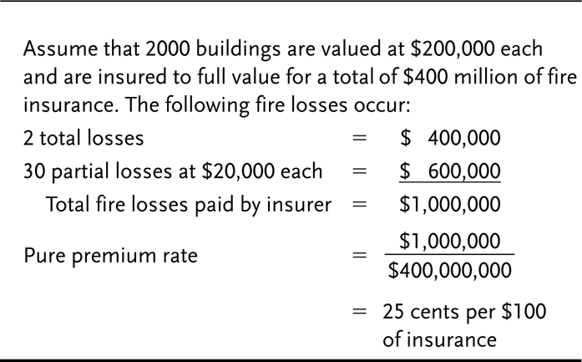
Exhibit 10.1 Insurance to Full Value

Slide 16
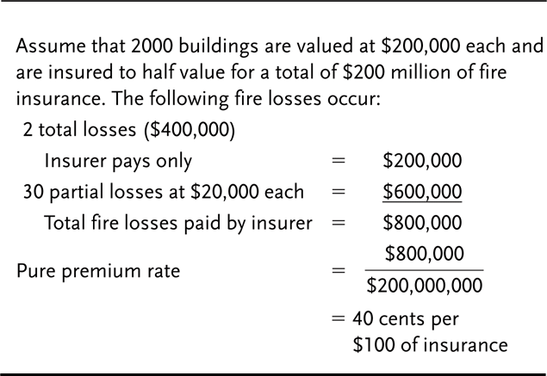
Exhibit 10.2 Insurance to Half Value

Slide 17
Coinsurance in Health Insurance
Health insurance policies frequently contain a percentage participation clause
The clause requires the insured to pay a certain percentage of covered medical expenses in excess of the deductible
The purpose is to reduce premiums and prevent overutilization of policy benefits

Slide 18
Other-insurance Provisions
The purpose of other-insurance provisions is to prevent profiting from insurance and violation of the principle of indemnity
Under a pro rata liability provision, each insurer’s share of the loss is based on the proportion that its insurance bears to the total amount of insurance on the property
Under contribution by equal shares, each insurer shares equally in the loss until the share paid by each insurer equals the lowest limit of liability under any policy, or until the full amount of the loss is paid

Slide 19
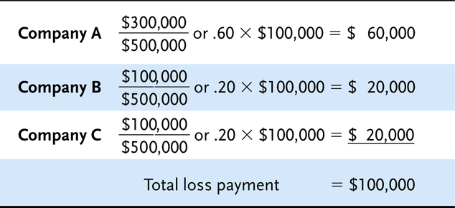
Exhibit 10.3 Pro Rata Liability Example

Slide 20
Exhibit 10.4 Contribution by Equal Shares (Example 1)

Slide 21
Exhibit 10.5 Contribution by Equal Shares (Example 2)

Slide 22
Other-insurance Provisions
Under a primary and excess insurance provision, the primary insurer pays first, and the excess insurer pays only after the policy limits under the primary policy are exhausted
The coordination of benefits provision in group health insurance is designed to prevent overinsurance and the duplication of benefits if one person is covered under more than one group health insurance plan
e.g., two employed spouses are insured as dependents under each other’s group health insurance plan

Slide 23
Transportation Insurance
One of the oldest and most vital forms of insurance
All types of trade depend heavily on the availability of insurance for successful and expedient handling
Insurance played a vital part in stimulating early commerce
In Roman times bottomry contracts and respondentia contracts covering the terms under which money was borrowed to finance ocean commerce
The lender of money took as security for loan either the ship itself (bottomry), or the cargo (respondentia)
However, if the ship or cargo was lost as a result of ocean perils, the loan was canceled
If the voyage was successful, the loan was repaid and substantial interest was charged
Mainly because the interest included an allowance for the possibility of loss of the security
Essentially an insurance premium

Slide 24
The Perils of Transportation
There is an inability to control adequately or completely the forces of nature
Or to prevent human failure as it affects the safe movement of goods
With ocean transportation, for instance
Storms can capsize even the largest ocean vessels
Hurricane winds often dump tons of sea water onto a vessel and damage cargo
Engine failure may drive ship aground
With ground transportation
Vehicles can overturn
Rough or careless handling can damage goods

Slide 25
The Liability of the Carrier
The question arises
“Is not the carrier of the goods responsible for their safe movement?”
To some extent, yes
The common law liability of the carrier differs depending on
The country in which the transportation conveyances are chartered
The applicable statutes
Custom
The type of shipping, etc.

Slide 26
The Carrier’s Liability in Ocean Transportation
The ship owner is responsible only for failure to exercise due diligence
The responsibility of the carrier is to
Make the ship seaworthy
Employ proper crew
To equip and supply the ship
Make all holds and other carrying compartments safe and fit for the goods stored there
Exercise due care in loading, handling, and stowing cargoes

Slide 27
The Carrier’s Liability in Ocean Transportation
The carrier is definitely not liable for certain things, including loss resulting from
Errors in navigation or management of the vessel
Strikes or lockouts
Acts of god
Acts of war or public enemies
Seizure of the goods under legal process
Quarantine
Inherent vice of the goods
Failure of the shipper to exercise due care in the handling or packing of the goods
Fire
Perils of the seas
Latent defects in the hull or machinery
Other losses where the carrier is not at fault

Slide 28
The Carrier’s Liability in Land Transportation
The common law liability of the land carrier is considerably greater than that of the ocean carrier
But it is still not absolute
In addition to being responsible for failure to exercise due diligence
The land carrier is responsible for all loss to the goods except for
Acts of god
Acts of public enemies or public authority
Acts or negligence of the shipper
Inherent vice or quality of the goods

Slide 29
The Carrier’s Liability in Land Transportation
Acts of god
Have been interpreted to mean perils such as the earthquakes, storms, and floods that could not have been reasonably guarded against
Fire is not an act of god
Public enemy
Action by forces at war with a domestic government
Not gangsters, mobs, or rioters
Acts of negligence of the shipper
Improper loading or packing and instances where the nature of the goods is concealed
Inherent nature of the goods
Losses due to decay, heat, rust, drying, or fermentation

Slide 30
Need for Transportation Insurance
Many types of transportation losses fall outside the responsibility of the common carrier
Common carriers have been slow to settle losses for which they’re legally liable
In land transportation, the shipper usually sends goods under what is known as a released bill of lading
The effect is to limit the dollar liability of the carrier for any loss to the goods
In return, the shipper obtains a lower freight rate

Slide 31
Ocean Transportation Insurance
Larger ships and more advanced instruments and navigation made long voyages possible
With these changes came the realization that insurance protection was almost a necessity
The major source of underwriting capacity was England
Probably because the country was among the first to develop a complex system of admiralty law
Table 10-1 shows that the U.S. market for ocean marine insurance increased almost 120 percent from 1980 to 2002

Slide 32
Table 10-1: United States Ocean Marine Insurance Premiums

Slide 33
End of Lecture 19

