Slide 1
Lecture No. 21
Life Insurance

Slide 2
Agenda
Premature Death
Financial Impact of Premature Death on Different Types of Families
Amount of Life Insurance to Own
Types of Life Insurance
Variations of Whole Life Insurance
Other Types of Life Insurance

Slide 3
Premature Death
The death of a family head with outstanding unfulfilled financial obligations can cause serious financial problems for the surviving family members
  The deceased’s future earnings are lost forever
  Additional expenses are incurred, e.g., funeral expenses, uninsured medical bills, and estate settlement costs
  Some families will experience a reduction in their standard of living
  Noneconomic costs are incurred, e.g., grief

Slide 4
Premature Death
Life expectancy has increased significantly over the past century
  Thus, the economic problem of premature death has declined
  Millions of Americans still die annually from heart disease, cancer and stroke
The purchase of life insurance is financially justified if the insured has earned income and others are dependent on those earnings for financial support

Slide 5
Financial Impact of Premature Death on Different Types of Families
The need for life insurance varies across family types:
  Single person
  Single-parent family
  Two income earners with children
  Traditional family
  Blended family
  Sandwiched family

Slide 6
Amount of Life Insurance to Own
Three approaches can be used to estimate the amount of life insurance to own:
  The human life value approach
    The amount needed depends on the insured’s human life value, which is the present value of the family’s share of the deceased breadwinner’s future earnings
    To calculate:
      Estimate the individual’s average annual earnings over his or her productive lifetime
      Deduct taxes, insurance premiums and self-maintenance costs
      Using a reasonable discount rate, determine the present value of the family’s share of earnings for the number of years until retirement
Notes:
Transparency Master 1.2

Slide 7
Amount of Life Insurance to Own
  The needs approach
    The amount needed depends on the financial needs that must be met if the family head should die
    Important family needs must consider:
      An estate clearance fund: cash needed for burial expenses, uninsured medical bills, and taxes
      Income needed for the readjustment period, a 1-2 year period in which the family adjusts to its new living standard
      The dependency period is the period until the youngest child reaches age 18
      Life income to the surviving spouse, including income during and after the blackout period. The blackout period refers to the period from the time that Social Security survivor benefits terminate to the time the benefits are resumed
      Families should also consider special needs, e.g., funds for college education and emergencies

Slide 8
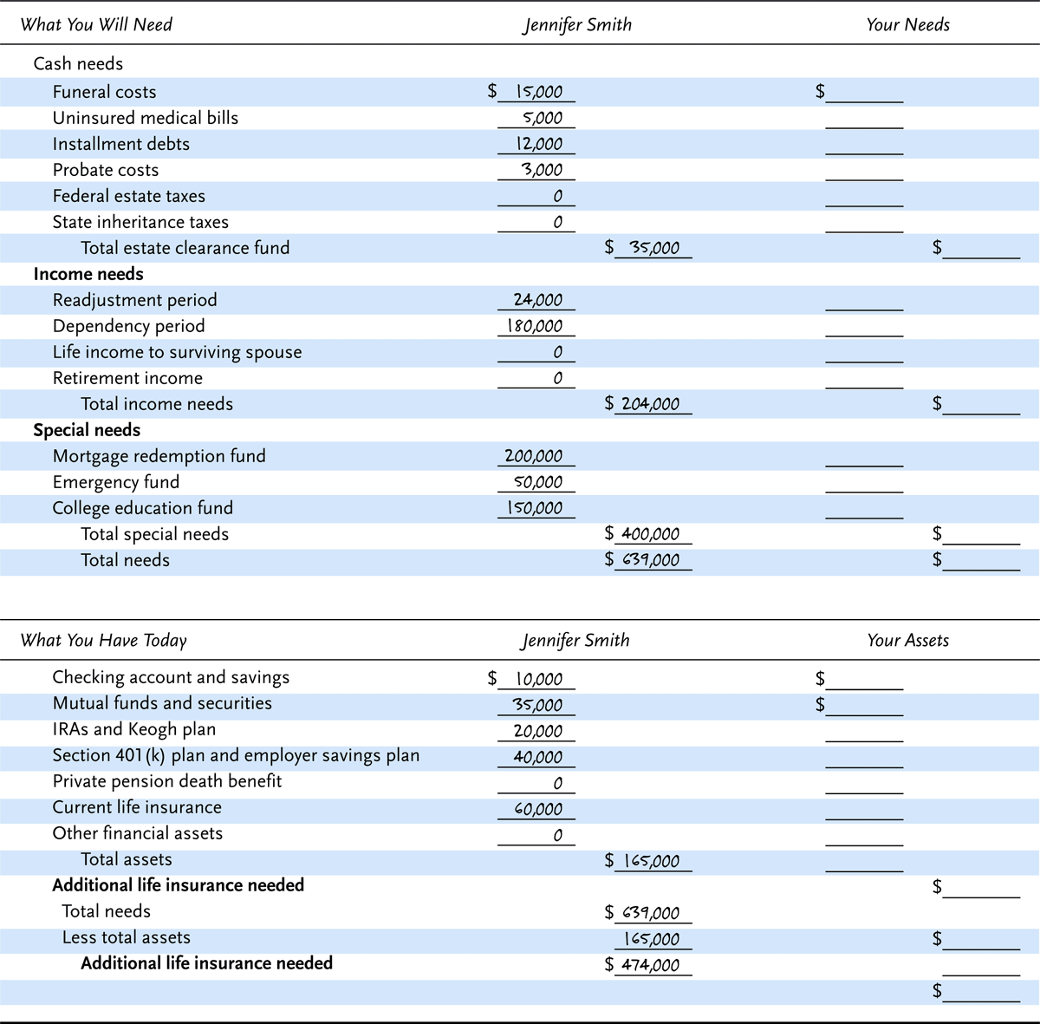
Exhibit 11.1 How Much Life Insurance Do You Need?

Slide 9
Amount of Life Insurance to Own
  The capital retention approach
    This approach preserves the capital needed to provide income to the family
      Income-producing assets are preserved for the heirs
    To calculate:
      Prepare a personal balance sheet
      Determine the amount of income-producing capital
      Determine the amount of additional capital needed to meet the family needs
  Internet-based life insurance calculators produce widely-varying results, but may be a good starting point

Slide 10
Amount of Life Insurance to Own
Most families own an insufficient amount of life insurance
  About one in five households have no life insurance
  Consumers procrastinate, and have difficulty in making correct decisions about the purchase of life insurance
Many families have only a limited amount of discretionary income
  The purchase of life insurance reduces the amount of discretionary income available for other needs
  Many families are in debt and have little savings
  After payment of high priority expenses, such as a mortgage, food and utilities, many families have only a limited amount of income to purchase life insurance
Notes:
Transparency Master 1.2

Slide 11
Types of Life Insurance
Life insurance policies can be classified in two general categories:
  Term insurance provide temporary protection
  Cash-value life insurance has a savings component and builds cash values
  There are many variations of both types available today

Slide 12
Types of Term Life Insurance
Under a term insurance policy, protection is temporary
  Protection expires at the end of the policy period, unless renewed
  Most term policies are renewable for additional periods
    Premiums increase at each renewal
  Most term policies are convertible, which means the policy can be exchanged for a cash-value policy without evidence of insurability
    Under the attained-age method, the premium charged for the new policy is based on the insured’s attained age at the time of conversion
    Under the original-age method, the premium charged for the new policy is based on the insured's original age when the term insurance was first purchased

Slide 13
Types of Term Life Insurance
Yearly-renewable term insurance is issued for a one-year period
Term insurance can also be issued for 5 or more years
A term to age 65 policy provides protection to age 65, at which time the policy expires
Under a decreasing term insurance policy, the face value gradually declines each year
Under a reentry term insurance policy, renewal premiums are based on select (lower) mortality rates if the insured can periodically demonstrate acceptable evidence of insurability (i.e., good health)
Under a return of premiums term, the premiums are refunded if the policyowner outlives the term of the policy

Slide 14
Uses and Limitations of Term Life Insurance
Term insurance is appropriate when:
  The amount of income that can be spent on life insurance is limited
  The need for protection is temporary
  The insured wants to guarantee future insurability
However,
  Term insurance premiums increase with age at an increasing rate and eventually reach prohibitive levels
  Term insurance is inappropriate if you wish to save money for a specific need

Slide 15
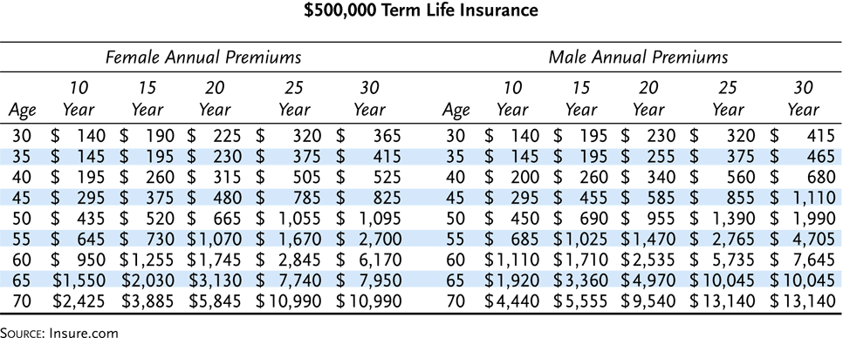
Exhibit 11.2 Examples of Term Life Insurance Premiums

Slide 16
Types of Whole Life Insurance
Whole life insurance is a cash value policy that provides lifetime protection
  A stated amount is paid to a designated beneficiary when the insured dies, regardless of when the death occurs
  Types include:
    ● Ordinary life
    ● Limited-payment life
    ● Endowment insurance
    ● Variable life
● Universal life
● Variable universal life
● Current assumption whole life
● Indeterminate-premium whole life

Slide 17
Types of Whole Life Insurance
Ordinary life insurance is a level-premium policy that provides lifetime protection
  Premiums are level throughout the premium paying period
  The excess premiums paid during the early years are used to supplement the inadequate premiums paid during the later years of the policy. It is referred to as a legal reserve
  The insurer’s legal reserve is a liability that must be offset by sufficient financial assets
  The net amount at risk is the difference between the legal reserve and the face amount of coverage

Slide 18
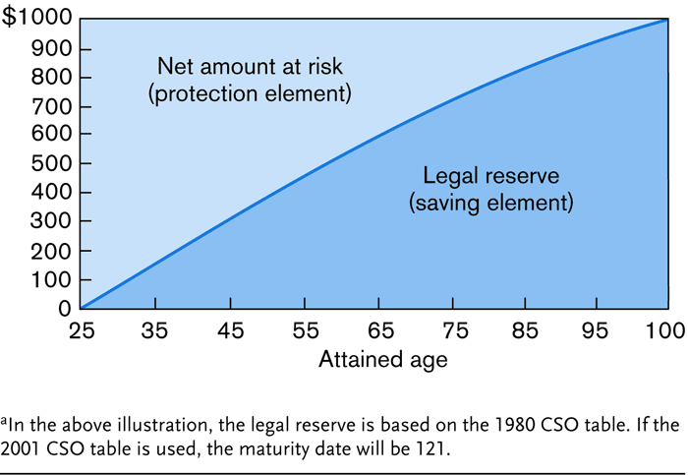
Exhibit 11.3 Relationship Between the Net Amount at Risk and Legal Reserve (1980 CSO Mortality Table)ª

Slide 19
Types of Whole Life Insurance
  Another characteristic of ordinary life insurance policies is the accumulation of cash surrender values
    A policyholder overpays for insurance protection during the early years, resulting in a legal reserve and the accumulation of cash values
    Because of the loading for expenses and high first-year acquisition costs, cash values are initially below the legal reserve
    The policyowner has the right to borrow the cash value or exercise a cash surrender options
  An ordinary life policy is appropriate when lifetime protection is needed

Slide 20
Types of Whole Life Insurance
The major limitation of ordinary life insurance is that some people are still underinsured after the policy is purchased
  A term policy for the same premium would purchase substantially more protection
Under a limited-payment life insurance policy, the insured has lifetime protection, and premiums are level, but they are paid only for a certain period
  A single-premium whole life policy provides lifetime protection with a single premium
Endowment insurance pays the face amount of insurance if the insured dies within a specified period. If the insured is still alive at the end of the period, the face amount is paid to the policyholder

Slide 21
Variations of Whole Life Insurance
Insurers have developed a wide variety of whole life products
Variable life insurance is a fixed-premium policy in which the death benefit and cash values vary according to the investment experience of a separate account maintained by the insurer
  The premium is level
  The entire reserve is held in a separate account and is invested in common stocks or other investments
    If the investment experience is favorable, the face amount of insurance is increased
  Cash surrender values are not guaranteed
    Although the insurer bears the risk of excessive mortality and expenses, the policyholder bears the risk of poor investment results

Slide 22
Variations of Whole Life Insurance
Universal Life Insurance is a flexible premium policy that provides lifetime protection
  After the first premium, the policyholder decides the amount and frequency of payments
    Most policies have a target premium, but the policyowner is not obligated to pay it
  The protection and savings components are unbundled
    the policyholder’s statement shows the premiums paid, death benefit, and value of the cash value account
    It also shows the mortality charge and the interest credited to the cash value account
Notes:
Transparency Master 1.2

Slide 23
Variations of Whole Life Insurance
  There are two forms of universal life insurance:
    Option A pays a level death benefit during the early years
      The death benefit increases in later years to meet the corridor test required by the Internal Revenue Code
    Option B provides for an increasing death benefit
      The death benefit is equal to a constant net amount at risk plus the accumulated cash value

Slide 24
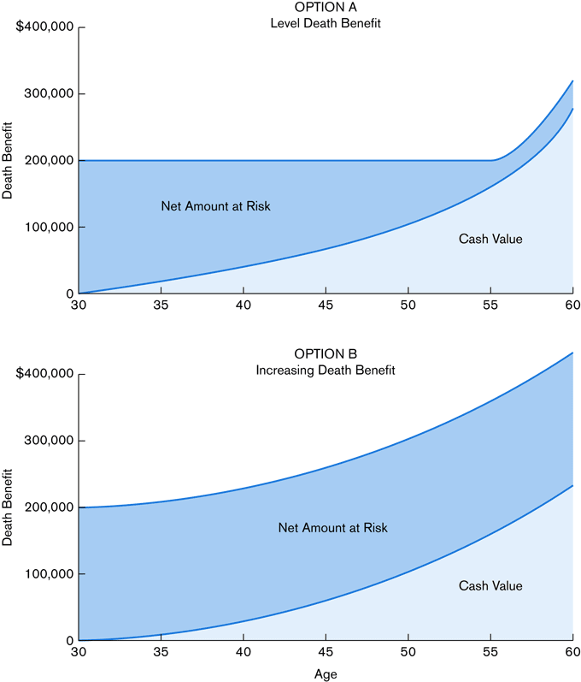
Exhibit 11.4 Two forms of Universal Life Insurance Death Benefits

Slide 25
Variations of Whole Life Insurance
  Universal life provides considerable flexibility
    Cash withdrawals are permitted
    Policies receive favorable federal income tax treatment
  Limitations of universal life policies include:
    Insurers advertise misleading rates of return
    Cash-value and premium-payment projections based on higher interest rates are misleading and invalid
    Insurers can increase the current mortality charge to recoup expenses
    A policy may lapse because some policyowners do not have a firm commitment to pay premiums

Slide 26
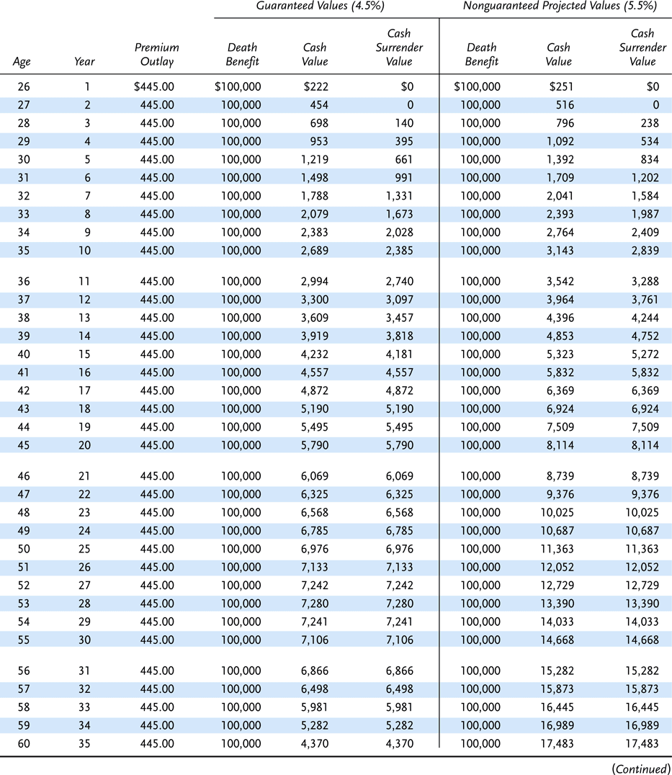
Exhibit 11.5 $100,000 Universal Life Policy, Level Death Benefit, Male Age 25, Nonsmoker, 5.5 Percent Assumed Interest (con’t)

Slide 27
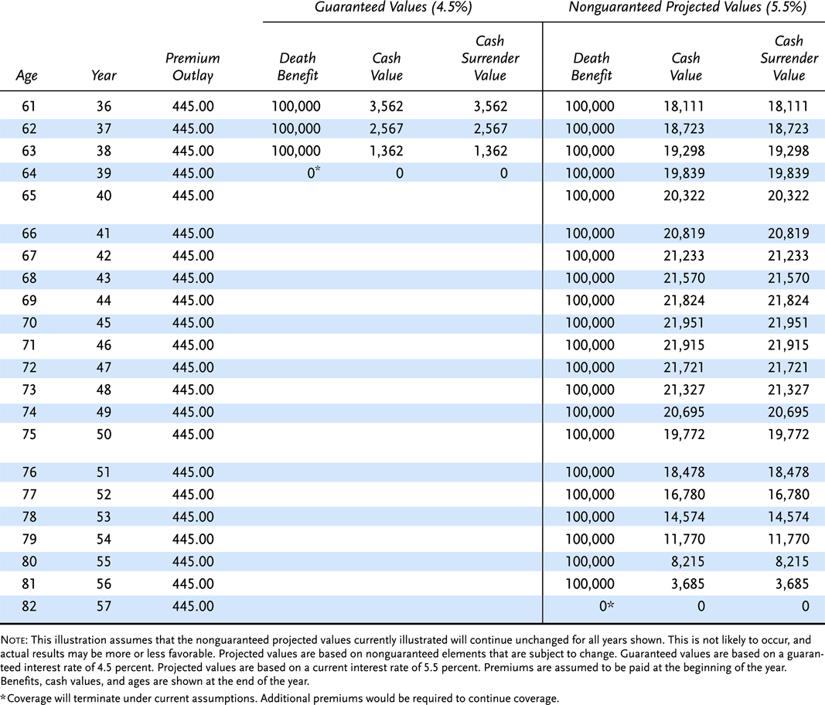
Exhibit 11.5 $100,000 Universal Life Policy, Level Death Benefit, Male Age 25, Nonsmoker, 5.5 Percent Assumed Interest

Slide 28
Variations of Whole Life Insurance
Variable universal life is an important variation of whole life insurance
  Most are sold as investments
  Similar to universal life except that:
    The policy owner decides how the premiums are invested
    The policy does not guarantee a minimum interest rate or minimum cash value
  These policies have relatively high expense charges, including front-end loads for sales commissions, back-end surrender charges, and investment management fees

Slide 29
Variations of Whole Life Insurance
Current assumption whole life insurance is a nonparticipating whole life policy in which the cash values are based on the insurer’s current mortality, investment, and expense experience
  An accumulation account reflects the cash value under the policy
  If the policy is surrendered, a surrender charge is deducted from the accumulation account
  A guaranteed interest rate and current interest rate are used to determine cash values
  A fixed death benefit and maximum premium level at the time of issue are stated in the policy
  Two forms of current assumption whole life products:
    Low-premium products, with a low initial premium
    High-premium products, with a vanishing premium provision

Slide 30
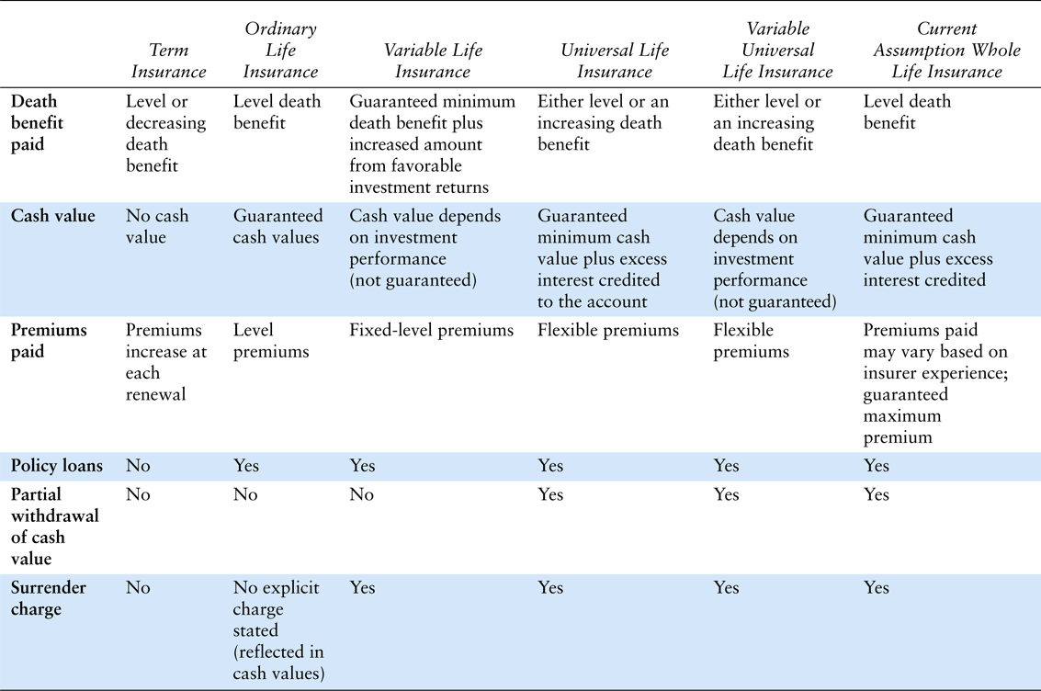
Exhibit 11.6 Comparison of Major Life Insurance Contracts

Slide 31
Variations of Whole Life Insurance
An indeterminate-premium whole life policy is a generic name for a nonparticipating policy that permits the insurer to adjust premiums based on anticipated future experience
  After an initial guaranteed period, the insurer can increase premiums up to the maximum limit if the insurer’s experience is expected to worsen

Slide 32
Other Types of Life Insurance
A modified life policy is a whole life policy in which premiums are lower for the first three to five years and higher thereafter
Preferred risk policies are sold at lower rates to individuals whose mortality experience is expected to be lower than average (e.g., a non-smoker)
Second-to-Die life insurance insures two or more lives and pays the death benefit upon the death of the second or last insured
  Usually whole life, but can be term

Slide 33
Other Types of Life Insurance
Savings Bank Life Insurance (SBLI) is a type of life insurance that is sold by savings banks
  Policies were sold originally by savings banks in Massachusetts, NY and Connecticut
  SBLI is also sold over the phone or through Websites
Historically, industrial life insurance was a class of life insurance that was issued in small amounts and an agent of the company collected the premiums at the insured’s home
  Also known as home service life insurance
Group life insurance provides life insurance on a group of people in a single master contract

Slide 34
End of Lecture 21

