Slide 1
Lecture No. 24
Life Insurance Contractual Provisions

Slide 2
Evaluation of Insurance Methods
Data from National Academy of Social Insurance show that
Private insurers incurred 55 percent
Self-insurers 23 percent
Federal and state funds 22 percent of the cost of workers’ compensation in 2001
Private insurers are preferred by most employers in states where they’re permitted to operate
Offer the employer an opportunity to insure in one contract all the liabilities likely for damages arising from work-connected injuries
Private insurers offer more certainty in handling out-of-state risks
While the expenses of state funds are somewhat lower than those of private insurers
The difference is not as great as rough comparisons often lead one to believe
Self-insurance has the handicap that it is necessary for the insured to enter the insurance business
Which is essentially unrelated to the insured’s main operations
Also, contributions to a self-insurance fund are often not tax deductible
Experience rating and retrospective rate plans enable large firm to use a private insurer’s facility in transferring as much or as little of the risk as is desired at a modest cost

Slide 3
Employment Covered
Compensation laws do not cover all workers
For example, domestic labor and farm labor are often excluded
Employers with only a few employees are excluded under compulsory laws
Only about 9 out of 10 workers are covered
Liability suits are necessary if an excluded worker is to recover anything
Even though a basic purpose of compensation legislation was to eliminate this condition as a prerequisite for employee recoveries
It is a small employer who is excluded from compensation laws and who is most likely to be the object of such suits
This often means that
A successful suit will bankrupt the employer
If the employer is more or less judgment-proof, the injured worker will recover nothing

Slide 4
Income Provisions
Compensation laws recognize four types of disability for which income benefits may be paid
Permanent and temporary total disability
Permanent and temporary partial disability
Generally limit payments by specifying the maximum duration of benefits and the maximum weekly and aggregate amounts payable

Slide 5
Income Provisions
For permanent total disability benefits, most states permit lifetime payments to the injured worker who is unable to perform the duties of any suitable occupation
In the remaining states, typical limitation is between 400 and 500 weeks of payments
There is often a limitation on the aggregate amount payable
A common limitation that income benefits cannot exceed about 2/3 of the worker’s average weekly wage or some dollar amount
Weekly benefits for temporary total disability are usually the same as for permanent total disability
Except that often there is a lower maximum aggregate limitation and a shorter time duration for such payments
Most workers’ compensation laws specify the lump sums may be paid to a worker as liquidating damages for a disability
Such as the loss of a leg or an eye
Loss is permanent but does not totally incapacitate the worker

Slide 6
Survivor Benefits
In the case of fatal injuries, the widow or widower and children of the worker are entitled to funeral and income benefits
Subject to various limitations
The maximum benefits to the widow or widower are generally less than they would have been to the disabled worker
But if the survivor has children, these benefits are comparable to what the worker would have received for permanent total disability
Highway crashes represent the single largest cause of workplace deaths
Accounting for ¼ of all fatalities in workers’ compensation

Slide 7
Medical Benefits
Most workers’ compensation laws provide relatively complete medical services to an injured worker
Including allowances for certain occupational diseases
In all jurisdictions unlimited medical care is provided for accidental work injuries
And broad coverage for occupational disease is provided

Slide 8
Rehabilitation Benefits
Provided by most states
Generally recognized that the quantity and quality of the services are subject to wide variation
Federal Vocational Rehabilitation Act includes federal funds to aid states in vocational rehabilitation of individuals who are injured in the workplace

Slide 9
Benefits
There is great variability between the states
Table 12-1 shows descriptive statistics for some states
A Federal Employees Compensation plan covers federal employees
It has the highest benefit of any plan

Slide 10
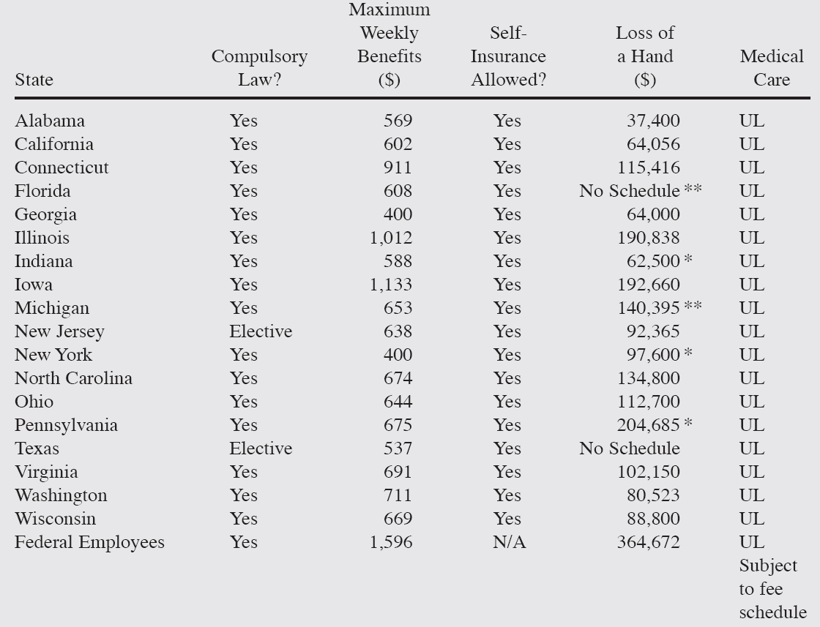
Table 12-1: State Workers’ Compensation Provisions

Slide 11
Experience Rating
Widely used in workers’ compensation insurance
General theory is that an employer has some control over the loss ratio and is entitled to a credit for good loss record
Or should pay a higher rate if the loss record is poorer than average
The details of the plan are very complex
General procedure is to determine, for each occupational class, some expected loss ratio against which the insured’s actual loss ratio is compared
Not all losses suffered by an insured are counted
The plan uses a stabilizing factor so that unusually large losses cannot operate to increase the small employer’s rate unreasonably
For the large employer, the employer’s loss experience becomes more important as its expected losses become greater
Experience rating in workers’ compensation gives employers an incentive to do whatever is within their control to prevent accidents

Slide 12
Retrospective Rating
Entirely voluntary agreement between the insured and the insurer
If the employer’s payroll is such that a standard of premium of $1,000 or more is incurred
Is considered that the firm is large enough to develop experience that is partially credible
Standard premium is defined as what the employer would have paid at manual rates after adjustment for experience rating
But before any adjustment for retrospective rating
In practice, an employer likely to use retrospective rating is generally considerably larger than this

Slide 13
Retrospective Rating
There are various plans of retrospective rating
The employer must choose one
Which plan should the employer choose?
Essentially, this question reduces to one of how much risk the employer is willing to assume
The basic retrospective rating formula is given by
R = [BP + (L)(LCF)]TM
R = retrospective premium payable for the year in question
BP = a basic premium designed to cover fixed costs of the insurer
L = losses actually suffered by the employer
LCF = loss conversion factor designed to cover the variable cost of the insurer
TM = tax multiplier designed to reflect the premium tax levied by the state of the insurer’s business
The basic premium declines as the size of the employer increases
Differs with the type of plan used
The formula is subject to the operation of certain minimums and maximums
Both of which decline as the size of the employer increases

Slide 14
Risk Management and Workers’ Compensation
Workers’ compensation is one of the most frequently self-insured coverages in the risk management area
Characterized by relatively high-frequency and low-severity losses
In recent years, the motivation to self-insure a portion or all of this exposure has increased
Due to rapidly rising premium levels
When premiums are high, the cash flow benefits of self-insurance are greater
Self-insurance becomes more attractive

Slide 15
Factors Favoring Self-Insurance
Lower administrative expenses
When a firm establishes a self-insured workers’ compensation program, it eliminates most of the premium paid to an insurer
Cash flow benefits
Probably greater than the cost saving aspects of self-insuring workers’ compensation
Under a traditional insured plan, the insured pays the premium
And at some later date the insurer pays all the claims
In the aggregate, this arrangement provides the insurance company with a large amount of money that can be invested in income-producing securities until the claims are paid
When a firm self-insurers, it holds the money until the claims are paid
As it takes several years to pay all the claims from a given year’s loss exposure
The self-insurer has the use of some of the funds for a fairly long time
There’s a perpetual sum available for investment in securities or in the self-insured’s own operations

Slide 16
Factors Favoring Self-Insurance
Claims-conscious management
Management often becomes more claims conscious when it is paying directly for workers’ compensation losses
When insurers are paying the claims, only an indirect effect is seen by operating managers
As a consequence, workers’ compensation losses often decline when a firm initiates a self-insurance program

Slide 17
Factors Against Self-Insurance
Size of firm
A company must be financially capable of retaining self-insured losses
It must have a large enough exposure so that it can predict much of its losses
Generally, a firm with an annual premium of less than $250,000 will not self-insure
Stability of workforce
Concerns how much turnover of the firm has and how rapidly it is expanding
Newly employed people, as well as younger employees, have higher accident rates than more mature workers
New plants tend to have higher accident rates than established ones

Slide 18
Factors Against Self-Insurance
Tax consequences
Under a self-insured program, one cannot take a tax deduction until the funds are actually paid
Availability of services
When a firm self-insures, it must provide or purchase services that were formally provided by the insurance company
These services include
Loss control activities, claims adjusting, data processing, and program administration
A firm can usually buy these services from companies that specialize in such activities

Slide 19
Excess Insurance
Most companies do not completely self-insure the workers’ compensation exposure
Because of the catastrophic nature of certain types of workers’ compensation losses
Such claims as long-term disability or death may add up to hundreds of thousands of dollars
To prevent such circumstances, self-insurers purchase excess insurance
Basic types of excess insurance
Specific
The self-insurer absorbs the first x dollars on any loss
Aggregate excess
The policy operates like an aggregate deductible
Typically, the aggregate limit is at least the level of what the workers’ compensation premiums would have been if insurance had been purchased

Slide 20
Potential Problems
Problems include, but are not limited to
Financial ability to retain losses
A large enough exposure base to be able to predict losses accurately
Actual management of the plan
Establishment of a loss prevention and protection program
Management of a risk management information system
Availability of excess-of-loss insurance
Top management commitment to the plan

Slide 21
Alternative Workers’ Compensation Risk Financing Strategies
Various financing plans for workers’ compensation programs often use a letter of credit issued by a financial institution on behalf of the insured
By using this approach, an insured obtains maximum cash flow and tax benefits
However, there are caveats that need to be considered
Each year a letter of credit must be issued
Letters of credit cost money and they’re more expensive than they used to be
The firm’s overall debt limit could be adversely affected
IRS is taking a tougher position on plans where the insured tries to take a tax deduction for the full premium but pays only a small part in cash

Slide 22
Alternative Workers’ Compensation Risk Financing Strategies
Alternative financing strategies include such programs as
Investment credit
Require one to pay the full premium in cash at the beginning of the year, but give the insured investment earnings from the premiums
Compensating balance
Reduce the firm’s obligations to banks that lend money to the insured

Slide 23
Captive Insurance Companies
General, auto, and product liability cases can give rise to large awards
For example, Domino’s Pizza, Inc., lost a lawsuit concerning an auto accident in which one of its delivery persons ran a red light and injured someone
Part of the evidence involved Domino’s promise to deliver pizza in 30 minutes and that drivers were not driving in a reasonable manner
The jury returned a verdict for $78 million
A captive insurance arrangement would have been useful in financing the loss

Slide 24
Special Tax Status of Insurance Companies
Insurance companies are the only type of company that can establish loss reserves and take a tax deduction for the loss’s accrual
Other corporations can take tax deductions for loss only after the loss has been paid
Insurance companies can pre-fund losses with pretax dollars
A manufacturer must use after-tax dollars
If a risk manager could create an insurance company or an organization that would pass the IRS definition of an insurance company
Pretax dollars could be used to fund self-insured losses of his or firm

Slide 25
Operation of a Captive
Captive insurer
A subsidiary formed by a company that is called a parent
It is a captive of the parent because the parent controls it
Captive insurance companies became very popular in the 1960s and 1970s
A firm paid a premium to the subsidiary and took the deduction
The captive recorded the premium as revenue and increased its loss reserve by almost an equal amount
So the captive did not show a profit
Resulted in a 100 percent tax deduction for the parent
The captive held the funds; it did not earn a profit, so did not pay any income taxes
IRS began to challenge this arrangement in the courts
Rule slowly involved that a parent could not take the deduction unless a subsidiary had a significant amount of non-related risks
The rule required a significant number of exposures that were not part of the parent organization

Slide 26
Onshore Versus Offshore Captives
Creating a captive insurance company in the United States is not a difficult task
But it is relatively expensive
Most states have minimum capital requirements that can run as high as several million dollars
An onshore captive is subject to the state laws in which it is incorporated
However offshore captives are not subject to such restrictive regulatory laws
Little upfront money is needed to start offshore captives
Offshore captives have very favorable income tax laws

Slide 27
Other Attributes of Captives
When a firm writes its insurance in a captive
It can write the policy exactly the way it wishes
Often the risk manager of the parent firm is the CEO of the captive
So the parent can make the insurance policy as liberal as it desires
For some firms that have sought to manage risk on a broader enterprise-wide basis
Captives have offered a useful tool for financing risks that have not traditionally been addressed in the insurance market
Such risks include reputation risk, branded risk, residual value risk on vehicle leases, and weather risk
In 2003 some firms begin to fund employee benefits through their captives

Slide 28
Other Attributes of Captives
Regulatory restraints on investments are less
Captive can invest its funds almost any way it wishes
Captive insurance companies can have direct contact with reinsurers
It is through reinsurance that captives can serve as a funding vehicle for self-insured plans and reduce the probability of catastrophic losses

Slide 29
Potential Problems of Captives
Demand time and energy of the risk manager
Require the firm to incorporate the captive either on- or offshore
Which takes time and money
The firm must have enough of a loss exposure to warrant these expenses
For this reason companies often group together to form association or industry captives
If a parent creates a single-owner captive the tax deductibility of payments will be problematic
IRS may require a substantial amount of unrelated business
One advantage of the association or industry captive is that it has diverse ownership and insures a significant amount of unrelated business

Slide 30
Potential Problems of Captives
Hard reinsurance markets may make it difficult for the captive to reinsure its business
Without reinsurance, the captive can be a very dangerous undertaking
Sometimes it is difficult for the risk manager to justify the continued use of a captive in extremely soft markets
The temptation may arise to shut down the captive because insurance is so cheap
However, it is important for the risk manager to have continuity in his or her own risk management program
Changing from insurance to a captive and then back again can break the continuity of the plan and cost more money
Financial officers often dislike captives because once money is placed or funds accumulate in a captive
It is difficult to obtain the money except for risk management purposes
Table 12-5 shows the most popular locations for captive insurance companies

Slide 31
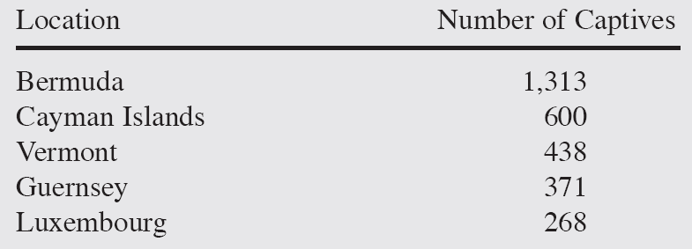
Table 12-5: Most Popular Locations for Captive Insurance Companies, 2002

Slide 32
End of Lecture 24

