Slide 1
Lecture No. 25
Buying Life Insurance

Slide 2
Objectives
Determining the Cost of Life Insurance
Rate of Return on Saving Component
Taxation of Life Insurance
Shopping for Life Insurance

Slide 3
Determining the Cost of Life Insurance
The cost of a life insurance policy is the difference between what you pay and what you get back
When determining the cost of life insurance, four major factors must be considered:
    Annual premiums
    Cash values
    Dividends
    Time value of money

Slide 4
Determining the Cost of Life Insurance
Under the traditional net cost method, the cash value and expected dividends are subtracted from annual premiums to obtain a net cost per year figure
  This method does not consider the time value of money

Slide 5
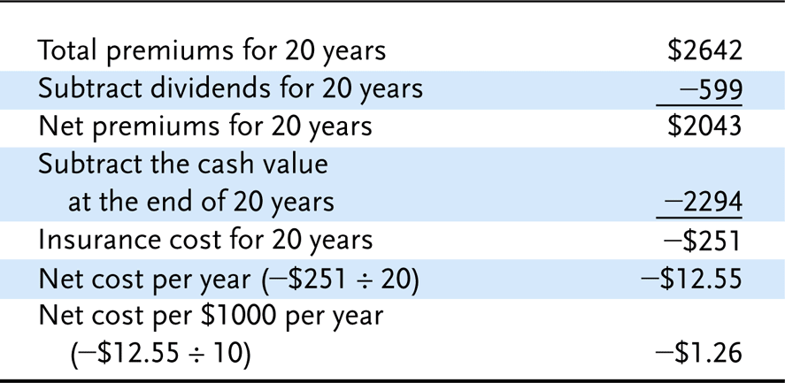
Exhibit 13.1 Traditional Net Cost Method

Slide 6
Determining the Cost of Life Insurance
The interest-adjusted cost method is more accurate because it considers the time value of money
Interest-adjusted cost indices come in two forms:
  The surrender cost index is useful if the owner expects to surrender the policy after some time period
  The net payment cost index is useful if the owner expects to keep the policy in force

Slide 7
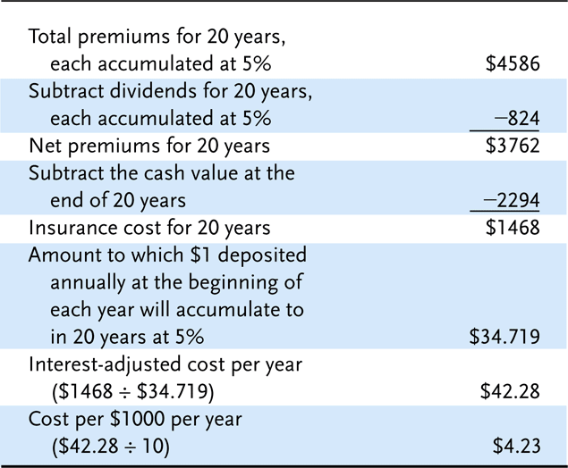
Exhibit 13.2 Surrender Cost Index

Slide 8
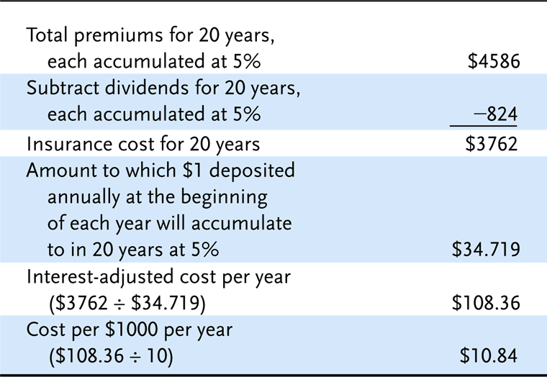
Exhibit 13.3 Net Payment Cost Index

Slide 9
Determining the Cost of Life Insurance
Interest-adjusted cost indices can be used to compare policies across insurers
  There is a wide variation in costs indices across insurers – it pays to shop around!
  Most consumers use premiums as a basis for comparison, but agents will supply cost indices

Slide 10
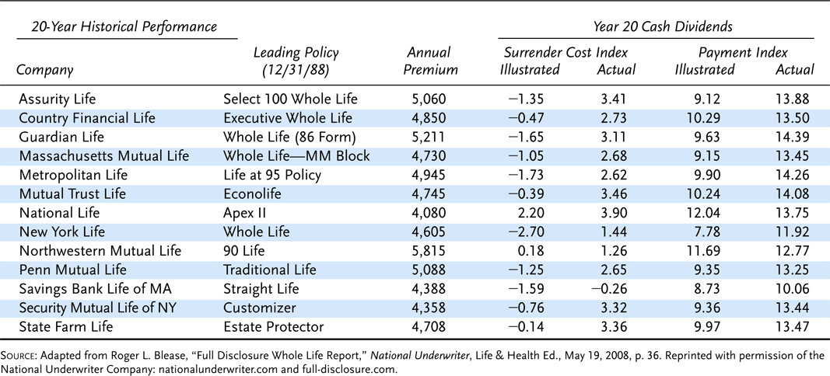
Exhibit 13.4 Whole Life Actual Historical Performance $250,000 Male Nonsmoker Preferred Class, Age 45 Policy Issued 12/31/1988. Last Day 12/31/2008.

Slide 11
Determining the Cost of Life Insurance
The Life Insurance Policy Illustration Model Act requires insurers to present certain information to applicants for life insurance
  The goal is to reduce misunderstanding of policy values by policyowners, and reduce deceptive sales practices by agents
  A narrative summary describes the basic characteristics of the policy
  A numeric summary shows the premium outlay, value of the accumulation account, cash surrender values and death benefit
  The act also prohibits certain sales practices and requires the insurer to provide an annual report

Slide 12
Rate of Return on Saving Component
The annual rate of return earned on the savings component of a policy is an important consideration if you intend to invest over a long period of time
The Linton yield is the average annual rate of return on a cash value policy if it is held for a specified number of years
  Current information is not readily available to consumers, so the method has limited use

Slide 13
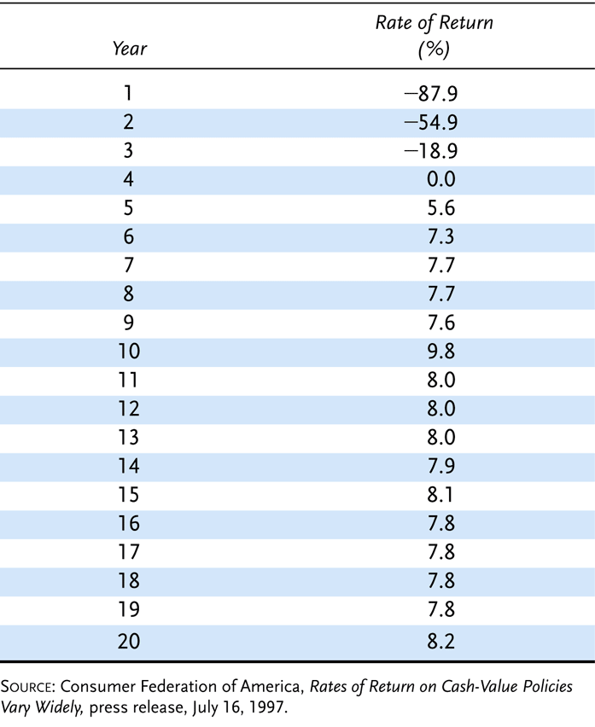
Exhibit 13.5 Average Annual Rates of Return for 109 Cash-Value Policies by Year of Policy

Slide 14
Rate of Return on Saving Component
The yearly rate of return method is based on a formula:
The information needed for the calculation is readily available to consumers

Slide 15
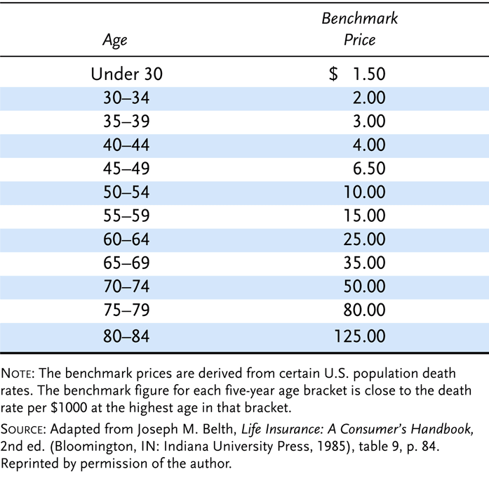
Exhibit 13.6 Benchmark Prices

Slide 16
Taxation of Life Insurance
Life insurance proceeds paid in a lump sum to a designated beneficiary are generally received income-tax free
  The interest component of periodic payments is taxable as ordinary income
  Premiums are generally not deductible
  Dividends are not taxable, but interest on dividends retained is taxable
  If a policy is surrendered for its cash value, any gain is taxable as ordinary income

Slide 17
Taxation of Life Insurance
Proceeds from a life insurance policy are included in the gross estate of the insured for federal estate-tax purposes if:
  the insured has any ownership interest
  they are payable to the estate
The proceeds may be removed from the gross estate if the policyowner makes an absolute assignment of the policy to someone else
  The policyowner must make the assignment more than three years before death

Slide 18
Taxation of Life Insurance
A federal estate tax is payable if the decedent's taxable estate exceeds certain limits
  A tentative tax on the taxable estate value is calculated
    The gross estate includes property you own, one-half of the value of property owned jointly with your spouse, life insurance death proceeds in which you have ownership interest
    The gross estate may be reduced by certain deductions, such as a marital deduction, in determining the taxable estate
    The taxable estate may be reduced or eliminated by a tax credit called a unified credit
  The amount of property exempt from taxation will increase in the future
  Federal estate taxes are scheduled to expire in 2010
    Tax will be reinstated in 2011 unless Congress acts

Slide 19
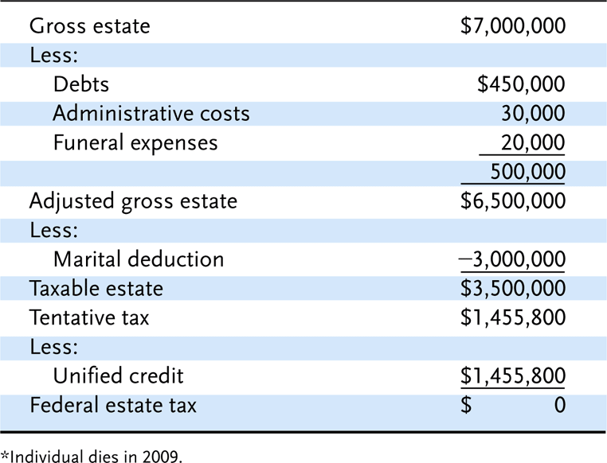
Exhibit 13.7 Calculating Federal Estate Taxes*

Slide 20
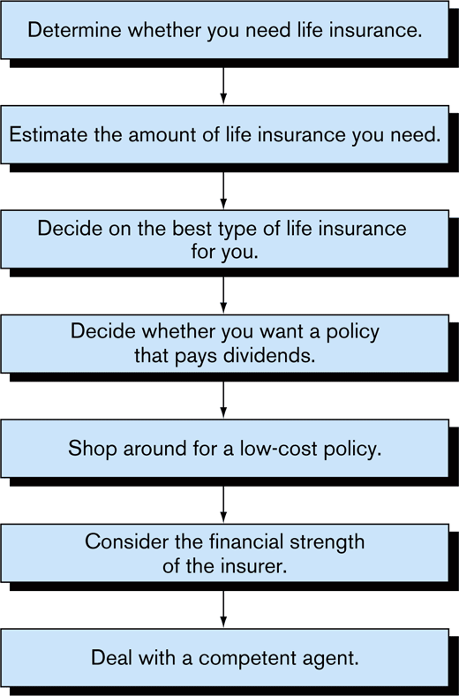
Exhibit 13.8 Shopping For Life Insurance

Slide 21
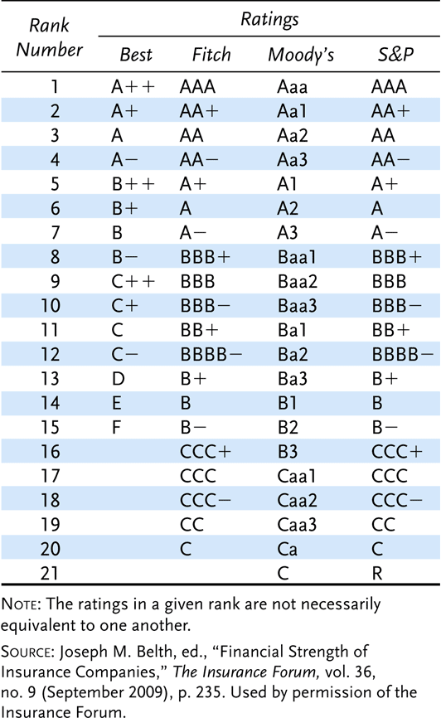
Exhibit 13.9 Rating Categories for Major Rating Agencies

Slide 22
Types of Life Insurance
In 2002 the face amount of new life insurance sold in the U.S. was $2.9 trillion
Total life insurance in force by the end of 2002 was $16.3 trillion
Three major types of life insurance
  Term
  Whole life
  Universal life
Other types of life insurance exist
  Some were more prevalent in past years but decreased in popularity as newer forms of life insurance were developed and marketed

Slide 23
Term Insurance
Designed to provide protection if the insured person dies during a specified period of time
Accounts for a substantial portion of the face amount of all life insurance purchased by individuals in the U.S. each year
In most cases it has no cash value and cannot be used to meet savings needs
Its exclusive focus on death protection means that, for a given amount of premium dollars
  A person can usually buy a larger face amount of term insurance coverage than can be purchased with any other type of life insurance

Slide 24
Duration of Term Coverage
Term insurance contracts are issued for a specific period of time
  Such as 1 year, 5 years, or 20 years
At the end of the period, the insurance protection ceases unless the coverage is renewed
Some term insurance is sold with the expectation that the coverage will be renewed several times
Straight term insurance is generally not renewable
Another way of stating the policy’s duration of coverage, instead of specifying an exact number of years
  The contract remains in effect up to a particular age

Slide 25
Coverage Options and Guarantees
A legitimate concern regarding the purchase of term insurance would arise if there were no guarantees allowing insureds to renew their term insurance protection
A person’s health might deteriorate while the coverage was in effect
  The individual could be considered uninsurable in the future
  Thus, when the term period ended, the insurance protection would expire
    And the former insured would be unable to obtain new coverage
Because many insureds want to protect their right to buy coverage in the future regardless of their health
  Most insurance companies issue what is known as renewable term insurance

Slide 26
Coverage Options and Guarantees
Renewable term policies are written for a specified number of years
  Are renewable for similar periods of time, regardless of the insured’s health
Each time the policy is renewed
  The premium increases to reflect the insured’s current age
Changes in health status that may have taken place since the policy was issued are not reflected in future premiums

Slide 27
Coverage Options and Guarantees
Term insurance renewal rights usually are not completely unlimited
  Due to insurers’ concerns about adverse selection
Without some limitation on the right to renew
  Overall mortality rates among insureds would be higher due to these types of behaviors
  Insurance premiums would have to be greater
Previously this concern about adverse selection caused many insurers to offer the renewability option only until about age 60 or 65
  However, with greater experience and in response to competitive pressures
    It is now common for insurers to issue policies that can be renewed until more advanced ages

Slide 28
Coverage Options and Guarantees
Most term policies are convertible into a different form of life insurance
Standard conversion provision gives the insured the option to change the term policy into some form of permanent coverage to remain in effect for the person’s entire lifetime
  Rather than expiring on a specified date
When term insurance is convertible, the right to change to permanent coverage is provided
  Regardless of the insured’s health at the time of conversion
Some policies can be converted at any time before they expire
  However, term insurance contracts that can be renewed up to very advanced ages often are more restrictive regarding conversion rights
    It is not unusual for conversion rights to end after age 65 for 70
      Even though right to renew policy as term insurance extends to age 90 or beyond

Slide 29
Face Amount Variability
The majority of term policies have a face amount that does not change over time
  Referred to as level term contracts
Term insurance can also be arranged so that the face amount either
  Decreases over time (decreasing term insurance)
    Usually purchased for specific purpose
      Such as providing cash to pay off a mortgage or other debt if the insured dies with some of the loan still outstanding
  Increases over time (increasing term insurance)
      Face amount increases periodically on a predetermined basis
      A more common approach for meeting an increasing need is through a cost-of-living rider or a guaranteed insurability rider
        Both of these are endorsements to a basic level term or permanent insurance policy

Slide 30
Face Amount Variability
Cost-of-living rider
  Automatically increases the amount of protection by the same percentage that the Consumer Price Index has increased since the basic policy was issued
  As long as the insured accepts and pays for the additional amount of coverage each time it is offered, no evidence of insurability is required
Guaranteed insurability rider
  Provides that the insured will be able to purchase additional amounts of insurance protection in the future
    Regardless of health
    Subject to stated maximums

Slide 31
Whole Life Insurance
May be kept in force for the insured’s entire lifetime
Has accounted for more than half of all life insurance policies sold in the U.S. in recent years
  Lags behind term insurance with respect to the total face amount of coverage issued
Contains the savings elements called cash values
  If the owner of the whole life policy decides to terminate it before the insured’s death, the cash value can be refunded

Slide 32
Whole Life Insurance
A straight life contract is arranged so that the premiums are payable as long as the insured lives
A limited-pay life policy requires that the premiums are payable for only a specified period of time
  Such as 20 years or until age 65
  After that time, no further premiums are necessary, but the coverage remains in effect until the insured’s death
Is also possible to pay for a whole life policy with only one premium
  Called a single-premium life

Slide 33
Whole Life Insurance
When a premium for whole life insurance is paid to the insurer
  Part of that premium is used to help pay the policy’s fair share of death benefits for insureds who die that year
  Part of the premium not needed to pay that year’s death benefits is used to pay current expenses of the insurer
  Any remaining amounts are invested to earn interest
Life insurance premiums are calculated such that, when they are combined over time with the premiums and investment earnings from other similar policies
  All mortality and expense costs can be paid as incurred until all insureds are dead

Slide 34
Whole Life Insurance
If insureds terminate their whole life contracts before death
  They are entitled to refunds of the excess premiums that have accumulated for their policies to date
  Called the policy’s cash value
The more premium dollars that are paid earlier in the life of the contract
  The greater the cash value available on policy termination
Life insurers make various assumptions about mortality costs, interest earnings, and expenses
  On the basis of these assumptions, it is possible to guarantee within the contract the cash values that will be generated by policy termination at various times

Slide 35
Universal Life Insurance
First introduced in the U.S. in 1979
Offers more flexible premium payment options than do most other forms of life insurance
The minimum initial premium required to activate the policy is specified by the insurer
  But the policyowner usually decides the timing and size of subsequent premiums
Policyowners can also periodically adjust the size of the death benefit in most universal life contracts
  Although insurers may require proof of insurability if a request is made to increase the death benefit

Slide 36
Universal Life Insurance
The cash value of the universal life policy is established deliberately and varies regularly
  Depending on such factors as
    The insurer’s investment savings, mortality experience, and expenses
    The amount and timing of premiums paid by the insured
Basic versions of life insurance contracts–differ only with respect to how the death benefit is designated
  Type A universal life
  Type B universal life

Slide 37
Universal Life Insurance
Type A universal life
  The death benefit is an amount that remains the same while the policy is in force
  The death benefit is the cash value plus whatever amount is necessary to bring the total to the specified amount
Type B universal life
  Has fluctuating death benefits that are made up of a specified amount of death protection plus the policy’s cash value
    Table 16-1 provides an illustration of the structure of the Type B universal life policy
      As the cash value grows over time so does the death benefit
      The actual rates credited correspond closely to money market rates
        The interest rate credited is an especially crucial item in determining the size of the cash value and the death benefit for Type B contracts

Slide 38
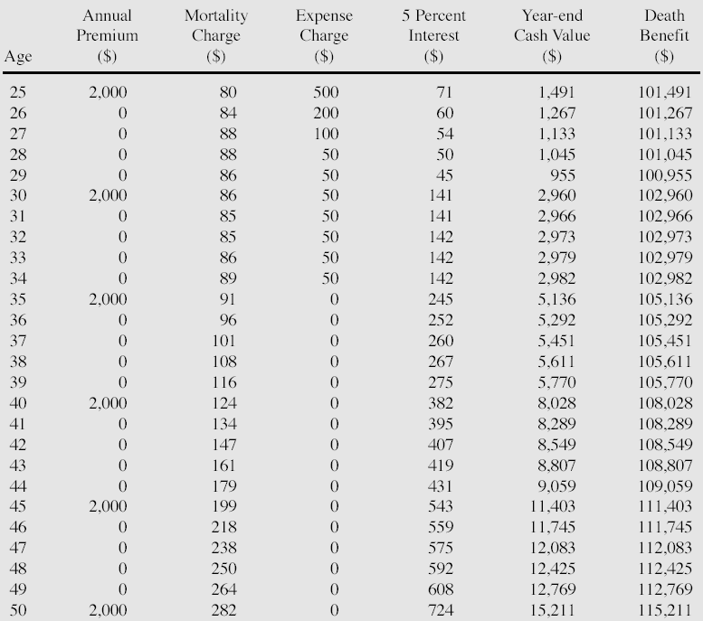
Table 16-1: Illustration of Type B Universal Life Insurance Policy Structure (Male, age 25)

Slide 39
Universal Life Insurance
In the first several years following their introduction
  Universal life cash values were credited with interest that substantially exceeded the minimum guarantees
  Illustrations for selling policies were often based on the assumption that interest rates of 10 or 11% would continue throughout the life of the policy
  However, in the early 1990s interest rates dipped to their lowest levels in decades
  Insurers were forced to credit universal life cash values with much lower interest rates
    Leading to dissatisfaction among many policyowners
For the policy illustrated in Table 16-1, a wide range of potential cash values may result at various ages
  Depending on the interest rate assumption
    Table 16-2 shows some of the possible results

Slide 40
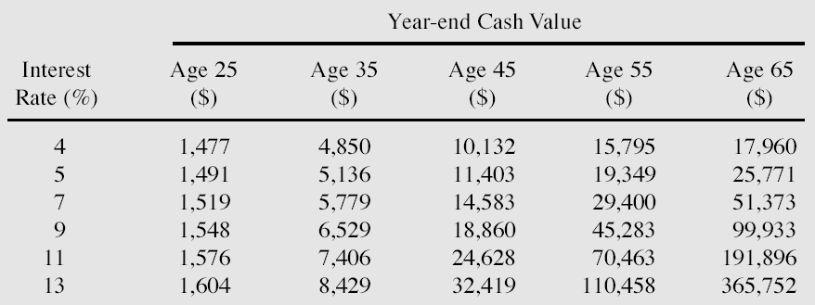
Table 16-2: Interest Rate Sensitivity of Type B Universal Life Policy Cash Values (Initial Death Benefit of $100,000)

Slide 41
Variable Life
The death benefit and cash value fluctuate with the investment performance of one or more portfolios of securities
Policyholders can designate the types of investments that they want supporting their policies
If the selected investments increase in value
  Both the face amount and the cash value of the variable life contract will also increase
Poor investment performance will result in decreasing coverage and cash values
  Although a minimal face amount is usually guaranteed
Originally designed to provide an inflation hedge for both the death protection and savings elements of the policy

Slide 42
Variable Universal Life
Combines some of the features of both universal life and variable life insurance
  Referred to as flexible premium variable life
Contract usually is designed similarly to a universal life policy with respect to death benefits and flexible premium arrangements
  A primary difference is that policyowners are given a choice of investments to be used to support the contract
    Rather than using only high-grade, short-term money market investments as in the standard universal life policy
Usually only the cash value of a variable universal policy varies with the performance of the underlying securities

Slide 43
Modified Life
Can describe many different policy structures
Usually the contract is a form of whole life insurance with premiums that are lower than usual for an initial period of time
  After that time, the premiums are somewhat higher than they otherwise would be
Can be especially appropriate for insureds with limited incomes who want to own permanent life insurance they cannot currently afforded
Convertible term insurance can meet the same need
  But many persons who plan to convert their term insurance do not actually do so because of the substantial premium increase
An advantage of modified life is that the policyowner does not have to initiate any type of positive action to obtain the permanent insurance

Slide 44
Endowment
The amount of endowment insurance sold in the U.S. is now negligible
Provides death benefits for a specified period time
  Has a cash value, and the policyowners pay the contract’s face amount at the end of the protection period if the insured is still alive
While the policy does provide death protection
  On a relative basis it emphasizes savings to a much greater degree than any policy discussed so far
Most insureds now seek other alternatives because of the adverse tax treatment now accorded to endowment policies

Slide 45
Industrial Life
Known variously as industrial life, home service life, or debit insurance
Type of cash value life insurance that is sold in very small amounts
  Primarily to meet burial needs of low income insureds
The face amount is only a few thousand dollars
Premiums are only a few dollars each week and are usually collected personally at the insureds’ homes

Slide 46
Industrial Life
More expensive on a relative basis than other forms of life insurance because
  Of the high cost of its premium collection method
  Mortality rates tend to be higher for persons who purchase this form of coverage
Because the face amount is so small, underwriting standards are often fairly liberal
  Medical exams are rarely required
Those who purchase industrial life insurance would be better served by regular term or whole life insurance
  The low-income status of most of these insureds makes it unlikely that they will be approached by traditional life agents

Slide 47
Credit Life
Offered in connection with installment sales of consumer durables, such as automobiles
Decreasing term insurance issued without a medical examination
Will expire when the installment sales contract is paid off
Cost of protection is incorporated into the regular payment made by the purchaser
If the insured dies before the loan is repaid
  Sufficient coverage exists to repay the balance of the debt
  Protects the insured’s dependents as well as the lender

Slide 48
End of Lecture 25

