Slide 1
Lecture No. 27
Employee Benefits: Group Life and Health Insurance

Slide 2
Objectives
Meaning of Employee Benefits
Fundamentals of Group Insurance
Group Life Insurance Plans
Group Medical Expense Insurance
Traditional Indemnity Plans
Managed Care Plans
Consumer-directed Health Plans
Recent Developments in Employer-Sponsored Health Plans
Group Medical Expense Contractual Provisions
Group Dental Insurance
Group Disability-Income Insurance
Cafeteria Plans

Slide 3
Meaning of Employee Benefits
Employee benefits are employer-sponsored benefits, other than wages, that are partly or fully paid by employers, which enhance the financial security of individuals and families
These benefits include:
Group life, medical and dental insurance
Paid holidays, vacations, medical leave
Educational assistance, employee discounts
Employer contributions to Social Security and Medicare

Slide 4
Fundamentals of Group Insurance
Group insurance differs from individual insurance in several ways:
Many people are covered under one contract
A master contract is formed between the group and insurer
Coverage costs less to the individual than comparable insurance purchased individually
Individual evidence of insurability is usually not required
Experience rating is used
Notes:
Transparency Master 1.2

Slide 5
Group Insurance
Group insurers observe certain underwriting principles:
The group should not be formed for the sole purpose of obtaining insurance
There should be a flow of persons through the group
Benefits should be automatically determined by a formula
This is to reduce adverse selection against the insurer
A minimum percentage of employees must participate
Individual members should not pay the entire cost
The plan should be easy to administer
Notes:
Transparency Master 1.2

Slide 6
Group Insurance
Eligibility for group status depends on company policy and state law
Usually a minimum size is required
Employees must meet certain participation requirements:
Be a full time employee
Satisfy a probationary period
Apply for coverage during the eligibility period
During the eligibility period, the employee can sign up for coverage without furnishing evidence of insurability
Be actively at work when the coverage begins

Slide 7
Group Life Insurance Plans
The most important form of group insurance is group term life insurance
Provides low-cost protection to employees
Coverage is yearly renewable term
The amount of coverage can be based on the workers’ earnings, position, or it can be a flat amount for all
It is typically 1-5 times the annual salary or earnings
Coverage usually ends when the employee leaves the company
Can convert to an individual cash value policy

Slide 8
Group Life Insurance Plans
Many group life insurance plans also provide group accidental death and dismemberment (AD&D) insurance
Pays additional benefits if the employee dies in an accident or incurs certain types of bodily injuries
Some plans offer voluntary accidental death and dismemberment insurance
Employees pay the full cost

Slide 9
Group Life Insurance Plans
Some employers make available group universal life insurance for their employees
The employer may offer a one or two plan design
In the single plan approach, the employee who wants only term insurance pays only the mortality and expense charges
In the two plan approach, the employee who wants only term insurance pays into the term insurance plan; the employee who wants universal life insurance must pay higher premiums to accumulate cash value
Employees select the amount of guaranteed coverage
Employees pay the full cost of universal life insurance
Premiums are flexible; loans and withdrawals are possible
Retired employees can continue the coverage
Dependents can be added with a rider

Slide 10
Group Medical Expense Insurance
Group medical expense insurance pays the cost of hospital care, physicians’ and surgeons’ fees, and related medical expenses
Insurance is available through:
Commercial insurers
Blue Cross and Blue Shield Plans
Managed Care organizations
Self-insured plans by employers
Commercial life & health insurers sell medical expense coverage and also sponsor managed care plans

Slide 11
Group Medical Expense Insurance
Blue Cross and Blue Shield plans sell individual, family and group coverages
Blue Cross plans cover hospital expenses
Blue Shield plans cover physicians’ and surgeons’ fees
Major medical is also available
In most states, plans operate as non-profit organizations
Some have converted to a for-profit status to raise capital
Managed care plans offer medical expense benefits in a cost effective manner
Plans emphasize cost control and services are monitored
Most organizations are for-profit
A managed care organization typically sponsors a health maintenance organization (HMO)
Comprehensive services are provided for a fixed, prepaid fee

Slide 12
Group Medical Expense Insurance
A large percentage of employers self-insure the health insurance benefits provided to their employees
Self insurance means the employer pays part or all of the cost of providing health insurance to the employees
Plans are usually established with stop-loss insurance
A commercial insurer will pay claims that exceed a certain limit
Some employers have an administrative services only (ASO) contract with a commercial insurer
The commercial insurer only provides administrative services, such as claim processing and record keeping
Self-insured plans are exempt from state laws that require insured plans to offer certain state-mandated benefits

Slide 13
Traditional Indemnity Plans
Under a traditional indemnity plan:
Physicians are paid a fee for each covered service
Insureds have freedom in selecting their own physician
Plans pay indemnity benefits for covered services up to certain limits
Cost-containment has not been heavily stressed
These plans have declined in importance over time
Some plans have implemented cost-containment provisions
Common types include basic medical expense insurance and major medical insurance

Slide 14
Traditional Indemnity Plans
Basic medical expense insurance is a generic name for group plans that provide only basic benefits
Covers routine medical expenses
Not designed to cover a catastrophic loss
Coverage includes:
Hospital expense insurance
Plans pay room and board or service benefits
Surgical expense insurance
Newer plans typically pay reasonable and customary charges
Physicians’ visits other than for surgery
Miscellaneous benefits, such as diagnostic x-rays

Slide 15
Traditional Indemnity Plans
Major medical insurance is designed to pay a high proportion of the covered expenses of a catastrophic illness or injury
Can be written as a supplement to a basic medical expense plan, or combined with a basic plan to form comprehensive coverage
Supplemental major medical insurance is designed to supplement the benefits provided by a basic plan and typically has:
High lifetime limits
A coinsurance provision, with a stop-loss limit
A corridor deductible, which applies only to eligible medical expenses not covered by the basic plan

Slide 16
Traditional Indemnity Plans
Comprehensive major medical insurance is a combination of basic benefits and major medical insurance in one policy, and typically has:
High lifetime limits
A coinsurance provision
A calendar-year deductible
A plan may contain a family deductible provision

Slide 17
Managed Care Plans
Managed care is a generic name for medical expense plans that provide covered services to the members in a cost-effective manner
An employee’s choice of physicians and hospitals may be limited
Cost control and cost reduction are heavily emphasized
Utilization review is done at all levels
The quality of care provided by physicians is monitored
Health care providers share in the financial results through risk-sharing techniques
Preventive care and healthy lifestyles are emphasized
Notes:
Transparency Master 1.2

Slide 18
Managed Care Plans
A health maintenance organization (HMO) is an organized system of health care that provides comprehensive services to its members for a fixed, prepaid fee
Basic characteristics include:
The HMO enters into agreements with hospitals and physicians to provide medical services
The HMO has general managerial control over the various services provided
Most services are covered in full, with few maximum limits
Choice of providers is limited
A gatekeeper physician controls access to specialty care
Providers may receive a capitation fee, which is a fixed annual payment for each plan member regardless of the frequency or type of service provided

Slide 19
Managed Care Plans
There are several types of HMOs:
Under a staff model, physicians are employees of the HMO and are paid a salary or a salary and an incentive bonus to hold down costs
Under a group model, physicians are employees of another group that has a contract with the HMO
Group receives a capitation fee for each member
Under a network model, the HMO contracts with two or more independent group practices
The group practices receive a capitation fee for each member
Under an individual practice association (IPA) model, an open panel of physicians agree to treat HMO members at reduced fees, on a fee-for-service basis
Most IPAs have risk-sharing agreements with the HMO

Slide 20
Managed Care Plans
A preferred provider organization (PPO) is a plan that contracts with health care providers to provide medical services to members at reduced fees
PPO providers typically do not provide care on a prepaid basis, but are paid on a fee-for-service basis
Patients are not required to use a preferred provider, but the deductible and co-payments are lower if they do
Most PPOs do not use a gatekeeper physician, and employees do not have to get permission from a primary care physician to see a specialist

Slide 21
Managed Care Plans
A point-of-service plan (POS) is typically structured as an HMO, but members are allowed to go outside the network for medical care
If patients see providers who are in the network, they pay little or nothing out of pocket
Deductibles and co-payments are higher if patients see providers outside the network
Managed care plans generally have lower hospital and surgical utilization rates than traditional indemnity plans
Emphasis on cost control has reduced the rate of increase in health benefit costs for employers

Slide 22
Managed Care
Managed care plans are criticized for:
Reducing the quality of care, because there is heavy emphasis on cost control
Delaying care, because gatekeepers do not promptly refer patients to specialists
Restricting physicians’ freedom to treat patients, thus compromising the doctor-patient relationship
Studies show the quality of care is improving, but variations in evidence-based care cause many people to receive substandard care
Quality varies widely depending on geographic location

Slide 23
Consumer-Directed Health Plans
A consumer-directed health plan is a generic term for an arrangement that gives employees a choice of health-care plans designed to:
Make employees more sensitive to health-care costs
To provide a financial incentive to avoid unnecessary care
To seek out low-cost providers
In a defined contribution health plan, the employer contributes a fixed amount, and the employee has a choice of plans, such as an HMO, PPO, or POS
In a high-deductible health plan (HDHP), the employee is covered under a major medical plan with a high deductible and a health savings account (HAS)

Slide 24
Recent Developments in Employer-Sponsored Health Plans
Health care costs continue to rise, and employers continue to emphasize cost control.
Employers are shifting more cost to employees through higher deductibles
Consumer-directed health plans are now offered by 20% of large employers
Large employers are giving employees financial incentives to participate in health management programs
Large employers are using health risk assessments to learn about their employees’ health habits
Employers are shedding medical coverage for retirees

Slide 25
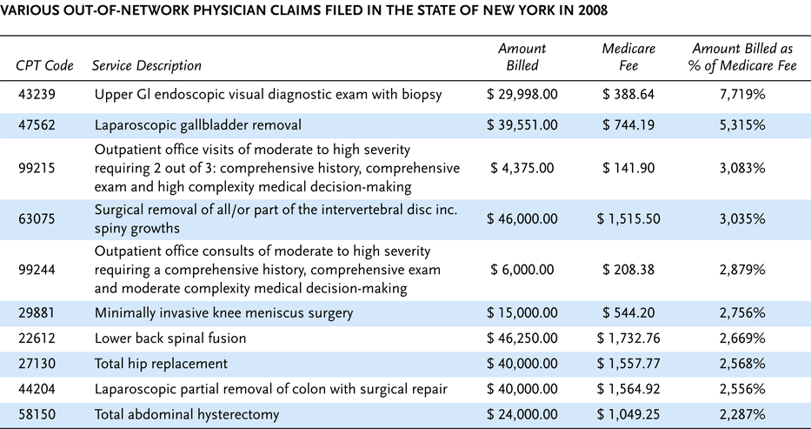
Exhibit 16.1 Examples of Exorbitant Charge by Some Out-of-Network Physicians in New York and North Carolina, 2008 (cont.)

Slide 26
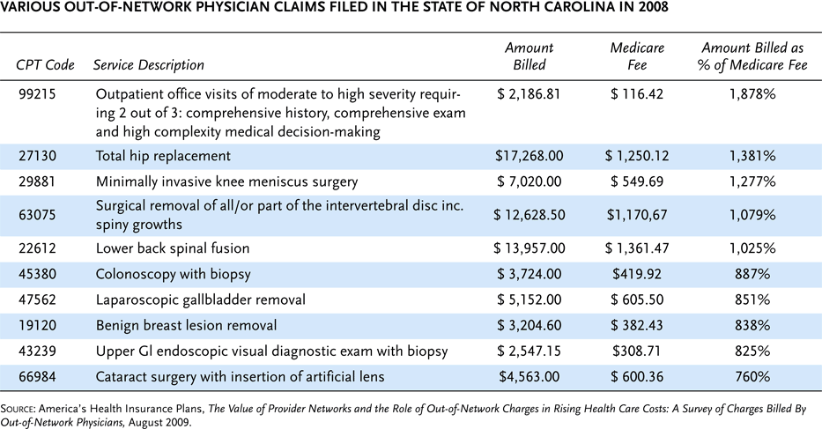
Exhibit 16.1 Examples of Exorbitant Charge by Some Out-of-Network Physicians in New York and North Carolina, 2008
Notes:
26

Slide 27
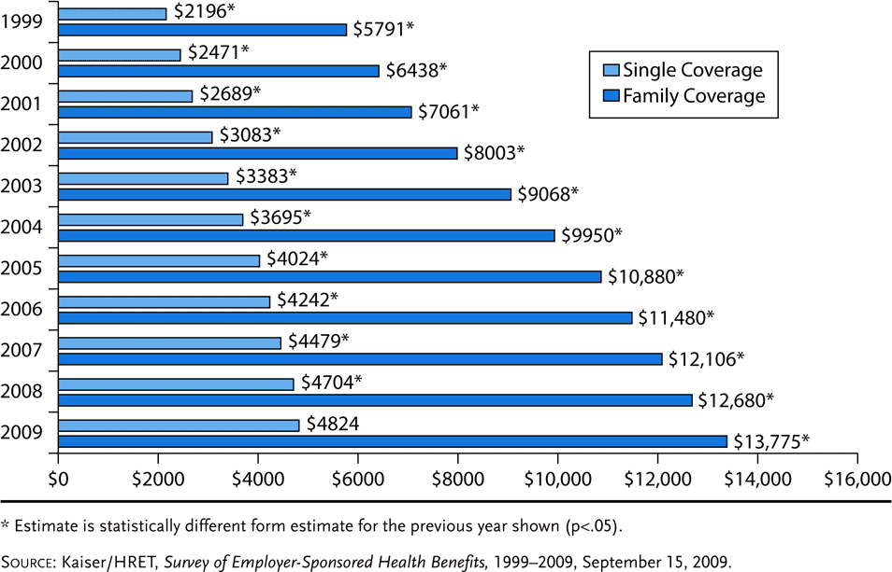
Exhibit 16.2 Average Annual Premiums for Single and Family Coverage,1999–2009

Slide 28
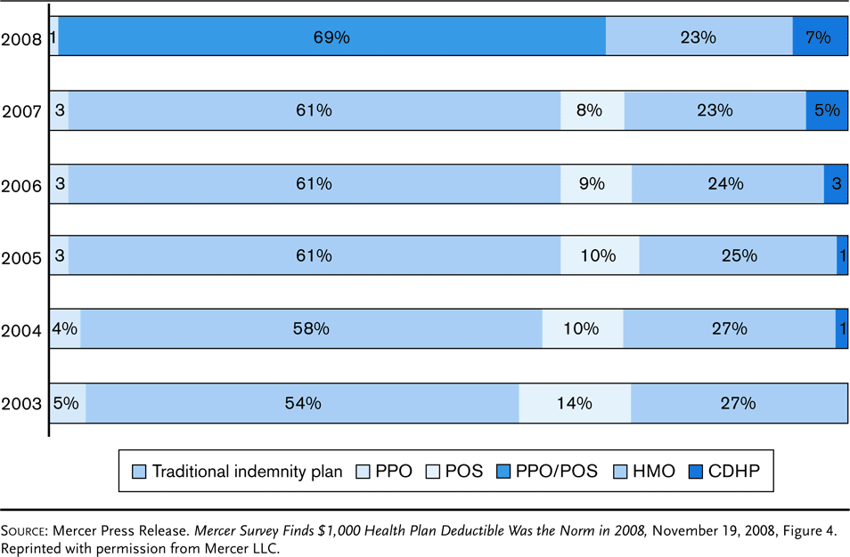
Exhibit 16.3 Enrollment in Consumer-Directed Health Plans Grows in 2008 (percentage of all covered employees enrolled in each plan type)

Slide 29
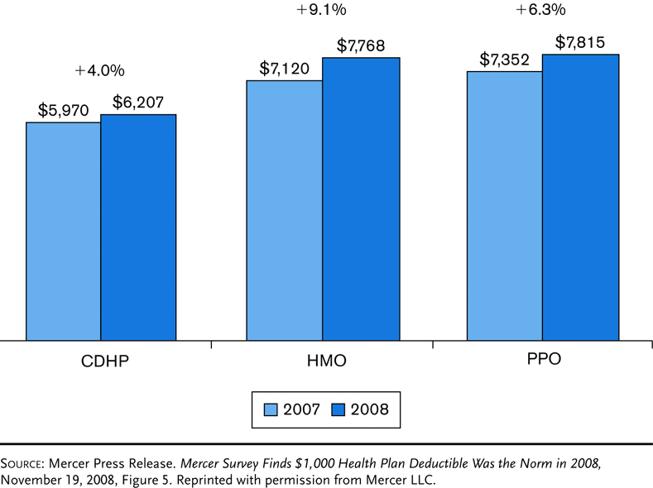
Exhibit 16.4 Medical Plan Cost Per Employee, 2007–2008

Slide 30
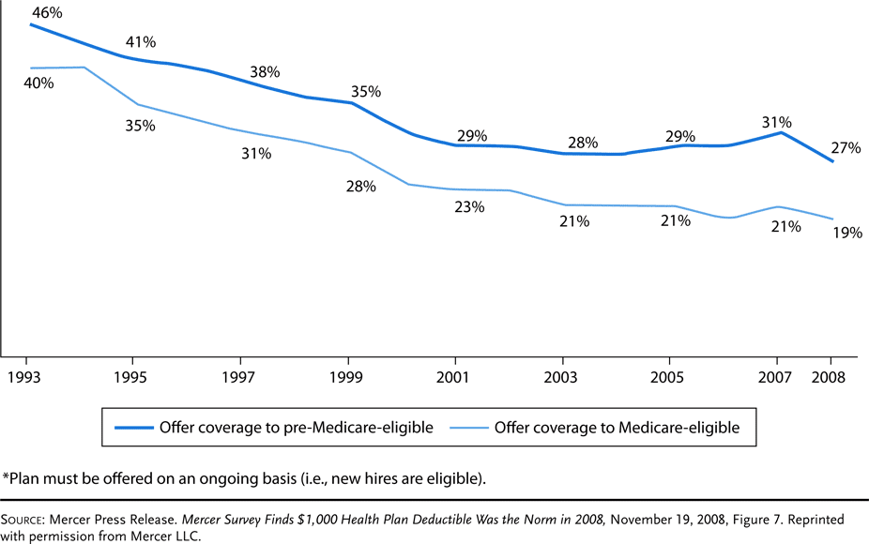
Exhibit 16.5 Offerings of Retiree Medical Plans Have Fallen Sharply Over the Past Decade (percentage of large employers)*
Notes:
30

Slide 31
Group Medical Expense Contractual Provisions
Important provisions in group medical expense insurance plans include:
A preexisting condition provision that excludes coverage for a preexisting medical condition for a limited period after the worker enters the plan
Period is restricted to 12 months by the Health Insurance Portability and Accountability Act of 1996 (HIPAA)
The act also establishes the portability of insurance coverage, whereby insurers must give an employee credit for previous coverage

Slide 32
Group Medical Expense Contractual Provisions
A coordination-of-benefits provision specifies the order of payment when an insured is covered under two or more group health insurance plans
Coverage as an employee is usually primary to coverage as a dependent
With respect to dependent children, the plan of the parent whose birthday occurs first during the year is primary
The Consolidated Omnibus Budget Reconciliation Act of 1985 (COBRA) gives employees the right to stay in the employer’s plan for a limited period after leaving employment

Slide 33
Group Dental Insurance
Group dental insurance helps pay the cost of normal dental care
Also covers damage to teeth from an accident
Covers x-rays, cleaning, fillings, extractions, etc.
Some plans cover orthodontia
Encourages insureds to see their dentists on a regular basis
Coinsurance requirements vary depending on the type of service provided
Maximum limits on benefits and waiting periods for certain types of services are used to control costs
A predetermination-of-benefits provision informs the employee of the amount that the insurer will pay for a service before the service is performed

Slide 34
Group Disability-Income Insurance
Group disability-income insurance pays weekly or monthly cash payments to employees who are disabled from accidents or illness
Under a short-term plan, benefit payments range from 13 weeks to two years
Most cover only nonoccupational disability, which means that an accident or illness must occur off the job
Employee must be totally disabled to qualify
You are considered totally disabled if you are unable to perform each and every duty of your regular occupation
Under a long-term plan, the benefit period ranges from 2 - 65 years
For the first two years, you are considered disabled if you are unable to perform all of the material duties of your own occupation. After two years, you are still considered disabled if you are unable to work in any occupation for which you are reasonably fitted by education, training, and experience
Plans typically cover occupational and nonoccupational disability
If the disabled worker is receiving Social Security or other disability benefits, the payments are reduced to discourage malingering

Slide 35
Cafeteria Plans
A cafeteria plan allows employees to select those benefits that best meet their specific needs
In many plans, the employer gives each employee a certain number of dollars or credits to spend on benefits, or take as cash
Many plans allow employees to make their premium contributions with before-tax dollars
Many plans include a flexible spending account which is an arrangement that permits employees to pay for certain unreimbursed medical expenses with before-tax dollars

Slide 36
Reasons for Employee Benefits
Usually, employers make benefits available to employees in order to
Improve employee relations
Take advantage of the special income tax status granted to many benefit programs

Slide 37
Employee Relations
In earlier years, employee benefits were frequently referred to as fringe benefits
Many employers viewed them as forms of extra compensation that were not required
Some employers suggested that they viewed employee benefits essentially as freely given goods
Employers expected employees to be grateful for their benefits
And to respond with increased loyalty, improved productivity, and better morale in the workplace

Slide 38
Employee Relations
Over time, however, attitudes of both employers and employees evolved
Benefits that address basic security issues are no longer viewed as frills that command special gratitude
Such as health care expenses, survivor needs due to premature death, and retirement income
Rather, they are an expected part of most compensation packages
Inclusion of such benefits does not often affect employee attitudes because the employer is only doing what is expected
However, excluding such benefits could have a negative impact on employee relations
Leading to increased employee turnover and difficulty in recruiting workers

Slide 39
Employee Relations
Employers hoping to significantly improve employee relations from their benefit packages must go beyond what is expected
Also, employers are becoming more flexible and allowing employees to select the benefits that best meet their individual needs
It is becoming harder for a standard benefit package to efficiently meet the varying needs of all workers

Slide 40
Tax Advantages
Many employee benefits are treated more favorably for tax purposes than are wages and salaries
When such tax advantages exist, it is usually to an employee’s advantage to receive the benefit
Rather than to receive a higher salary and then purchase the product separately

Slide 41
Tax Advantages
In general, tax advantages may be associated with employee benefits if qualification rules are met
The ability of the employer to deduct the cost of the benefit from current taxable income
The ability of employees to avoid reporting benefit costs paid by their employers as taxable income
Benefit payments may be partially or totally exempt from income taxes
The employer’s ability to fund some benefit costs in advance
With taxes on associated investment earnings either deferred or avoided completely

Slide 42
Tax Advantages
Although favorable tax status is a major factor affecting an employer’s willingness to grant employee benefits
The continuation of current tax advantages is not assured
Frequent changes in the U.S. tax laws affecting employee benefits are common
Periodic proposals are made to restrict the tax advantages associated with one or more benefits
And qualification rules are changed regularly

Slide 43
Premature Death Benefits
From an individual employee’s perspective, the financial needs likely to be associated with premature death include
The cost of funeral, burial, and other executor fund expenses
As well as the possible provision of income for surviving dependents
Employers usually provide death benefits through group life insurance
However, both employers and employees should recognize that some death benefits also may be available to employees through Social Security or workers’ compensation

Slide 44
Social Security Benefits
The Old Age, Survivors’, Disability and Health Insurance Program was established in 1935
The four major categories of Social Security benefits are
Retirement
Disability income
Survivors’ income
Medicare

Slide 45
Social Security Benefits
Social Security benefits are financed through a tax on employees and employers
Originally, an employee paid a 1% tax on the first $3,000 of annual income earned, but this base has increased gradually
By 2004, workers and their employees each paid 6.2% on the first $87,900 of earned income
This level of income is referred to as the OASDHI wage base
The wage base increases automatically each year as earnings levels rise
To finance Medicare, an additional 1.45% tax is payable on all earned income

Slide 46
Social Security Benefits
Are payable only if the worker meets certain tests based on the length of service in a job for which OASDHI taxes have been paid
A person becomes fully insured after meeting either of two tests
Having worked in covered employment for 40 quarters
Subject to a minimum of six calendar quarters, having worked in covered employment for at least one-fourth of the number of calendar quarters elapsing from the starting date
Until age 62 is attained, or disability or death occurs, whichever happens first
Workers are currently insured if they have worked in covered employment at least six of the last 13 quarters
Including the quarter in which death occurs or in which they become entitled to benefits

Slide 47
Social Security Benefits
Dependents of covered workers who die are entitled to Social Security survivors’ benefits
Payable as a monthly income for as long as the survivors meet specified eligibility criteria
Widows and widowers may receive survivor income benefits as long as they have dependent children under 16, and again, upon reaching age 60
Benefits may be reduced if the surviving spouse earns more than a specified amount
Children of deceased workers also receive survivors’ benefits until age 18

Slide 48
End of Lecture 27

