Slide 1
Lecture No. 29
Employee Benefits: Retirement Plans

Slide 2
Objectives
Fundamentals of Private Retirement Plans
Defined Benefit Plans
Defined Contribution Plans
Profit-sharing Plans
Retirement Plans for the Self-Employed
Simplified Employee Pension
Simple Retirement Plans
Funding Agency and Funding Instruments

Slide 3
Fundamentals of Private Retirement Plans
Private retirement plans have an enormous social and economic impact
The Employee Retirement Income Security Act of 1974 (ERISA) established minimum pension standards
The Pension Protection Act of 2006 also has had a significant impact on private pension plans
Private plans that meet certain requirements are called qualified plans and receive favorable income tax treatment
The employer’s contributions are deductible, to certain limits
Investment earnings on the plan assets accumulate on a tax-deferred basis

Slide 4
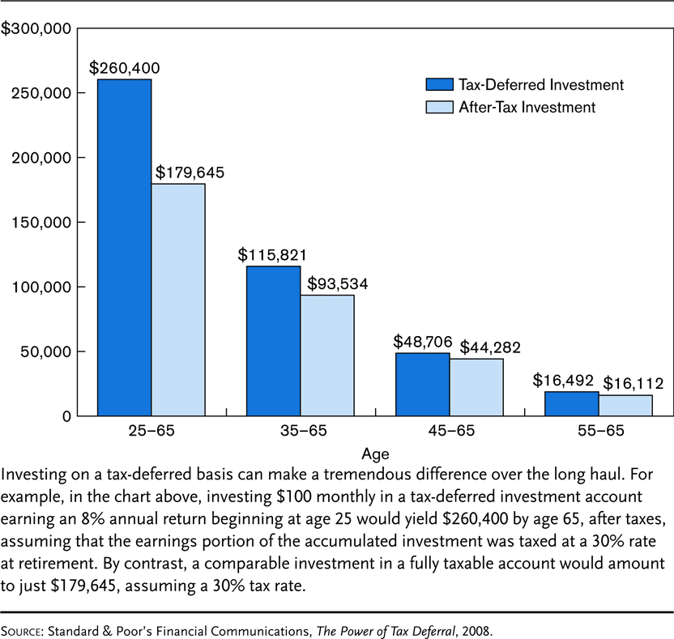
Exhibit 17.1 The Benefits of Starting Early in a Tax-Deferred Retirement Plan

Slide 5
Fundamentals of Private Retirement Plans
A qualified plan must benefit workers in general and not only highly compensated employees, so certain minimum coverage requirements must be satisfied
Under the ratio-percentage test, the percentage of non-highly compensated employees covered under the plan must be at least 70% of the percentage of highly compensated employees who are covered
Under the average benefits test:
The plan must benefit a reasonable classification of employees and not discriminate in favor of highly compensated employees
The average benefit for the non-highly compensated employees must be at least 70% of the average benefit provided to all highly compensated employees

Slide 6
Fundamentals of Private Retirement Plans
Most plans have a minimum age and service requirement that must be met
Under current law, all eligible employees who have attained age 21 and have completed one year of service must be allowed to participate in the plan
Normal retirement age is the age that a worker can retire and receive a full, unreduced pension benefit
Age 65 in most plans
An early retirement age is the earliest age that workers can retire and receive a retirement benefit
The deferred retirement age is any age beyond the normal retirement age
Employees working beyond age 65 continue to accrue benefits under the plan

Slide 7
Fundamentals of Private Retirement Plans
A benefit formula is used to determine contributions or benefits
In a defined-contribution formula, the contribution rate is fixed, but the retirement benefit is variable
In a defined-benefit plan, the retirement benefit is known, but the contributions will vary depending on the amount needed to fund the desired benefit
The amount can be based on career-average earnings or on a final average pay, which generally is an average of the last 3-5 years earnings
Under a unit-benefit formula, both earnings and years of service are considered
Some plans pay a flat percentage of annual earnings, while some pay a flat amount for each year of service
Some plans pay a flat amount for each employee, regardless of earnings or years of service

Slide 8
Fundamentals of Private Retirement Plans
Vesting refers to the employee’s right to the employer’s contributions or benefits attributable to the contributions if employment terminates prior to retirement
A qualified defined-benefit plan must meet a minimum vesting standard:
Under cliff vesting, the worker must be 100% vested after 5 years of service
Under graded vesting, the worker must be 20% vested by the 3rd year of service, and the minimum vesting increases another 20% for each year until the worker is 100% vested at year 7
Faster vesting is required for qualified defined-contribution plans to encourage greater employee participation
Employer contributions must be 100% vested after 3 years
The worker must be 20% vested by the 2rd year of service, and the minimum vesting increases another 20% for each year until the worker is 100% vested at year 6

Slide 9
Fundamentals of Private Retirement Plans
Funds withdrawn from a qualified plan before age 59½ are subject to a 10% early distribution penalty
There are some exceptions to this rule, for example if the distribution is:
Made because the employee has a qualifying disability
Made to an employee for medical care up to the amount allowable as a medical expense deduction
Pension contributions cannot remain in the plan indefinitely
Distributions must start no later than April 1st of the calendar year following the year in which the individual attains age 70½
If the participant is still working, the distributions can be delayed
The rule does not apply to IRAs and Roth IRAs
For 2009, the minimum distribution rules are temporarily waived.

Slide 10
Fundamentals of Private Retirement Plans
Many qualified private pension plans are integrated with Social Security
Integration provides a method for increasing pension benefits for highly compensated employees without increasing the cost of providing benefits to lower-paid employees
Employers must follow complex integration rules, such as the excess method.
A top-heavy plan is a retirement plan in which more than 60% of the plan assets are in accounts attributed to key employees
To retain its qualified status, a rapid vesting schedule must be used for nonkey employees
Certain minimum benefits or contributions must be provided for nonkey employees

Slide 11
Types of Qualified Retirement Plans
A wide variety of qualified plans are available today to meet the specific needs of employers
The two basic types of plans are
Defined benefit plans
Defined contribution plans
Different rules apply to each type of plan

Slide 12
Defined Benefit Plans
Recall: in a defined benefit plan, the retirement benefit is known in advance, but the contributions vary depending on the amount needed to fund the desired benefit
Plans typically pay benefits based on a unit-benefit formula
A firm may give an employee past-service credits for prior service
A worker’s retirement benefit is guaranteed
The investment risk falls on the employer
These types of plans have declined in relative importance because they are more complex and expensive to administer than defined contribution plans

Slide 13
Defined Benefit Plans
Contributions to defined benefit plans are limited:
For 2009:
The maximum annual benefit is limited to 100% of the worker’s average compensation for the three highest consecutive years or $195,000, whichever is lower
The maximum annual compensation that can be counted in the contribution of benefits formula for all plans is $245,000

Slide 14
Defined Benefit Plans
The Defined Benefit amount can be based on career-average earnings or final average pay
Formulas include:
Unit-benefit formula considers both earnings and years of service
Flat percentage of annual earnings
Flat dollar amount for each year of service
Flat dollar amount for all employees

Slide 15
Defined Benefit Plans
The Pension Benefit Guaranty Corporation (PBGC) is a federal corporation that guarantees the payment of vested benefits to certain limits if a private pension plan is terminated
For plans terminated in 2009, the maximum guaranteed pension at age 65 is $4500 per month
Many traditional defined benefits plans are substantially underfunded at the present time

Slide 16
Defined Benefit Plans
A cash-balance plan is a defined-benefit plan in which the benefits are defined in terms of a hypothetical account balance
Actual retirement benefits will depend on the value of the participant’s account at retirement
Each year, a participant’s “hypothetical” account is credited with a pay credit, which is related to compensation, and an interest credit
The employer bears the investment risks and realizes any investment gains
Many employers have converted traditional defined-benefit plans into cash-balance plans to hold down pension costs

Slide 17
Defined Contribution Plans
In a defined contribution plan, the contribution rate is fixed by the actual retirement benefit is variable
For example, a money purchase plan is an arrangement in which each participant has an individual account, and the employer’s contribution is a fixed percentage of the participant’s compensation
Contributions to defined contribution retirement plans are limited:
For 2009, the maximum annual contribution to a defined-contribution plan is 100% of earnings or $49,000, whichever is lower
Workers age 50 or older can make an additional catch-up contribution of $5000 per year

Slide 18
Defined Contribution Plans
Most newly installed qualified retirement plans are defined contribution plans
Cost to employer is lower because they do not grant past-service credits
Disadvantages to the employee include:
Employees can only estimate their retirement benefits
Investment losses are borne by the employee
Some employees do not understand the factors to consider in choosing investments

Slide 19
Profit-Sharing Plans
A profit-sharing plan is a defined-contribution plan in which the employer’s contributions are typically based on the firm’s profits
There is no requirement that the employer must actually earn a profit to contribute to the plan
The plan encourages employees to work more efficiently
Funds are distributed to the employees at retirement, death, disability, or termination of employment (only the vested portion), or after a fixed number of years
For 2009, the maximum employer tax-deductible contribution is limited to 25% of the employee’s compensation or $49,000, whichever is less

Slide 20
Retirement Plans for the Self-Employed
Retirement plans for the owners of unincorporated business firms are commonly called Keogh plans
Contributions to the plan are income-tax deductible, up to certain limits
Investment income accumulates on a tax-deferred basis
Amounts deposited and investment earnings are not taxed until the funds are distributed
The maximum annual contribution into a defined-contribution Keogh plan is limited to 20% of net earnings after subtracting ½ of the Social Security self-employment tax
For 2009, if the plan is a defined-benefit plan, a self-employed individual can fund for a maximum annual benefit equal to 100% of average compensation for the three highest consecutive years of compensation, or $195,000, whichever is lower

Slide 21
Retirement Plans for the Self-Employed
Some requirements for Keogh plans include:
All employees at least age 21 and with one year of service must be included in the plan
Certain annual reports must be filed with the IRS
Special top-heavy rules must be met
An individual 401(k) retirement plan combines a profit sharing plan with an individual 401(k) plan
Tax savings are significant
The plan is limited to self-employed individuals or business owners with no employees other than a spouse
For 2009, the plan allows a maximum contribution of 25 percent of compensation
Total profit-sharing contributions and salary deferral for an individual under age 50 cannot exceed $49,000

Slide 22
Simplified Employee Pension
A simplified employee pension (SEP) is a retirement plan in which the employer contributes to an IRA established for each eligible employee
The annual contribution limits are substantially higher
Popular with smaller employers because they involve minimal paperwork
In a SEP-IRA, the employer contributes to an IRA owned by each employee
Must cover all workers who are at least age 21 and have worked for at least three of the past five years
For 2009, the maximum annual tax-deductible contribution is limited to 25% of the employee’s compensation or $49,000, whichever is less

Slide 23
SIMPLE Retirement Plans
Smaller employers are eligible to establish a Savings Incentive Match Plan for Employees, or SIMPLE plan
Limited to employers that employ 100 or fewer employees and do not maintain another qualified plan
Smaller employers are exempt from most nondiscrimination and administrative rules that apply to qualified plans
Can be structured as an IRA or 401(k) plan
For 2009, eligible employees can elect to contribute up to 100% of compensation up to a maximum of $11,500
Employers can contribute in one of two ways:
Under a matching option, the employer matches the employee’s contributions on a dollar-for-dollar basis up to 3% of the employee’s compensation, subject to a maximum limit
Under the nonelective contribution option, the employer must contribute 2% of compensation for each eligible employee, subject to a maximum limit

Slide 24
Funding Agency and Funding Instruments
A funding agency is a financial institution that provides for the accumulation or administration of the funds that will be used to pay pension benefits
The plan is called a trust-fund plan if it is administered by a commercial bank or individual trustee
If the funding agency is a life insurer, the plan is called an insured plan
If both funding agencies are used, the plan is called a split-funded plan
A funding instrument is a trust agreement or insurance contract that states the terms under which the funding agency will accumulate, administer, and disburse the pension funds

Slide 25
Funding Agency and Funding Instruments
Under a trust-fund plan, all contributions are deposited with a trustee, who invests the funds according to the trust agreement
The trustee does not guarantee the adequacy of the fund, the principal itself, or interest rates
A separate investment account is a group pension product with a life insurance company
The plan administrator can invest in one or more of the separate accounts offered by the insurer
These accounts are popular because pension contributions can be invested in a wide variety of investments, including stock funds, bond funds, or similar investments

Slide 26
Funding Agency and Funding Instruments
A guaranteed investment contract (GIC) is an arrangement in which the insurer guarantees the interest rate for a number of years on a lump sum deposit
These contracts are popular with employers because of interest rate guarantees and protection against the loss of principal
An investment guarantee contract is similar to a GIC, except that the insurer receives the pension funds over a number of years, and the guaranteed interest rate for the later years is only a projected rate
These contracts are appealing to employers who expect interest rates to rise in the future

Slide 27
Social Security Retirement Benefits
The level of retirement income that can be expected from Social Security depends on many factors including
The age an individual elects to begin receiving benefits
The number of years he or she worked in employment subject to Social Security taxes
The wages earned in such employment
The age at which retirees can begin collecting their full retirement benefit amounts has historically been 65
However, this age is gradually increasing and is scheduled to reach 67 for those born in 1960 or later
See Table 20-1

Slide 28
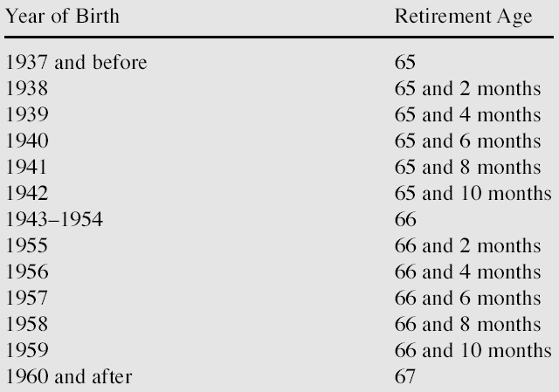
Future Social Security Normal Retirement Ages

Slide 29
Social Security Retirement Benefits
Workers retiring at the Social Security normal retirement age after a lifetime of full-time employment at salaries equal to the OASDI wage base
Can now expect to receive a benefit of approximately 25% of what they earned just before retirement
Workers with a lower earnings history can expect a benefit that is relatively higher in relationship to prior earnings
Workers can retire earlier than their Social Security normal retirement age
But their benefits will be relatively lower than would otherwise be the case

Slide 30
Relationship of Work History to Benefit Amount
Social Security retirement benefits are based on average earnings in employment subject to Social Security taxes
The period for computing average earnings begins with the year 1950 (or the year in which an individual reaches age 22, if later) and it ends in the year before the individual’s attaining age 62
The actual earnings during this period are adjusted for changes and average wage levels
The resulting figure is called the average indexed monthly earnings (AIME)
From this number is calculated the primary insurance amount (PIA) on which all retirement benefits are based
The formula for transforming the AIME into the PIA is intentionally designed to weight lower earnings more than higher earnings

Slide 31
Benefits Payable to Retired Workers
The initial monthly Social Security benefits for a retired worker equal that person’s PIA if he or she begins receiving benefits at the Social Security normal retirement age
Many retirees elect to begin collecting benefits before that age
However, age 62 is the earliest age at which benefits may begin
An actuarial reduction of 0.555% occurs in each of the first 36 months that a worker retires “early”
Plus an additional 0.4167% for each additional month early
This reduced benefit will continue to be payable even after an early retiree reaches the normal retirement age
Benefits for workers who delay benefits until after the normal retirement age are also adjusted
Through increases for each month “late”

Slide 32
Benefits Payable to Retired Workers
It is also possible to receive Social Security retirement benefits without totally exiting the workforce
But limits are placed on how much younger retirees [those under the Social Security normal retirement age] may earn before a reduction in Social Security benefits is triggered
Can earn up to $11,640 per year without penalty
For earnings exceeding this limit, the worker’s Social Security benefit is reduced by $1 for every $2 in wages
Once retirees reach their Social Security normal retirement age, they may earn an unlimited amount of income and still collect Social Security benefits to which they’re entitled
Only earned income is counted
Funds received from investments, pensions, annuities, and interest are not considered in applying the retirement test

Slide 33
Benefits Payable to Retired Workers
After an individual begins receiving retirement benefits, those benefits are automatically increased annually for changes in the cost of living
Measured by the Consumer Price Index for All Urban Wage Earners and Clerical Workers
As published by the U.S. Department of Labor

Slide 34
Benefits Payable to Spouses and Children
A retired worker’s spouse and dependent children may be entitled to Social Security benefits based on the worker’s earnings
The benefit amount for a spouse who has attained the normal retirement age is 50 percent of the worker’s PIA
However, spouses can elect to collect as early as age 62
At an actuarially reduced level or at any age if they’re caring for children under age 16
The spouse is not required to be financially dependent on the retired worker in order to collect the benefit
But spouses who have earned income are impacted by the retirement test in the same manner as for retirees

Slide 35
Benefits Payable to Spouses and Children
An increasingly common situation is for both husband and wife to be entitled to Social Security retirement benefits on the basis of their own earnings history
The question arises as to whether such people are still entitled to receive spouse’s benefits from Social Security
The basic rule governing these cases
An individual is entitled to receive only the one Social Security benefit that will pay the greatest monthly income

Slide 36
Benefits Payable to Spouses and Children
In some cases, children of retired workers are young enough to be entitled to Social Security benefits
The child’s benefit is 50% of the worker’s PIA
Eligibility is generally limited to unmarried children under the age of 18
Extended to 19 if a child is a full-time student in elementary or high school
Age limit is removed entirely for unmarried children who become severely disabled before age 22 and who continue in that condition

Slide 37
Taxation of Benefits
Social Security retirement benefits are not subject to federal income tax unless one’s adjusted gross income exceeds certain limits
For example, if half of an individual’s Social Security benefit + investment income exceeds $25,000
Then 1/2 of the Social Security benefit is taxable

Slide 38
End of Lecture 29

