Slide 1
Lecture No. 3
Insurance and Risk

Slide 2
Objectives
Definition and Basic Characteristics of Insurance
Characteristics of An Ideally Insurable Risk
Adverse Selection and Insurance
Insurance vs. Gambling
Insurance vs. Hedging
Types of Insurance
Benefits and Costs of Insurance to Society

Slide 3
Definition of Insurance
Insurance is the pooling of fortuitous losses by transfer of such risks to insurers, who agree to indemnify insureds for such losses, to provide other pecuniary benefits on their occurrence, or to render services connected with the risk

Slide 4
Basic Characteristics of Insurance
Pooling of losses
Spreading losses incurred by the few over the entire group
Risk reduction based on the Law of Large Numbers
Example:
Two business owners own identical buildings valued at $50,000
There is a 10 percent chance each building will be destroyed by a peril in any year; loss to either building is an independent event
Expected value and standard deviation of the loss for each owner is:
Notes:
Transparency Master 1.2

Slide 5
Basic Characteristics of Insurance
Example, continued:
If the owners instead pool (combine) their loss exposures, and each agrees to pay an equal share of any loss that might occur:
As additional individuals are added to the pooling arrangement, the standard deviation continues to decline while the expected value of the loss remains unchanged

Slide 6
Basic Characteristics of Insurance
Payment of fortuitous losses
Insurance pays for losses that are unforeseen, unexpected, and occur as a result of chance
Risk transfer
A pure risk is transferred from the insured to the insurer, who typically is in a stronger financial position
Indemnification
The insured is restored to his or her approximate financial position prior to the occurrence of the loss

Slide 7
Characteristics of an Ideally Insurable Risk
Large number of exposure units
to predict average loss
Accidental and unintentional loss
to control moral hazard
to assure randomness
Determinable and measurable loss
to facilitate loss adjustment
insurer must be able to determine if the loss is covered and if so, how much should be paid.
Notes:
Transparency Master 1.2

Slide 8
Requirements of an Insurable Risk
No catastrophic loss
to allow the pooling technique to work
exposures to catastrophic loss can be managed by:
dispersing coverage over a large geographic area
using reinsurance
catastrophe bonds
Calculable chance of loss
to establish an adequate premium

Slide 9
Requirements of an Insurable Risk
Economically feasible premium
so people can afford to buy
Premium must be substantially less than the face value of the policy
Based on these requirements:
Most personal, property and liability risks can be insured
Market risks, financial risks, production risks and political risks are difficult to insure

Slide 10
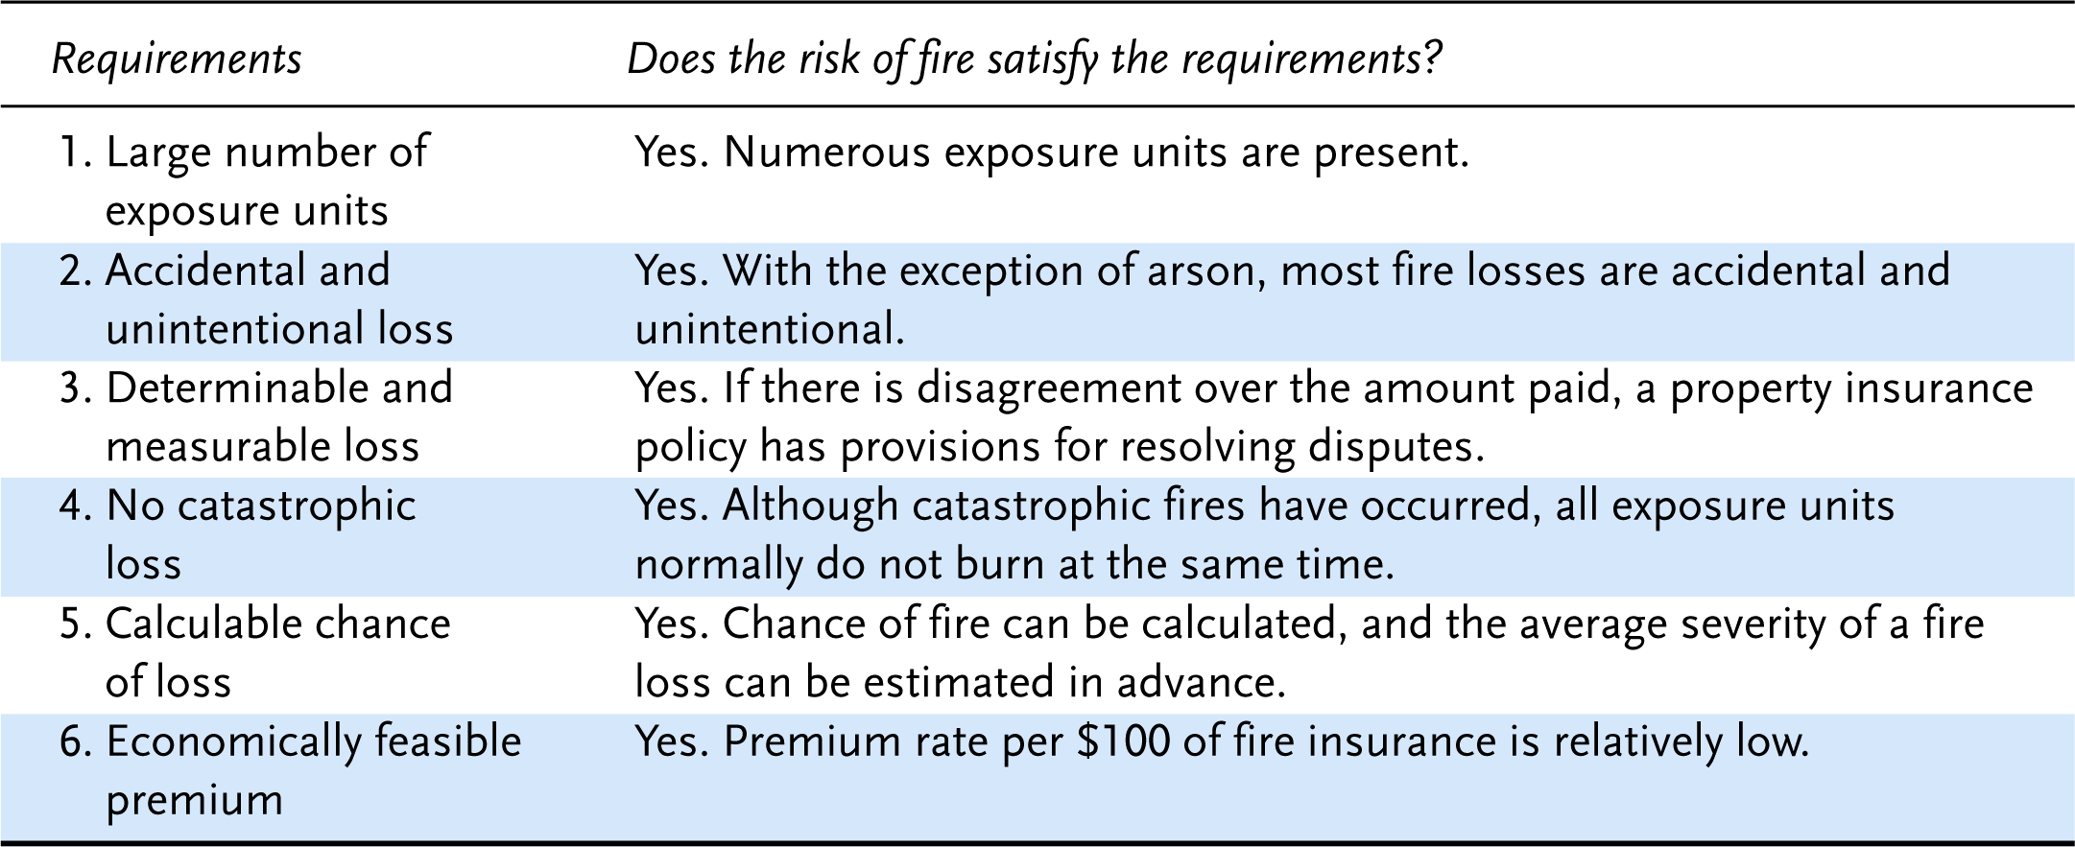
Exhibit 2.1 Risk of Fire as an Insurable Risk

Slide 11
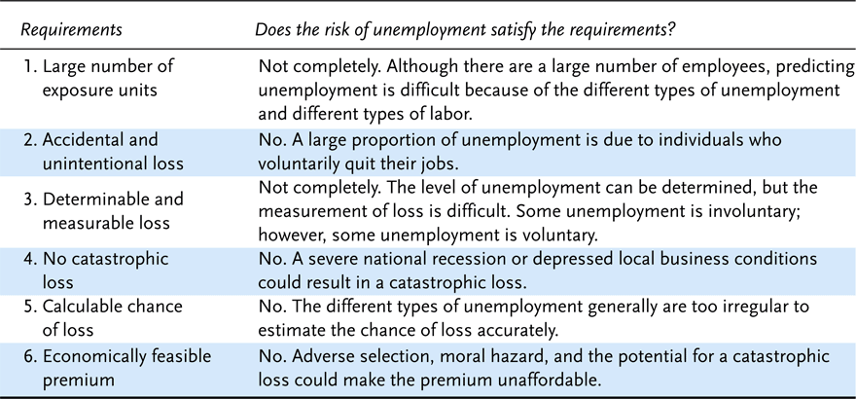
Exhibit 2.2 Risk of Unemployment as an Insurable Risk

Slide 12
Adverse Selection and Insurance
Adverse selection is the tendency of persons with a higher-than-average chance of loss to seek insurance at standard rates
If not controlled, adverse selection result in higher-than-expected loss levels
Adverse selection can be controlled by:
careful underwriting (selection and classification of applicants for insurance)
policy provisions (e.g., suicide clause in life insurance)

Slide 13
Insurance vs. Gambling
Insurance
Insurance is a technique for handing an already existing pure risk
Insurance is socially productive:
both parties have a common interest in the prevention of a loss
Gambling
Gambling creates a new speculative risk
Gambling is not socially productive
The winner’s gain comes at the expense of the loser

Slide 14
Insurance vs. Hedging
Insurance
Risk is transferred by a contract
Insurance involves the transfer of insurable risks
Insurance can reduce the objective risk of an insurer through the Law of Large Numbers
Hedging
Risk is transferred by a contract
Hedging involves risks that are typically uninsurable
Hedging does not result in reduced risk

Slide 15
Types of Insurance
Private Insurance
Life and Health
Property and Liability
Government Insurance
Social Insurance
Other Government Insurance

Slide 16
Private Insurance
Life and Health
Life insurance pays death benefits to beneficiaries when the insured dies
Health insurance covers medical expenses because of sickness or injury
Disability plans pay income benefits
Property and Liability
Property insurance indemnifies property owners against the loss or damage of real or personal property
Liability insurance covers the insured’s legal liability arising out of property damage or bodily injury to others
Casualty insurance refers to insurance that covers whatever is not covered by fire, marine, and life insurance

Slide 17
Private Insurance
Private insurance coverages can be grouped into two major categories
Personal lines
coverages that insure the real estate and personal property of individuals and families or provide protection against legal liability
Commercial lines
coverages for business firms, nonprofit organizations, and government agencies

Slide 18
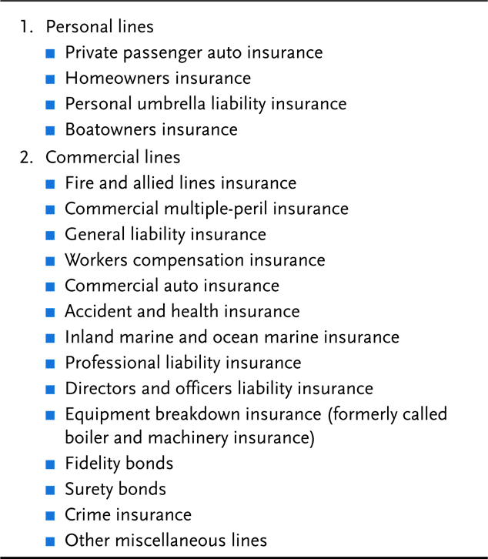
Exhibit 2.3 Property and Casualty Insurance Coverages

Slide 19
Government Insurance
Social Insurance Programs
Financed entirely or in large part by contributions from employers and/or employees
Benefits are heavily weighted in favor of low-income groups
Eligibility and benefits are prescribed by statute
Examples:
Social Security, Unemployment, Workers Comp
Other Government Insurance Programs
Found at both the federal and state level
Examples:
Federal flood insurance, state health insurance pools

Slide 20
Social Benefits of Insurance
Indemnification for Loss
Contributes to family and business stability
Reduction of Worry and Fear
Insureds are less worried about losses
Source of Investment Funds
Premiums may be invested, promoting economic growth
Loss Prevention
Insurers support loss-prevention activities that reduce direct and indirect losses
Enhancement of Credit
Insured individuals are better credit risks than individuals without insurance

Slide 21
Social Costs of Insurance
Cost of Doing Business
Insurers consume resources in providing insurance to society
An expense loading is the amount needed to pay all expenses, including commissions, general administrative expenses, state premium taxes, acquisition expenses, and an allowance for contingencies and profit
Cost of Fraudulent and Inflated Claims
Payment of fraudulent or inflated claims results in higher premiums to all insureds, thus reducing disposable income and consumption of other goods and services

Slide 22
End of Lecture No. 3

