Slide 1
Lecture No. 31
Annuities and Individual Retirement Accounts

Slide 2
Objectives
Individual Annuities
Types of Annuities
Taxation of Individual Annuities
Individual Retirement Accounts

Slide 3
Individual Annuities
An annuity is a periodic payment that continues for a fixed period or for the duration of a designated life or lives
  The person who receives the payments is the annuitant
An annuity provides protection against the risk of excessive longevity
The fundamental purpose of an annuity is to provide a lifetime income that cannot be outlived
The major types of annuities sold today include:
  Fixed annuity
  Variable annuity
  Equity-indexed annuity

Slide 4
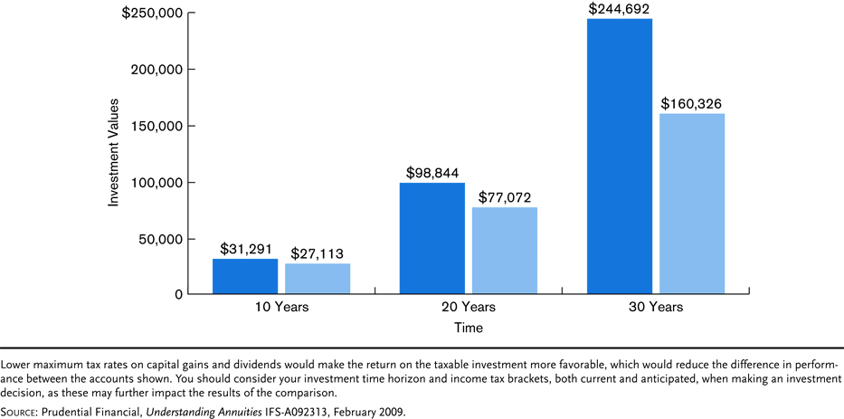
Exhibit 14.1 How Tax Deferral Works

Slide 5
Fixed Annuities
A fixed annuity pays periodic income payments that are guaranteed and fixed in amount
  During the accumulation period prior to retirement, premiums are credited with interest
    The guaranteed rate is the minimum interest rate that will be credited to the fixed annuity
    The current rate is based on current market conditions, and is guaranteed only for a limited period
  A bonus annuity pays a higher interest rate initially
  The liquidation period is the period in which funds are paid out, or annuitized
Notes:
Transparency Master 1.2

Slide 6
Fixed Annuities
Fixed annuity income payments can be paid immediately, or at a future date:
  An immediate annuity is one where the first payment is due one payment interval from the date of purchase
    Provides a guaranteed lifetime income that cannot be outlived
  A deferred annuity provides income payments at some future date
    A deferred annuity purchase with a lump sum is called a single-premium deferred annuity
    A flexible-premium annuity allows the owner to vary the premium payments

Slide 7
Fixed Annuities
The annuity owner has a choice of annuity settlement offers
  Most annuities are not annuitized
  Under the cash option, the funds can be withdrawn in a lump sum or in installments
  A life annuity option provides a life income to the annuitant only while the annuitant remains alive
  A life annuity with guaranteed payments pays a life income to the annuitant with a certain number of guaranteed payments

Slide 8
Fixed Annuities
  An installment refund option pays a life income to the annuitant
    If the annuitant dies before receiving the total income payments, the payments continue to a beneficiary
    A cash refund option is similar, but pays the beneficiary a lump sum
  A joint-and-survivor annuity pays benefits based on the lives of two or more annuitants. The annuity income is paid until the last annuitant dies
  An inflation-indexed annuity option provides periodic payments that are adjusted for inflation

Slide 9
Variable Annuities
A variable annuity pays a lifetime income, but the income payments vary depending on common stock prices
  The purpose is to provide an inflation hedge by maintaining the real purchasing power of the payments
  Premiums are used to purchase accumulation units during the period prior to retirement
    The value of an accumulation unit depends on common stock prices at the time of purchase
  At retirement, the accumulation units are converted into annuity units
    The number of annuity units remains constant during the liquidation period, but the value of each unit changes with common stock prices

Slide 10
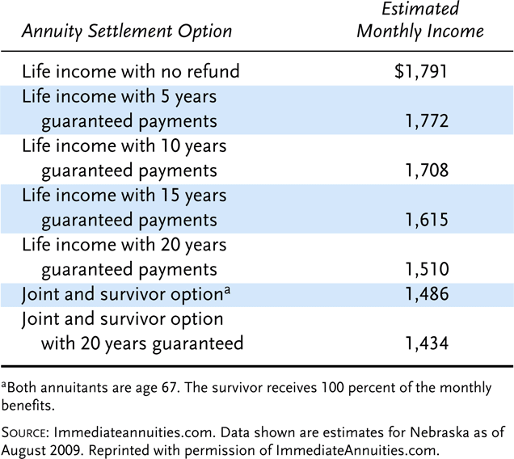
Exhibit 14.2 Examples of Monthly Income Annuity Payments from an Immediate Annuity, $250,000 Purchase Price, Male, Age 67

Slide 11
Variable Annuities
A guaranteed death benefit protects the principal against loss due to market declines
Typically, if the annuitant dies before retirement, the amount paid to the beneficiary will be the higher of two amounts: the amount invested in the contract or the value of the account at the time of death
Some variable annuities pay enhanced death benefits
  Some contracts guarantee the principal
  Some contracts periodically adjust the value of the account to lock in investment gains. Examples include:
    A rising-floor death benefit
    A stepped-up benefit
    An enhanced earning benefit

Slide 12
Variable Annuities
Variable annuities contain the following fees and expenses:
  Investment management charge, for brokerage services
  Administrative charge, for paperwork, etc.
  Mortality and expense risk charge, to pay for
    The mortality risk associated with the death benefit
    A guarantee on the maximum annual expenses
    An allowance for profit
  Surrender charge, if annuity is surrendered in the early years of the contract
Total fees and expenses in most variable annuities are high

Slide 13
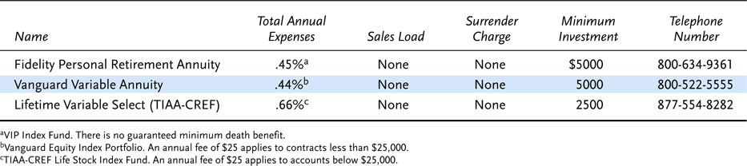
Exhibit 14.3 Three Low-Cost Variable Annuities

Slide 14
Equity-Indexed Annuities
An equity-indexed annuity is a fixed, deferred annuity that:
  allows the owner to participate in the growth of the stock market
    A cap specifies the maximum percentage of gain that is credited to the contract
  provides downside protection against the loss of principal and prior interest earnings if the annuity is held to term
The participation rate is the percent of increase in the stock index that is credited to the contract
Insurers use different indexing methods to credit excess interest to the annuity
Equity-indexed annuities with terms longer than one year have a guaranteed minimum value at the end of the index period

Slide 15
Taxation of Individual Annuities
An individual annuity purchased from a commercial insurer is a nonqualified annuity
  It does not meet IRS code requirements
  It does not quality for most income tax benefits
    Premiums are not tax deductible
    Investment income is tax deferred
    The net cost of annuity payments is recovered income-tax free over the payment period, but the amount that exceeds the net cost is taxable as ordinary income

Slide 16
Taxation of Individual Annuities
An exclusion ratio is used to determine the taxable and nontaxable portions of the payments
Annuities can be attractive to investors who have made maximum contributions to other tax-advantaged plans

Slide 17
Individual Retirement Accounts
An individual retirement account (IRA) allows workers with taxable compensation to make annual contributions to a retirement plan up to certain limits and receive favorable income-tax treatment
Two basic types of IRAs are:
  Traditional IRA
  Roth IRA

Slide 18
Traditional IRA
A traditional IRA allows workers to take a tax deduction for part or all of their IRA contributions
  The investment income accumulates income-tax free on a tax-deferred basis
  Distributions are taxed as ordinary income
  The participant must have earned income during the year, and must be under age 70½
  For 2009, the maximum annual contribution is $5000 or 100 percent of earned compensation, whichever is less
    Workers over 50 can contribute up to $6000
  A full deduction for IRA contributions is allowed if:
    The worker is not an active participant in an employer’s retirement plan
    The worker’s modified adjusted gross income is below certain thresholds

Slide 19
Traditional IRA
The full IRA tax deduction is gradually phased out as a person’s modified gross income increases
Taxpayers with incomes that exceed the phase-out limits can contribute to a nondeductible IRA
A spousal IRA allows a spouse who is not in the paid labor force, or a low-earning spouse to make a fully deductible contribution to a traditional IRA
  For 2009, the maximum annual IRA deduction for a spouse who is not an active participant is $5000 ($6000 if over 50)
Distributions from a traditional IRA before age 59½ are considered an early withdrawal, and subject to a 10% tax penalty unless certain conditions apply, e.g., death or disability

Slide 20
Traditional IRA
Distributions from traditional IRAs are treated as ordinary income
  Any nondeductible contributions are received income-tax free
  A formula is used to compute the taxable and nontaxable portions of each distribution
  For 2009, the required minimum distribution rules were temporarily waived
Traditional IRAs can be established at a bank, mutual fund, stock brokerage firm, or insurer
The IRA can be set up as either:
  An individual retirement account
  An individual retirement annuity
IRA contributions can be invested in a variety of investments
An IRA rollover account is an account established with funds distributed from another retirement plan

Slide 21
Roth IRA
A Roth IRA is another type of IRA that provides substantial tax advantages
  The annual contributions to a Roth IRA are not tax deductible
  The investment income accumulates income-tax free
  Qualified distributions are not taxable under certain conditions
  Contributions can be made after age 70½
  Roth IRAs have generous income limits
  A traditional IRA can be converted to a Roth IRA

Slide 22
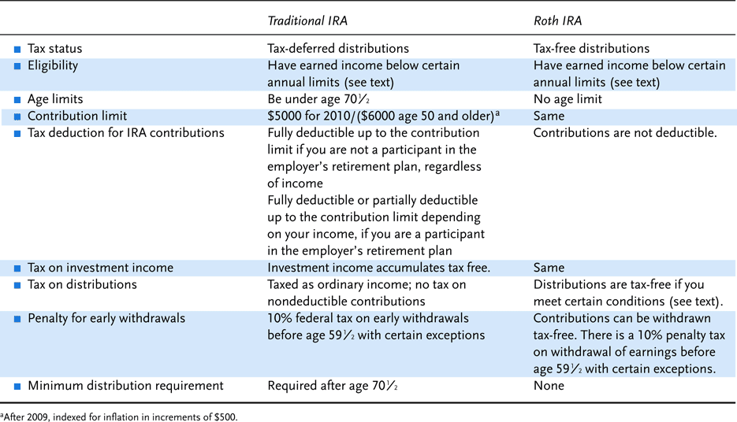
Exhibit 14.4 Comparison of a Traditional IRA with a Roth IRA

Slide 23
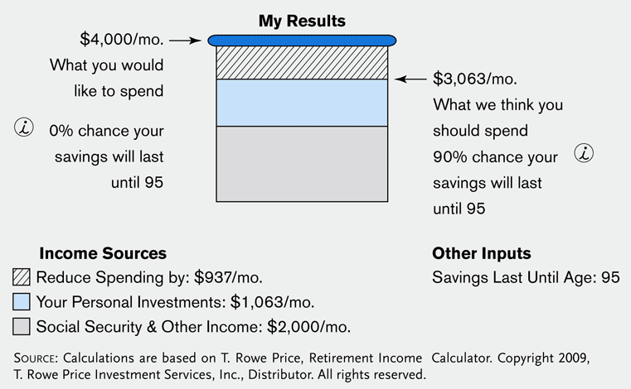
Insight 14.4 Retirement Income Calculator

Slide 24

Three-Legged Stool Approach to Retirement Planning

Slide 25
Structure of Annuities
Are structured so that annuitants’ payments are composed of both interest earnings and a partial liquidation of principal
For contracts guaranteeing payments for as long as an annuitant is alive
  Each payment consists not only of interest and principal but also of a third element called the survivorship benefit

Slide 26
How are Annuity Premiums Paid?
An annuity can be purchased with one lump-sum payment
  Called a single-premium annuity
Or it can be purchased in installments over a period of years
  Called an annual-premium annuity
Considerable latitude is allowed regarding the timing and amount of premiums
  The installment arrangement is a flexible-premium annuity
  The size of the eventual annuity benefit is a function of the accumulated premium dollars at the time the annuitant decides to begin collecting benefits
Many of the life insurance settlement options discussed in Chapter 16 are, in essence, single-premium annuities
  The life insurance proceeds are used as the single premium to purchase a particular income stream described in the policy

Slide 27
When Do Benefits Begin?
Benefits can begin as soon as the annuity is purchased
  And continue at specified intervals thereafter
    Called an immediate annuity
Deferred annuity
  Benefits are deferred until some future time
  The particular time when benefits are to begin may or may not be specified ahead of time
    If such a time is designated, changes usually can be made if desired

Slide 28
Annuity Certain
An annuity that is payable for a specified period of time
  Without regard to the life or death of the annuitant
For example, benefits might be payable for exactly ten years
  If the annuitant dies before all payments have been made
    The remaining benefits continue to be paid to either the annuitant’s heirs or a secondary person named in the annuity contract
    An annuity certain has no survivorship benefit
      Payments consists entirely of interest earnings and liquidation of principal

Slide 29
Straight Life Annuity
Pays benefits only during the lifetime of the annuitant
If the annuitant dies the day after purchasing the annuity
  There is no obligation for the insurer to return any of the purchase price
  Rather, the money is used to provide the survivorship element of the payments made to those persons still living and collecting benefits
The older an annuitant is when benefits begin under a straight life annuity
  The greater is the size of each periodic payment
  Older persons can be expected to die before collecting as many annuity payments as their younger counterparts

Slide 30
Joint and Survivor Annuity
An annuity may be issued on more than one life
A common arrangement provides that the annuity payments will continue as long as either annuitant is alive
The periodic payment may be constant during the entire period
  Or it may be arranged so that the amount of each payment is reduced on the death of the first annuitant
The size of the survivor’s benefit is often stated as a percentage of the joint benefit
  Using the terminology joint and x percent survivor annuity
    A joint and 100 percent survivor annuity would pay the same benefit regardless of whether one or two annuitants were still alive
    A joint and 50 percent survivor annuity would pay the survivor only one-half of the joint benefit

Slide 31
Joint and Survivor Annuity
Assuming all other factors are the same, the greater the reduction in benefits when the first person dies
  The larger will be the joint benefit while both persons live
Another important determinant of benefit’s size for joint and survivor annuities is age
  Joint and survivor annuity benefits are more expensive at younger ages

Slide 32
Period-Certain Guarantees
Annuities based on the lives of one or more persons can be arranged so that, regardless of the life or death of the annuitant(s)
  At least a minimum number of annuity payments is made
In general, a period-certain life annuity ceases payments when the later of the following events occurs
  Death of the annuitant
  Expiration of the minimum guarantee period

Slide 33
Period-Certain Guarantees
If an annuitant is relatively young, the addition of a period-certain guarantee to a life annuity will not have a large effect on the size of each annuity payment
The reason for the much greater effect on benefits at older ages is the increased likelihood that the period-certain guarantee will be the factor governing the length of the payout period
It is more expensive at older ages to add a guarantee providing at least a minimum number of payments regardless of the annuitant’s life or death
  The increased price for the guarantee is reflected in relatively lower benefits

Slide 34
Refund Guarantees
Other arrangements to ensure at least a minimum return from an annuity are the refund guarantees that can be added to straight life and joint and survivor annuities
When a straight life annuity has an installment refund guarantee
  Benefits continue after the death of the annuitant until the combined benefits paid before and after death equal the original purchase price
With the cash refund guarantee
  The difference between the total payments received in the original premium would be paid immediately in cash to the beneficiary
  More expensive than the installment refund option because the insurer forfeits the right to earn interest on the money immediately refunded

Slide 35
Temporary Life Annuity
Rarely used
Pays benefits until the expiration of a specified period of years or until the annuitant dies
  Whichever comes first
A temporary life annuity can be considered the opposite of a period-certain life annuity

Slide 36
Is the Contract Fixed or Variable?
Fixed annuity
  An annuity that has a benefit expressed in terms of a stated dollar amount based on a guaranteed rate of return
  In practice, the actual benefit paid under a fixed annuity may vary over time
    If interest earnings, expenses, and/or mortality experience are better than what was assumed in computing the annuity premium
Market value-adjusted annuity
  Sometimes referred to as the modified guaranteed annuity
  Can be used with fixed deferred annuities to provide relatively higher minimal interest rate guarantees during the first several years after a contract is issued but before benefits begin

Slide 37
Is the Contract Fixed or Variable ?
Variable annuity
  Benefit associated with a variable annuity is expressed in terms of annuity units
  The value of each annuity unit fluctuates with the performance of a specified portfolio of investments
    This causes the annuity income to fluctuate as well
  General objective is to provide the annuitant with an income that fluctuates in dollar value
    But remains reasonably constant in terms of purchasing power
    To be successful, the investment portfolio underlying the variable annuity must increase in value when general price levels increase
      In past years, variable annuities were invested almost exclusively in common stocks; however, today many different investment choices are available

Slide 38
Taxation of Annuity Benefits
In determining the income tax payable on annuity benefits
  It would be unfair to tax the entire amount of benefits paid
    Because each payment consist partly of a return of an individual’s principal
The general approach currently required is to exclude a portion of each annuity payment from federal income taxes
  Until the sum of all of the excluded amounts equals exactly the original purchase price of the annuity
    After that time, the entire amount of each annuity payment becomes fully taxable

Slide 39
Taxation of Annuity Benefits
The amount of each benefit that can be excluded from taxes is computed according to rules specified by the IRS
  Publishes tables for use in computing the probable number of years that a person can be expected to live and thus continue to receive annuity benefits
    See Table 18-1
      For a straight life annuity with payments beginning at age 60, payments can be expected for 24.2 years
Exclusion ratio
  Fraction of each payment that can be excluded from income taxation

Slide 40
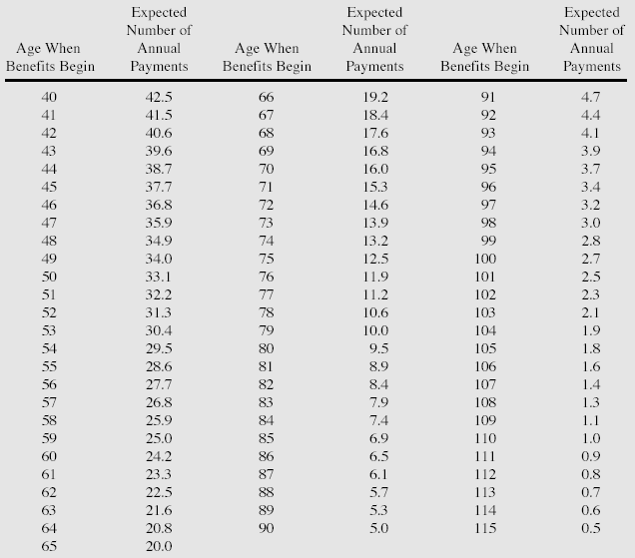
Expected Years to Receive the Straight Life Annuity

Slide 41
Tax Issues Before Benefits Begin
In recognition of their role as longer-term savings vehicles
  Annuities usually do not produce taxable income for their owners until income benefits begin
Some annuities are participating and may pay dividends to their owners
  If the owner of a deferred annuity receives a dividend before benefits begin
    The dividend is considered to be a return of premium and is not subject to income taxation
  If the dividend is received after annuity benefits begin
    Dividends serve to increase the size of the periodic benefit and are taxed accordingly

Slide 42
Tax Issues Before Benefits Begin
One situation that may result in taxable income for an annuitant before benefits become payable
  If the owner of a deferred annuity makes a partial withdrawal of funds
    The withdrawal is treated as taxable income to the extent that the annuity value exceeds the total premiums paid
  This rule was enacted to reduce the possibility that annuities might be used as short-term, temporary tax shelters
The tax law also says for withdrawals that occur before age 59.5 a penalty tax of 10% may be added to the regular income tax payable on the withdrawal

Slide 43
Tax Issues Before Benefits Begin
Withdrawals associated with some circumstances are exempt from the additional penalty tax
  Such as death, disability, etc.
The exemptions are few enough to cause many potential buyers of deferred annuities to think twice before committing the funds to such contracts at young ages
  Unless an individual seriously intends to use the funds accumulating in a deferred annuity to help provide income during retirement
    Alternative savings vehicles may be the better choice

Slide 44
End of Lecture 31

