Slide 1
Lecture No. 32
Revision

Slide 2
Buying Life Insurance

Slide 3
Determining the Cost of Life Insurance
The cost of a life insurance policy is the difference between what you pay and what you get back
When determining the cost of life insurance, four major factors must be considered:
    Annual premiums
    Cash values
    Dividends
    Time value of money

Slide 4
Determining the Cost of Life Insurance
Under the traditional net cost method, the cash value and expected dividends are subtracted from annual premiums to obtain a net cost per year figure
  This method does not consider the time value of money

Slide 5
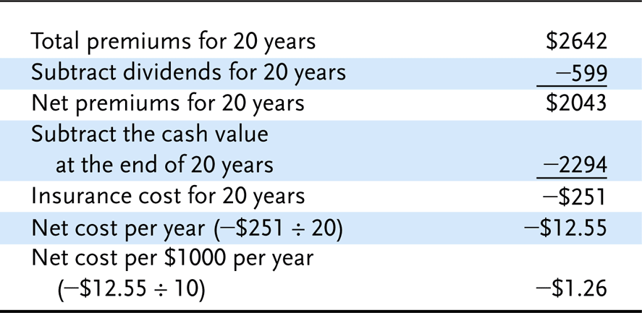
Traditional Net Cost Method

Slide 6
Determining the Cost of Life Insurance
The interest-adjusted cost method is more accurate because it considers the time value of money
Interest-adjusted cost indices come in two forms:
  The surrender cost index is useful if the owner expects to surrender the policy after some time period
  The net payment cost index is useful if the owner expects to keep the policy in force

Slide 7
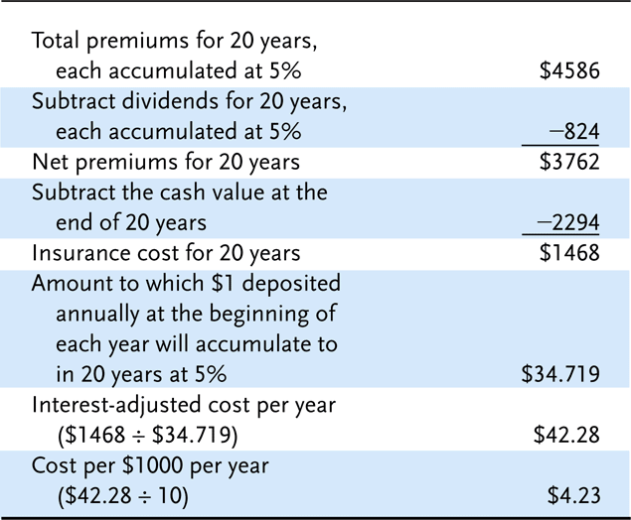
Surrender Cost Index

Slide 8
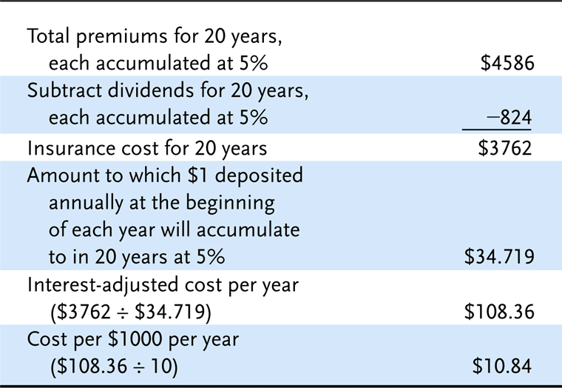
Net Payment Cost Index

Slide 9
Determining the Cost of Life Insurance
Interest-adjusted cost indices can be used to compare policies across insurers
  There is a wide variation in costs indices across insurers – it pays to shop around!
  Most consumers use premiums as a basis for comparison, but agents will supply cost indices

Slide 10
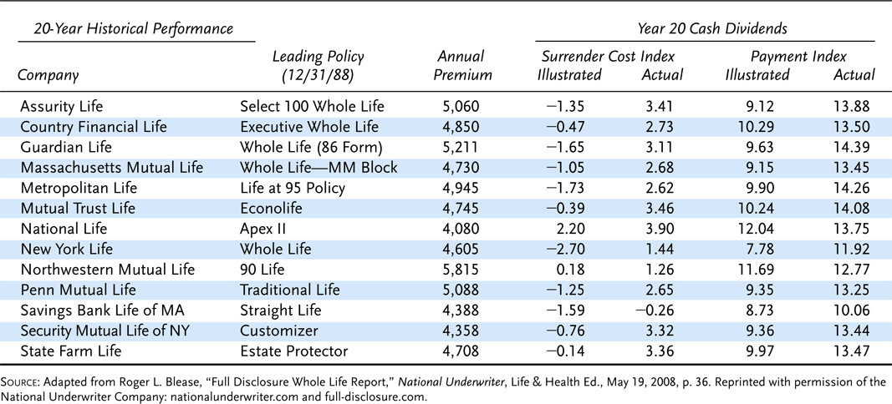
Whole Life Actual Historical Performance $250,000 Male Nonsmoker Preferred Class, Age 45 Policy Issued 12/31/1988. Last Day 12/31/2008.

Slide 11
Determining the Cost of Life Insurance
The Life Insurance Policy Illustration Model Act requires insurers to present certain information to applicants for life insurance
  The goal is to reduce misunderstanding of policy values by policyowners, and reduce deceptive sales practices by agents
  A narrative summary describes the basic characteristics of the policy
  A numeric summary shows the premium outlay, value of the accumulation account, cash surrender values and death benefit
  The act also prohibits certain sales practices and requires the insurer to provide an annual report

Slide 12
Rate of Return on Saving Component
The annual rate of return earned on the savings component of a policy is an important consideration if you intend to invest over a long period of time
The Linton yield is the average annual rate of return on a cash value policy if it is held for a specified number of years
  Current information is not readily available to consumers, so the method has limited use

Slide 13
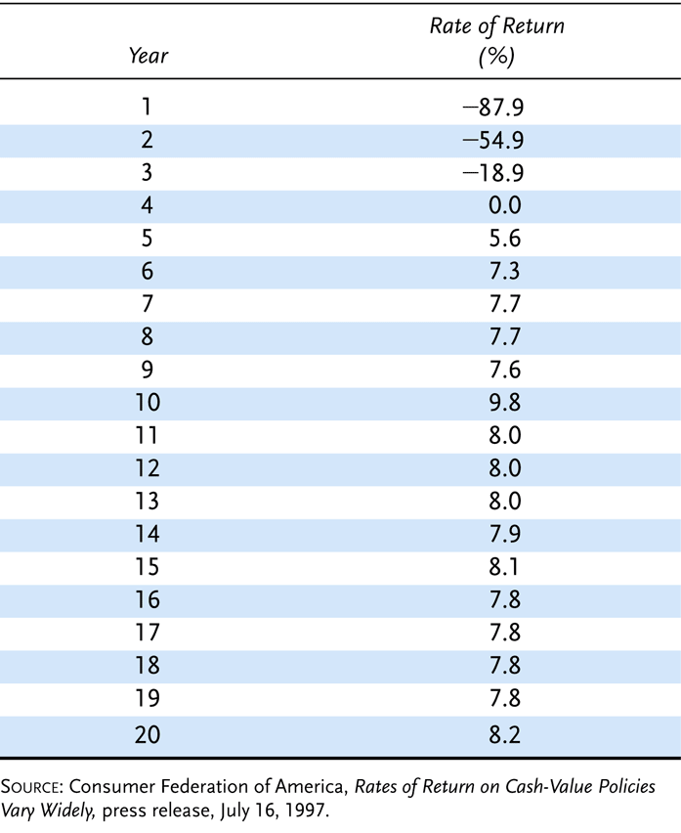
Average Annual Rates of Return for 109 Cash-Value Policies by Year of Policy

Slide 14
Rate of Return on Saving Component
The yearly rate of return method is based on a formula:
The information needed for the calculation is readily available to consumers

Slide 15
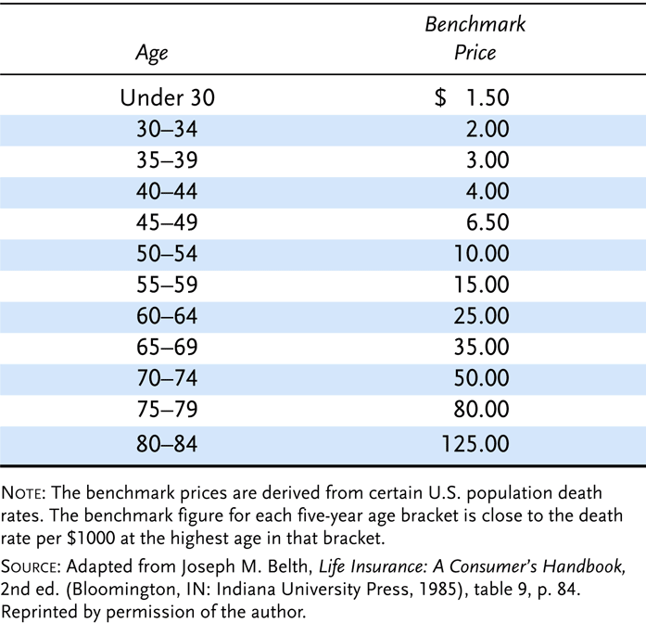
Benchmark Prices

Slide 16
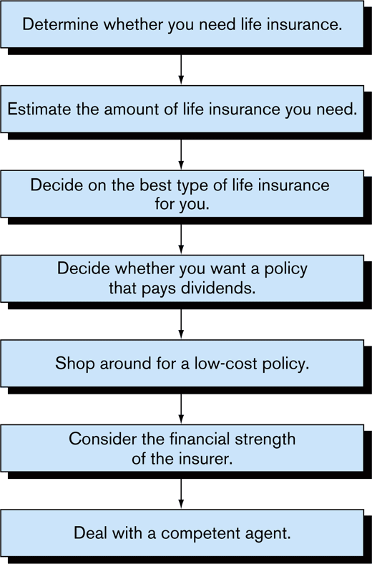
Shopping For Life Insurance

Slide 17
Insurance Types

Slide 18
Types of Life Insurance
In 2002 the face amount of new life insurance sold in the U.S. was $2.9 trillion
Total life insurance in force by the end of 2002 was $16.3 trillion
Three major types of life insurance
  Term
  Whole life
  Universal life
Other types of life insurance exist
  Some were more prevalent in past years but decreased in popularity as newer forms of life insurance were developed and marketed

Slide 19
Whole Life Insurance
May be kept in force for the insured’s entire lifetime
Has accounted for more than half of all life insurance policies sold in the U.S. in recent years
  Lags behind term insurance with respect to the total face amount of coverage issued
Contains the savings elements called cash values
  If the owner of the whole life policy decides to terminate it before the insured’s death, the cash value can be refunded

Slide 20
Whole Life Insurance
A straight life contract is arranged so that the premiums are payable as long as the insured lives
A limited-pay life policy requires that the premiums are payable for only a specified period of time
  Such as 20 years or until age 65
  After that time, no further premiums are necessary, but the coverage remains in effect until the insured’s death
Is also possible to pay for a whole life policy with only one premium
  Called a single-premium life

Slide 21
Whole Life Insurance
When a premium for whole life insurance is paid to the insurer
  Part of that premium is used to help pay the policy’s fair share of death benefits for insureds who die that year
  Part of the premium not needed to pay that year’s death benefits is used to pay current expenses of the insurer
  Any remaining amounts are invested to earn interest
Life insurance premiums are calculated such that, when they are combined over time with the premiums and investment earnings from other similar policies
  All mortality and expense costs can be paid as incurred until all insureds are dead

Slide 22
Whole Life Insurance
If insureds terminate their whole life contracts before death
  They are entitled to refunds of the excess premiums that have accumulated for their policies to date
  Called the policy’s cash value
The more premium dollars that are paid earlier in the life of the contract
  The greater the cash value available on policy termination
Life insurers make various assumptions about mortality costs, interest earnings, and expenses
  On the basis of these assumptions, it is possible to guarantee within the contract the cash values that will be generated by policy termination at various times

Slide 23
Universal Life Insurance
First introduced in the U.S. in 1979
Offers more flexible premium payment options than do most other forms of life insurance
The minimum initial premium required to activate the policy is specified by the insurer
  But the policyowner usually decides the timing and size of subsequent premiums
Policyowners can also periodically adjust the size of the death benefit in most universal life contracts
  Although insurers may require proof of insurability if a request is made to increase the death benefit

Slide 24
Universal Life Insurance
The cash value of the universal life policy is established deliberately and varies regularly
  Depending on such factors as
    The insurer’s investment savings, mortality experience, and expenses
    The amount and timing of premiums paid by the insured
Basic versions of life insurance contracts–differ only with respect to how the death benefit is designated
  Type A universal life
  Type B universal life

Slide 25
Universal Life Insurance
Type A universal life
  The death benefit is an amount that remains the same while the policy is in force
  The death benefit is the cash value plus whatever amount is necessary to bring the total to the specified amount
Type B universal life
  Has fluctuating death benefits that are made up of a specified amount of death protection plus the policy’s cash value
    Table 16-1 provides an illustration of the structure of the Type B universal life policy
      As the cash value grows over time so does the death benefit
      The actual rates credited correspond closely to money market rates
        The interest rate credited is an especially crucial item in determining the size of the cash value and the death benefit for Type B contracts

Slide 26
Universal Life Insurance
In the first several years following their introduction
  Universal life cash values were credited with interest that substantially exceeded the minimum guarantees
  Illustrations for selling policies were often based on the assumption that interest rates of 10 or 11% would continue throughout the life of the policy
  However, in the early 1990s interest rates dipped to their lowest levels in decades
  Insurers were forced to credit universal life cash values with much lower interest rates
    Leading to dissatisfaction among many policyowners
For the policy illustrated in Table 16-1, a wide range of potential cash values may result at various ages
  Depending on the interest rate assumption
    Table 16-2 shows some of the possible results

Slide 27
Variable Life
The death benefit and cash value fluctuate with the investment performance of one or more portfolios of securities
Policyholders can designate the types of investments that they want supporting their policies
If the selected investments increase in value
  Both the face amount and the cash value of the variable life contract will also increase
Poor investment performance will result in decreasing coverage and cash values
  Although a minimal face amount is usually guaranteed
Originally designed to provide an inflation hedge for both the death protection and savings elements of the policy

Slide 28
Variable Universal Life
Combines some of the features of both universal life and variable life insurance
  Referred to as flexible premium variable life
Contract usually is designed similarly to a universal life policy with respect to death benefits and flexible premium arrangements
  A primary difference is that policyowners are given a choice of investments to be used to support the contract
    Rather than using only high-grade, short-term money market investments as in the standard universal life policy
Usually only the cash value of a variable universal policy varies with the performance of the underlying securities

Slide 29
Modified Life
Can describe many different policy structures
Usually the contract is a form of whole life insurance with premiums that are lower than usual for an initial period of time
  After that time, the premiums are somewhat higher than they otherwise would be
Can be especially appropriate for insureds with limited incomes who want to own permanent life insurance they cannot currently afforded
Convertible term insurance can meet the same need
  But many persons who plan to convert their term insurance do not actually do so because of the substantial premium increase
An advantage of modified life is that the policyowner does not have to initiate any type of positive action to obtain the permanent insurance

Slide 30
Endowment
The amount of endowment insurance sold in the U.S. is now negligible
Provides death benefits for a specified period time
  Has a cash value, and the policyowners pay the contract’s face amount at the end of the protection period if the insured is still alive
While the policy does provide death protection
  On a relative basis it emphasizes savings to a much greater degree than any policy discussed so far
Most insureds now seek other alternatives because of the adverse tax treatment now accorded to endowment policies

Slide 31
Industrial Life
Known variously as industrial life, home service life, or debit insurance
Type of cash value life insurance that is sold in very small amounts
  Primarily to meet burial needs of low income insureds
The face amount is only a few thousand dollars
Premiums are only a few dollars each week and are usually collected personally at the insureds’ homes

Slide 32
Industrial Life
More expensive on a relative basis than other forms of life insurance because
  Of the high cost of its premium collection method
  Mortality rates tend to be higher for persons who purchase this form of coverage
Because the face amount is so small, underwriting standards are often fairly liberal
  Medical exams are rarely required
Those who purchase industrial life insurance would be better served by regular term or whole life insurance
  The low-income status of most of these insureds makes it unlikely that they will be approached by traditional life agents

Slide 33
Credit Life
Offered in connection with installment sales of consumer durables, such as automobiles
Decreasing term insurance issued without a medical examination
Will expire when the installment sales contract is paid off
Cost of protection is incorporated into the regular payment made by the purchaser
If the insured dies before the loan is repaid
  Sufficient coverage exists to repay the balance of the debt
  Protects the insured’s dependents as well as the lender

Slide 34
Life Insurance Clauses

Slide 35
Incontestability Clause
If the policy has been in force for a given period and if the insured has not died during that time
  The insurer may not afterward refuse to pay the proceeds, nor may it cancel or contest the contract, even due to fraud
Thus, if an insured is found to have lied about his or her physical condition at the time the application was made for life insurance
  And this misrepresentation is not discovered until after the expiration of the incontestability clause
    The insurer may neither cancel the policy nor refuse to pay the face amount if the insured has died from a cause not excluded under the basic terms of the policy
Serves as a time limit within which the insurer must discover any fraud or misrepresentation in the application or be barred thereafter from asserting what would otherwise be its legal right
The legal justification for this clause is protection of beneficiaries from doubtful claims by an insurer
  That the deceased had made misrepresentations after it becomes impossible for the deceased to defend against or to deny the allegation

Slide 36
Suicide Clause
Partially protects the beneficiary from the financial consequences of suicide
States that if the insured does not commit suicide for at least a stated period (usually two years after issuance of the contract)
  The insurer may not deny liability under the policy for subsequent suicide
If the suicide occurs within two years of the issuance of the policy
  The insurer’s only obligation is to return without interest the premiums that have been paid

Slide 37
Misstatement of Age or Sex
Misrepresenting one’s age in life insurance is material to accepting the risk and normally would become a defense against payment of the proceeds
  If it were not for the incontestability clause
Without some control over this possibility
  It would become possible for people to understate their ages to obtain lower life insurance premiums
Proof of age is therefore required before proceeds are paid
Under the misstatement-of-age clause
  If it is determined that the policyholder’s age has been misrepresented
    The insurer adjusts the amount of proceeds payable rather than canceling the agreement altogether
Proceeds will be adjusted in a similar manner through the misstatement-of-sex clause
  It is common for females to pay lower premiums than males of the same age when purchasing life insurance

Slide 38
Entire Contract Clause
Provides that the policy, together with the application, constitutes the entire contract between the parties
Desirable for the protection of the insured and the beneficiary because
  Without the clause it might be possible to affect the rights of the respective parties through changes in the bylaws or in the charter of the insurer

Slide 39
Assignments
An insured may wish to assign the benefits of a life insurance policy
  Often as collateral for a loan
Permission of the insurer is not necessary
  But the insurer must be properly notified in writing of an assignment or else is not bound by it
If the insured dies, the insurer pays the holder of the assignment that part of the proceeds equal to the outstanding debt
  Then pays the remainder to the named beneficiaries

Slide 40
Dividend Options
Some life insurance policies are participating
  They pay the policyowner dividends
The dividend is not a distribution of profit but a partial return of the premium payment
  Reflects the insurer’s experience with respect to mortality, investment income, and expenses
Dividends are not taxable to the recipient
Insurers are not required to pay dividends
However, dividends may be substantial

Slide 41
Paid-Up Additions
Policyowners of whole life policies usually are offered the paid-up additions option
  Each dividend is used to purchase as much single premium whole life insurance as possible
An economical way to buy additional life insurance
  No commission or other acquisition expenses must be paid
No medical examination or other evidence of insurability is required
The insurance purchased under this option provides additional death protection and has a cash value

Slide 42
Paid-Up Insurance Option
The insurer uses the cash value to buy as much single-premium insurance as possible on the life of the insured
  Given the size of the cash value
The same type of insurance is purchased as existed for the original policy
  The only difference is that the new death benefit will be for lower now than before
  And no more premiums will be required after the option is exercised

Slide 43
Extended-Term Option
If the insured does not select a nonforfeiture option and has not implemented the automatic premium loan provision
  Most insurers automatically place a cash value policy on the extended-term option
    If premiums remain unpaid after expiration of the grace period
The policy’s cash value is used to purchase term insurance for as many years and months as are allowed by the rates in effect for the insured’s age when the lapse occurs
Minimum guarantees regarding this option are included in the policy

Slide 44
Policy Loans
Sometimes the policyowner may need access to funds that are only available through the cash value of his or her life insurance policy
  And it may not be desirable to terminate the policy
The cash value may be borrowed from the insurer with the insurance coverage remaining intact
If the insured dies with an outstanding policy loan
  The amount of the loan is subtracted from the policy proceeds before payment is made to the beneficiary
  Otherwise, there is no obligation to repay policy loans
However, because the insurer calculates premiums on the assumption that interest will be earned on the funds supporting the policy
  Interest is charged to anyone--including the policyowner—who borrows some of these funds
  Unpaid interest accumulates and is added to the total loan outstanding

Slide 45
Policy Loans
If the policyowner takes a policy loan but still wants to maintain the full amount of death protection
  The one-year term dividend option can be helpful, assuming that the contract is participating
Because policies without flexible premium arrangements will lapse after expiration of the grace period if premiums are not paid when due
  Many insurers encourage the use of an automatic premium loan provision
    Automatically authorizes the insured to use cash values to pay unpaid premiums that are due
Policy loans from cash value life insurance contracts generally are not taxable as income

Slide 46
Settlement Options
The different ways in which the policyowner or beneficiary may elect to have the benefits of a policy paid
Lump-sum option
  Proceeds of the life insurance are paid in a lump sum
  Vast majority of benefits are paid in this manner
  Insurer’s obligations are over
Fixed-period option
  The insurer pays the proceeds in equal installments over a specific time frame
  The size of each installment varies with the
    Desired frequency of payment
    Length of the total time period during which payments are to be made
    Interest rate paid by the insurer on proceeds not yet distributed

Slide 47
Settlement Options
Fixed-amount option
  Used when a specified amount of income is desired
  The length of time the payments are made is a function of the size and frequency of each payment and the interest rate paid by the insurer on the proceeds
  Interest earned in excess of the guaranteed level increases the length of time during which payments are made

Slide 48
Settlement Options
Interest option
  The insurer holds the proceeds of the policy and pays the beneficiary an income consisting of interest only
  A guaranteed minimum rate is stated in the policy
    With excess interest often used to increase the amount of each payment
  The beneficiary usually has the right to withdraw some or all of the principal amount

Slide 49
Settlement Options
Life income options
  Several variations guarantee a beneficiary an income for his or her remaining lifetime
  Additional guarantees may be made concerning the number of payments that will be made or the guaranteed total dollars to be paid
    Regardless of how long the beneficiary lives

Slide 50
End of Lecture 24

