Slide 1
Lecture No. 4
Insurance and Risk

Slide 2
Objectives
Definition and Basic Characteristics of Insurance
Characteristics of An Ideally Insurable Risk
Adverse Selection and Insurance
Insurance vs. Gambling
Insurance vs. Hedging
Types of Insurance
Benefits and Costs of Insurance to Society

Slide 3
Risk Identification
Loss exposure
Potential loss that may be associated with a specific type of risk
Can be categorized as to whether they result from
Property
Liability
Life
Health
Loss from income risks

Slide 4
Risk Identification
Loss exposure Checklists
Specifies numerous potential sources of loss from the destruction of assets and from legal liability
Some are designed for specific industries
Such as manufacturers, retailers, educational institutions, religious organizations
Others focus on a specific category of exposure
Such as real and personal property

Slide 5
Risk Identification
Financial statement analysis
All items on a firm’s balance sheet and income statement are analyzed in regard to risks that may be present
Flowcharts
Allows risk managers to pinpoint areas of potential losses
Only through careful inspection of the entire production process can the full range of loss exposures be identified

Slide 6
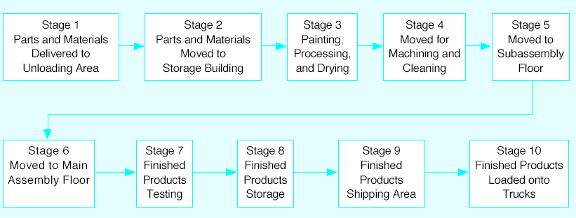
Figure 2-1: Flowchart for a Production Process

Slide 7
Risk Identification
Contract analysis
It is not unusual for contracts to state that some losses, if they occur, are to be borne by specific parties
May be found in construction contracts, sales contracts and lease agreements
Ideally the specification of who is to pay for various losses should be a conscious decision that is made as part of the overall contract negotiation process
Decision should reflect the comparative advantage of each party in managing and bearing the risk
On-site inspections
During these visits, it can be helpful to talk with department managers and other employees regarding their activities
Statistical analysis of past losses
Can use a risk management information system (software) to assist in performing this task
As these systems become more sophisticated and user friendly , it is anticipated that more businesses will be able to use statistical analysis in their risk management activities

Slide 8
Risk Evaluation
Once a risk is identified, the next step is to estimate both the frequency and severity of potential losses
Maximum probable loss
An estimate of the likely severity of losses that occur
Maximum possible loss
An estimate of the catastrophe potential associated with a particular exposure to risk
Most firms attempt to be precise in evaluating risks
Now common to use probability distributions and statistical techniques in estimating loss frequency and severity

Slide 9
Risk Mapping or Profiling
Involves arraying risks in a matrix
With one dimension being the frequency of events and the other dimension the severity
Each risk is marked to indicate whether it is covered by insurance or not

Slide 10
Statistical Concepts
Probability
Long term frequency of occurrence
The probability is 0 for an event that is certain not to occur
The probability is 1 for an event that is certain to occur
To calculate the probability of any event, the number of times a given event occurs is divided by all possible events of that type
Probability distribution
Mutually exclusive and collectively exhaustive list of all events that can result from a chance process
Contains the probability associated with each event

Slide 11
Statistical Concepts
Measures of central tendency or location
Measuring the center of a probability distribution
Mean
Sum of a set of n measurements divided by n

Slide 12
Statistical Concepts
Median
Midpoint in a range of measurements
Half of the items are larger and half are smaller
Not greatly affected by extreme values
Mode
Value of the variable that occurs most often in a frequency distribution

Slide 13
Measures of Variation or Dispersion
Standard deviation
Measures how all close a group of individual measurements is to its expected value or mean
First determine the mean or expected value
Then subtract the mean from each individual value and square the result
Add the squared differences together and divide the sum by the total number of measurements
Then take the square root of that value
Coefficient of variation
Standard deviation expressed as a percentage of the mean

Slide 14
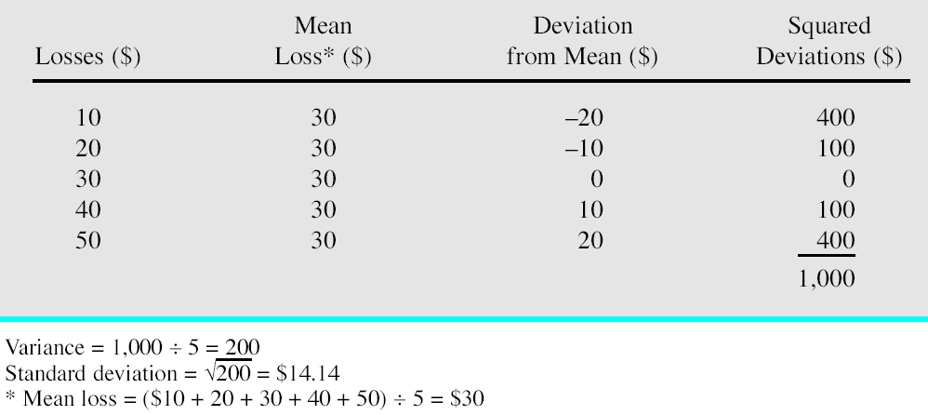
Table 2-1: Calculating the Standard Deviation of Losses

Slide 15
Loss Distributions Used in Risk Management
To form an empirical probability distribution
Risk manager actually observes the events that occur
To create a theoretical probability distribution
Use a mathematical formula
Widely used theoretical distributions include binomial, normal, Poisson

Slide 16
The Binomial Distribution
Suppose the probability that an event will occur at any point in time is p
The probability q that an event will not occur can be stated as 1 – p
One can calculate how often an event will happen with the binomial formula
Indicates that the probability of r events in n possible times equals

Slide 17
The Normal Distribution
Central limit theorem
States that the expected results for a pool or portfolio of independent observations can be approximated by the normal distribution
Shown graphically in Figure 2.2
Perfectly bell-shaped
If risk managers know that their loss distributions are normal
They can assume that these relationships hold
They can predict the probability of a given loss level occurring or the probability of losses being within a certain range of the mean
Binomial distributions require variables to be discreet
Normal distributions can have continuous variables

Slide 18
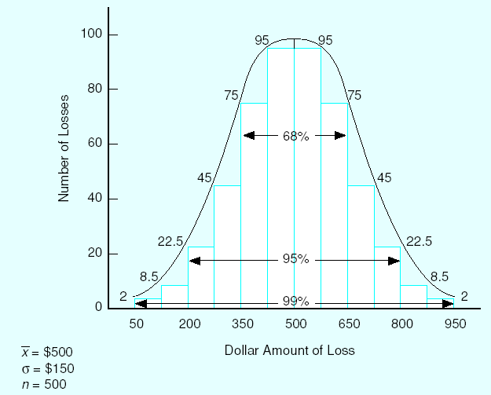
Normal Probability Distribution of 500 Losses

Slide 19
The Poisson Distribution
Determine the probability of an event using the following formula
Mean of the distribution is also its variance
Standard deviation is equal to the square root of m
p = probability that an event n occurs
r = number of events for which the probability estimate is needed
m = mean = expected loss frequency
e = a constant, the base of the natural logarithms, equal to 2.71828

Slide 20
The Poisson Distribution
As the number of exposure units increases and the probability of loss decreases
The binomial distribution becomes more and more like the Poisson distribution
Most desirable when more than 50 independent exposure units exist and
The probability that any one item will suffer a loss is 0.1 or less

Slide 21
Integrated Risk Measures
Value at risk (VAR)
Constructs probability distributions of the risks alone and in various combinations
To obtain estimates of the risk of loss at various probability levels
Yields a numerical statement of the maximum expected loss in a specific time and at a given probability level
Provides the firm with an assessment of the overall impact of risk on the firm
Considers correlation between different categories of risk
Risk-adjusted return on capital
Attempts to allocate risk costs to the many different activities of the firm
Assesses how much capital would be required by the organization’s various activities to keep the probability of bankruptcy below a specified level

Slide 22
Accuracy of Predictions
A question of interest to risk managers
How many individual exposure units are necessary before a given degree of accuracy can be achieved in obtaining an actual loss frequency that is close to the expected loss frequency?
The number of losses for particular firm must be fairly large to accurately predict future losses

Slide 23
Law of Large Numbers
Degree of objective risk is meaningful only when the group is fairly large
States that as the number of exposure units increases
The more likely it becomes that actual loss experience will equal probable loss experience
Two most important applications
As the number of exposure units increases, the degree of risk decreases
Given a constant number of exposure units, as the chance of loss increases, the degree of risk decreases

Slide 24
Number of Exposure Units Required
Question arises as to how much error is introduced when a group is not sufficiently large
Required assumption
Each loss occurs independently of each other loss, and the probability of losses is constant from occurrence to occurrence
Formula is based on knowledge that the normal distribution is an approximation of the binomial distribution
Known percentages of losses will fall within 1, 2, 3, or more standard deviations of the mean

Slide 25
Number of Exposure Units Required
Value of S indicates the level of confidence that can be stated for the results
If S is 1
It is known with 68 percent confidence that losses will be as predicted
If S is 2
It is known with 95 percent confidence
Fundamental truth about risk management
If the probability of loss is small a larger number of exposure units is needed for an acceptable degree of risk than is commonly recognized

Slide 26
End of Lecture No. 4

