Slide 1
Lecture No. 9
Types of Insurers and Marketing Systems

Slide 2
Objectives
Overview of Private Insurance in the Financial Services Industry
Types of Private Insurers
Agents and Brokers
Types of Marketing Systems
Group Insurance Marketing

Slide 3
Overview of Private Insurance in the Financial Services Industry
The financial services industry consists of:
Commercial banks
Savings and loan institutions
Credit unions
Life and health insurers
Property and casualty insurers
Mutual Funds
Securities brokers and dealers
Private and state pension funds
Government-related financial institions

Slide 4
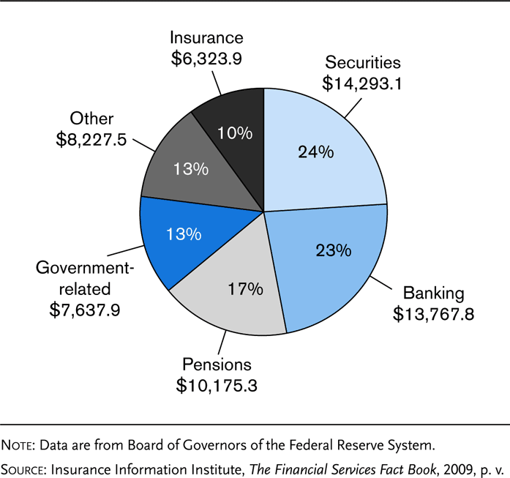
Exhibit 5.1 Assets of Financial Services Sectors, 2007 ($billions)

Slide 5
Overview of Private Insurance in the Financial Services Industry
Changes in the financial services industry include:
Consolidations
The number of firms has declined due to mergers and acquisitions
Convergence
Existing financial institutions now sell a wide variety of financial products that earlier were outside their core business area

Slide 6
Types of Private Insurers
Size of the insurance market, 2007
Life and health insurers: 1009
These insurers sell life and health insurance products, annuities, mutual funds, pension plans, and related financial products
Property and casualty insurers: 2723
These insurers sell property and casualty insurance and related lines, including marine coverages and surety and fidelity bonds

Slide 7
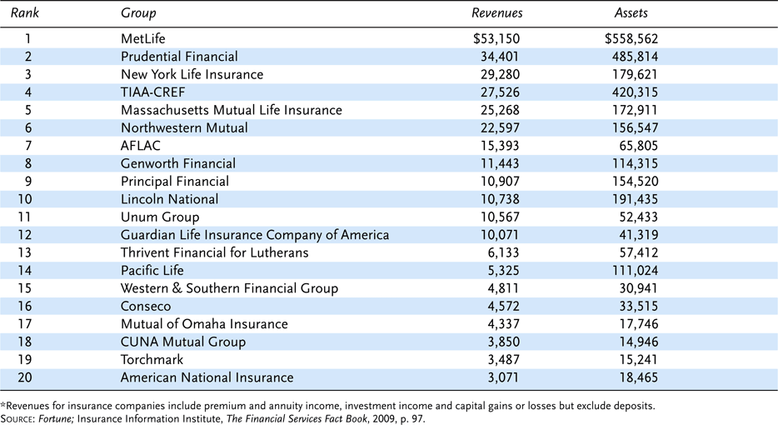
Exhibit 5.2 Top Twenty U.S. Life/Health Insurance Groups by Revenues, 2007 ($ millions)

Slide 8
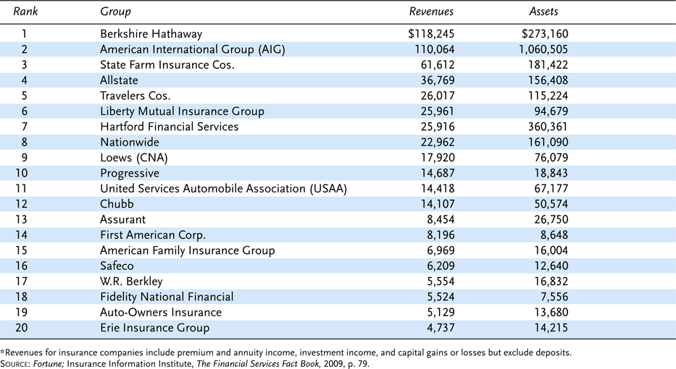
Exhibit 5.3 Top Twenty U.S. Property/ Casualty Companies by Revenues, 2007 ($millions)

Slide 9
Types of Private Insurers
Insurers can be classified by their organizational form:
Stock insurers
Mutual insurers
Reciprocal exchanges
Lloyd’s of London
Blue Cross and Blue Shield Plans
Health maintenance organizations (HMOs)
Other types of private insurers

Slide 10
Types of Private Insurers
A stock insurer is a corporation owned by stockholders
Objective: earn profit for stockholders
Increase value of stock
Pay dividends
Stockholders elect board of directors
Stockholders bear all losses
Insurer cannot issue an assessable policy

Slide 11
Types of Private Insurers
A mutual insurer is a corporation owned by the policyowners
Policyowners elect board of directors, who have effective management control
May pay dividends to policyowners, or give a rate reduction in advance
There are three main types of mutual insurers:
An advance premium mutual is owned by the policyowners; there are no stockholders, and the insurer does not issue assessable policies
An assessment mutual has the right to assess policyowners an additional amount if the insurer’s financial operations are unfavorable
A fraternal insurer is a mutual insurer that provides life and health insurance to members of a social or religious organization

Slide 12
Types of Private Insurers
The corporate structure of mutual insurers is changing due to:
An increase in company mergers
Demutualization, in which a mutual company is converted into a stock insurer by:
Pure conversion
Merger
Bulk reinsurance
The creation of mutual holding companies
A holding company is a company that directly or indirectly controls an authorized insurer

Slide 13
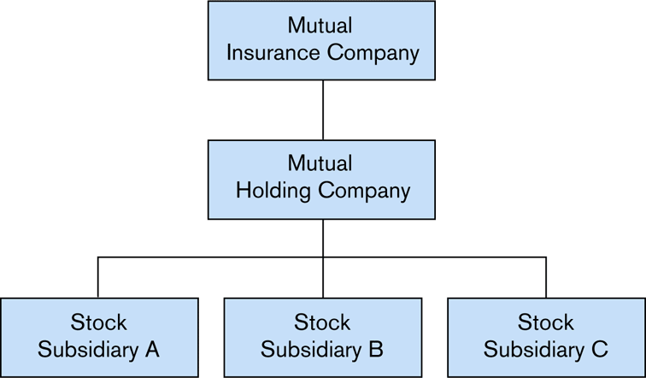
Exhibit 5.4 Mutual Holding Company Illustration

Slide 14
Types of Private Insurers
Lloyd’s of London is not an insurer, but a society of members who underwrite insurance in syndicates
Membership includes corporations, individual members (Names), and Scottish limited partnerships
New individual members, or Names, who belong to the various syndicates now have limited legal liability
Corporations with limited legal liability and limited liability partnerships can also join Lloyd’s of London
Lloyd’s is licensed only in a small number of jurisdictions in the U.S.

Slide 15
Types of Private Insurers
A reciprocal exchange is an unincorporated mutual
The reciprocal is managed by an attorney-in-fact
In a pure reciprocal exchange, insurance is exchanged among the members; each member of the reciprocal insures the other members
A separate account is kept for each member
A modified reciprocal exchange is similar to an advance premium mutual
No individual accounts

Slide 16
Types of Private Insurers
Blue Cross and Blue Shield Plans are generally organized as nonprofit, community oriented plans
Blue Cross plans provide coverage for hospital services
Blue Shield plans provide coverage for physicians’ and surgeons’ fees
Most plans have merged into one entity
Many sponsor HMOs and PPOs
Some plans have converted to a for-profit status to raise capital and become more competitive

Slide 17
Types of Private Insurers
A Health Maintenance Organization (HMO) provides comprehensive health care services to its members
Broad health care services are provided for a fixed prepaid fee
Cost control is emphasized
Choice of health care providers may be restricted
Less costly forms of treatment are often provided

Slide 18
Types of Private Insurers
A captive insurer is an insurer owned by a parent firm for the purposes of insuring the parent firm’s loss exposures
More than 5100 captives exist today
Savings Bank Life Insurance refers to life insurance that is sold by mutual savings banks, over the phone or through Web sites

Slide 19
Agents and Brokers
An agent is someone who legally represents the principal and has the authority to act on the principal's behalf
Authority may be:
Expressed
Implied
Apparent
The principal is responsible for all acts of an agent when the agent is acting within the scope of authority

Slide 20
Agents and Brokers
A property and casualty agent has the power to bind the insurer
A binder provides temporary insurance until the policy is actually written
A life insurance agent normally does not have the authority to bind the insurer
The applicant for life insurance must be approved by the insurer before the insurance becomes effective

Slide 21
Agents and Brokers
A broker is someone who legally represents the insured, and:
solicits applications and attempts to place coverage with an appropriate insurer
is paid a commission from the insurers where the business is placed
does not have the authority to bind the insurer
A surplus lines broker is licensed to place business with a nonadmitted insurer
Surplus lines refer to any type of insurance for which there is no available market within the state, and coverage must be placed with a nonadmitted insurer

Slide 22
Marketing Systems in Life Insurance
An agency building system is a system by which an insurer builds its own agency force by recruiting, financing, training, and supervising new agents
General agency system
The general agent is an independent contractor who represents only one insurer, and receives a commission based on the amount of business produced
Insurer provides some financial assistance, but the general agent is responsible for recruiting, training, and motivating new agents
Managerial system
Branch offices are established in various areas
The branch manager is responsible for hiring and training new agents, and receives a commission from the insurer
Insurer pays expenses of the branch office
Notes:
Transparency Master 1.2

Slide 23
Marketing Systems in Life Insurance
A nonbuilding agency system is a marketing system by which an insurer sells its products through established agents
A personal-producing general agent is a successful agent who is hired primarily to sell insurance under a contract
Under a direct response system, insurance is sold directly to customers without the services of an agent

Slide 24
Marketing Systems in Property and Liability Insurance
The independent agency is a business firm that usually represents several unrelated insurers
Agents are paid a commission based on the amount of business produced, which vary by the line of insurance
Agency owns the expirations or renewal rights to the business
Under the exclusive agency system, the agent represents only one insurer or group of insurers under common ownership
Agents do not usually own the expirations or renewal rights to the policies
Agents are generally paid a lower commission rate on renewal business than on new business
Notes:
Transparency Master 1.2

Slide 25
Marketing Systems in Property and Liability Insurance
A direct writer is an insurer in which the salesperson is an employee of the insurer, not an independent contractor.
Employees are usually compensated on a “salary plus” arrangement
A direct response insurer sells directly to the consumer by television or some other media
Used primarily to sell personal lines of insurance
Many property and casualty insurers use multiple distribution systems

Slide 26
Group Insurance Marketing
Many insurers use group marketing methods to sell individual insurance policies to:
Employer groups
Labor unions
Trade associations
Some property and liability insurers use mass merchandising plans to market their insurance
Employees pay for insurance by payroll deduction

Slide 27
End of Lecture No. 9

