Slide 1
Real Analysis I
Course Code MTH 321
By
Dr. Moiz ud Din khan
Professor of Mathematics

Slide 2
Lecture # 10

Slide 3

Lecture Outline
In this Lecture we will prove:
suppose $K⊂Y⊂X.$Then $K$ is compact relative to $X$ if and only if $K$ is compact relative to $Y.$

Slide 4

Lecture Outline
In this Lecture we will prove:
suppose $K⊂Y⊂X.$Then $K$ is compact relative to $X$ if and only if $K$ is compact relative to $Y.$
$Compact subsets of metric spaces are closed.$

Slide 5

Lecture Outline
In this Lecture we will prove:
suppose $K⊂Y⊂X.$Then $K$ is compact relative to $X$ if and only if $K$ is compact relative to $Y.$
$Compact subsets of metric spaces are closed.$
$Closed subsets of compact sets are compact.$

Slide 6
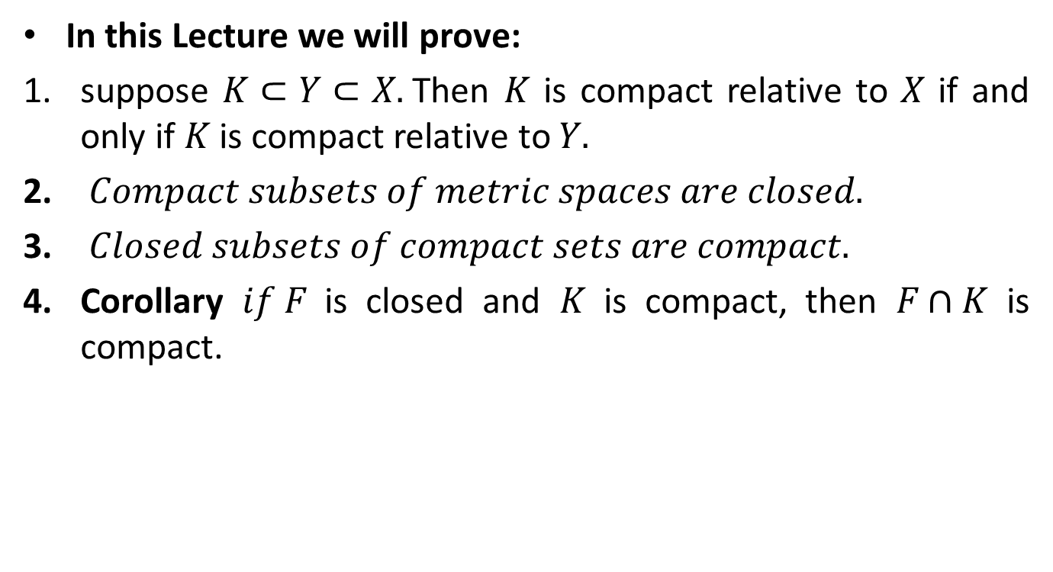
Lecture Outline
In this Lecture we will prove:
suppose $K⊂Y⊂X.$Then $K$ is compact relative to $X$ if and only if $K$ is compact relative to $Y.$
$Compact subsets of metric spaces are closed.$
$Closed subsets of compact sets are compact.$
Corollary $if F$ is closed and $K$ is compact, then $F∩K$ is compact.

Slide 7
Covering and Open Covering

Slide 8
Compact Set.
Note: Every finite set is compact.

Slide 9

Theorem. Let $(X,d)$ be a metric space and $K⊂Y⊂X.$Then $K$ is compact relative to $X$ if and only if $K$ is compact relative to $Y.$
Proof.

Slide 15
Theorem. Prove that compact subsets of metric spaces are closed.
Proof.

Slide 20

Theorem. Let $(X,d)$ be a metric space. Prove that closed subsets of compact sets are compact.

Slide 25

Corollary $if F$ is closed and $K$ is compact, then $F∩K$ is compact.
Proof.

Slide 29
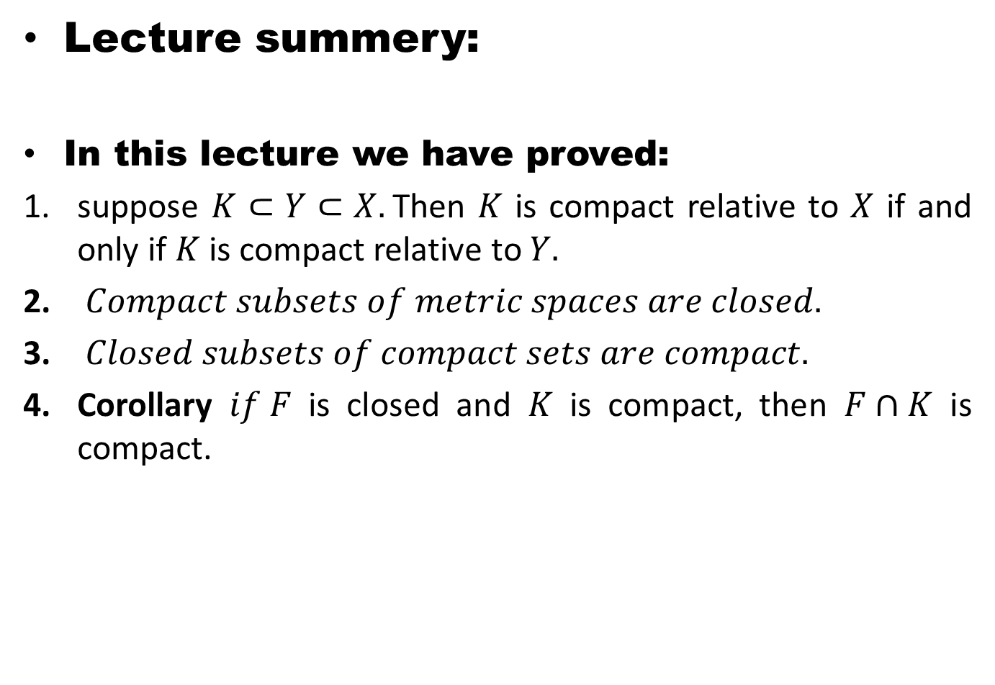
Lecture summery:
In this lecture we have proved:
suppose $K⊂Y⊂X.$Then $K$ is compact relative to $X$ if and only if $K$ is compact relative to $Y.$
$Compact subsets of metric spaces are closed.$
$Closed subsets of compact sets are compact.$
Corollary $if F$ is closed and $K$ is compact, then $F∩K$ is compact.

Slide 30
THANK YOU

