Slide 1
Real Analysis I
Course Code MTH 321
By
Dr. Moiz ud Din khan
Professor of Mathematics

Slide 2
Lecture # 11

Slide 3
Lecture Outline
In this Lecture we will Define and study:

Slide 4
Lecture Outline
In this Lecture we will Define and study:
Ordered Fields

Slide 5
Lecture Outline
In this Lecture we will Define and study:
Ordered Fields
The Field of Reals

Slide 6
Lecture Outline
In this Lecture we will Define and study:
Ordered Fields
The Field of Reals and
Extended Real umber System

Slide 7
Field:

Slide 8
Field:
A field is a set F with two operations, called addition and multiplication, which satisfy the following “field axioms” (A), (M), and (D):

Slide 9
Field:
A field is a set F with two operations, called addition and multiplication, which satisfy the following “field axioms” (A), (M), and (D):
(A) Axioms for Addition:

Slide 10
Field:
A field is a set F with two operations, called addition and multiplication, which satisfy the following “field axioms” (A), (M), and (D):
(A) Axioms for Addition:
F is closed under addition

Slide 11
Field:
A field is a set F with two operations, called addition and multiplication, which satisfy the following “field axioms” (A), (M), and (D):
(A) Axioms for Addition:
F is closed under addition
Addition is commutative in F

Slide 12
Field:
A field is a set F with two operations, called addition and multiplication, which satisfy the following “field axioms” (A), (M), and (D):
(A) Axioms for Addition:
F is closed under addition
Addition is commutative in F
Addition is associative in F

Slide 13
Field:
A field is a set F with two operations, called addition and multiplication, which satisfy the following “field axioms” (A), (M), and (D):
(A) Axioms for Addition:
F is closed under addition
Addition is commutative in F
Addition is associative in F
0 is in F and is additive identity of F

Slide 14
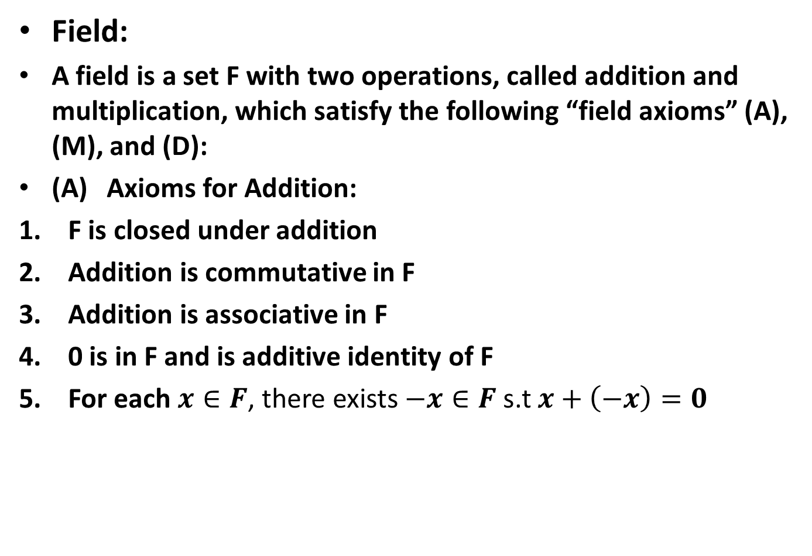
Field:
A field is a set F with two operations, called addition and multiplication, which satisfy the following “field axioms” (A), (M), and (D):
(A) Axioms for Addition:
F is closed under addition
Addition is commutative in F
Addition is associative in F
0 is in F and is additive identity of F
For each $x∈F$, there exists $−x∈F$ s.t $x+\left(−x\right)=0$

Slide 15
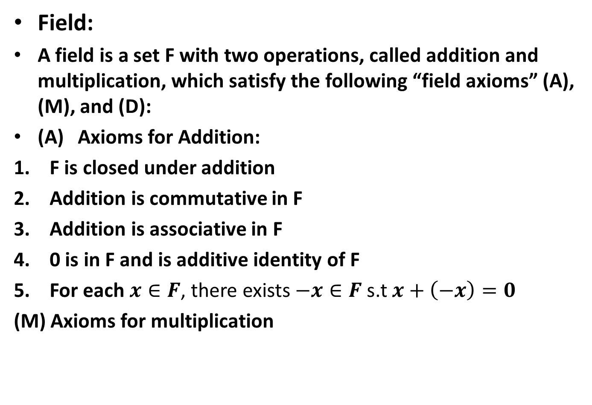
Field:
A field is a set F with two operations, called addition and multiplication, which satisfy the following “field axioms” (A), (M), and (D):
(A) Axioms for Addition:
F is closed under addition
Addition is commutative in F
Addition is associative in F
0 is in F and is additive identity of F
For each $x∈F$, there exists $−x∈F$ s.t $x+\left(−x\right)=0$
(M) Axioms for multiplication

Slide 16
(M) Axioms for multiplication
F is closed under multiplication

Slide 17
(M) Axioms for multiplication
F is closed under multiplication
multiplication is commutative in F

Slide 18
(M) Axioms for multiplication
F is closed under multiplication
multiplication is commutative in F
Multiplication is associative in F

Slide 19
(M) Axioms for multiplication
F is closed under multiplication
multiplication is commutative in F
Multiplication is associative in F
1 is in F and is multiplicative identity of F

Slide 20
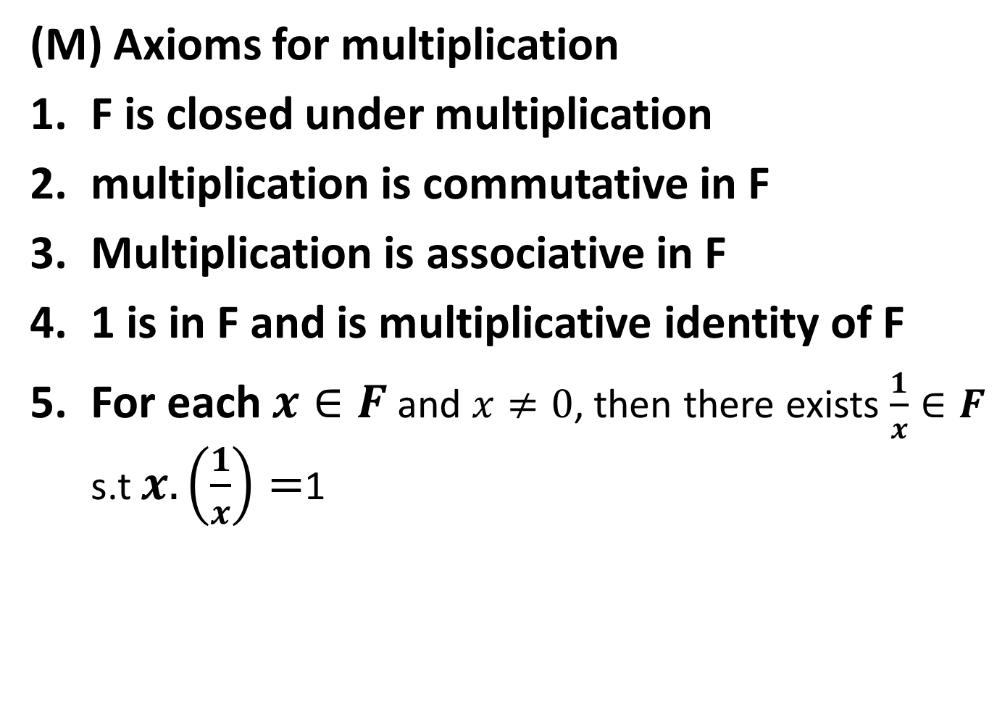
(M) Axioms for multiplication
F is closed under multiplication
multiplication is commutative in F
Multiplication is associative in F
1 is in F and is multiplicative identity of F
For each $x∈F$ and $x≠0$, then there exists $\frac{1}{x}∈F$ s.t $x.\left(\frac{1}{x}\right)=$1

Slide 21
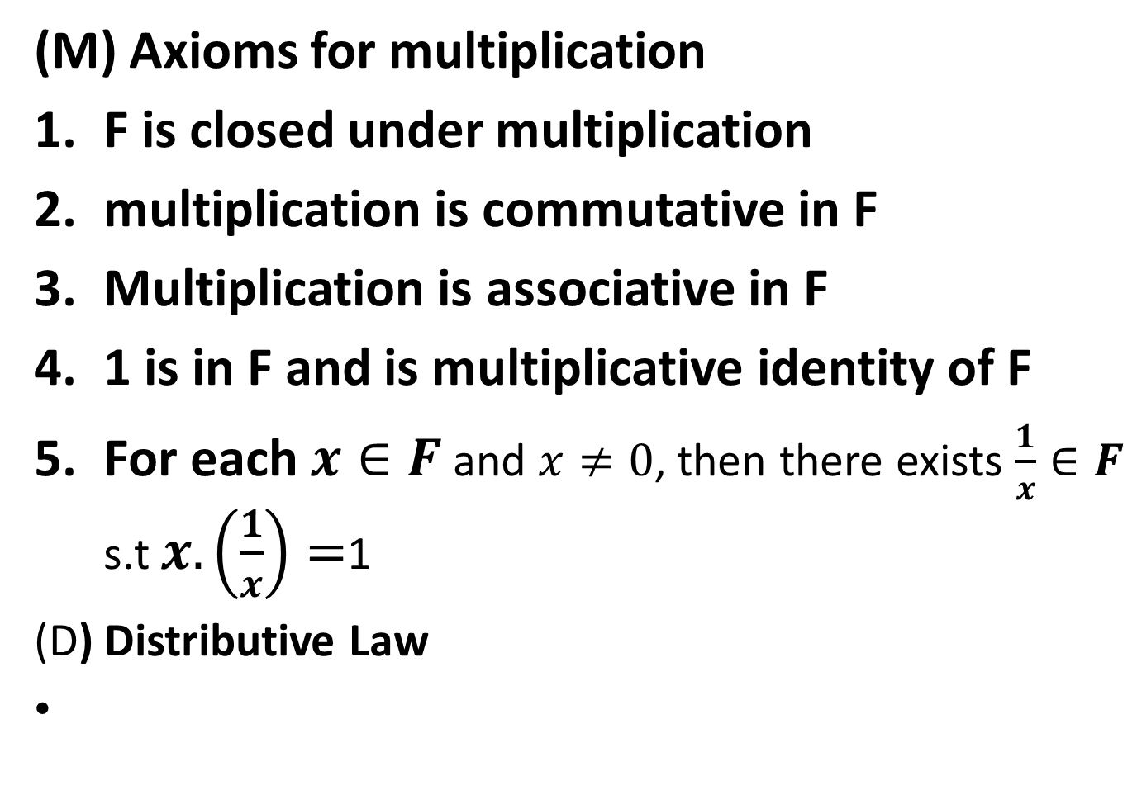
(M) Axioms for multiplication
F is closed under multiplication
multiplication is commutative in F
Multiplication is associative in F
1 is in F and is multiplicative identity of F
For each $x∈F$ and $x≠0$, then there exists $\frac{1}{x}∈F$ s.t $x.\left(\frac{1}{x}\right)=$1
(D) Distributive Law

Slide 22
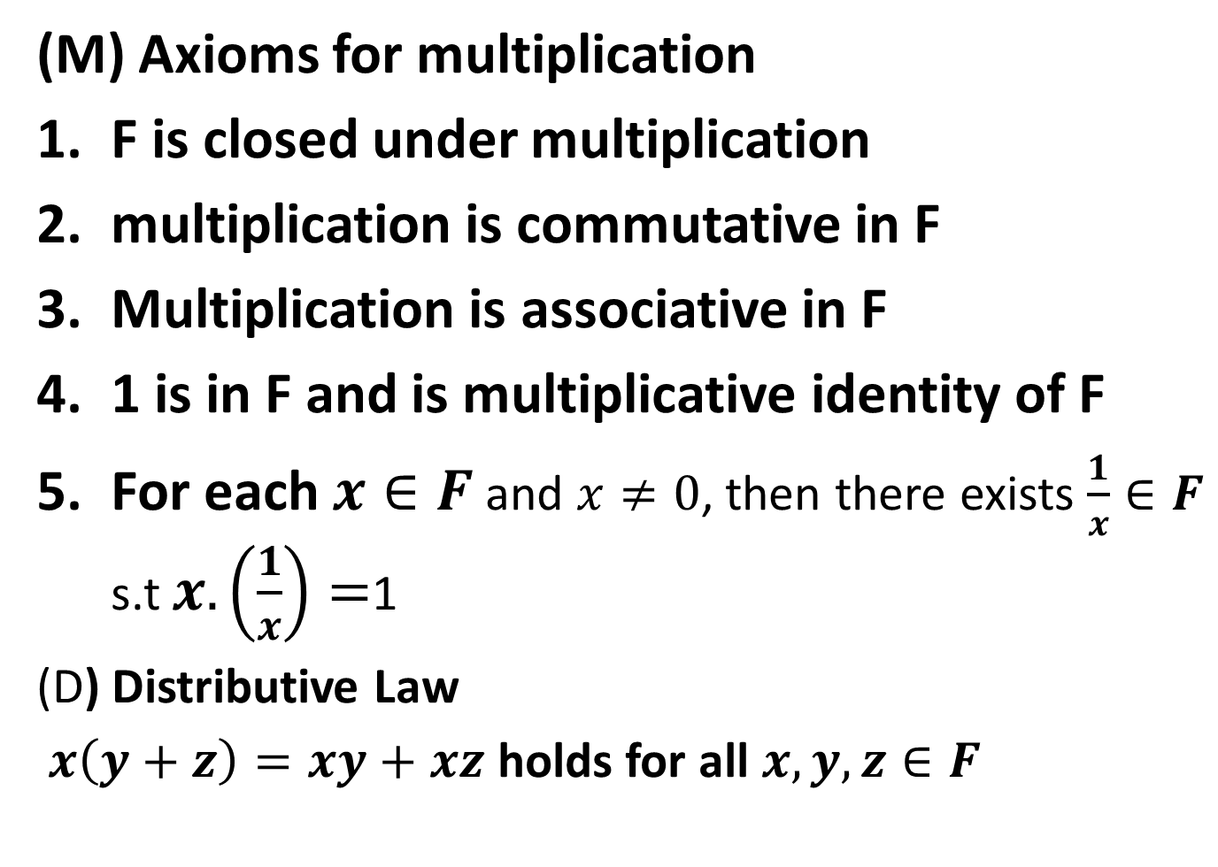
(M) Axioms for multiplication
F is closed under multiplication
multiplication is commutative in F
Multiplication is associative in F
1 is in F and is multiplicative identity of F
For each $x∈F$ and $x≠0$, then there exists $\frac{1}{x}∈F$ s.t $x.\left(\frac{1}{x}\right)=$1
(D) Distributive Law
$x\left(y+z\right)=xy+xz$ holds for all $x,y,z∈F$

Slide 23

Note:
$ℚ$ is a field.

Slide 24
Ordered Field:
An ordered field is a field F which is also an ordered set, such that:

Slide 25

Ordered Field:
An ordered field is a field F which is also an ordered set, such that:
$x+y<x+z$ if $x,y,z∈F$ and $y<z$

Slide 26

Ordered Field:
An ordered field is a field F which is also an ordered set, such that:
$x+y<x+z$ if $x,y,z∈F$ and $y<z$
$xy>0$ if $x∈F, y∈F, x>0,$ and $y>0$

Slide 28

Real Field
Let $F=ℝ$, then $(ℝ,+,.)$is a field.

Slide 29

Complex Field
Let $F=ℂ=\{\left(x,y\right):x,y∈ℝ\}$then $(ℂ,+,.)$is a field where addition and multiplication is defined as:

Slide 33
Extended Real Number System:

Slide 34

Extended Real Number System:
  The extended real number system consists of the real field $ℝ$ and two symbols, $+∞$ and $−∞$, we define

Slide 35

Extended Real Number System:
  The extended real number system consists of the real field $ℝ$ and two symbols, $+∞$ and $−∞$, we define
  $−∞<x<+∞$ for every $x∈$$ℝ$.

Slide 36

Extended Real Number System:
  The extended real number system consists of the real field $ℝ$ and two symbols, $+∞$ and $−∞$, we define
  $−∞<x<+∞$ for every $x∈$$ℝ$.
  Note.

Slide 37
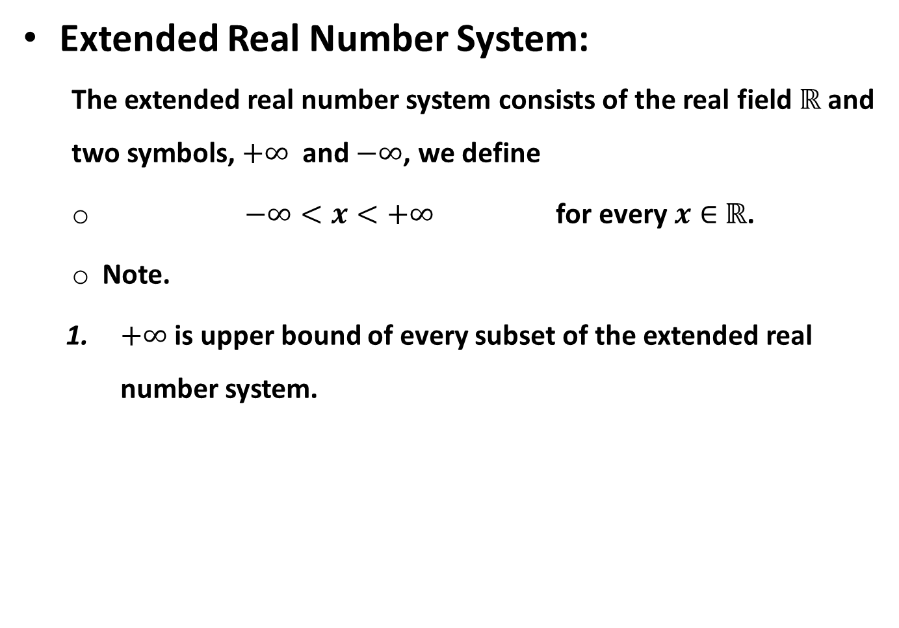
Extended Real Number System:
  The extended real number system consists of the real field $ℝ$ and two symbols, $+∞$ and $−∞$, we define
  $−∞<x<+∞$ for every $x∈$$ℝ$.
  Note.
  $+∞$ is upper bound of every subset of the extended real number system.

Slide 38
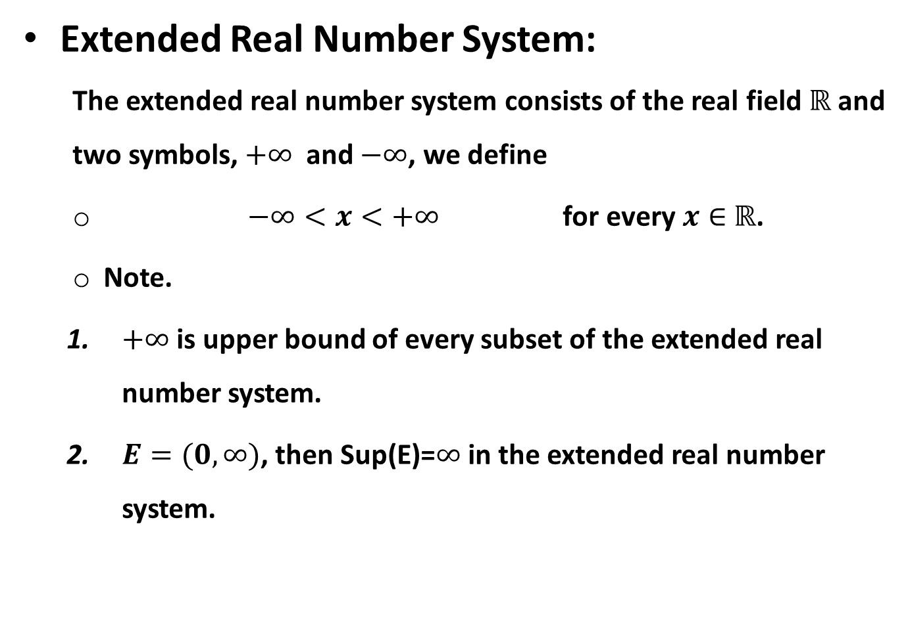
Extended Real Number System:
  The extended real number system consists of the real field $ℝ$ and two symbols, $+∞$ and $−∞$, we define
  $−∞<x<+∞$ for every $x∈$$ℝ$.
  Note.
  $+∞$ is upper bound of every subset of the extended real number system.
  $E=(0,∞)$, then Sup(E)=$∞$ in the extended real number system.

Slide 39
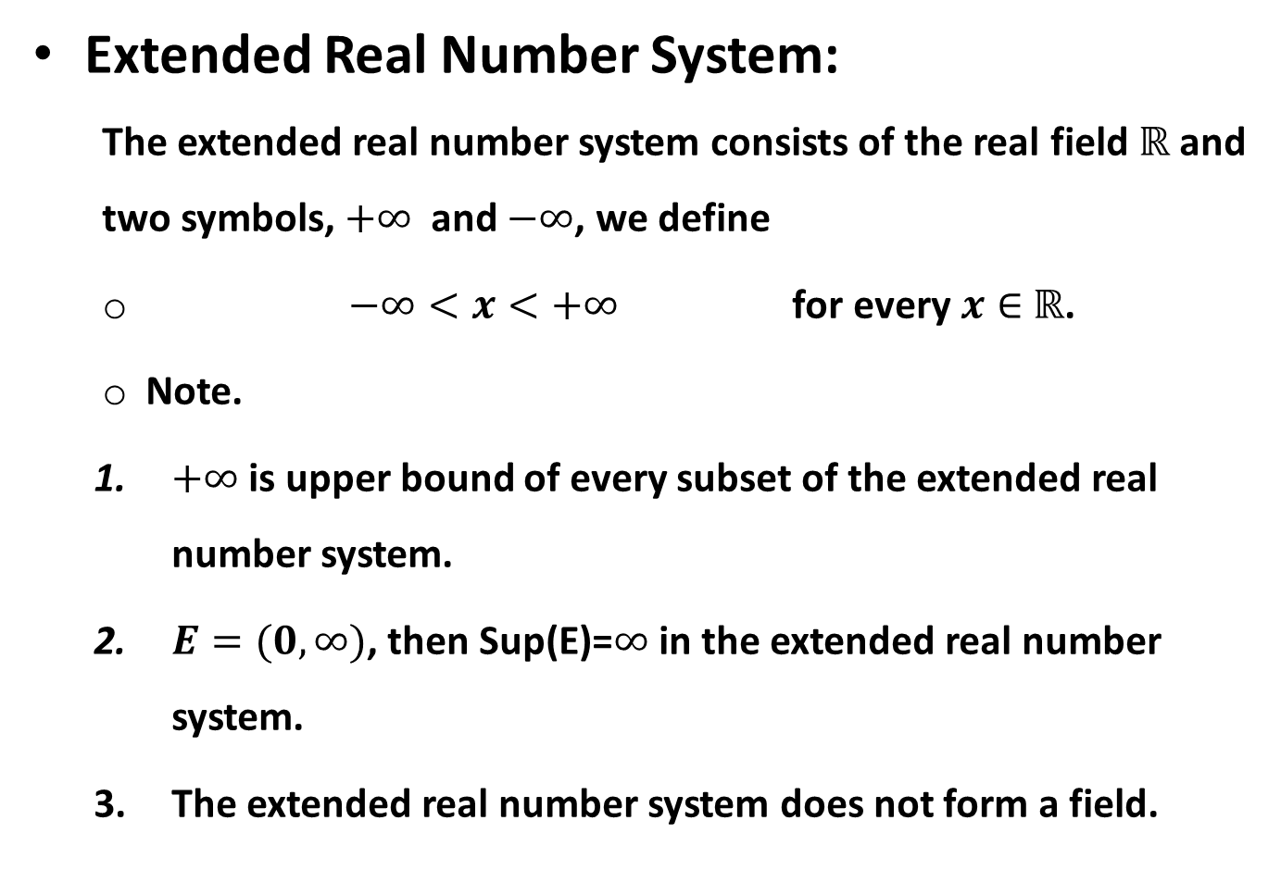
Extended Real Number System:
  The extended real number system consists of the real field $ℝ$ and two symbols, $+∞$ and $−∞$, we define
  $−∞<x<+∞$ for every $x∈$$ℝ$.
  Note.
  $+∞$ is upper bound of every subset of the extended real number system.
  $E=(0,∞)$, then Sup(E)=$∞$ in the extended real number system.
  The extended real number system does not form a field.

Slide 40

Note: In extended real number system, for every real number $x$:

Slide 41

Note: In extended real number system, for every real number $x$:
$x+∞=∞$

Slide 42

Note: In extended real number system, for every real number $x$:
$x+∞=∞$
$x−∞=−∞$

Slide 43

Note: In extended real number system, for every real number $x$:
$x+∞=∞$
$x−∞=−∞$
$x . ∞= ∞$ if $x>0$

Slide 44

Note: In extended real number system, for every real number $x$:
$x+∞=∞$
$x−∞=−∞$
$x . ∞= ∞$ if $x>0$
$x . −∞=−∞$ if $x >0$

Slide 45

Note: In extended real number system, for every real number $x$:
$x+∞=∞$
$x−∞=−∞$
$x . ∞= ∞$ if $x>0$
$x . −∞=−∞$ if $x >0$
$∞+∞=∞$

Slide 46

Note: In extended real number system, for every real number $x$:
$x+∞=∞$
$x−∞=−∞$
$x . ∞= ∞$ if $x>0$
$x . −∞=−∞$ if $x >0$
$∞+∞=∞$
$−∞−∞=−∞$

Slide 47

Note: In extended real number system, for every real number $x$:
$x+∞=∞$
$x−∞=−∞$
$x . ∞= ∞$ if $x>0$
$x . −∞=−∞$ if $x >0$
$∞+∞=∞$
$−∞−∞=−∞$
$∞.\left(∓∞\right)=∓∞$

Slide 48
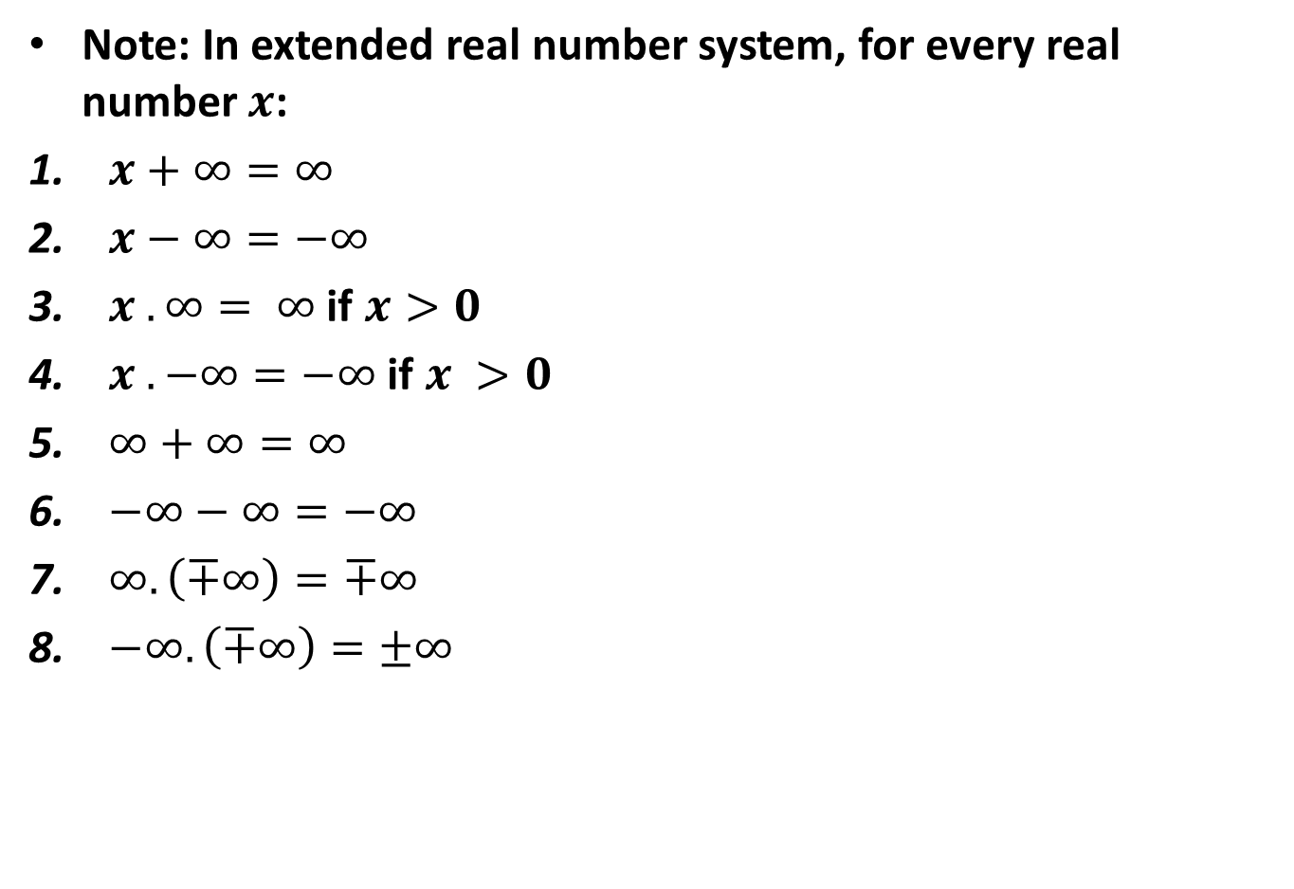
Note: In extended real number system, for every real number $x$:
$x+∞=∞$
$x−∞=−∞$
$x . ∞= ∞$ if $x>0$
$x . −∞=−∞$ if $x >0$
$∞+∞=∞$
$−∞−∞=−∞$
$∞.\left(∓∞\right)=∓∞$
$−∞.\left(∓∞\right)=±∞$

Slide 49
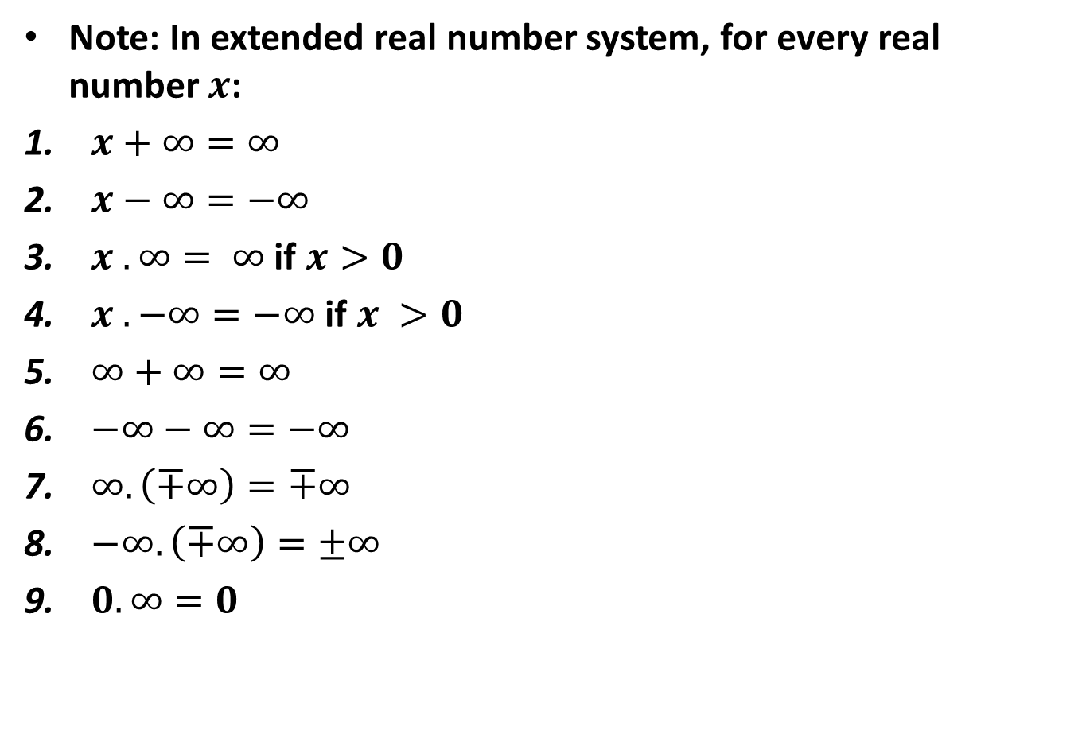
Note: In extended real number system, for every real number $x$:
$x+∞=∞$
$x−∞=−∞$
$x . ∞= ∞$ if $x>0$
$x . −∞=−∞$ if $x >0$
$∞+∞=∞$
$−∞−∞=−∞$
$∞.\left(∓∞\right)=∓∞$
$−∞.\left(∓∞\right)=±∞$
$0.∞=0$

Slide 50
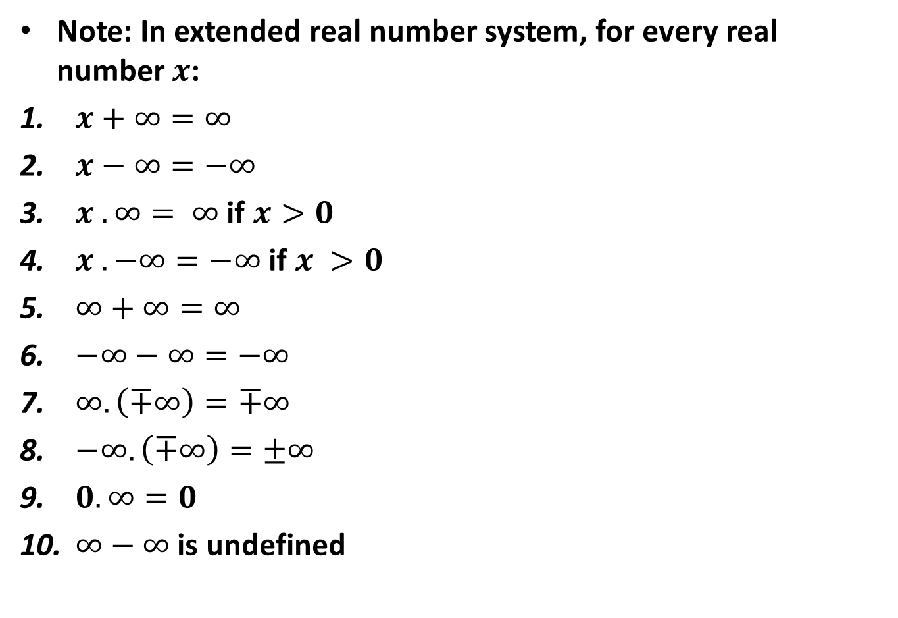
Note: In extended real number system, for every real number $x$:
$x+∞=∞$
$x−∞=−∞$
$x . ∞= ∞$ if $x>0$
$x . −∞=−∞$ if $x >0$
$∞+∞=∞$
$−∞−∞=−∞$
$∞.\left(∓∞\right)=∓∞$
$−∞.\left(∓∞\right)=±∞$
$0.∞=0$
$∞−∞$ is undefined

Slide 54
THANK YOU

