Slide 1
Real Analysis I
Course Code MTH 321
By
Dr. Moiz ud Din khan
Professor of Mathematics

Slide 2
Lecture # 12

Slide 3
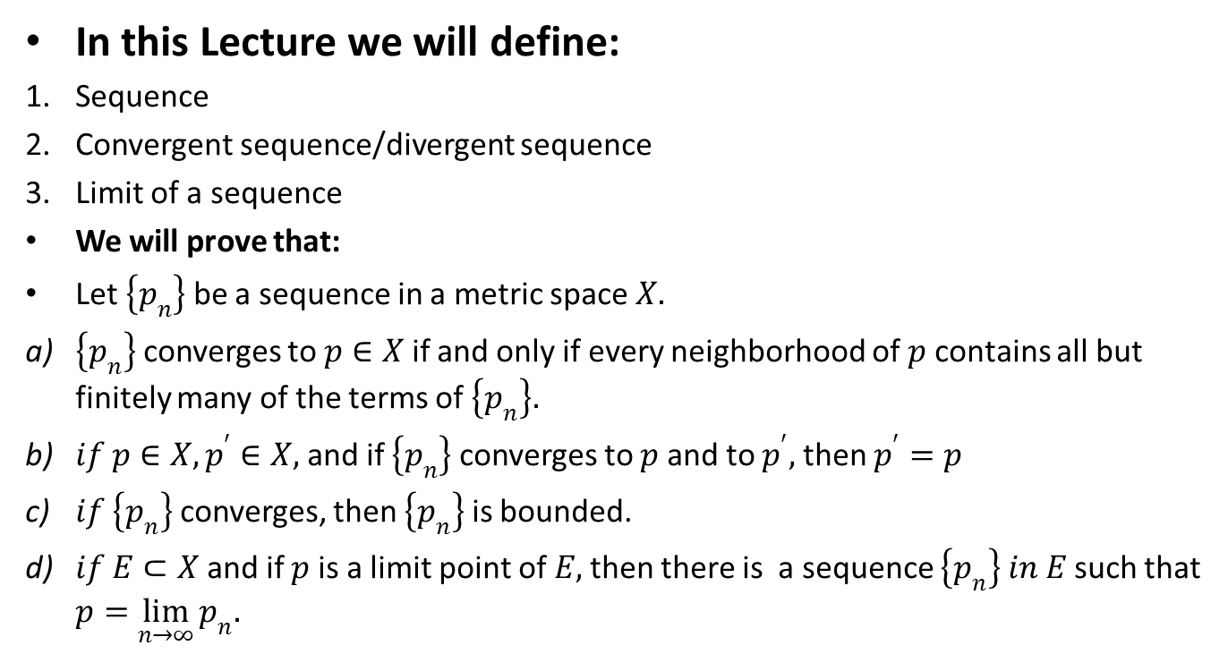
Lecture Outline
In this Lecture we will define:
Sequence
Convergent sequence/divergent sequence
Limit of a sequence
We will prove that:
Let $\left\{p_{n}\right\}$ be a sequence in a metric space $X.$
$\left\{p_{n}\right\}$ converges to $p∈X$ if and only if every neighborhood of $p$ contains all but finitely many of the terms of $\left\{p_{n}\right\}.$
$if p∈X, p^{′}∈X,$ and if $\left\{p_{n}\right\}$ converges to $p$ and to $p^{′},$ then $p^{′}=p$
$if \left\{p_{n}\right\}$ converges, then $\left\{p_{n}\right\}$ is bounded.
$if E⊂X$ and if $p$ is a limit point of $E,$ then there is a sequence $\left\{p_{n}\right\} in E$ such that $p=\lim_{n→∞}{p_{n}.}$

Slide 4
Sequence:

Slide 5
Definition: convergent Sequence

Slide 6

Definition: A sequence {$p_{n}$} in a metric space $(X,d)$ is said to converge

Slide 7

Definition: A sequence {$p_{n}$} in a metric space $(X,d)$ is said to converge
if there is a point $p∈X$ with the following property:

Slide 8

Definition: A sequence {$p_{n}$} in a metric space $(X,d)$ is said to converge
if there is a point $p∈X$ with the following property:
For every $ε>0$ there is an integer $N$ such that $n≥N$ implies that $d(p_{n},p)< ε$

Slide 9
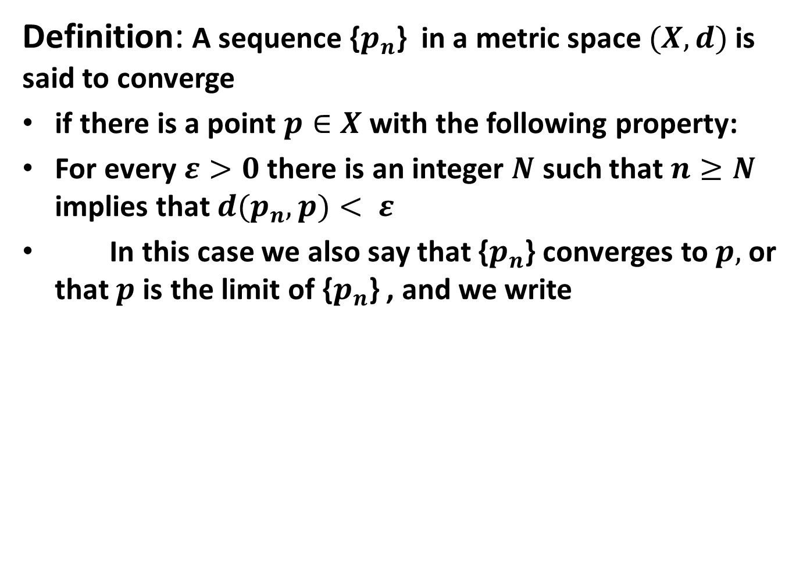
Definition: A sequence {$p_{n}$} in a metric space $(X,d)$ is said to converge
if there is a point $p∈X$ with the following property:
For every $ε>0$ there is an integer $N$ such that $n≥N$ implies that $d(p_{n},p)< ε$
In this case we also say that {$p_{n}$} converges to $p,$ or that $p$ is the limit of {$p_{n}$} , and we write

Slide 10
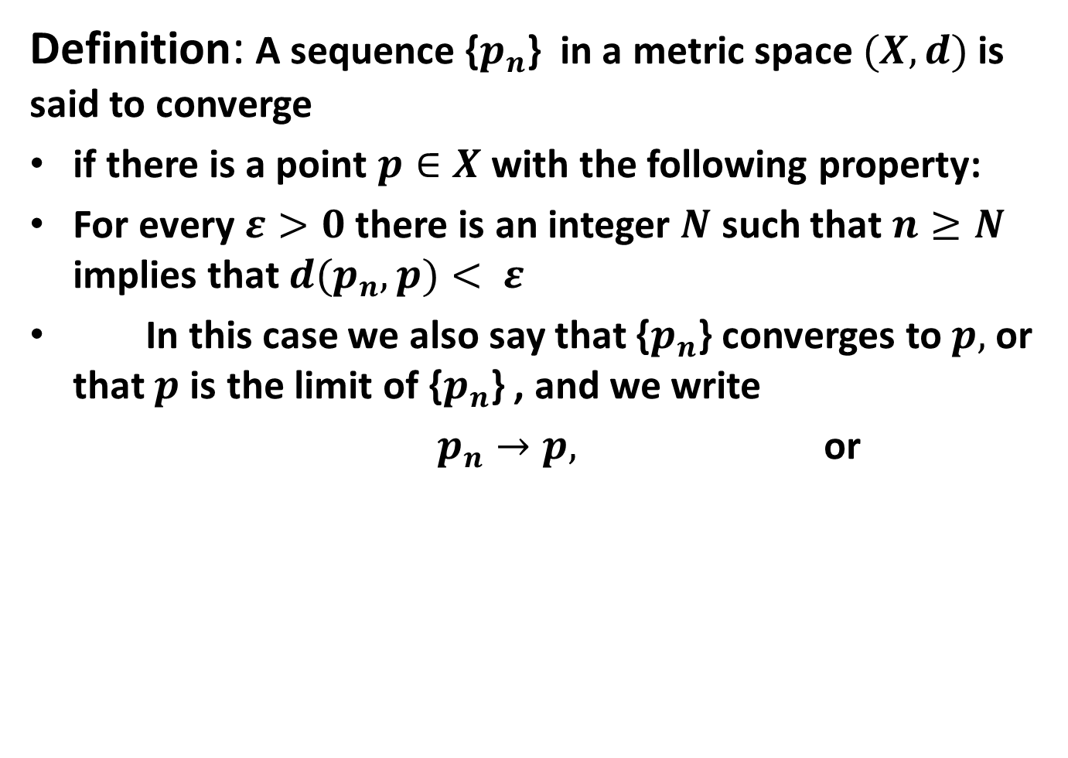
Definition: A sequence {$p_{n}$} in a metric space $(X,d)$ is said to converge
if there is a point $p∈X$ with the following property:
For every $ε>0$ there is an integer $N$ such that $n≥N$ implies that $d(p_{n},p)< ε$
In this case we also say that {$p_{n}$} converges to $p,$ or that $p$ is the limit of {$p_{n}$} , and we write
$p_{n}→p,$ or

Slide 11
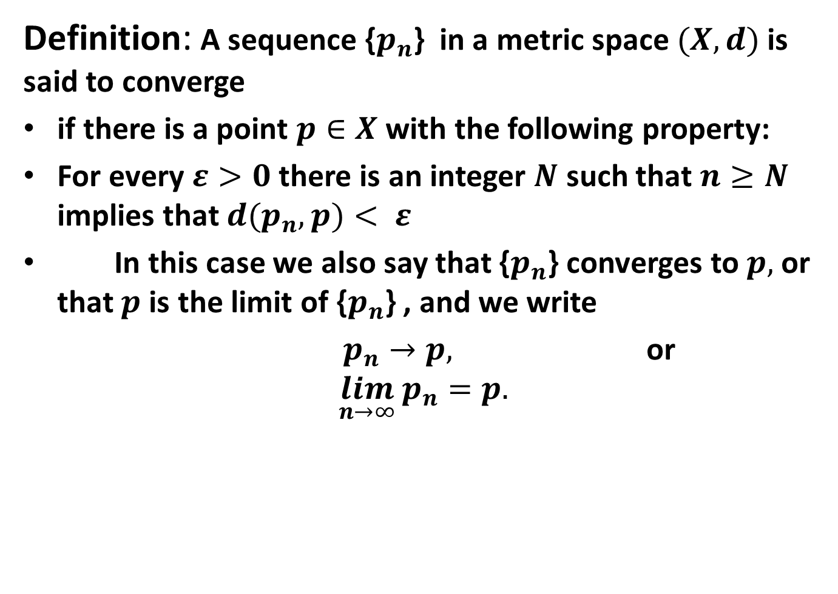
Definition: A sequence {$p_{n}$} in a metric space $(X,d)$ is said to converge
if there is a point $p∈X$ with the following property:
For every $ε>0$ there is an integer $N$ such that $n≥N$ implies that $d(p_{n},p)< ε$
In this case we also say that {$p_{n}$} converges to $p,$ or that $p$ is the limit of {$p_{n}$} , and we write
$p_{n}→p,$ or
$$\lim_{n→∞}{p_{n}=p.}$$

Slide 12
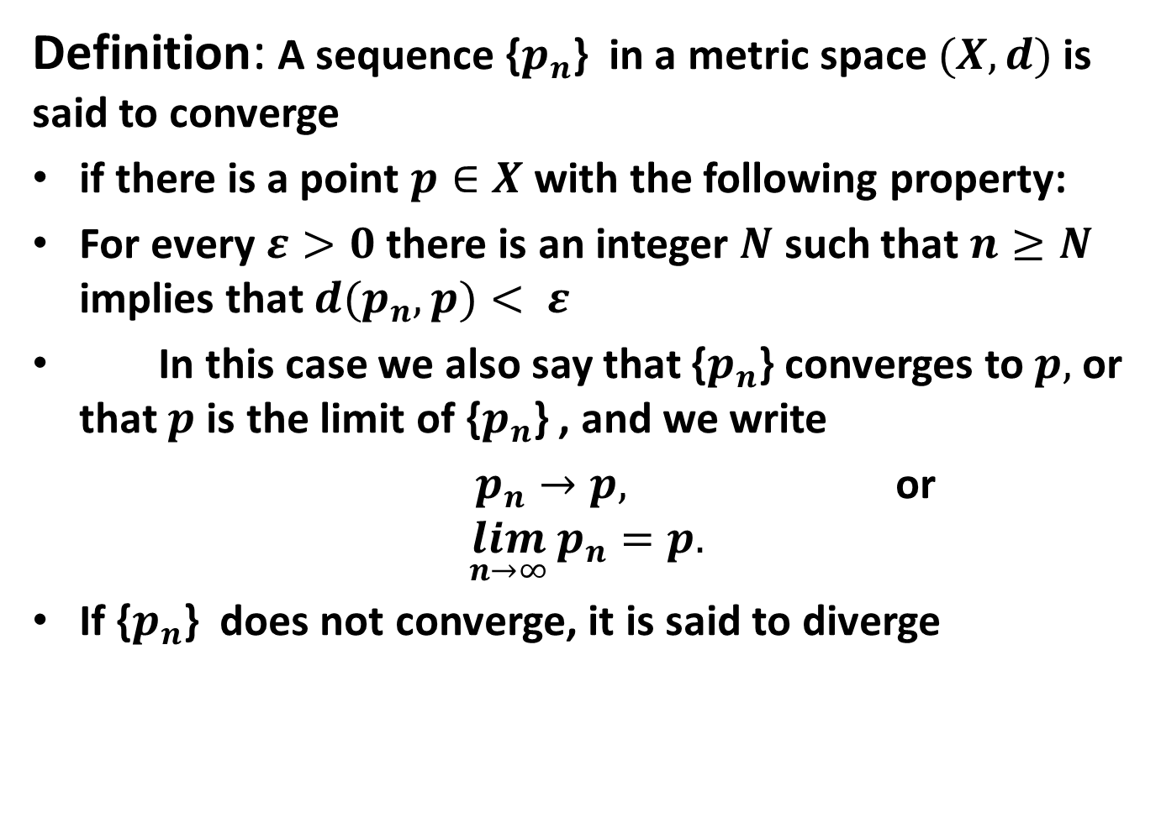
Definition: A sequence {$p_{n}$} in a metric space $(X,d)$ is said to converge
if there is a point $p∈X$ with the following property:
For every $ε>0$ there is an integer $N$ such that $n≥N$ implies that $d(p_{n},p)< ε$
In this case we also say that {$p_{n}$} converges to $p,$ or that $p$ is the limit of {$p_{n}$} , and we write
$p_{n}→p,$ or
$$\lim_{n→∞}{p_{n}=p.}$$
If {$p_{n}$} does not converge, it is said to diverge

Slide 13
Examples:

Slide 14

Examples:
$\left\{s_{n}\right\} = \{\frac{1}{n}\}$ ,

Slide 15

Examples:
$\left\{s_{n}\right\} = \{\frac{1}{n}\}$ ,
$\left\{s_{n}\right\} = \{n^{2}\}$

Slide 16

Examples:
$\left\{s_{n}\right\} = \{\frac{1}{n}\}$ ,
$\left\{s_{n}\right\} = \{n^{2}\}$
$\left\{s_{n}\right\} = 1 + \{\frac{{(−1)}^{n}}{n}\}$

Slide 17

Examples:
$\left\{s_{n}\right\} = \{\frac{1}{n}\}$ ,
$\left\{s_{n}\right\} = \{n^{2}\}$
$\left\{s_{n}\right\} = 1 + \{\frac{{(−1)}^{n}}{n}\}$
$\left\{s_{n}\right\} = \{i^{n}\}$

Slide 18

Examples:
$\left\{s_{n}\right\} = \{\frac{1}{n}\}$ ,
$\left\{s_{n}\right\} = \{n^{2}\}$
$\left\{s_{n}\right\} = 1 + \{\frac{{(−1)}^{n}}{n}\}$
$\left\{s_{n}\right\} = \{i^{n}\}$
$\left\{s_{n}\right\} = \{1\}$

Slide 20

Theorem. Let $\left\{p_{n}\right\}$ be a sequence in a metric space $X.$
$\left\{p_{n}\right\}$ converges to $p∈X$ if and only if every neighborhood of $p$ contains all but finitely many of the terms of $\left\{p_{n}\right\}.$
Proof.

Slide 25

Theorem. Let $\left\{p_{n}\right\}$ be a sequence in a metric space $(X,d).$ $if p∈X, p^{′}∈X,$ and if $\left\{p_{n}\right\}$ converges to $p$ and to $p^{′},$ then $p^{′}=p$
Proof.

Slide 30

Theorem. Let $\left\{p_{n}\right\}$ be a sequence in a metric space $X.$ $if \left\{p_{n}\right\}$ converges, then $\left\{p_{n}\right\}$ is bounded.
Proof.

Slide 34

Theorem. Let $\left\{p_{n}\right\}$ be a sequence in a metric space $X.$ If$E⊂X$ and if $p$ is a limit point of $E,$ then there is a sequence $\left\{p_{n}\right\} in E$ such that $p=\lim_{n→∞}{p_{n}.}$
Proof.

Slide 39
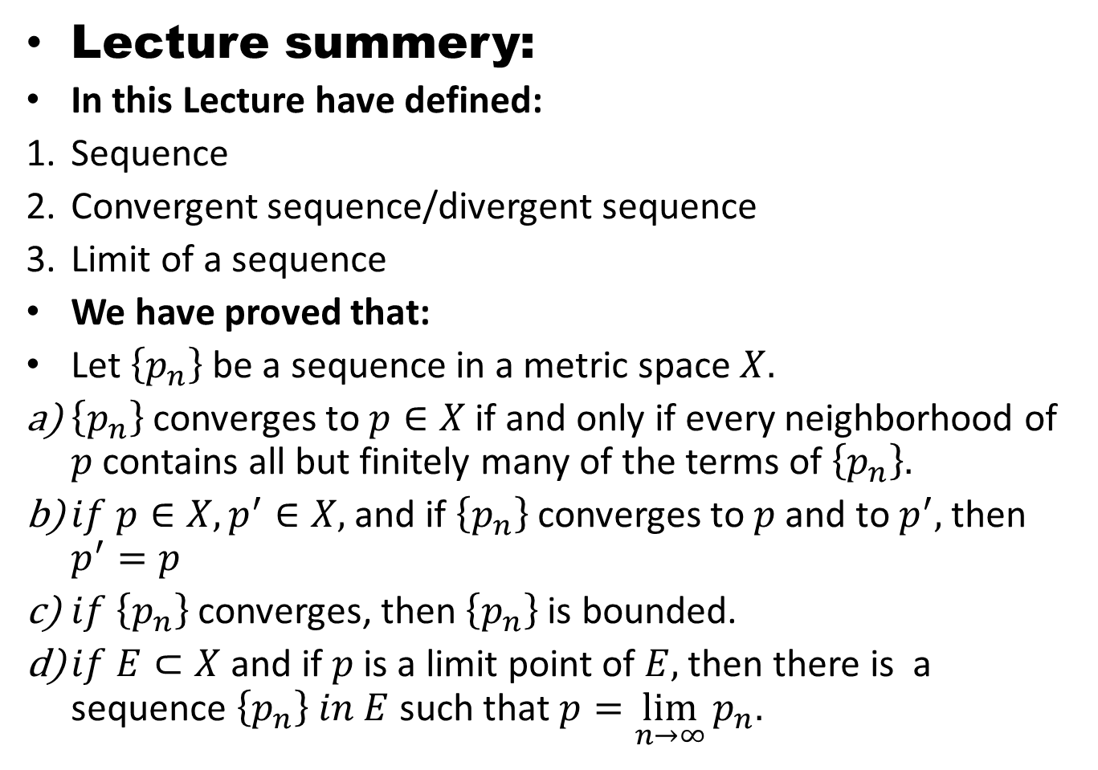
Lecture summery:
In this Lecture have defined:
Sequence
Convergent sequence/divergent sequence
Limit of a sequence
We have proved that:
Let $\left\{p_{n}\right\}$ be a sequence in a metric space $X.$
$\left\{p_{n}\right\}$ converges to $p∈X$ if and only if every neighborhood of $p$ contains all but finitely many of the terms of $\left\{p_{n}\right\}.$
$if p∈X, p^{′}∈X,$ and if $\left\{p_{n}\right\}$ converges to $p$ and to $p^{′},$ then $p^{′}=p$
$if \left\{p_{n}\right\}$ converges, then $\left\{p_{n}\right\}$ is bounded.
$if E⊂X$ and if $p$ is a limit point of $E,$ then there is a sequence $\left\{p_{n}\right\} in E$ such that $p=\lim_{n→∞}{p_{n}.}$

Slide 40
THANK YOU

