Slide 1
Real Analysis I
Course Code MTH 321
By
Dr. Moiz ud Din khan
Professor of Mathematics

Slide 2
Lecture # 13

Slide 3
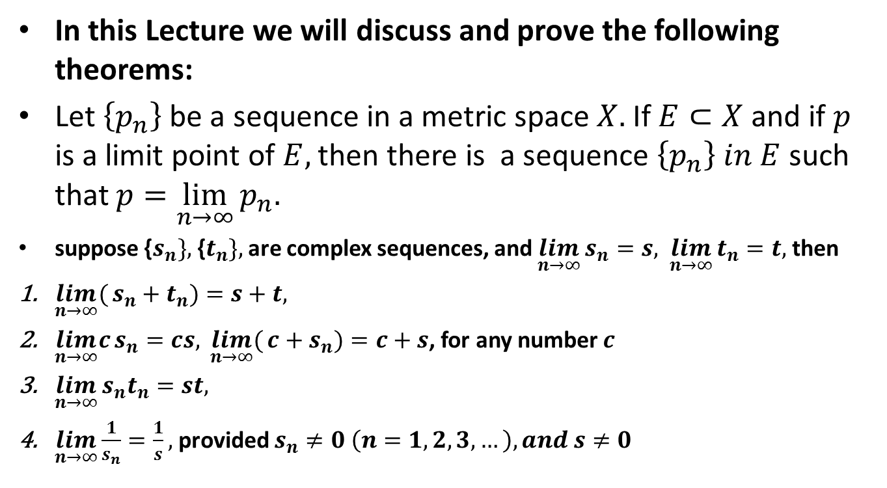
Lecture Outline
In this Lecture we will discuss and prove the following theorems:
Let $\left\{p_{n}\right\}$ be a sequence in a metric space $X.$ If$E⊂X$ and if $p$ is a limit point of $E,$ then there is a sequence $\left\{p_{n}\right\} in E$ such that $p=\lim_{n→∞}{p_{n}.}$
suppose {$s_{n}\},$ {$t_{n}\},$ are complex sequences, and $\lim_{n→∞}{s_{n}=s,}$$\lim_{n→∞}{t_{n}=t,}$ then
$\lim_{n→∞}({s_{n}+t_{n})=s+t,}$
$\lim_{n→∞}c{s_{n}=cs, }\lim_{n→∞}({{c+s}_{n})=c+s}$, for any number $c$
$\lim_{n→∞}{s_{n}t_{n}=st,}$
$\lim_{n→∞}\frac{1}{s_{n}}{=\frac{1}{s},}$ provided $s_{n}≠0 \left(n=1,2,3,…\right), and s≠0$

Slide 5

Theorem.Let $\left\{p_{n}\right\}$ be a sequence in a metric space $X.$ If$E⊂X$ and if $p$ is a limit point of $E,$ then there is a sequence $\left\{p_{n}\right\} in E$ such that $p=\lim_{n→∞}{p_{n}.}$
Proof.

Slide 11

Theorem.suppose {$s_{n}\},$ {$t_{n}\},$ are complex sequences, and $\lim_{n→∞}{s_{n}=s,}$$\lim_{n→∞}{t_{n}=t,}$then prove that $\lim_{n→∞}({s_{n}+t_{n})=s+t,}$
Proof.

Slide 16

Theorem. Suppose {$s_{n}\},$is a complex sequence, and $\lim_{n→∞}{s_{n}=s,}$ then
$\lim_{n→∞}c{s_{n}=cs, }$ for any number $c$
Proof.

Slide 19

Theorem. Suppose {$s_{n}\}$is complex sequence, and
$\lim_{n→∞}{s_{n}=s,}$then
$\lim_{n→∞}({{c+s}_{n})=c+s}$, for any number $c.$
Proof.

Slide 22

Theorem.Suppose {$s_{n}\},$ {$t_{n}\},$ are complex sequences, and $\lim_{n→∞}{s_{n}=s,}$$\lim_{n→∞}{t_{n}=t,}$ then
$$\lim_{n→∞}{s_{n}t_{n}=st.}$$
Proof.

Slide 27
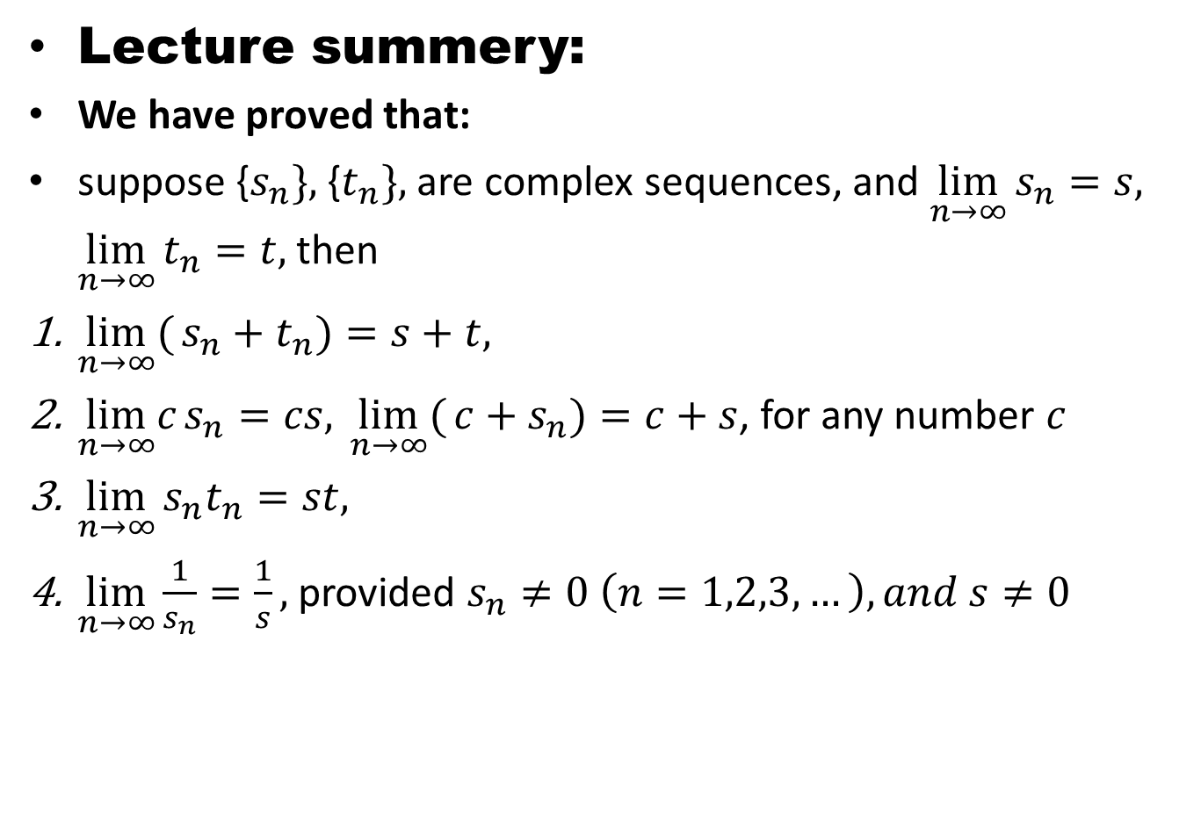
Lecture summery:
We have proved that:
suppose {$s_{n}\},$ {$t_{n}\},$ are complex sequences, and $\lim_{n→∞}{s_{n}=s,}$$\lim_{n→∞}{t_{n}=t,}$ then
$\lim_{n→∞}({s_{n}+t_{n})=s+t,}$
$\lim_{n→∞}c{s_{n}=cs, }\lim_{n→∞}({{c+s}_{n})=c+s}$, for any number $c$
$\lim_{n→∞}{s_{n}t_{n}=st,}$
$\lim_{n→∞}\frac{1}{s_{n}}{=\frac{1}{s},}$ provided $s_{n}≠0 \left(n=1,2,3,…\right), and s≠0$

Slide 28
THANK YOU

