Slide 1
Real Analysis I
Course Code MTH 321
By
Dr. Moiz ud Din khan
Professor of Mathematics

Slide 2
Lecture # 14

Slide 3
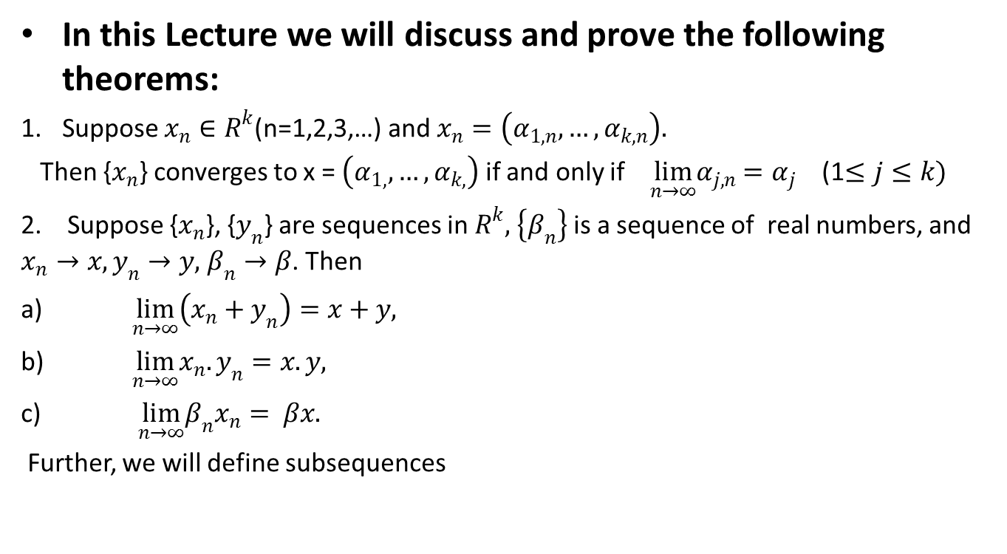
Lecture Outline
In this Lecture we will discuss and prove the following theorems:
Suppose $x_{n}∈R^{k}$(n=1,2,3,…) and $x_{n}=\left(α_{1,n},…,α_{k,n}\right).$
Then {$x_{n}$} converges to x = $\left(α_{1,},…,α_{k,}\right)$ if and only if $\lim_{n→∞}α_{j,n}$$=α_{j}$ (1$≤j≤k)$
2. Suppose {$x_{n}$},{$y_{n}$} are sequences in $R^{k},$$\left\{β_{n}\right\}$ is a sequence of real numbers, and $x_{n}→x, y_{n}→y,$$β_{n}→β$. Then
$\lim_{n→∞}\left(x_{n}+y_{n}\right)=x+y,$
$\lim_{n→∞}x_{n}.y_{n}=x.y,$
$\lim_{n→∞}β_{n}x_{n}= βx.$
Further, we will define subsequences

Slide 4

Theorem. Suppose {$s_{n}\},$is a complex sequence, and $\lim_{n→∞}{s_{n}=s,}$then
$\lim_{n→∞}\frac{1}{s_{n}}{=\frac{1}{s},}$
provided $s_{n}≠0 \left(n=1,2,3,…\right), and s≠0$
Proof.

Slide 9

Suppose $x_{n}∈R^{k}$ (n=1,2,3,…) and
$x_{n}=\left(α_{1,n},…,α_{k,n}\right).$
Then {$x_{n}$} converges to x = $\left(α_{1,},…,α_{k,}\right)$
if and only if
$\lim_{n→∞}α_{j,n}$$=α_{j}$ (1$≤j≤k)$
Discussion.

Slide 12

Theorem. Suppose $x_{n}∈R^{k}$ (n=1,2,3,…) and
$x_{n}=\left(α_{1,n},…,α_{k,n}\right).$
Then {$x_{n}$} converges to x = $\left(α_{1,},…,α_{k,}\right)$
if and only if
$\lim_{n→∞}α_{j,n}$$=α_{j}$ (1$≤j≤k)$
Proof.

Slide 17

Theorem. Suppose {$x_{n}$}, {$y_{n}$} are sequences in $R^{k},$
and
$x_{n}→x, y_{n}→y,$ Then
$\lim_{n→∞}\left(x_{n}+y_{n}\right)=x+y$
Proof.

Slide 21

Theorem. Suppose {$x_{n}$} is a sequence in $R^{k},$
$\left\{β_{n}\right\}$ is a sequence of real numbers, and
$x_{n}→x,$$β_{n}→β$. Then
$$\lim_{n→∞}β_{n}x_{n}= βx.$$
Proof.

Slide 25

Definition. Subsequence.
Given a sequence $\left\{p_{n}\right\}$, consider a sequence
$\left\{n_{k}\right\}$ of positive integers, such that $n_{1}<n_{2}<n_{3}<….$
Then the sequence $\left\{p_{nk}\right\}$ is called a subsequence of $\left\{p_{n}\right\}$.
Examples:

Slide 28
Lecture summery:
We have proved that:
Suppose $x_{n}∈R^{k}$(n=1,2,3,…) and $x_{n}=\left(α_{1,n},…,α_{k,n}\right).$
Then {$x_{n}$} converges to x = $\left(α_{1,},…,α_{k,}\right)$ if and only if $\lim_{n→∞}α_{j,n}$$=α_{j}$ (1$≤j≤k)$
2. Suppose {$x_{n}$}, {$y_{n}$} are sequences in $R^{k},$$\left\{β_{n}\right\}$ is a sequence of real numbers, and $x_{n}→x, y_{n}→y,$$β_{n}→β$. Then
$\lim_{n→∞}\left(x_{n}+y_{n}\right)=x+y,$
$\lim_{n→∞}x_{n}.y_{n}=x.y,$
$\lim_{n→∞}β_{n}x_{n}= βx.$
Further, we have defined subsequences.

Slide 29
THANK YOU

