Slide 1
Real Analysis I
Course Code MTH 321
By
Dr. Moiz ud Din khan
Professor of Mathematics

Slide 2
Lecture # 16

Slide 3
Lecture Outline
In this Lecture we will Define:
Continuity
Limit of a function.
Theorems on the limit of a function

Slide 4
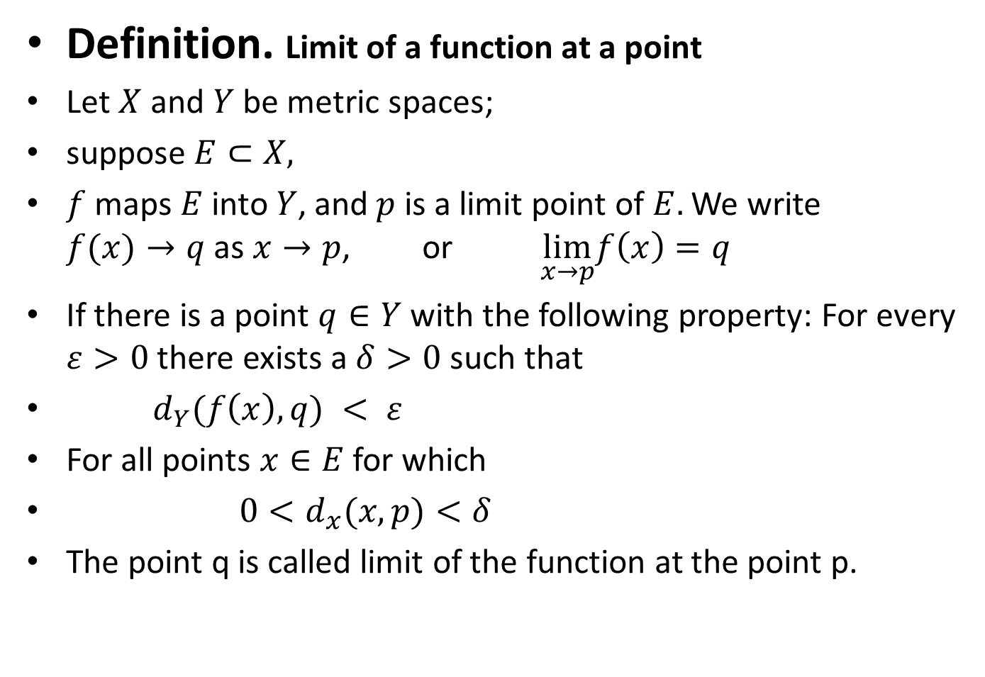
Definition. Limit of a function at a point
Let $X$ and $Y$ be metric spaces;
suppose $E⊂X,$
$f$maps $E$ into$Y$, and$p$ is a limit point of $E.$ We write $f(x)→q$ as $x→p$, or $\lim_{x→p}f\left(x\right)=q$
If there is a point $q∈Y$ with the following property: For every $ε>0$ there exists a $δ>0$ such that
${ d}_{Y}(f\left(x\right),q) < ε$
For all points $x∈E$ for which
$0<d_{x}(x,p)<δ$
The point q is called limit of the function at the point p.

Slide 7

Example.
$\lim_{x→0}f\left(x\right)=x$
$\lim_{x→0}f\left(x\right)=x^{2}$
$\lim_{x→0}f\left(x\right)=x^{3}$

Slide 15
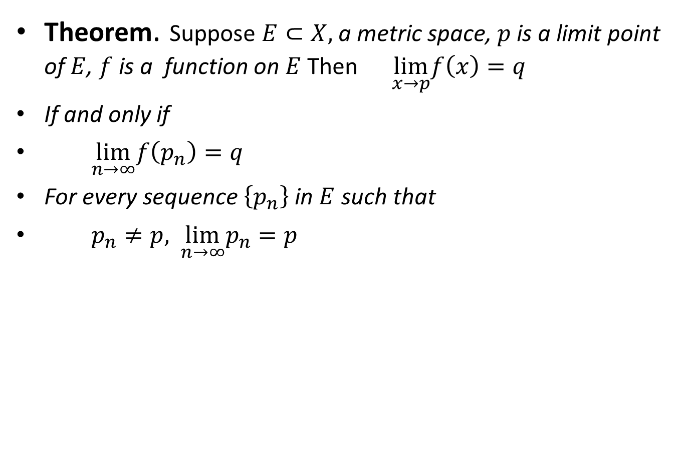
Theorem. Suppose $E⊂X,$a metric space, $p$ is a limit point of $E$, $f$is a function on $E$Then$\lim_{x→p}f\left(x\right)=q$
If and only if
$\lim_{n→∞}f\left(p_{n}\right)=q$
For every sequence $\left\{p_{n}\right\}$ in $E$ such that
$p_{n}≠p,$$\lim_{n→∞}p_{n}=p$

Slide 19

Corollary.If f has a limit at $p$,this limit is unique.

Slide 21

Theorem.Suppose $E⊂X,$a metric space, $p$ is a limit point of $E$, $f$ and $g$ are complex functions on $E,$ and
$\lim_{x→p}f\left(x\right)=A, \lim_{x→p}g\left(x\right)=B.$ Then
(a) $\lim_{x→p}\left(f+g\right)(x)=A+B$
Proof.

Slide 24

Theorem.Suppose $E⊂X,$a metric space, $p$ is a limit point of $E$, $f$ and $g$ are complex functions on $E,$ and
$\lim_{x→p}f\left(x\right)=A, \lim_{x→p}g\left(x\right)=B.$ Then
(b) $\lim_{x→p}(f(g\left(x\right))=AB;$
Proof.

Slide 27

Theorem.Suppose $E⊂X,$a metric space, $p$ is a limit point of $E$, $f$ and $g$ are complex functions on $E,$ and
$\lim_{x→p}f\left(x\right)=A, \lim_{x→p}g\left(x\right)=B.$ Then
(c) $\lim_{x→p}\left(\frac{f}{g}\right)\left(x\right)=\frac{A}{B}$, $if B≠0.$
Proof.

Slide 30
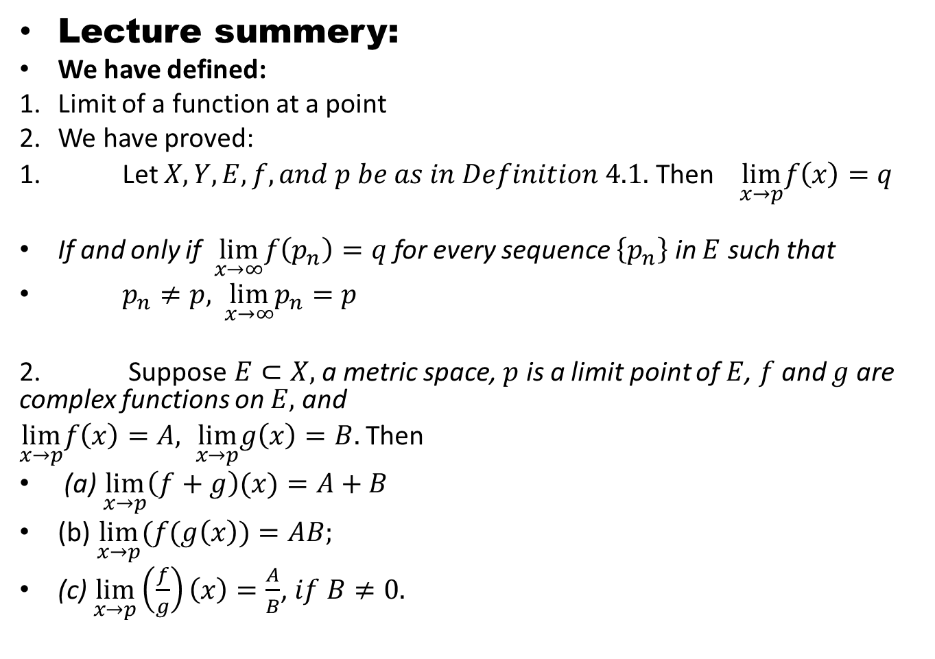
Lecture summery:
We have defined:
Limit of a function at a point
We have proved:
1. Let $X, Y, E,f, and p be as in Definition 4.1.$ Then $\lim_{x→p}f\left(x\right)=q$
If and only if $\lim_{x→∞}f\left(p_{n}\right)=q$ for every sequence $\left\{p_{n}\right\}$ in $E$ such that
$p_{n}≠p,$$\lim_{x→∞}p_{n}=p$
2. Suppose $E⊂X,$a metric space, $p$ is a limit point of $E$, $f$ and $g$ are complex functions on $E,$ and
$\lim_{x→p}f\left(x\right)=A, \lim_{x→p}g\left(x\right)=B.$ Then
(a) $\lim_{x→p}\left(f+g\right)(x)=A+B$
(b) $\lim_{x→p}(f(g\left(x\right))=AB;$
(c) $\lim_{x→p}\left(\frac{f}{g}\right)\left(x\right)=\frac{A}{B}$, $if B≠0.$

Slide 31
THANK YOU

