Slide 1
Real Analysis I
Course Code MTH 321
By
Dr. Moiz ud Din khan
Professor of Mathematics

Slide 2
Lecture # 18

Slide 3
Lecture Outline
In this Lecture we will Define:
Continuity of a function.
Theorems on continuity of a function

Slide 4
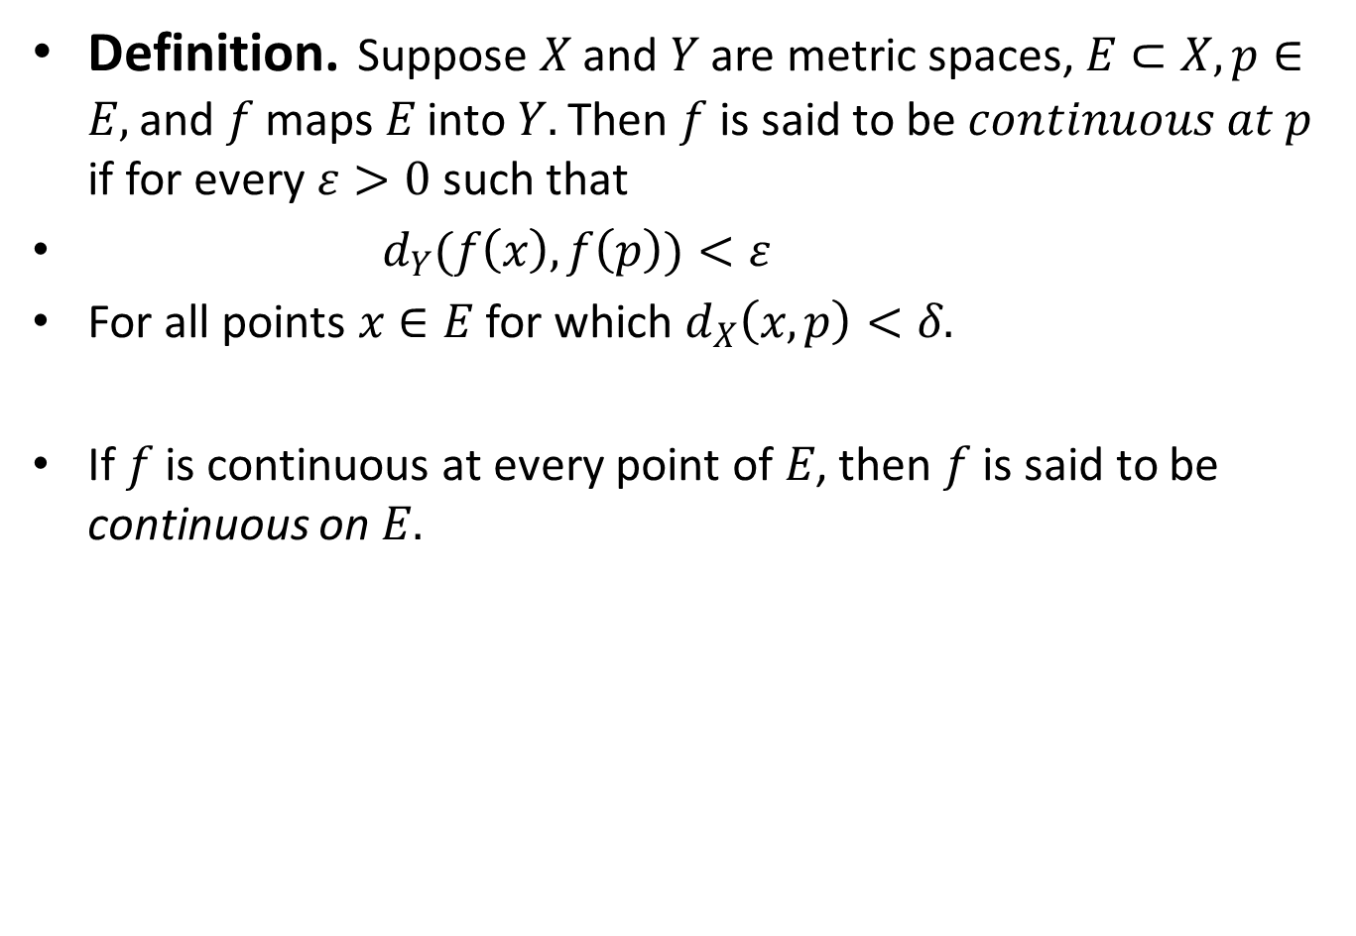
Definition.Suppose $X$ and $Y$ are metric spaces, $E⊂X,p∈E,$ and $f$ maps $E$ into $Y.$ Then $f$ is said to be $continuous at p$ if for every $ε>0$ such that
${ d}_{Y}(f\left(x\right),f\left(p\right))<ε$
For all points $x∈E$ for which $d_{X}\left(x,p\right)<δ.$
If $f$ is continuous at every point of $E$, then $f$ is said to be continuous on $E.$

Slide 9
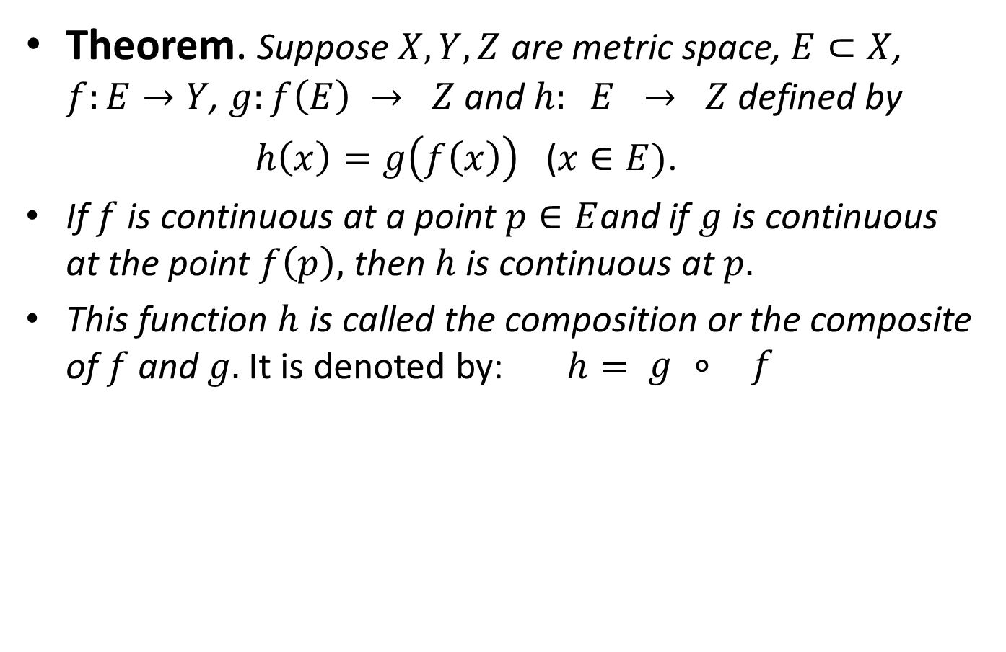
Theorem. Suppose $X,Y,Z$ are metric space, $E⊂X$, $f:E→Y$, $g:f\left(E\right) → Z$ and $h: E → Z$ defined by
$h\left(x\right)=g\left(f\left(x\right)\right)$($x∈E)$.
If $f$ is continuous at a point $p∈E$and if $g$ is continuous at the point $f\left(p\right),$ then $h$ is continuous at $p.$
This function $h$ is called the composition or the composite of $f$ and $g.$ It is denoted by:$h= \begin{matrix}g & ⃘ & f\end{matrix}$

Slide 14

Theorem.A mapping of a metric space $X$ into a metric space $Y$ is continuous on $X$ if and only if $f^{−1}(V)$ is open in $X$ for every open set $V$ in $Y.$

Slide 18
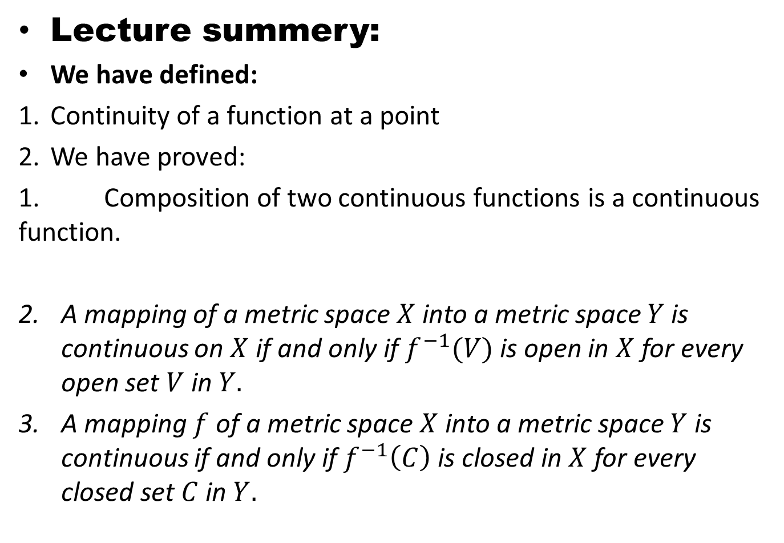
Lecture summery:
We have defined:
Continuity of a function at a point
We have proved:
1. Composition of two continuous functions is a continuous function.
A mapping of a metric space $X$ into a metric space $Y$ is continuous on $X$ if and only if $f^{−1}(V)$ is open in $X$ for every open set $V$ in $Y.$
A mapping $f$ of a metric space $X$ into a metric space $Y$ is continuous if and only if $f^{−1}\left(C\right)$ is closed in $X$ for every closed set $C$ in $Y.$

Slide 19
THANK YOU

