Slide 1
Real Analysis I
Course Code MTH 321
By
Dr. Moiz ud Din khan
Professor of Mathematics

Slide 2
Lecture # 19

Slide 3
Lecture Outline
In this Lecture we will Define:
Continuity of a function.
Theorems on continuity of a function

Slide 4

Theorem. Let $f$ and $g$ be complex continuous functions on a metric space $X.$ Then $f+g,fg,$ and $f/g$ are continuous on $X.$
Proof.

Slide 12

Definition. A mapping f of a set $E$ into $R^{k}$ is said to be bounded if there is a real number $M$ such that $\left|f\left(x\right)\right|≤M$ for all $x∈E.$

Slide 14

Theorem.Suppose $f$ is a continuous mapping of a compact metric space $X$ into a metric space $Y.$ Then $f\left(X\right)is compact.$

Slide 19

Theorem.Suppose $f$ is a continuous 1-1 mapping of a compact metric space $X$ onto a metric space $Y$. Then the inverse mapping $f^{−1}$ defined on $Y$ by
${ f}^{−1}\left(f\left(x\right)\right)=x$$(x∈X)$
is a continuous mapping of $Y$ onto $X.$
Proof.

Slide 25
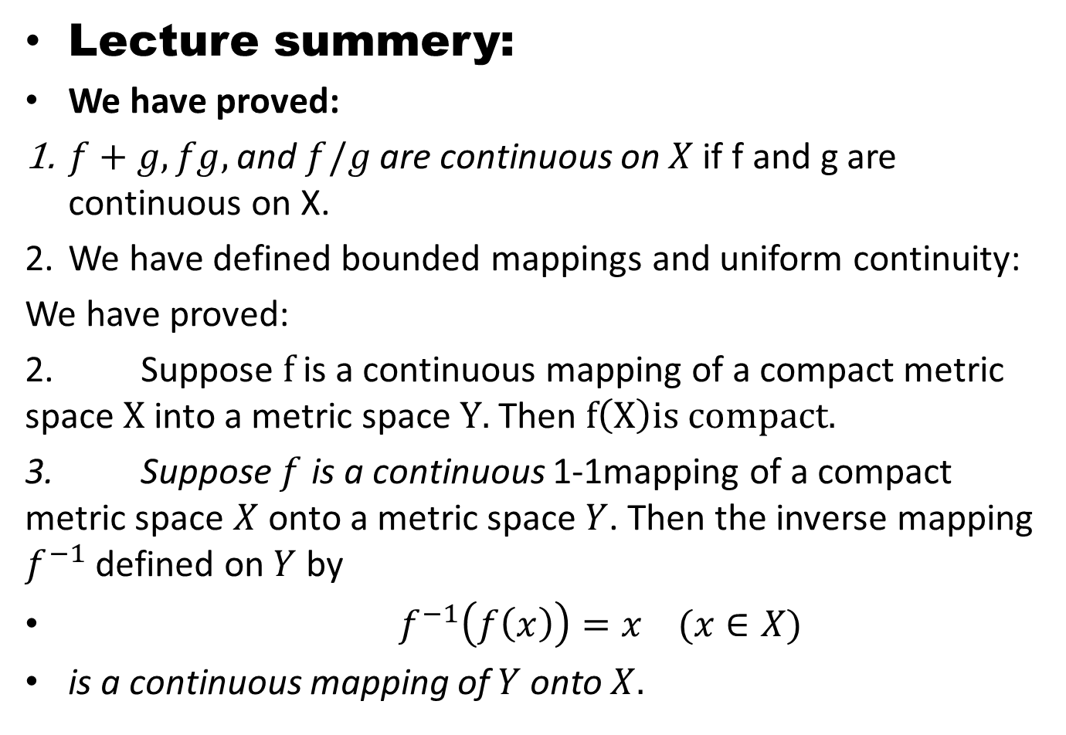
Lecture summery:
We have proved:
$f+g,fg,$ and $f/g$ are continuous on $X$if f and g are continuous on X.
We have defined bounded mappings and uniform continuity:
We have proved:
2. Suppose $f$ is a continuous mapping of a compact metric space $X$ into a metric space $Y.$ Then $f\left(X\right)is compact.$
3. Suppose $f$ is a continuous 1-1mapping of a compact metric space $X$ onto a metric space $Y$. Then the inverse mapping $f^{−1}$ defined on $Y$ by
${ f}^{−1}\left(f\left(x\right)\right)=x$$(x∈X)$
is a continuous mapping of $Y$ onto $X.$

Slide 26
THANK YOU

