Slide 1
Real Analysis I
Course Code MTH 321

Slide 2
Real Analysis I
Course Code MTH 321
By
Dr. Moiz ud Din khan
Professor of Mathematics

Slide 3
Lecture # 02

Slide 4
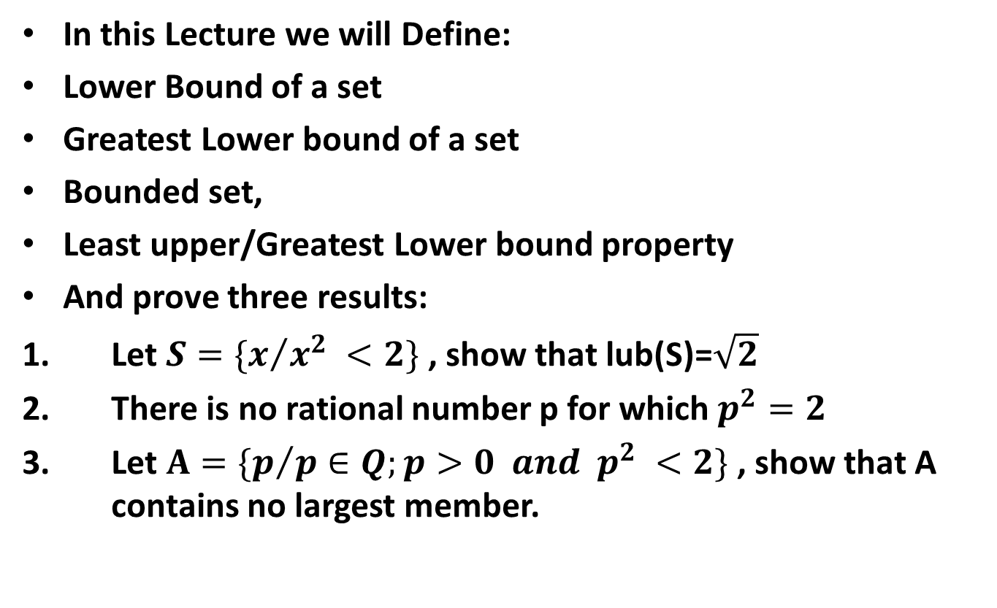
Lecture Outline
In this Lecture we will Define:
Lower Bound of a set
Greatest Lower bound of a set
Bounded set,
Least upper/Greatest Lower bound property
And prove three results:
Let $S=\{x/{x^{2}} <2\}$ , show that lub(S)=$\sqrt{2}$
There is no rational number p for which $p^{2}=2$
Let $A=\{p/{{p∈Q;p>0 and p}^{2}} <2\}$ , show that A contains no largest member.

Slide 5
Lower Bound of a Set:

Slide 6
Greatest Lower Bound of a Set:

Slide 7
Bounded Set:

Slide 8

Least Upper Bound Property of $ℝ$:

Slide 9

Greatest Lower Bound Property of $ℝ$.

Slide 11

Theorem.
Let $S=\{x/{x^{2}} <2\}$ , show that lub(S)=$\sqrt{2}$
Proof.

Slide 16

Theorem.
There is no rational number p for which $p^{2}=2$
Proof.

Slide 18

Theorem.Let $A=\{p/{{p∈Q;p>0 and p}^{2}} <2\}$ , show that A contains no largest member.
Proof.

Slide 24
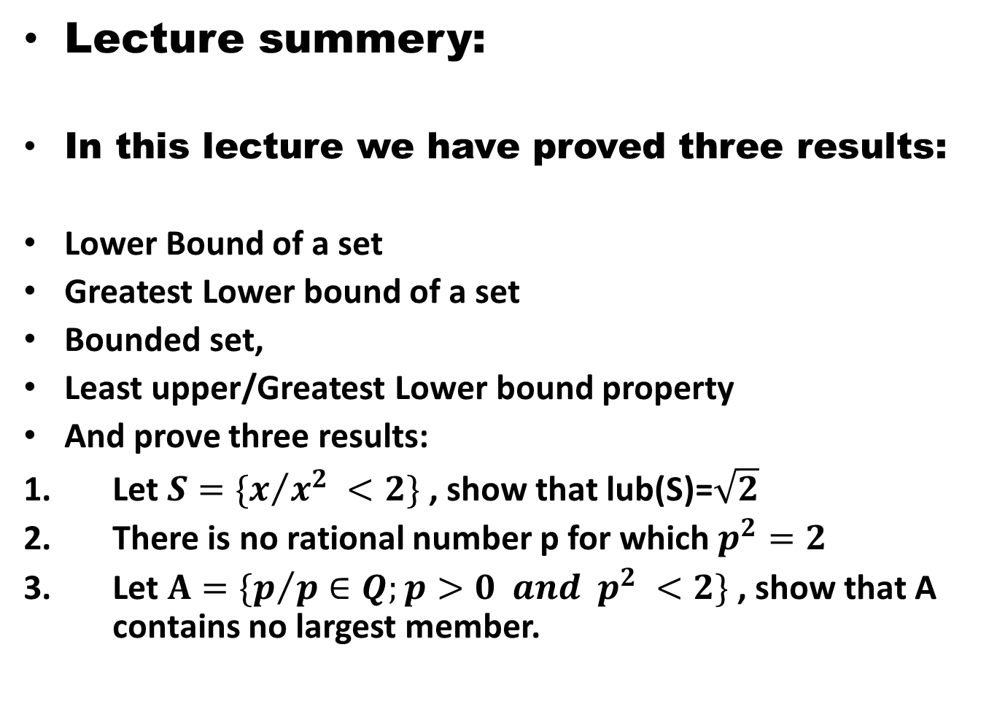
Lecture summery:
In this lecture we have proved three results:
Lower Bound of a set
Greatest Lower bound of a set
Bounded set,
Least upper/Greatest Lower bound property
And prove three results:
Let $S=\{x/{x^{2}} <2\}$ , show that lub(S)=$\sqrt{2}$
There is no rational number p for which $p^{2}=2$
Let $A=\{p/{{p∈Q;p>0 and p}^{2}} <2\}$ , show that A contains no largest member.

Slide 25
THANK YOU

