Slide 1
Real Analysis I
Course Code MTH 321
By
Dr. Moiz ud Din khan
Professor of Mathematics

Slide 2
Lecture # 20

Slide 3
Lecture Outline
In this Lecture we will study:
Discontinuity of a function.

Slide 4
Lecture Outline
In this Lecture we will study:
Discontinuity of a function.
We will define:

Slide 5
Lecture Outline
In this Lecture we will study:
Discontinuity of a function.
We will define:
Left handed limit of a function at a point

Slide 6
Lecture Outline
In this Lecture we will study:
Discontinuity of a function.
We will define:
Left handed limit of a function at a point
Right handed limit of a function at a point

Slide 7
Lecture Outline
In this Lecture we will study:
Discontinuity of a function.
We will define:
Left handed limit of a function at a point
Right handed limit of a function at a point
Discontinuity of first kind

Slide 8
Lecture Outline
In this Lecture we will study:
Discontinuity of a function.
We will define:
Left handed limit of a function at a point
Right handed limit of a function at a point
Discontinuity of first kind
Discontinuity of second kind

Slide 9
Lecture Outline
In this Lecture we will study:
Discontinuity of a function.
We will define:
Left handed limit of a function at a point
Right handed limit of a function at a point
Discontinuity of first kind
Discontinuity of second kind
And discuss

Slide 10
Lecture Outline
In this Lecture we will study:
Discontinuity of a function.
We will define:
Left handed limit of a function at a point
Right handed limit of a function at a point
Discontinuity of first kind
Discontinuity of second kind
And discuss
Some Examples on discontinuities of functions

Slide 11
Discontinuity of a function at a point:

Slide 12
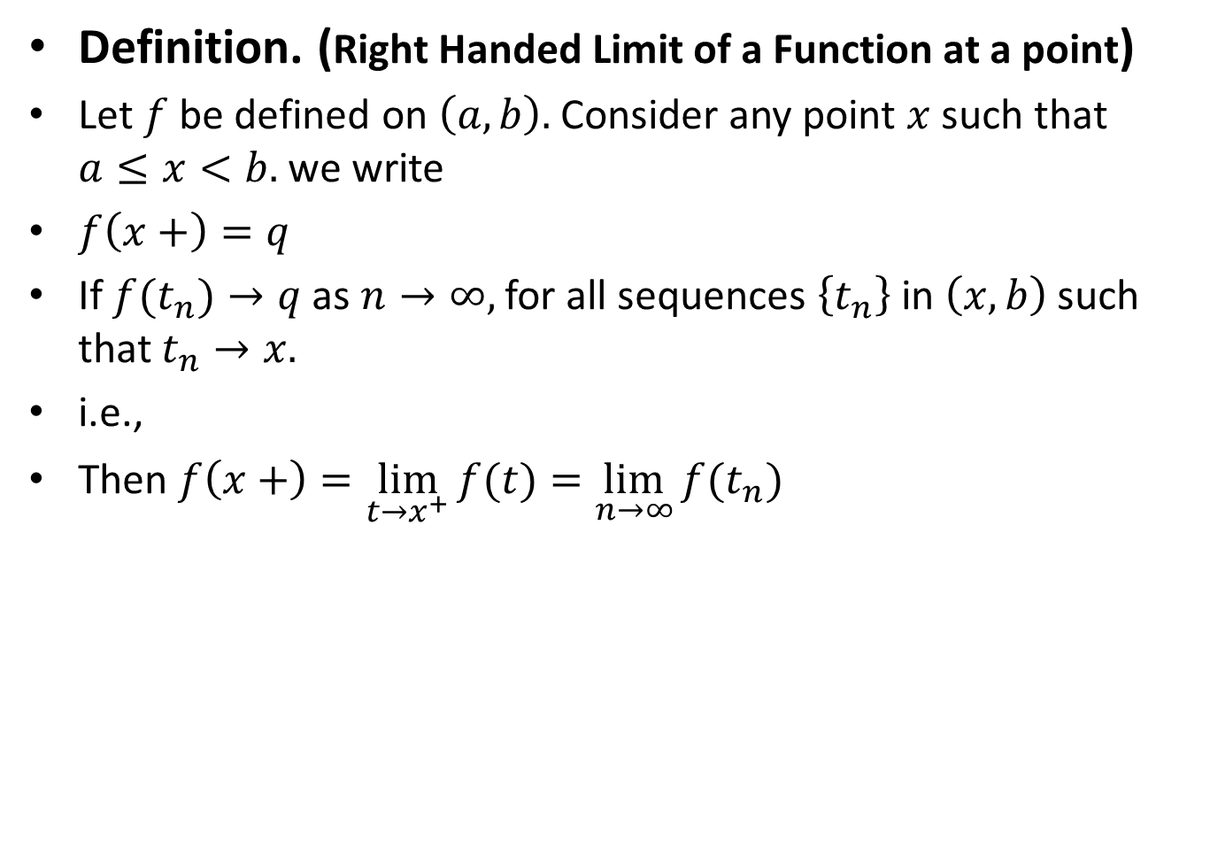
Definition. (Right Handed Limit of a Function at a point)
Let $f$ be defined on $\left(a,b\right).$ Consider any point $x$ such that $a≤x<b.$ we write
$f\left(x+\right)=q$
If $f(t_{n})→q$ as $n→∞,$ for all sequences $\left\{t_{n}\right\}$ in $\left(x,b\right)$such that $t_{n}→x.$
i.e.,
Then $f\left(x+\right)=\lim_{t→x^{+}}{f(t)}=\lim_{n→∞}{f(t_{n})}$

Slide 13
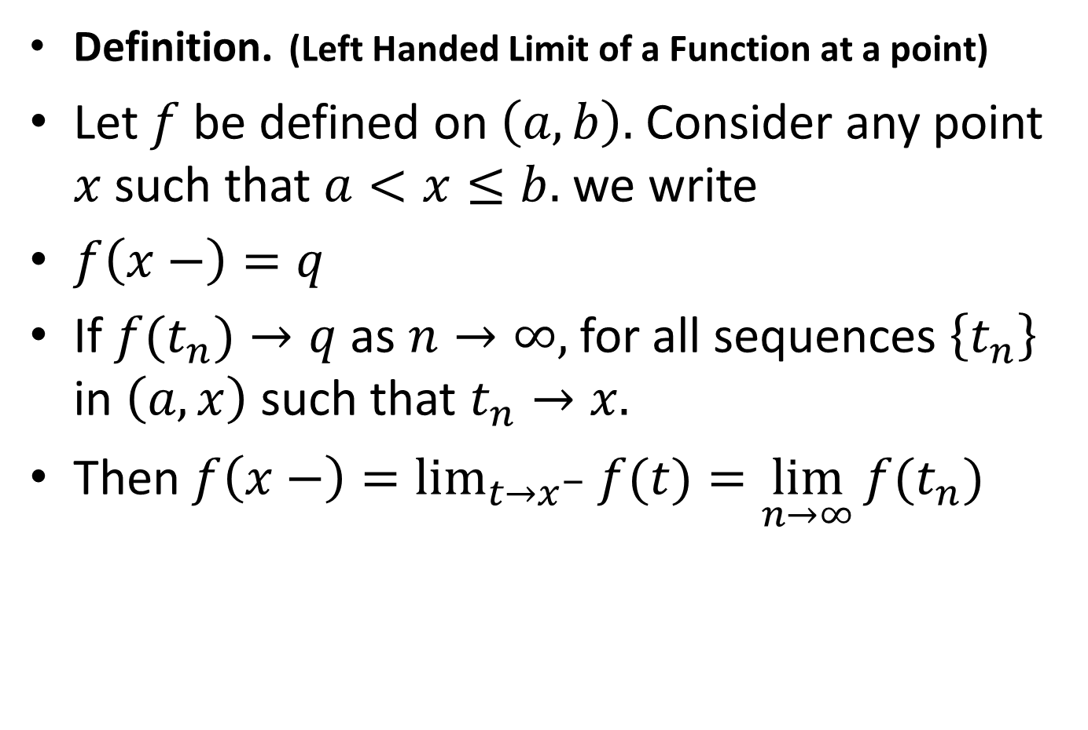
Definition.(Left Handed Limit of a Function at a point)
Let $f$ be defined on $\left(a,b\right).$ Consider any point $x$ such that $a<x≤b.$ we write
$f\left(x−\right)=q$
If $f(t_{n})→q$ as $n→∞,$ for all sequences $\left\{t_{n}\right\}$ in $\left(a,x\right)$ such that $t_{n}→x.$
Then $f\left(x−\right)=\lim_{t→x^{−}}{f(t)}=\lim_{n→∞}{f(t_{n})}$

Slide 14

It is clear that for any point $x$ of$\left(a,b\right)$,$\lim_{t→x} f(t)$ exists if and only if
$f\left(x+\right)= f\left(x−\right)=\lim_{t→x} f(t)$.

Slide 15

Definition. Let $f$ be defined on $\left(a,b\right).$
If $f$ is discontinuous at a point $x,$ and
if $f\left(x+\right)$ and $f\left(x−\right)$ exist,
then $f$ is said to have a discontinuity of the first kind, or a simple discontinuity, at $x$.
Otherwise the discontinuity is said to be of the second kind.

Slide 16

Note.
There are two ways in which a function can have a simple discontinuity:
either $f(x+)≠ f\left(x−\right)$
[in which case the value $f(x)$ is immaterial],
or
$f(x+)≠ f\left(x−\right)≠f(x)$.

Slide 17

Examples
$\left(a\right)$Define
$f\left(x\right)=\left\{\begin{aligned}1 , if x is rational \\ 0, if x is irrational\end{aligned}\right.$
Then $f$ has a discontinuity of the second kind at every point $x,$ since neither $f(x+)$ nor $f(x−)$ exists.

Slide 21

Example. $)$Define
$f\left(x\right)= \left\{\begin{matrix}x & \left(x rational\right), \\ 0 & (x irrational).\end{matrix}\right.$
Then $f$ is continuous at $x=0$ and has a discontinuity of the second kind at every other point.

Slide 25

Example. Define
$f\left(x\right)=\left\{\begin{matrix}x+2 & \left(−3<x<−2\right), \\ −x−2 & \left(−2≤x<0\right), \\ x+2 & \left(0≤x<1\right).\end{matrix}\right.$
Then $f$has a simple discontinuity at $x=0$ and is continuous at every other point of (-3, 1).

Slide 31
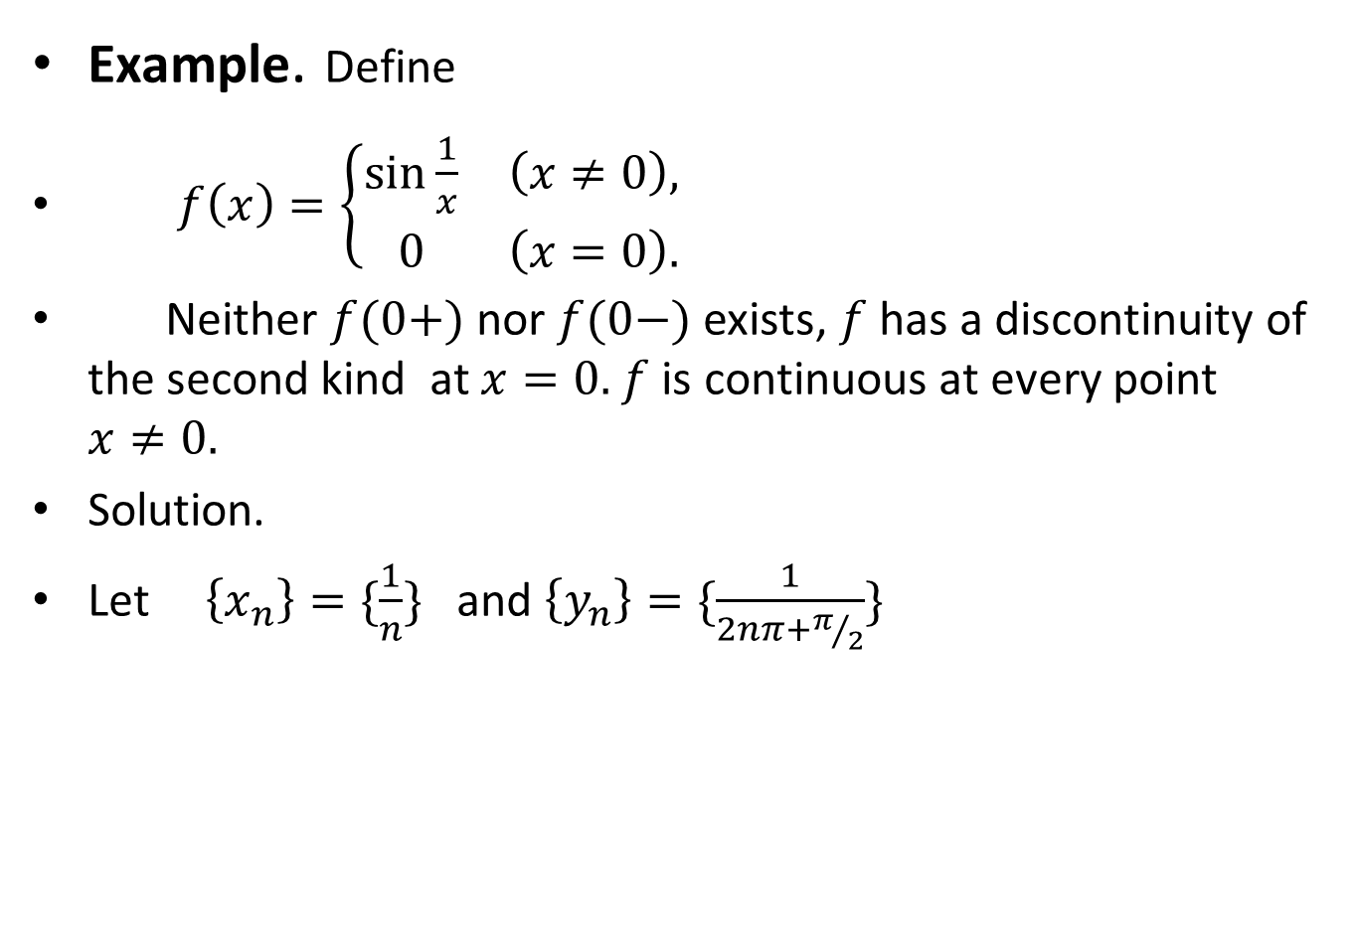
Example. Define
$f\left(x\right)=\left\{\begin{matrix}\sin{\frac{1}{x}} & \left(x≠0\right), \\ 0 & \left(x=0\right).\end{matrix}\right.$
Neither $f(0+)$ nor $f(0−)$ exists, $f$ has a discontinuity of the second kind at $x=0.$$f$ is continuous at every point $x≠0.$
Solution.
Let $\left\{x_{n}\right\}=\{\frac{1}{n}\}$ and $\left\{y_{n}\right\}=\{\frac{1}{2nπ+π/2}\}$

Slide 34

Example. Find $\lim_{x→1}{\frac{\left|x−1\right|}{x−1}}$

Slide 37

Example.Find $\lim_{x→0}{\frac{1+\left[x\right]}{1−\left[x\right]}}$
Where $\left[x\right]$ is the largest integer less then or equal to $x$.

Slide 40

Example:Examine the continuity of $f :\left[0,4\right] → ℝ$ defined by
$f\left(x\right)= \left\{\begin{aligned}x+1 ; for 0≤x≤1 \\ \left(x−1\right)\left(x−3\right); for 1<x≤3 \\ \frac{x−3}{2} ;for 3<x≤4\end{aligned}\right.$

Slide 44

Uniform continuous function.
A function $f:E→R$ is said to be uniformaly continuous if, for each $∈>0$, there is $δ>0$ such that $\left|f\left(x\right)−f(y)\right|<∈$ whenever $\left|x−y\right|<δ, x,yεE$

Slide 45
Lecture summery:
We have defined:
Left handed limit of a function at a point
Right handed limit of a function at a point
Discontinuity of first kind
Discontinuity of second kind
Some Examples on discontinuities of functions.

Slide 46
THANK YOU

