Slide 1
Real Analysis I
Course Code MTH 321
By
Dr. Moiz ud Din khan
Professor of Mathematics

Slide 2
Lecture # 21

Slide 3
Lecture Outline
In this Lecture we will initiate the study of differentiation:
We have defined:

Slide 4
Lecture Outline
In this Lecture we will initiate the study of differentiation:
We have defined:
Differentiable function

Slide 5
Lecture Outline
In this Lecture we will initiate the study of differentiation:
We have defined:
Differentiable function
We will proved that

Slide 6

Lecture Outline
In this Lecture we will initiate the study of differentiation:
We have defined:
Differentiable function
We will proved that
Let $f$ be defined on$\left[a, b\right]$. If $f$ is differentiable at a point $x∈\left[a, b\right],$ then $f$ is continuous at $x.$

Slide 7
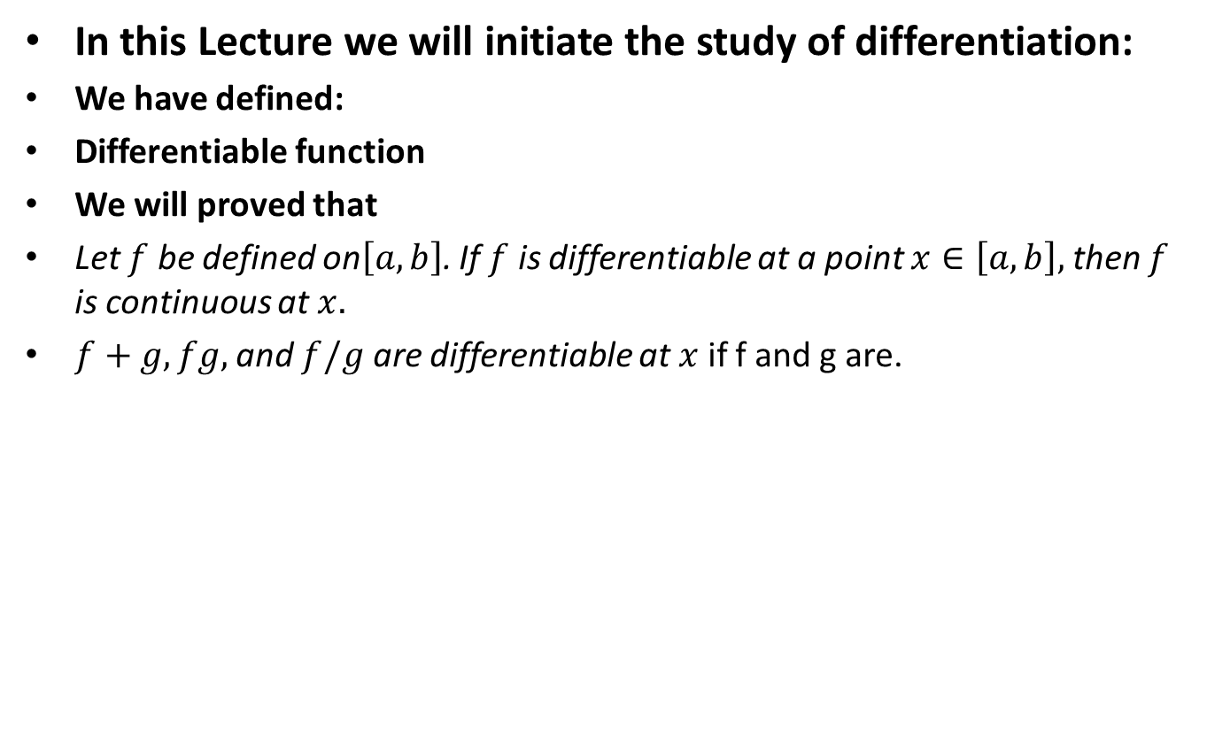
Lecture Outline
In this Lecture we will initiate the study of differentiation:
We have defined:
Differentiable function
We will proved that
Let $f$ be defined on$\left[a, b\right]$. If $f$ is differentiable at a point $x∈\left[a, b\right],$ then $f$ is continuous at $x.$
$f+g,fg,$ and $f/g$ are differentiable at $x$ if f and g are.

Slide 8
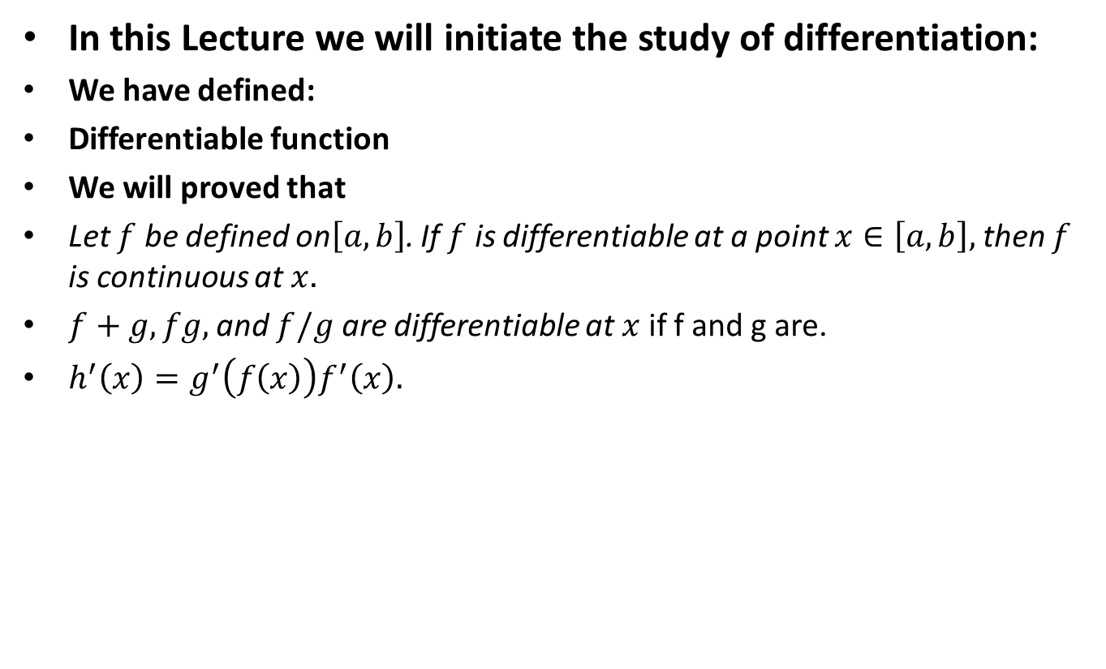
Lecture Outline
In this Lecture we will initiate the study of differentiation:
We have defined:
Differentiable function
We will proved that
Let $f$ be defined on$\left[a, b\right]$. If $f$ is differentiable at a point $x∈\left[a, b\right],$ then $f$ is continuous at $x.$
$f+g,fg,$ and $f/g$ are differentiable at $x$ if f and g are.
$h^{′}\left(x\right)=g^{′}\left(f\left(x\right)\right)f^{′}\left(x\right).$

Slide 9
Definition. Derivative of a function at a point.

Slide 10

Definition. Derivative of a function at a point.
Let $f$ be defined (and real-valued) on$\left[a, b\right]$.

Slide 11

Definition. Derivative of a function at a point.
Let $f$ be defined (and real-valued) on$\left[a, b\right]$.
For any $x∈\left[a, b\right]$. Form the quotient

Slide 12

Definition. Derivative of a function at a point.
Let $f$ be defined (and real-valued) on$\left[a, b\right]$.
For any $x∈\left[a, b\right]$. Form the quotient
(1) $φ\left(t\right)=\frac{f\left(t\right)−f(x)}{t−x}$ $\left(a<t<b,t≠x\right),$

Slide 13

Definition. Derivative of a function at a point.
Let $f$ be defined (and real-valued) on$\left[a, b\right]$.
For any $x∈\left[a, b\right]$. Form the quotient
(1) $φ\left(t\right)=\frac{f\left(t\right)−f(x)}{t−x}$ $\left(a<t<b,t≠x\right),$
and define

Slide 14
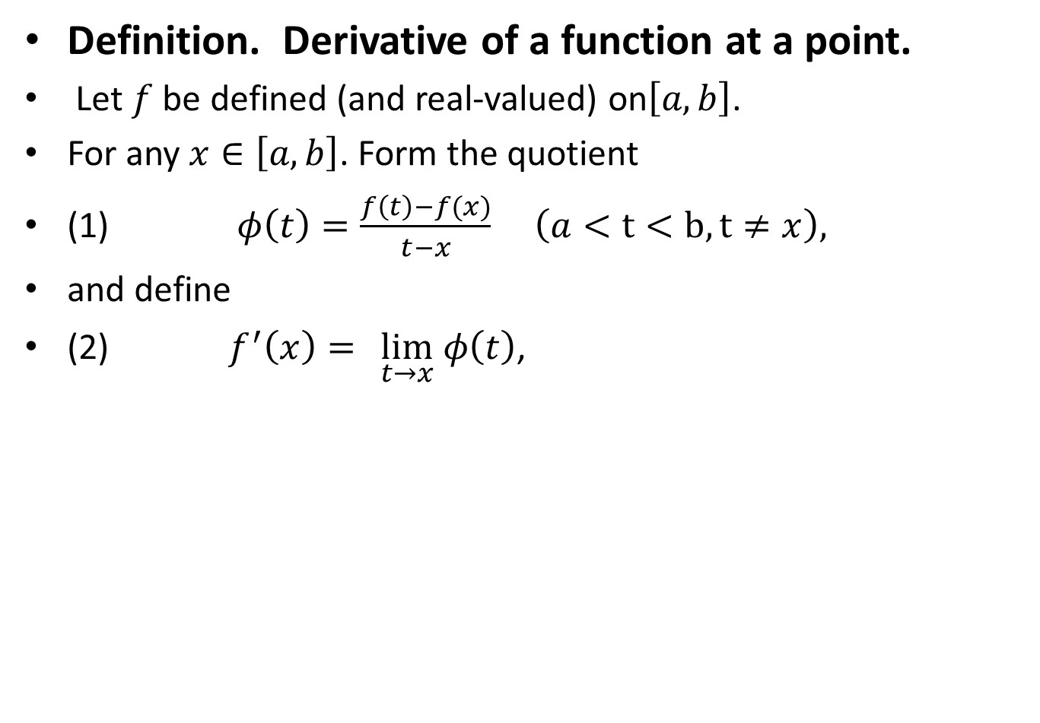
Definition. Derivative of a function at a point.
Let $f$ be defined (and real-valued) on$\left[a, b\right]$.
For any $x∈\left[a, b\right]$. Form the quotient
(1) $φ\left(t\right)=\frac{f\left(t\right)−f(x)}{t−x}$ $\left(a<t<b,t≠x\right),$
and define
(2) $f^{′}\left(x\right)=$ $\lim_{t→x} φ\left(t\right)$,

Slide 15
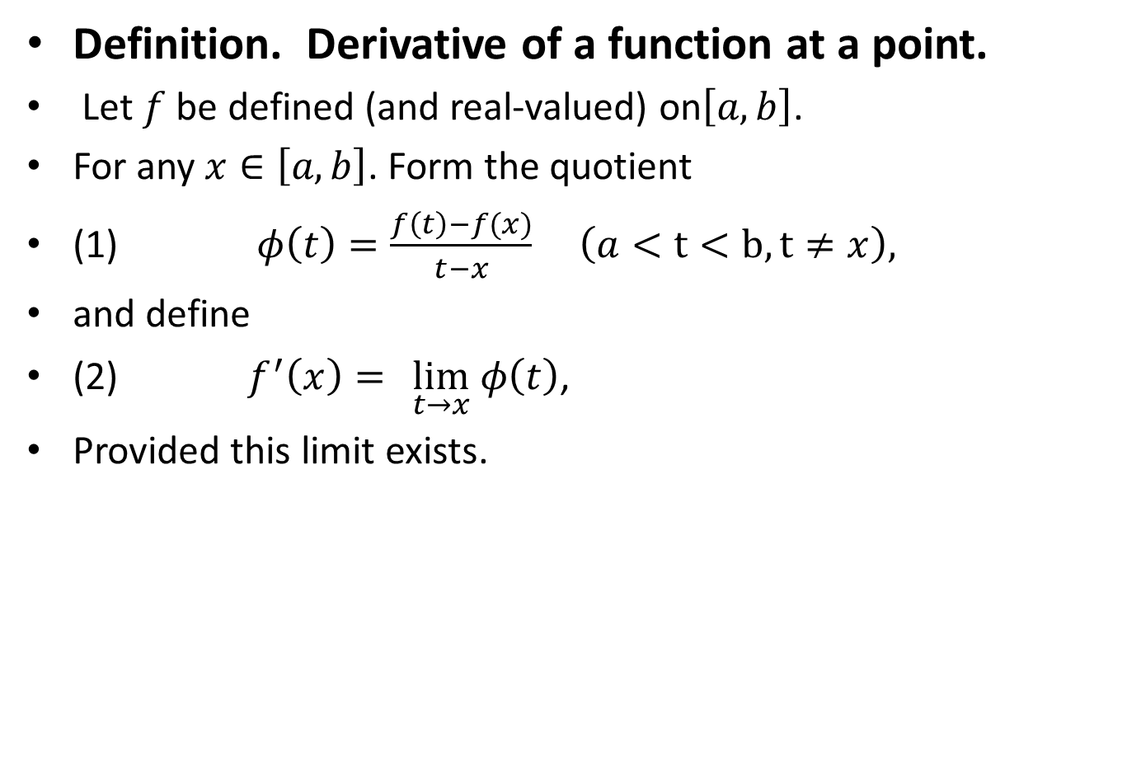
Definition. Derivative of a function at a point.
Let $f$ be defined (and real-valued) on$\left[a, b\right]$.
For any $x∈\left[a, b\right]$. Form the quotient
(1) $φ\left(t\right)=\frac{f\left(t\right)−f(x)}{t−x}$ $\left(a<t<b,t≠x\right),$
and define
(2) $f^{′}\left(x\right)=$ $\lim_{t→x} φ\left(t\right)$,
Provided this limit exists.

Slide 16
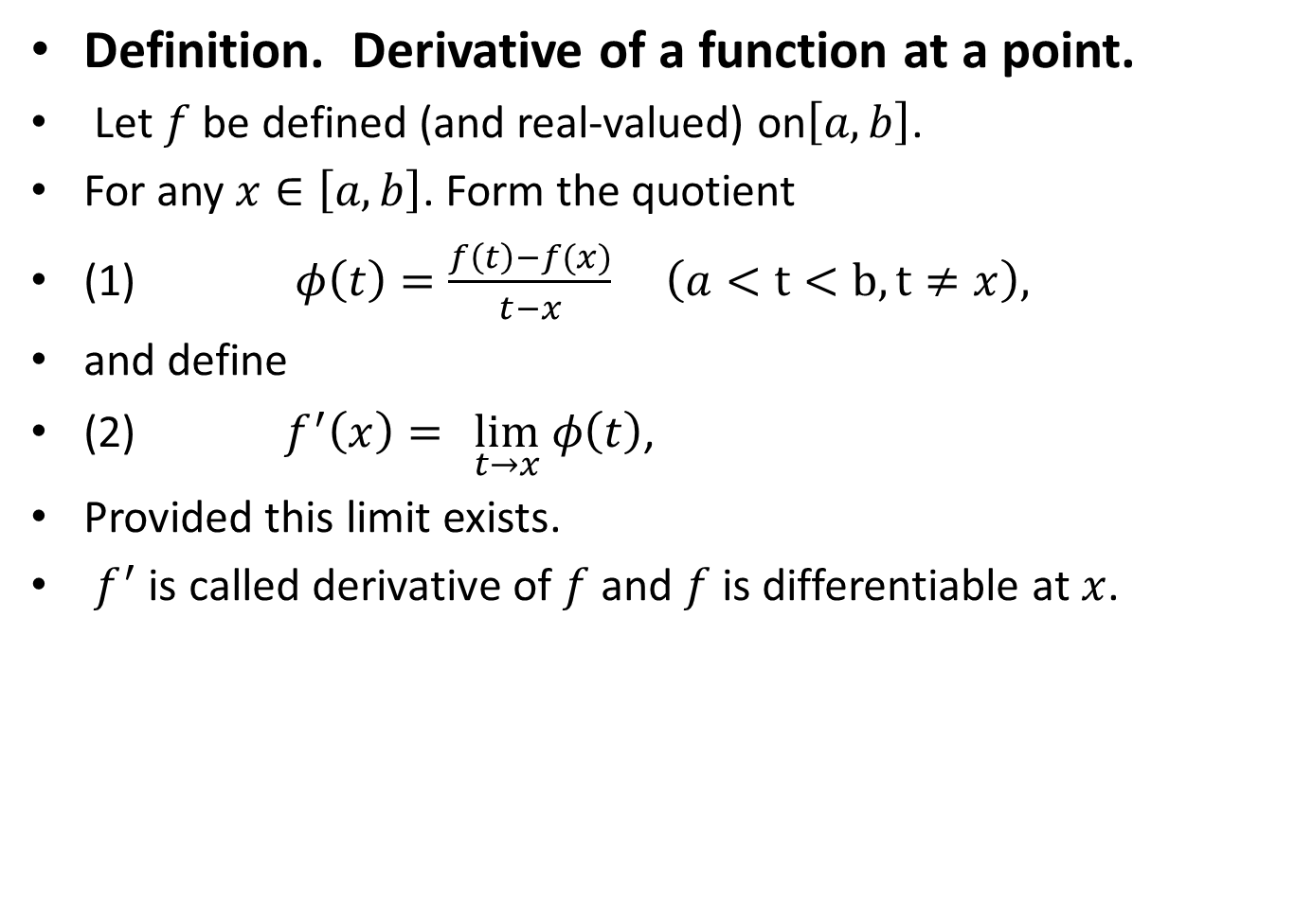
Definition. Derivative of a function at a point.
Let $f$ be defined (and real-valued) on$\left[a, b\right]$.
For any $x∈\left[a, b\right]$. Form the quotient
(1) $φ\left(t\right)=\frac{f\left(t\right)−f(x)}{t−x}$ $\left(a<t<b,t≠x\right),$
and define
(2) $f^{′}\left(x\right)=$ $\lim_{t→x} φ\left(t\right)$,
Provided this limit exists.
$f^{′}$ is called derivative of $f$ and $f$ is differentiable at $x$.

Slide 17
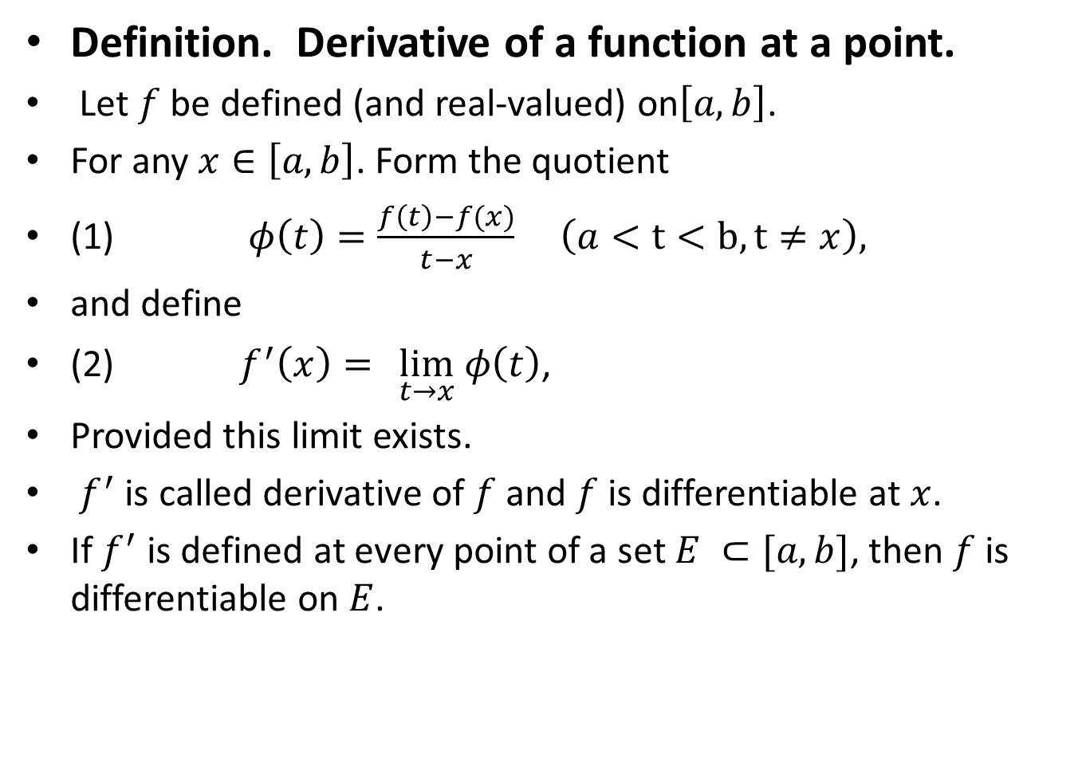
Definition. Derivative of a function at a point.
Let $f$ be defined (and real-valued) on$\left[a, b\right]$.
For any $x∈\left[a, b\right]$. Form the quotient
(1) $φ\left(t\right)=\frac{f\left(t\right)−f(x)}{t−x}$ $\left(a<t<b,t≠x\right),$
and define
(2) $f^{′}\left(x\right)=$ $\lim_{t→x} φ\left(t\right)$,
Provided this limit exists.
$f^{′}$ is called derivative of $f$ and $f$ is differentiable at $x$.
If $f^{′}$ is defined at every point of a set $E ⊂[a,b]$, then $f$ is differentiable on $E$.

Slide 18

Left Handed Derivative.
Let $f:\left[a,b\right] → R.$
If $a≤x≤b$, then left handed derivative at $x$ is
${f′}_{_}^{}\left(x\right)=\lim_{t→x^{_}}{\frac{f\left(t\right)−f(x)}{t−x}}$
provided this limit exists.

Slide 19

Right Handed Derivative.
Let $f:\left[a,b\right] → R.$
If $a≤x≤b$, then right handed derivative at $x$ is
${f′}_{+}^{}\left(x\right)=\lim_{t→x+}{\frac{f\left(t\right)−f(x)}{t−x}}$
provided this limit exists.

Slide 20

Theorem. Let $f$ be defined on$\left[a, b\right]$. If $f$ is differentiable at a point $x∈\left[a, b\right],$ then $f$ is continuous at $x.$
Proof.

Slide 26

Theorem. Suppose $f$ and $g$ are defined on $\left[a, b\right]$ and are differentiable at $a$ point $x∈\left[a, b\right].$

Slide 27

Theorem. Suppose $f$ and $g$ are defined on $\left[a, b\right]$ and are differentiable at $a$ point $x∈\left[a, b\right].$
Then $f+g,fg,$ and $f/g$ are differentiable at $x,$ and

Slide 28

Theorem. Suppose $f$ and $g$ are defined on $\left[a, b\right]$ and are differentiable at $a$ point $x∈\left[a, b\right].$
Then $f+g,fg,$ and $f/g$ are differentiable at $x,$ and
${\left(f+g\right)}^{′}\left(x\right)=f^{′}\left(x\right)+g^{′}(x)$

Slide 29
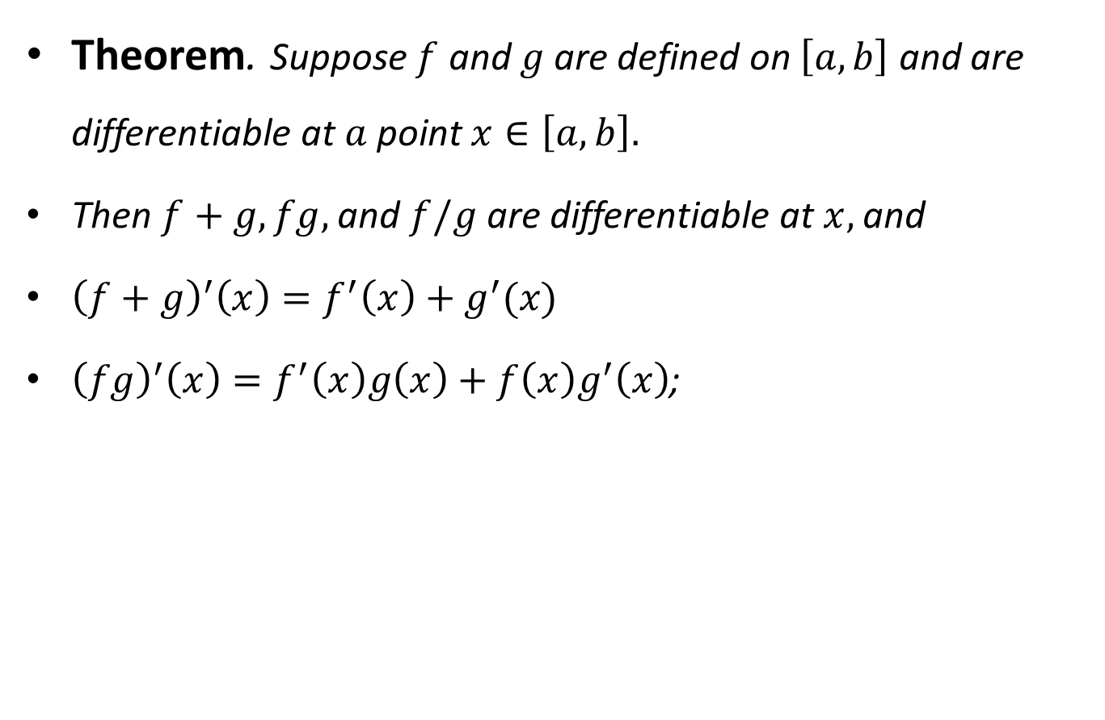
Theorem. Suppose $f$ and $g$ are defined on $\left[a, b\right]$ and are differentiable at $a$ point $x∈\left[a, b\right].$
Then $f+g,fg,$ and $f/g$ are differentiable at $x,$ and
${\left(f+g\right)}^{′}\left(x\right)=f^{′}\left(x\right)+g^{′}(x)$
${\left(fg\right)}^{′}\left(x\right)=f^{′}\left(x\right)g\left(x\right)+f\left(x\right)g^{′}\left(x\right)$;

Slide 30
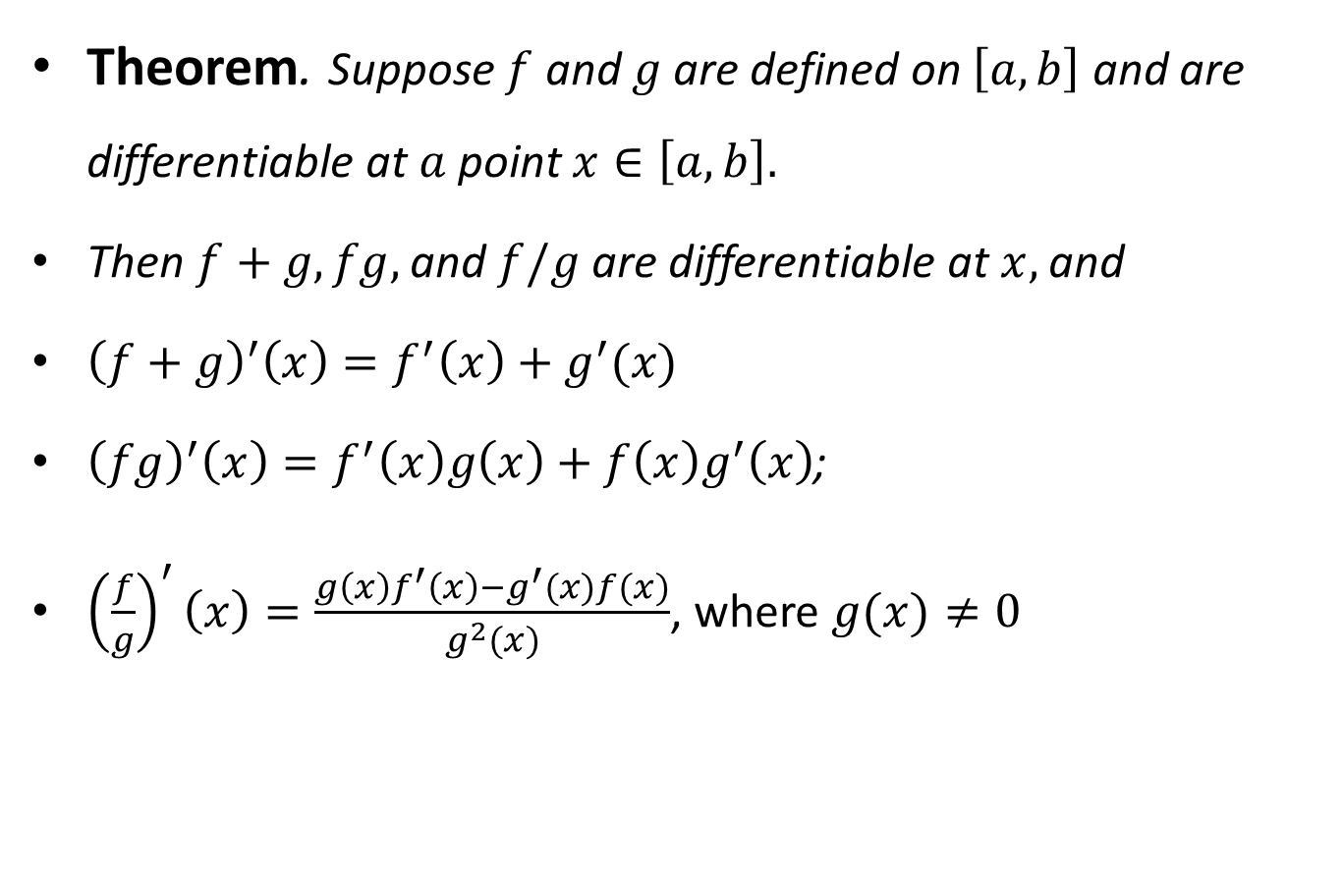
Theorem. Suppose $f$ and $g$ are defined on $\left[a, b\right]$ and are differentiable at $a$ point $x∈\left[a, b\right].$
Then $f+g,fg,$ and $f/g$ are differentiable at $x,$ and
${\left(f+g\right)}^{′}\left(x\right)=f^{′}\left(x\right)+g^{′}(x)$
${\left(fg\right)}^{′}\left(x\right)=f^{′}\left(x\right)g\left(x\right)+f\left(x\right)g^{′}\left(x\right)$;
${\left(\frac{f}{g}\right)}^{′}\left(x\right)=\frac{g\left(x\right)f^{′}\left(x\right)−g^{′}(x)f(x)}{g^{2}(x)}$, where $g(x)≠0$

Slide 31

Theorem. Suppose $f$ and $g$ are defined on $\left[a, b\right]$ and are differentiable at $a$ point $x∈\left[a, b\right].$
Then $f+g,$ is differentiable at $x,$ and
${\left(f+g\right)}^{′}\left(x\right)=f^{′}\left(x\right)+g^{′}(x)$
Proof.

Slide 36
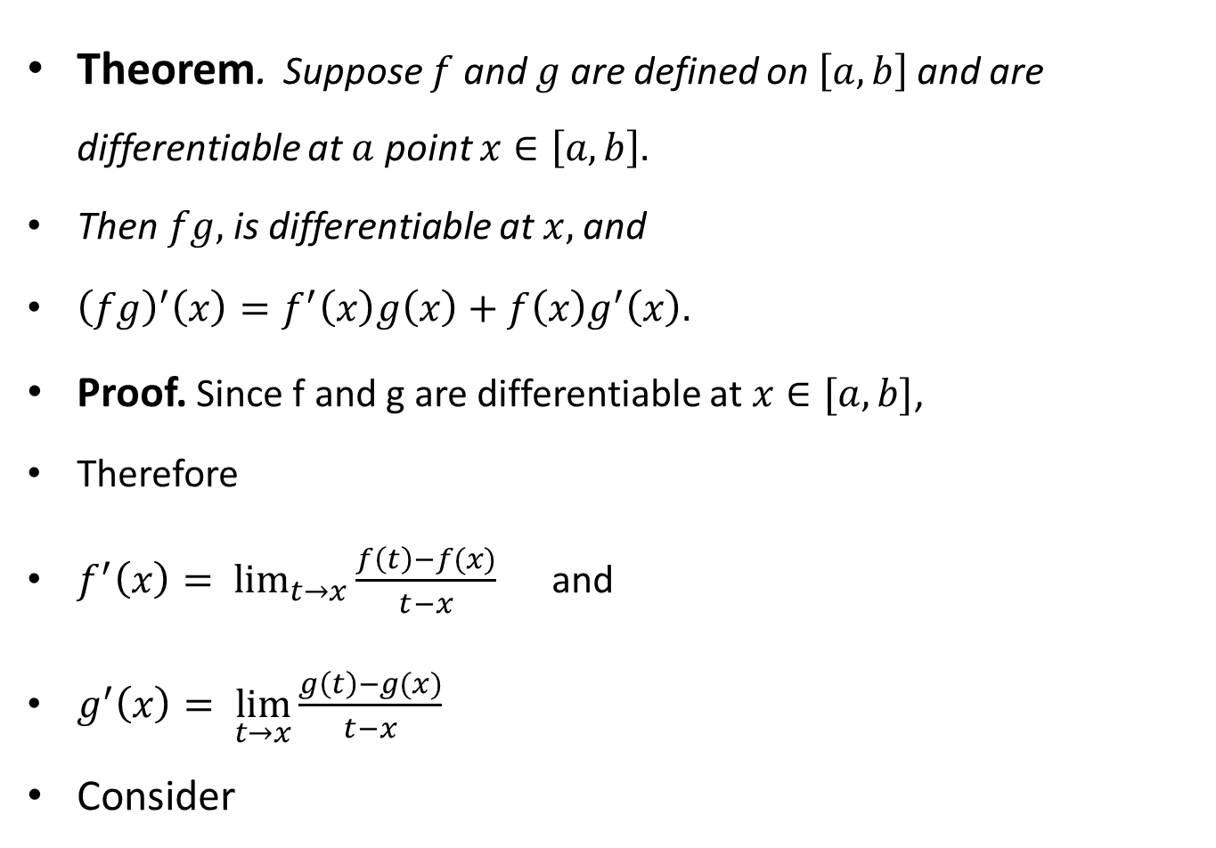
Theorem. Suppose $f$ and $g$ are defined on $\left[a, b\right]$ and are differentiable at $a$ point $x∈\left[a, b\right].$
Then $fg,$ is differentiable at $x,$ and
${\left(fg\right)}^{′}\left(x\right)=f^{′}\left(x\right)g\left(x\right)+f\left(x\right)g^{′}\left(x\right).$
Proof. Since f and g are differentiable at $x∈[a,b]$,
Therefore
$f^{′}\left(x\right)= \lim_{t→x}{\frac{f\left(t\right)−f(x)}{t−x}}$ and
$g^{′}\left(x\right)= \lim_{t→x}{\frac{g\left(t\right)−g(x)}{t−x}}$
Consider

Slide 37

$\frac{\left(fg\right)\left(t\right)−\left(fg\right)\left(x\right) }{t−x}$ =$\frac{f\left(t\right)g\left(t\right)−f\left(x\right)g\left(x\right) }{t−x}$

Slide 38

$\frac{\left(fg\right)\left(t\right)−\left(fg\right)\left(x\right) }{t−x}$ =$\frac{f\left(t\right)g\left(t\right)−f\left(x\right)g\left(x\right) }{t−x}$
$=\frac{f\left(t\right)g\left(t\right)−f\left(x\right)g\left(t\right)+f\left(x\right)g\left(t\right)−f\left(x\right)g\left(x\right) }{t−x}$

Slide 39

$\frac{\left(fg\right)\left(t\right)−\left(fg\right)\left(x\right) }{t−x}$ =$\frac{f\left(t\right)g\left(t\right)−f\left(x\right)g\left(x\right) }{t−x}$
$=\frac{f\left(t\right)g\left(t\right)−f\left(x\right)g\left(t\right)+f\left(x\right)g\left(t\right)−f\left(x\right)g\left(x\right) }{t−x}$
$=\frac{\left[f\left(t\right)−f\left(x\right)\right]g(t)}{t−x} + \frac{f\left(x\right)[g\left(t\right)−g(x)]}{t−x}$

Slide 40
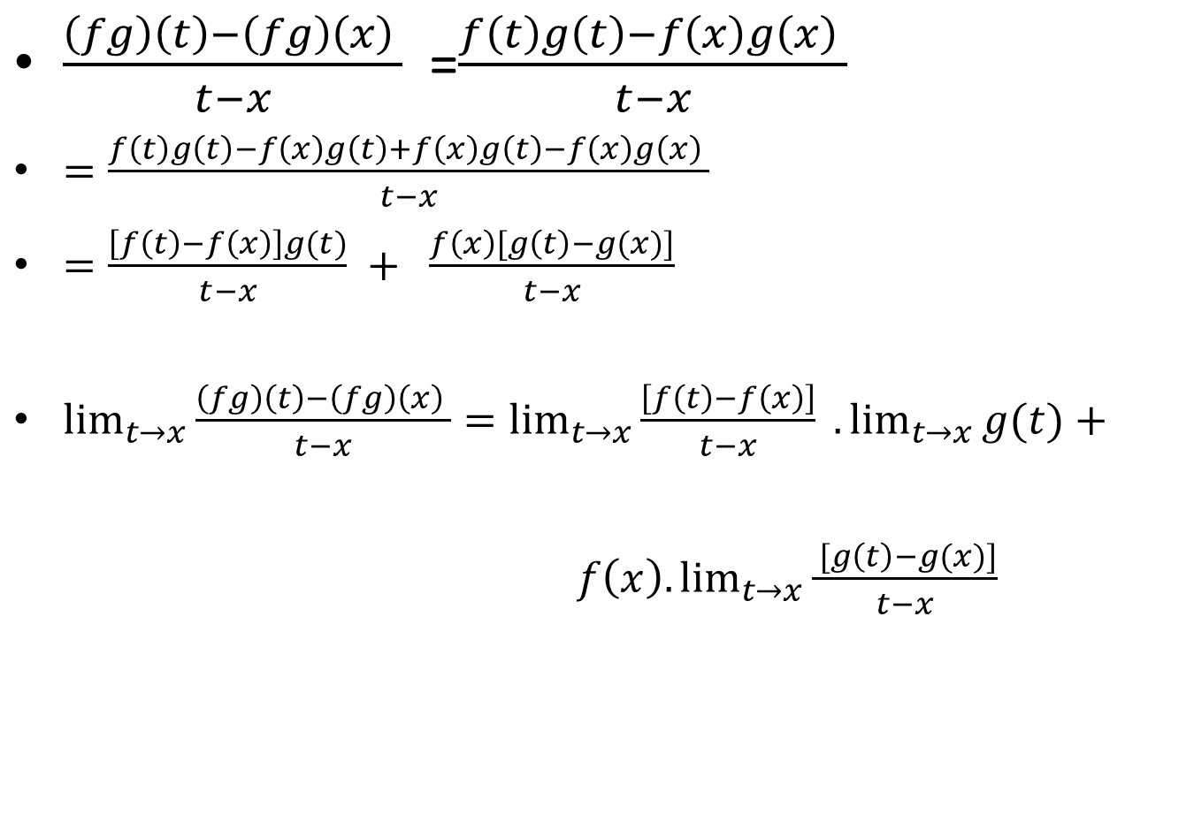
$\frac{\left(fg\right)\left(t\right)−\left(fg\right)\left(x\right) }{t−x}$ =$\frac{f\left(t\right)g\left(t\right)−f\left(x\right)g\left(x\right) }{t−x}$
$=\frac{f\left(t\right)g\left(t\right)−f\left(x\right)g\left(t\right)+f\left(x\right)g\left(t\right)−f\left(x\right)g\left(x\right) }{t−x}$
$=\frac{\left[f\left(t\right)−f\left(x\right)\right]g(t)}{t−x} + \frac{f\left(x\right)[g\left(t\right)−g(x)]}{t−x}$
$\lim_{t→x}{\frac{\left(fg\right)\left(t\right)−\left(fg\right)\left(x\right) }{t−x}}=\lim_{t→x}{\frac{\left[f\left(t\right)−f\left(x\right)\right]}{t−x}} .\lim_{t→x}{g(t)}+ f\left(x\right). \lim_{t→x}{\frac{ [g\left(t\right)−g(x)]}{t−x}}$

Slide 41
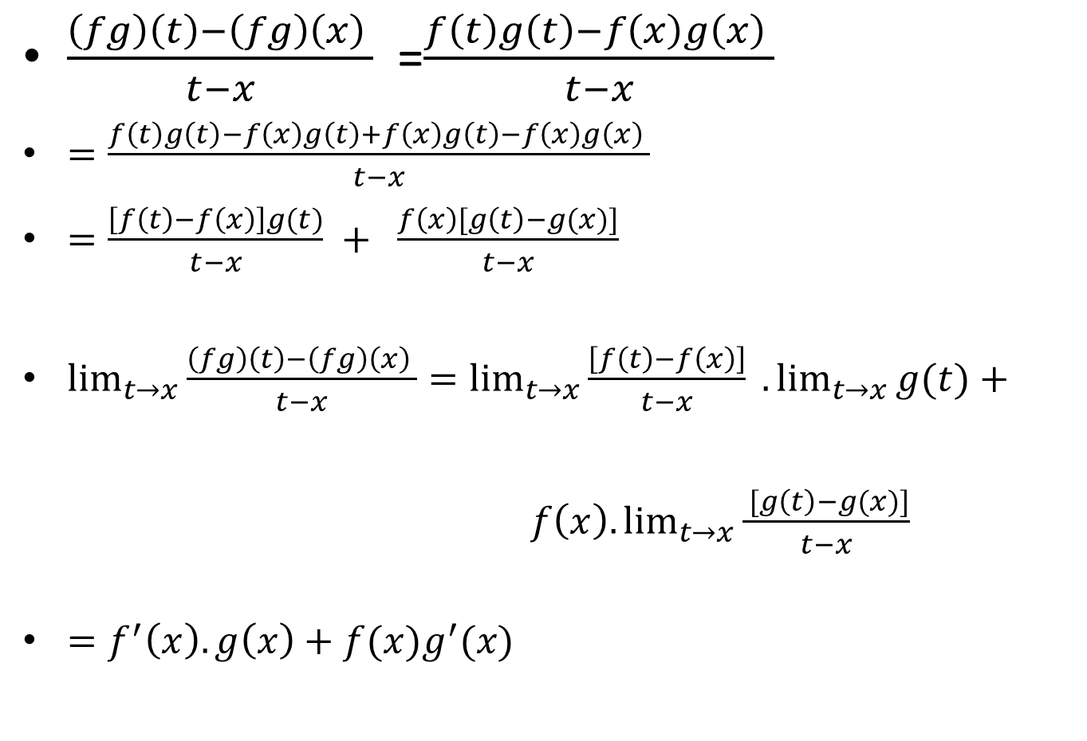
$\frac{\left(fg\right)\left(t\right)−\left(fg\right)\left(x\right) }{t−x}$ =$\frac{f\left(t\right)g\left(t\right)−f\left(x\right)g\left(x\right) }{t−x}$
$=\frac{f\left(t\right)g\left(t\right)−f\left(x\right)g\left(t\right)+f\left(x\right)g\left(t\right)−f\left(x\right)g\left(x\right) }{t−x}$
$=\frac{\left[f\left(t\right)−f\left(x\right)\right]g(t)}{t−x} + \frac{f\left(x\right)[g\left(t\right)−g(x)]}{t−x}$
$\lim_{t→x}{\frac{\left(fg\right)\left(t\right)−\left(fg\right)\left(x\right) }{t−x}}=\lim_{t→x}{\frac{\left[f\left(t\right)−f\left(x\right)\right]}{t−x}} .\lim_{t→x}{g(t)}+ f\left(x\right). \lim_{t→x}{\frac{ [g\left(t\right)−g(x)]}{t−x}}$
$=f^{′}\left(x\right).g\left(x\right)+f(x)g^{′}(x)$

Slide 42

Since limit on RHS exists, therefore it must exist on LHS as well and hence:
$\frac{d}{dx}\left[f.g\right]\left(x\right)=\frac{d}{dx}\left[f\left(x\right).g\left(x\right)\right]=f^{′}\left(x\right).g\left(x\right)+f(x)g^{′}(x)$

Slide 43
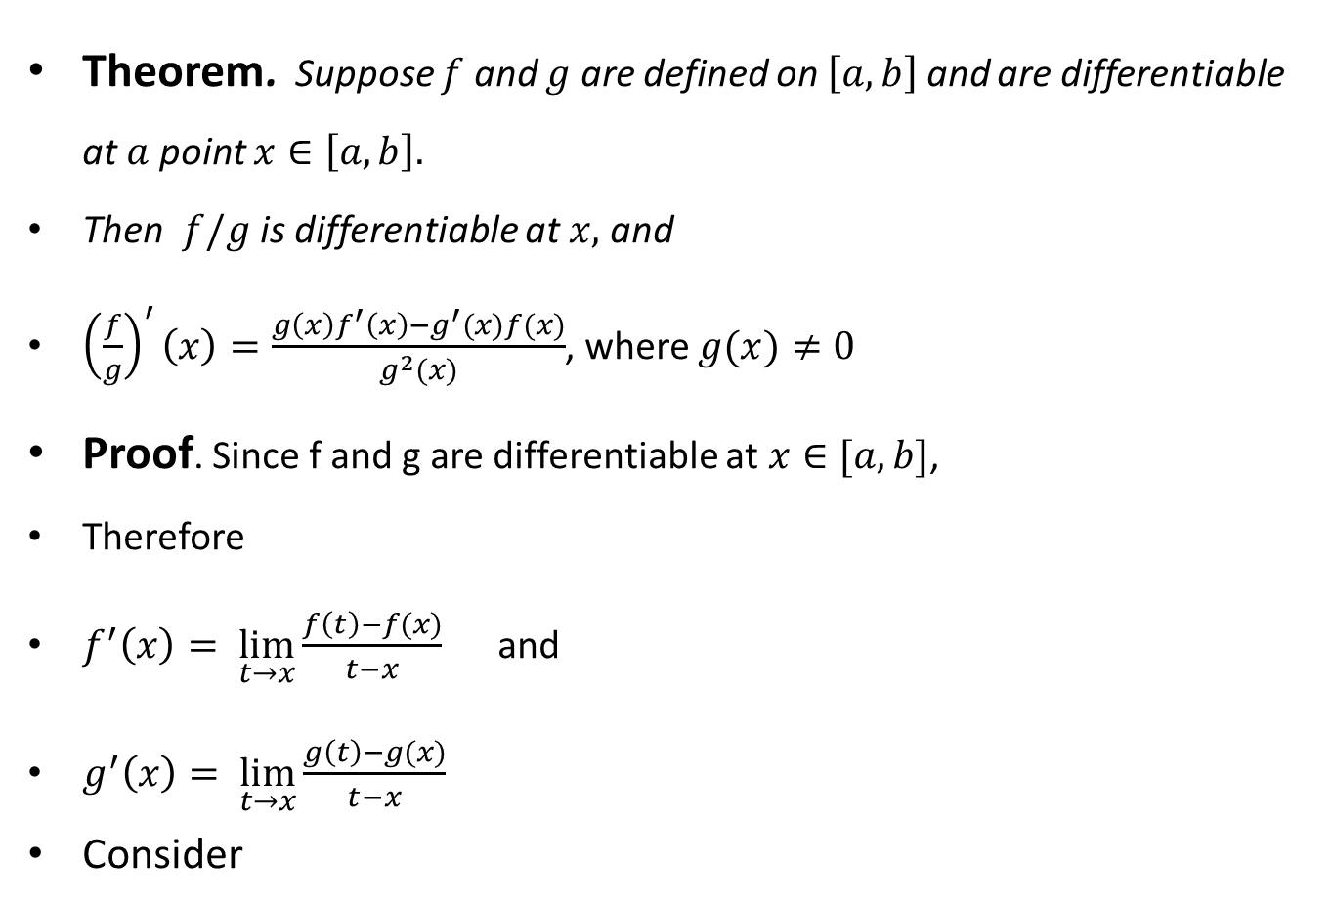
Theorem. Suppose $f$ and $g$ are defined on $\left[a, b\right]$ and are differentiable at $a$ point $x∈\left[a, b\right].$
Then $f/g$ is differentiable at $x,$ and
${\left(\frac{f}{g}\right)}^{′}\left(x\right)=\frac{g\left(x\right)f^{′}\left(x\right)−g^{′}(x)f(x)}{g^{2}(x)}$, where $g(x)≠0$
Proof. Since f and g are differentiable at $x∈[a,b]$,
Therefore
$f^{′}\left(x\right)= \lim_{t→x}{\frac{f\left(t\right)−f(x)}{t−x}}$ and
$g^{′}\left(x\right)= \lim_{t→x}{\frac{g\left(t\right)−g(x)}{t−x}}$
Consider

Slide 44

$h\left(t\right)=\frac{f(t)}{g(t)}$, then

Slide 45

$h\left(t\right)=\frac{f(t)}{g(t)}$, then
$\frac{h\left(t\right)−h(x)}{t−x}=\left[\frac{f(t)}{g(t)} − \frac{f(x)}{g(x)}\right]. \frac{1}{t−x}$

Slide 46

$h\left(t\right)=\frac{f(t)}{g(t)}$, then
$\frac{h\left(t\right)−h(x)}{t−x}=\left[\frac{f(t)}{g(t)} − \frac{f(x)}{g(x)}\right]. \frac{1}{t−x}$
$=\left[\frac{f\left(t\right)g\left(x\right)−g\left(t\right)f(x)}{g\left(t\right)g(x)}\right].\frac{1}{t−x}$

Slide 47

$h\left(t\right)=\frac{f(t)}{g(t)}$, then
$\frac{h\left(t\right)−h(x)}{t−x}=\left[\frac{f(t)}{g(t)} − \frac{f(x)}{g(x)}\right]. \frac{1}{t−x}$
$=\left[\frac{f\left(t\right)g\left(x\right)−g\left(t\right)f(x)}{g\left(t\right)g(x)}\right].\frac{1}{t−x}$
$=\frac{1}{g\left(t\right).g(x)}[f\left(t\right)g\left(x\right)−f\left(x\right)g\left(x\right)+f\left(x\right)g\left(x\right)−g\left(t\right)f(x))]\frac{1}{t−x}$

Slide 48
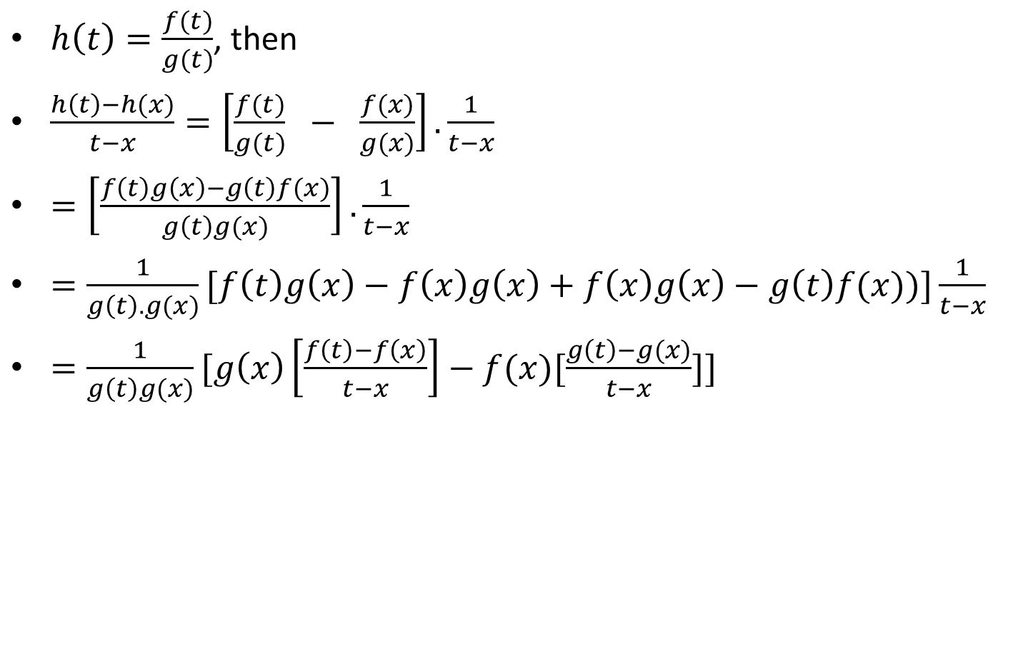
$h\left(t\right)=\frac{f(t)}{g(t)}$, then
$\frac{h\left(t\right)−h(x)}{t−x}=\left[\frac{f(t)}{g(t)} − \frac{f(x)}{g(x)}\right]. \frac{1}{t−x}$
$=\left[\frac{f\left(t\right)g\left(x\right)−g\left(t\right)f(x)}{g\left(t\right)g(x)}\right].\frac{1}{t−x}$
$=\frac{1}{g\left(t\right).g(x)}[f\left(t\right)g\left(x\right)−f\left(x\right)g\left(x\right)+f\left(x\right)g\left(x\right)−g\left(t\right)f(x))]\frac{1}{t−x}$
$=\frac{1}{g\left(t\right)g(x)}[g\left(x\right)\left[\frac{f\left(t\right)−f\left(x\right)}{t−x}\right]−f(x)[\frac{g\left(t\right)−g(x)}{t−x}]]$

Slide 49
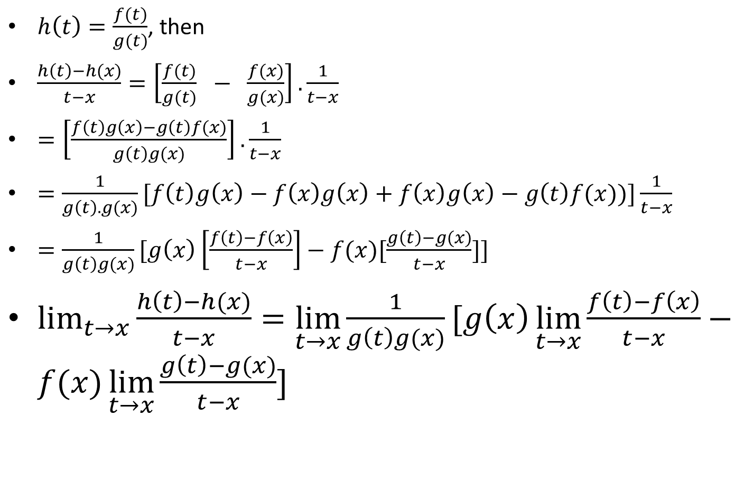
$h\left(t\right)=\frac{f(t)}{g(t)}$, then
$\frac{h\left(t\right)−h(x)}{t−x}=\left[\frac{f(t)}{g(t)} − \frac{f(x)}{g(x)}\right]. \frac{1}{t−x}$
$=\left[\frac{f\left(t\right)g\left(x\right)−g\left(t\right)f(x)}{g\left(t\right)g(x)}\right].\frac{1}{t−x}$
$=\frac{1}{g\left(t\right).g(x)}[f\left(t\right)g\left(x\right)−f\left(x\right)g\left(x\right)+f\left(x\right)g\left(x\right)−g\left(t\right)f(x))]\frac{1}{t−x}$
$=\frac{1}{g\left(t\right)g(x)}[g\left(x\right)\left[\frac{f\left(t\right)−f\left(x\right)}{t−x}\right]−f(x)[\frac{g\left(t\right)−g(x)}{t−x}]]$
$\lim_{t→x}{\frac{h\left(t\right)−h(x)}{t−x}}=\lim_{t→x}\frac{1}{g\left(t\right)g(x)}[g\left(x\right)\lim_{t→x}{\frac{f\left(t\right)−f\left(x\right)}{t−x}}−f(x)\lim_{t→x}{\frac{g\left(t\right)−g(x)}{t−x}}]$

Slide 50
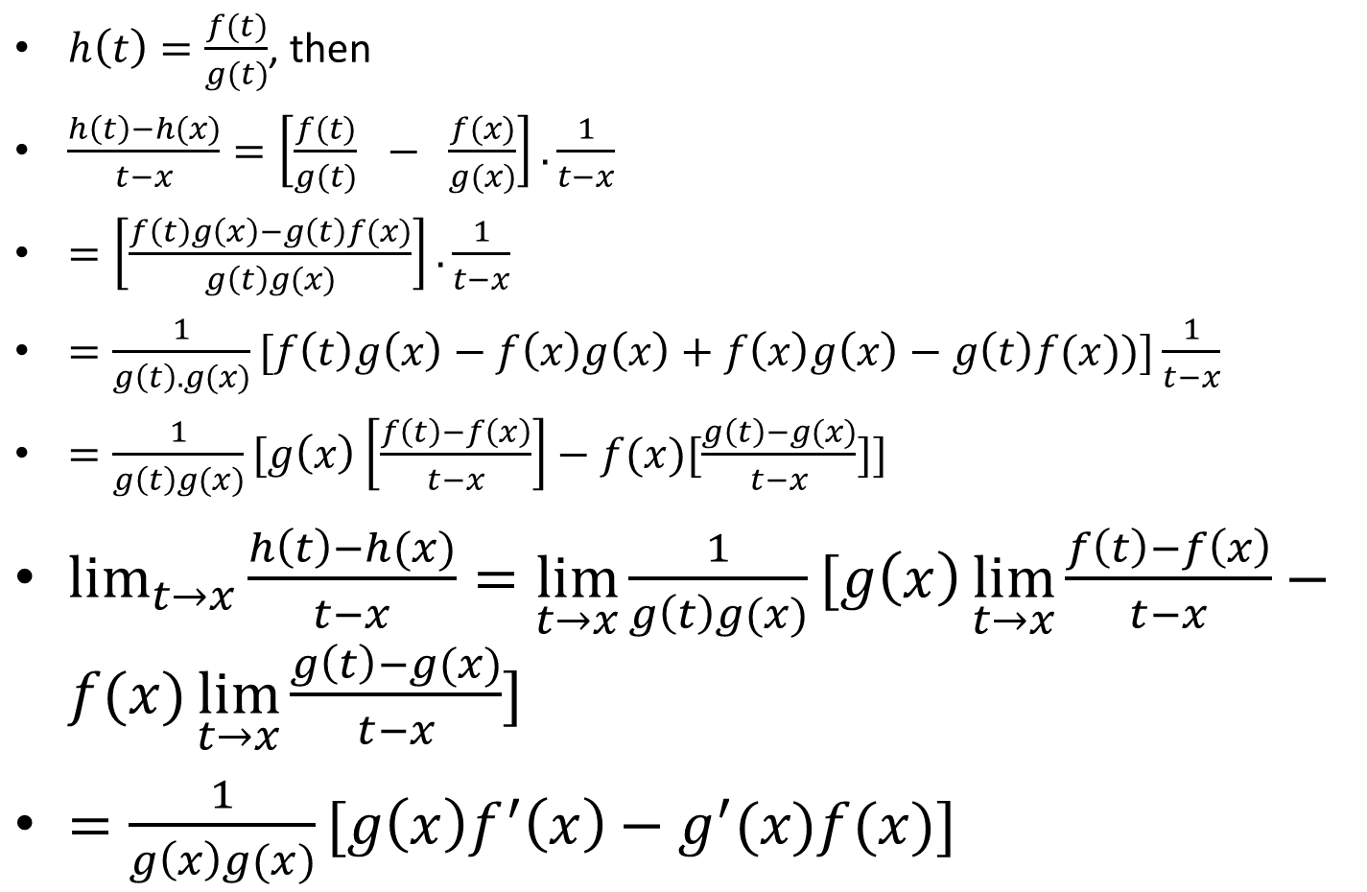
$h\left(t\right)=\frac{f(t)}{g(t)}$, then
$\frac{h\left(t\right)−h(x)}{t−x}=\left[\frac{f(t)}{g(t)} − \frac{f(x)}{g(x)}\right]. \frac{1}{t−x}$
$=\left[\frac{f\left(t\right)g\left(x\right)−g\left(t\right)f(x)}{g\left(t\right)g(x)}\right].\frac{1}{t−x}$
$=\frac{1}{g\left(t\right).g(x)}[f\left(t\right)g\left(x\right)−f\left(x\right)g\left(x\right)+f\left(x\right)g\left(x\right)−g\left(t\right)f(x))]\frac{1}{t−x}$
$=\frac{1}{g\left(t\right)g(x)}[g\left(x\right)\left[\frac{f\left(t\right)−f\left(x\right)}{t−x}\right]−f(x)[\frac{g\left(t\right)−g(x)}{t−x}]]$
$\lim_{t→x}{\frac{h\left(t\right)−h(x)}{t−x}}=\lim_{t→x}\frac{1}{g\left(t\right)g(x)}[g\left(x\right)\lim_{t→x}{\frac{f\left(t\right)−f\left(x\right)}{t−x}}−f(x)\lim_{t→x}{\frac{g\left(t\right)−g(x)}{t−x}}]$
$=\frac{1}{g\left(x\right)g(x)}[g\left(x\right)f^{′}\left(x\right)−g^{′}(x)f(x)]$

Slide 51

Since limit on RHS exists, therefore it must exist on LHS and hence
$\frac{d}{dx}\left[\frac{f(x)}{g(x)}\right]={(f/g)}^{′}(x)=\frac{g\left(x\right)f^{′}\left(x\right)−g^{′}(x)f(x)}{g^{2}(x)}$

Slide 52
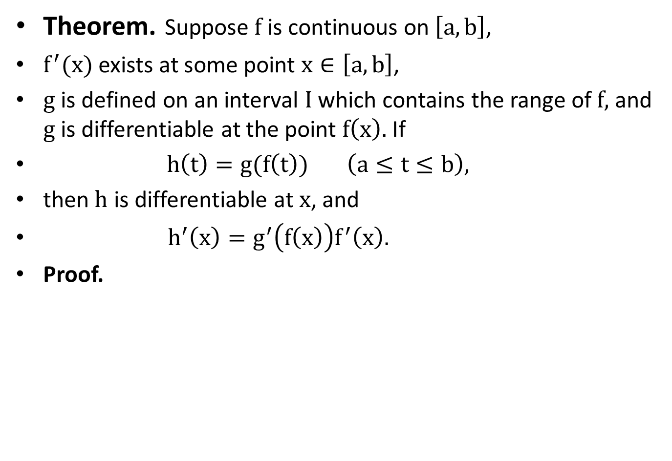
Theorem. Suppose $f$ is continuous on $\left[a, b\right]$,
$f^{′}(x)$ exists at some point $x∈\left[a, b\right]$,
$g$ is defined on an interval $I$ which contains the range of $f,$ and $g$ is differentiable at the point $f\left(x\right).$If
$h\left(t\right)=g(f\left(t\right))$ $\left(a≤t≤b\right),$
then $h$ is differentiable at $x$, and
$h^{′}\left(x\right)=g^{′}\left(f\left(x\right)\right)f^{′}\left(x\right).$
Proof.

Slide 57
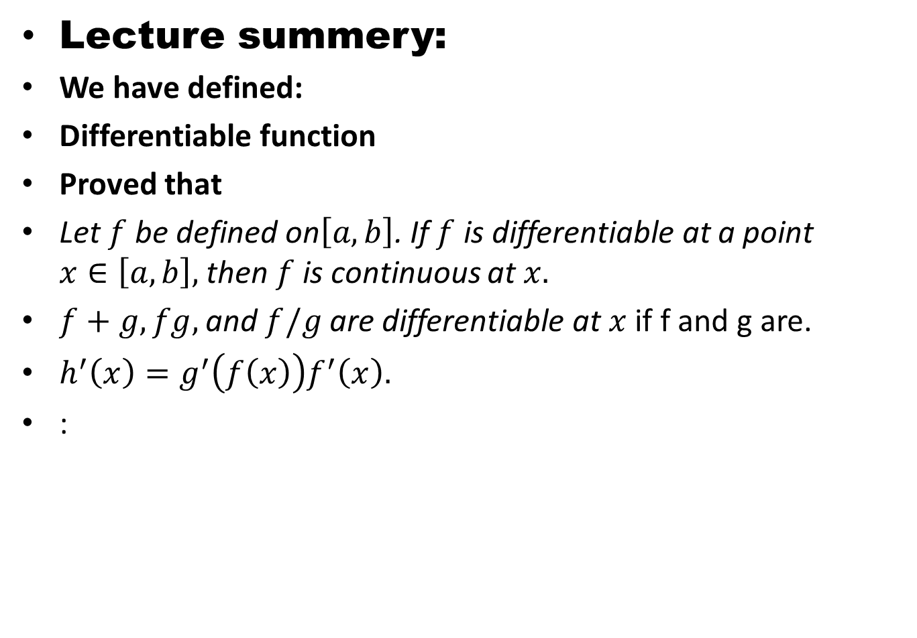
Lecture summery:
We have defined:
Differentiable function
Proved that
Let $f$ be defined on$\left[a, b\right]$. If $f$ is differentiable at a point $x∈\left[a, b\right],$ then $f$ is continuous at $x.$
$f+g,fg,$ and $f/g$ are differentiable at $x$ if f and g are.
$h^{′}\left(x\right)=g^{′}\left(f\left(x\right)\right)f^{′}\left(x\right).$
:

Slide 58
THANK YOU

