Slide 1
Real Analysis I
Course Code MTH 321
By
Dr. Moiz ud Din khan
Professor of Mathematics

Slide 2
Lecture # 22

Slide 3
Lecture Outline
In this Lecture we will will discuss two examples prove theorems on minima and maxima:

Slide 4

Example.
Let $f$ be defined by
$f\left(x\right)= \left\{\begin{matrix}x\sin{\frac{1}{x}} & \left(x≠0\right), \\ 0 & \left(x=0\right).\end{matrix}\right.$

Slide 7

Example.
Let $f$ be defined by
$f\left(x\right)=\left\{\begin{matrix}x^{2}sin{\frac{1}{x}} & ,\left(x≠0\right), \\ 0 & ,\left(x=0\right).\end{matrix}\right.$

Slide 12
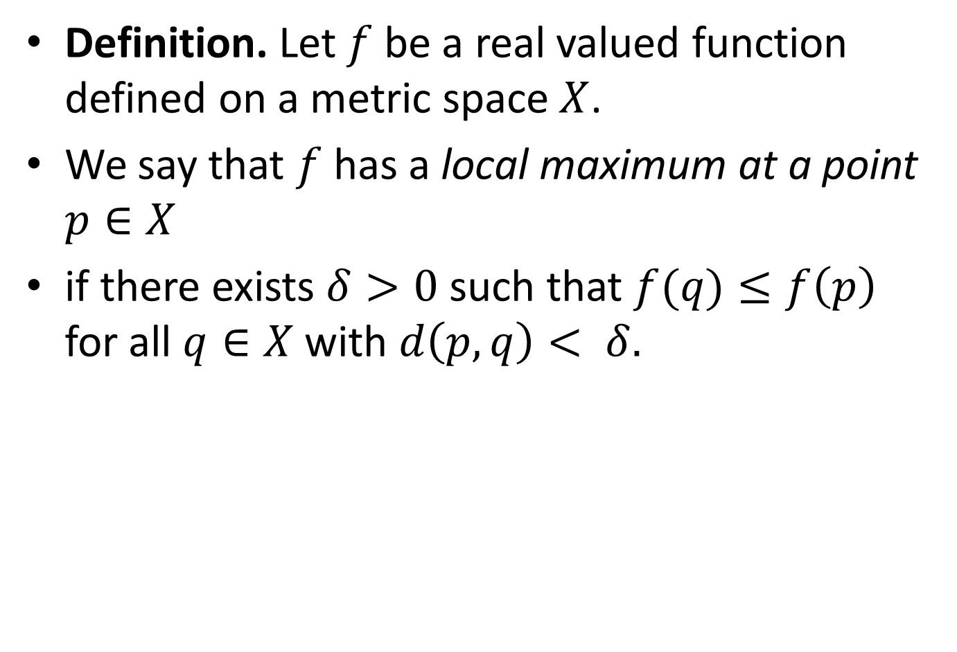
Definition. Let $f$ be a real valued function defined on a metric space $X$.
We say that $f$ has a local maximum at a point $p∈X$
if there exists $δ>0$ such that $f(q)≤f\left(p\right)$ for all $q∈X$ with $d\left(p,q\right)< δ.$

Slide 14
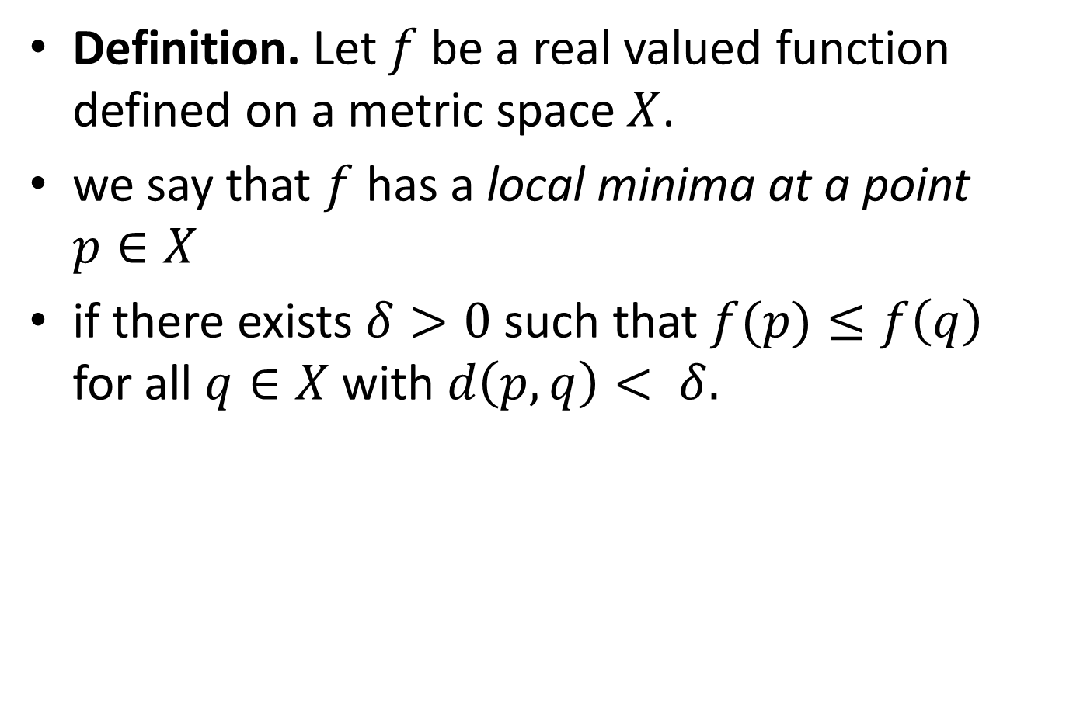
Definition. Let $f$ be a real valued function defined on a metric space $X$.
we say that $f$ has a local minima at a point $p∈X$
if there exists $δ>0$ such that $f(p)≤f\left(q\right)$ for all $q∈X$ with $d\left(p,q\right)< δ.$

Slide 17

Theorem. Let $f$ be defined on $\left[a,b\right];$ if $f$ has a local maximum at a point $x∈\left(a,b\right),$ and if $f^{′}(x)$ exists, then $f^{′}\left(x\right)=0.$

Slide 21
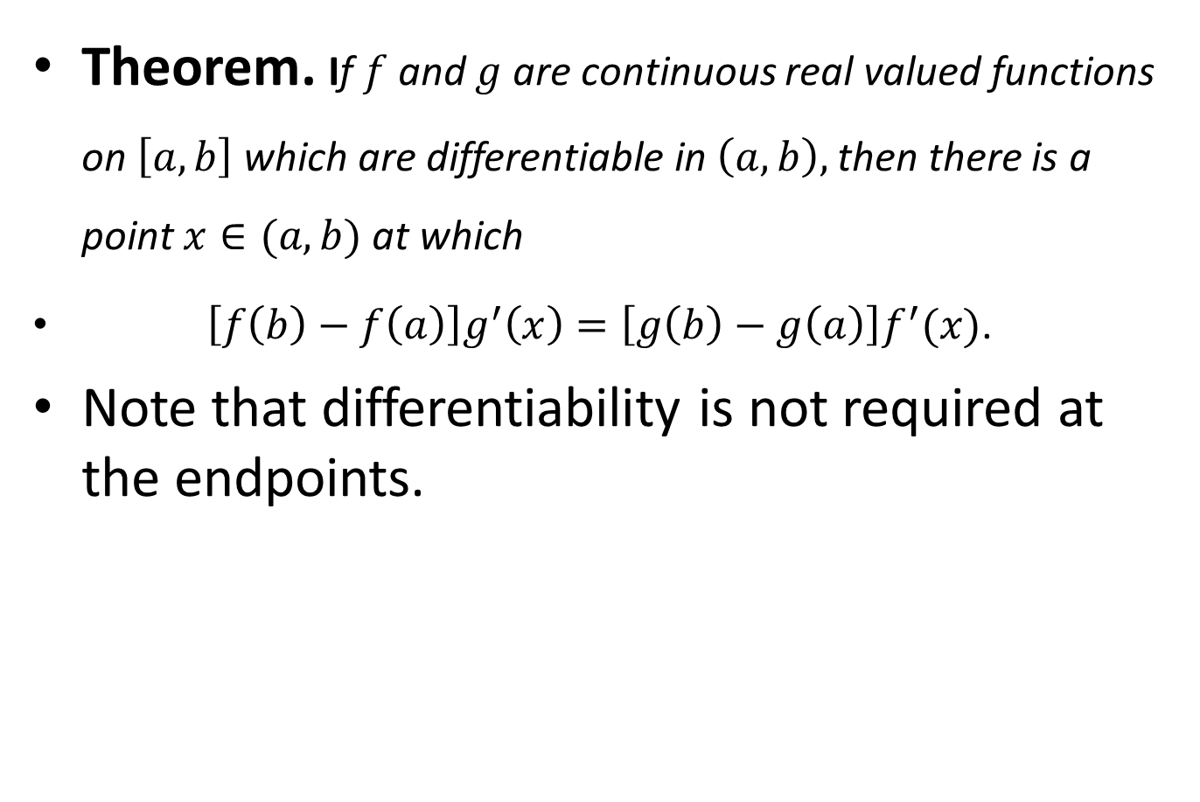
Theorem. If $f$ and $g$ are continuous real valued functions on $\left[a,b\right]$ which are differentiable in $\left(a,b\right),$then there is a point $x∈(a,b)$ at which
$\left[f\left(b\right)−f\left(a\right)\right]g^{′}\left(x\right)=\left[g\left(b\right)−g\left(a\right)\right]f^{′}(x)$.
Note that differentiability is not required at the endpoints.

Slide 26
Lecture summery:
We have discussed discontinuity of functions in two example.
We have defined local maxima and local minima of functions
Two theorems on local maxima and local minima

Slide 27
THANK YOU

