Slide 1
Real Analysis I
Course Code MTH 321
By
Dr. Moiz ud Din khan
Professor of Mathematics

Slide 2
Lecture # 23

Slide 3
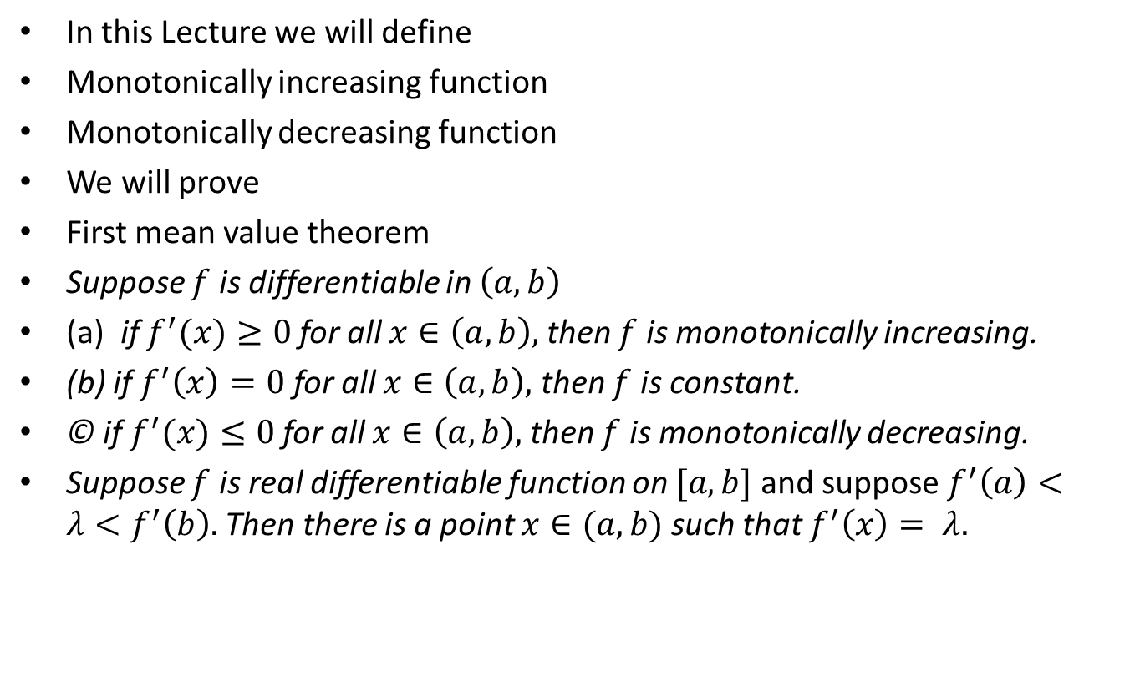
Lecture Outline
In this Lecture we will define
Monotonically increasing function
Monotonically decreasing function
We will prove
First mean value theorem
Suppose $f$ is differentiable in $\left(a,b\right)$
(a) if $f^{′}(x)≥0$ for all $x∈\left(a,b\right),$ then $f$ is monotonically increasing.
(b) if $f^{′}\left(x\right)=0$ for all $x∈\left(a,b\right),$ then $f$ is constant.
© if $f^{′}(x)≤0$ for all $x∈\left(a,b\right),$ then $f$ is monotonically decreasing.
Suppose $f$ is real differentiable function on $[a,b]$and suppose $f^{′}\left(a\right)<λ<f^{′}\left(b\right).$Then there is a point $x∈(a,b)$ such that $f^{′}\left(x\right)= λ.$

Slide 4
Monotonically Increasing function.

Slide 6
Monotonically decreasing function.

Slide 8

First mean value theorem or Lagranges mean value theorem.
Theorem.If f is real valued continuous function on $[a,b]$ which is differentiable in $\left(a,b\right)$, then there is a point $c∈(a,b)$ at which
$f\left(b\right)−f\left(a\right)= (b−a)f^{′}(c)$
Proof.

Slide 12

Theorem.Suppose $f$ is differentiable in $\left(a,b\right)$
(a) if $f^{′}(x)≥0$ for all $x∈\left(a,b\right),$ then $f$ is monotonically increasing.
(b) if $f^{′}\left(x\right)=0$ for all $x∈\left(a,b\right),$ then $f$ is constant.
© if $f^{′}(x)≤0$ for all $x∈\left(a,b\right),$ then $f$ is monotonically decreasing.

Slide 20

Theorem.Suppose $f$ is real differentiable function on $[a,b]$and suppose $f^{′}\left(a\right)<λ<f^{′}\left(b\right).$Then there is a point $x∈(a,b)$ such that $f^{′}\left(x\right)= λ.$
A similar result holds of course if $f^{′}\left(a\right)>f^{′}\left(b\right).$
Proof.

Slide 25
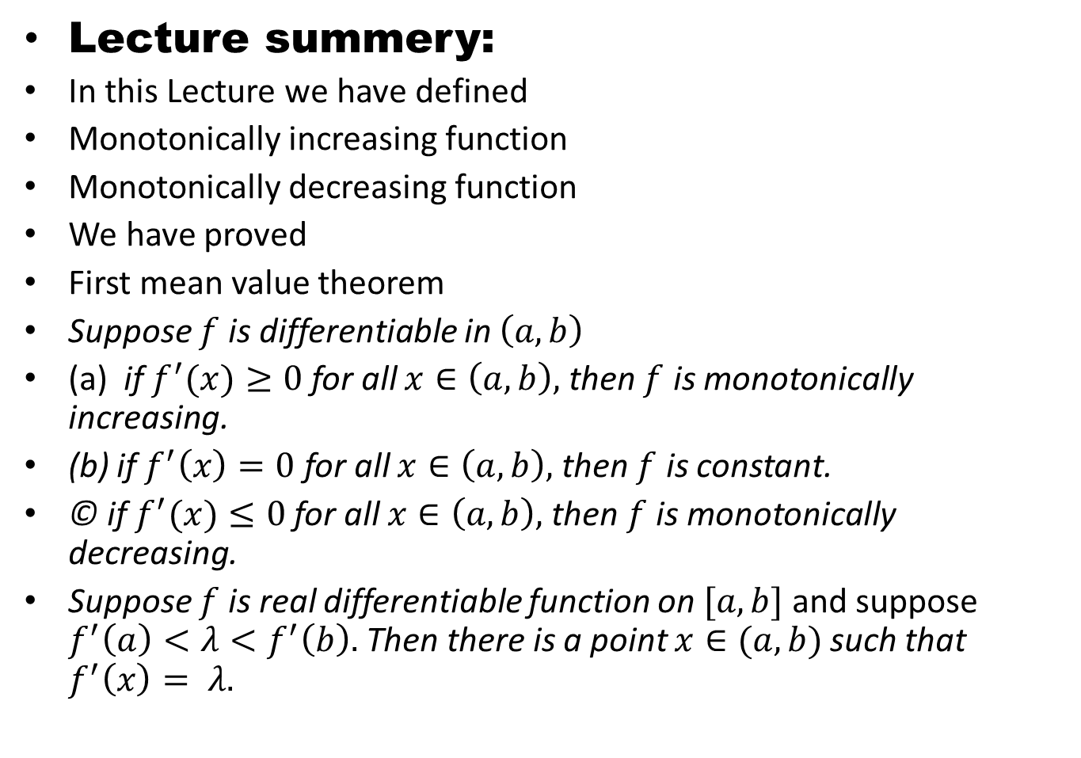
Lecture summery:
In this Lecture we have defined
Monotonically increasing function
Monotonically decreasing function
We have proved
First mean value theorem
Suppose $f$ is differentiable in $\left(a,b\right)$
(a) if $f^{′}(x)≥0$ for all $x∈\left(a,b\right),$ then $f$ is monotonically increasing.
(b) if $f^{′}\left(x\right)=0$ for all $x∈\left(a,b\right),$ then $f$ is constant.
© if $f^{′}(x)≤0$ for all $x∈\left(a,b\right),$ then $f$ is monotonically decreasing.
Suppose $f$ is real differentiable function on $[a,b]$and suppose $f^{′}\left(a\right)<λ<f^{′}\left(b\right).$Then there is a point $x∈(a,b)$ such that $f^{′}\left(x\right)= λ.$

Slide 26
THANK YOU

