Slide 1
Real Analysis I
Course Code MTH 321
By
Dr. Moiz ud Din khan
Professor of Mathematics

Slide 2
Lecture # 24

Slide 3
Lecture Outline
In this Lecture we will state and prove Taylor,s Theorem.

Slide 4
Theorem.Suppose $f$ is real differentiable function on $[a,b]$and suppose $f^{′}\left(a\right)<λ<f^{′}\left(b\right).$Then there is a point $x∈(a,b)$ such that $f^{′}\left(x\right)= λ.$
A similar result holds of course if $f^{′}\left(a\right)>f^{′}\left(b\right).$
Proof.

Slide 8
Derivatives of Higher Order
If f has a derivative $f^{′}$ on an interval, and if $f^{′}$is itself differentiable, then it is denoted by $f^{′′}$ and call second derivative of f.
$f^{′}$, $f^{′′}$, $f^{′′′}$, $f^{(4)}$, $f^{(5)}$, …, $f^{(n)}.$
$f^{(n)}$ is called nth derivative of f or derivative of order “n” of f.

Slide 9
Taylor’s Theorem.
If $f^{(n−1)}$ is continuous on $[a,b]$ derivable on $(a,b)$ and $p∈N$, then there exists a point $c∈(a,b)$ such that $f\left(b\right)=f\left(a\right)+\left(b−a\right)f^{′}\left(a\right)+\frac{{(b−a)}^{2}}{2!} f^{′′}\left(a\right)+…+\frac{{\left(b−a\right)}^{n−1}}{\left(n−1\right)!} f^{\left(n−1\right)}\left(a\right)+R_{n}$
Where $R_{n}=\frac{{(b−a)}^{p}{(b−c)}^{n−p}}{\left(n−1\right)!p} f^{(n)}(c)$

Slide 12
Proof
$f^{(n−1)}$ is continuous on $[a,b]$ and derivable on $(a,b)$.
This implies: $f^{′}$, $f^{′′}$, $f^{′′′}$, $f^{(4)}$, $f^{(5)}$, …, $f^{(n−1)}$ are all continuous on $[a,b]$ and derivable on $(a,b)$.
Define
$F\left(x\right)=f\left(b\right)−f\left(x\right)−\left(b−x\right)f^{′}\left(x\right)−\frac{{\left(b−x\right)}^{2}}{2!} f^{′′}\left(x\right)−…−\frac{{\left(b−x\right)}^{n−1}}{\left(n−1\right)!} f^{\left(n−1\right)}\left(x\right)−A\frac{{(b−x)}^{p}}{{(b−a)}^{p}}$
Where $A$ is chosen such that $F\left(a\right)=0$, i.e.

Slide 13
$F\left(a\right)=0=f\left(b\right)−f\left(a\right)−\left(b−a\right)f^{′}\left(a\right)−\frac{{\left(b−a\right)}^{2}}{2!} f^{′′}\left(a\right)−…−\frac{{\left(b−a\right)}^{n−1}}{\left(n−1\right)!} f^{\left(n−1\right)}\left(a\right)−A\frac{{(b−a)}^{p}}{{(b−a)}^{p}}$
Thus $F$ is continuous on $\left[a,b\right],$ differentiable on $(a,b)$ and $F\left(a\right)=F\left(b\right)=0$.
Hence there exists $c∈(a,b)$ such that $F^{′}\left(c\right)=0$
This gives:

Slide 16
$F^{′}\left(x\right)=−\frac{{\left(b−x\right)}^{n−1}}{\left(n−1\right)!} f^{\left(n\right)}\left(x\right)+PA\frac{{(b−x)}^{n−1}}{{(b−a)}^{p}}$
Thus from $F^{′}\left(c\right)=0$, we get,
$A=\frac{{\left(b−a\right)}^{p}{\left(b−c\right)}^{n−p}}{\left(n−1\right)!p}f^{\left(n\right)}(c)$
Putting this value of $A$ we get the required result.

Slide 17
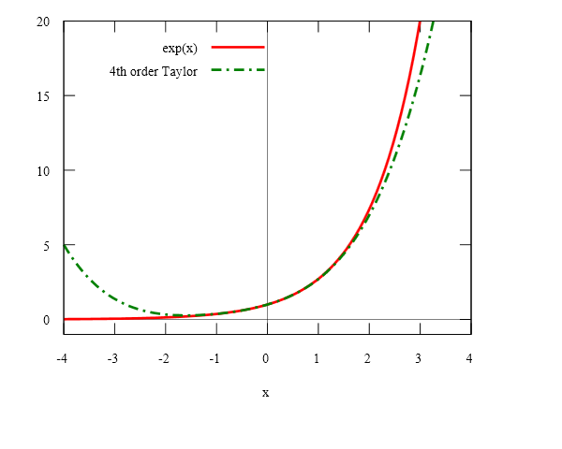

Slide 19
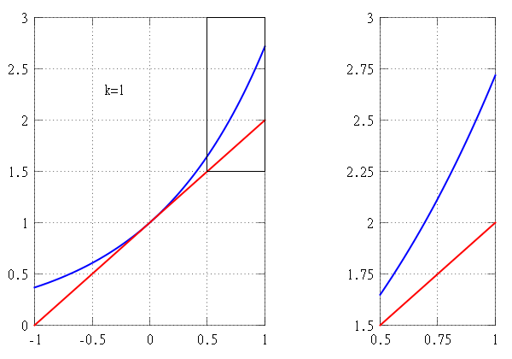
Approximation of e^{x} (blue) by its Taylor polynomials P_{k} of order k=1,...,7 centered at x=0 (red).

Slide 20
Suppose that we wish to approximate the function f(x) = e^{x} on the interval [−1,1] while ensuring that the error in the approximation is no more than 10⁻⁵.
In this example we pretend that we only know the following properties of the exponential function:

Slide 21
$f\left(b\right)=f\left(a\right)+\left(b−a\right)f^{′}\left(a\right)+\frac{{(b−a)}^{2}}{2!} f^{′′}\left(a\right)+…+\frac{{\left(b−a\right)}^{n−1}}{\left(n−1\right)!} f^{\left(n−1\right)}\left(a\right)+R_{n}$
$\text{Where} R_{n}=\frac{{(b−a)}^{p}{(b−c)}^{n−p}}{\left(n−1\right)!p} f^{(n)}(c)$
$f\left(x\right)= e^{x}$, $[−1,1]$

Slide 22
THANK YOU

