Slide 1
Real Analysis I
Course Code MTH 321
By
Dr. Moiz ud Din khan
Professor of Mathematics

Slide 2
Lecture # 25

Slide 3
Lecture Outline
In this Lecture we will discuss following examples:

Slide 4

Lecture Outline
In this Lecture we will discuss following examples:
Let $f :\left[0,∞\right] → R$ be defined by
$f\left(x\right)= \left\{\begin{aligned}x ;if x∈[0,1) \\ 2x−1, if x∈[1,∞)\end{aligned}\right.$
Then show that $f^{′}(1)$ does not exist.

Slide 5
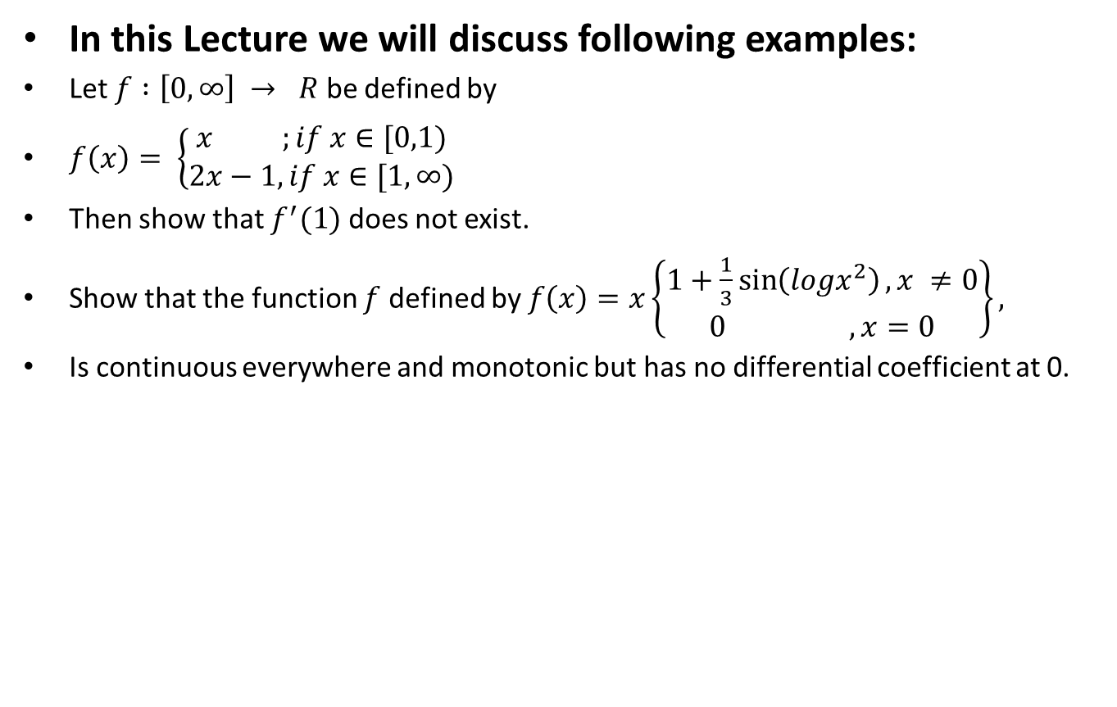
Lecture Outline
In this Lecture we will discuss following examples:
Let $f :\left[0,∞\right] → R$ be defined by
$f\left(x\right)= \left\{\begin{aligned}x ;if x∈[0,1) \\ 2x−1, if x∈[1,∞)\end{aligned}\right.$
Then show that $f^{′}(1)$ does not exist.
Show that the function $f$ defined by $f\left(x\right)=x\left\{\begin{aligned}1+\frac{1}{3}\sin\left(logx^{2}\right), x ≠0 \\ 0 , x=0\end{aligned}\right\},$
Is continuous everywhere and monotonic but has no differential coefficient at 0.

Slide 6
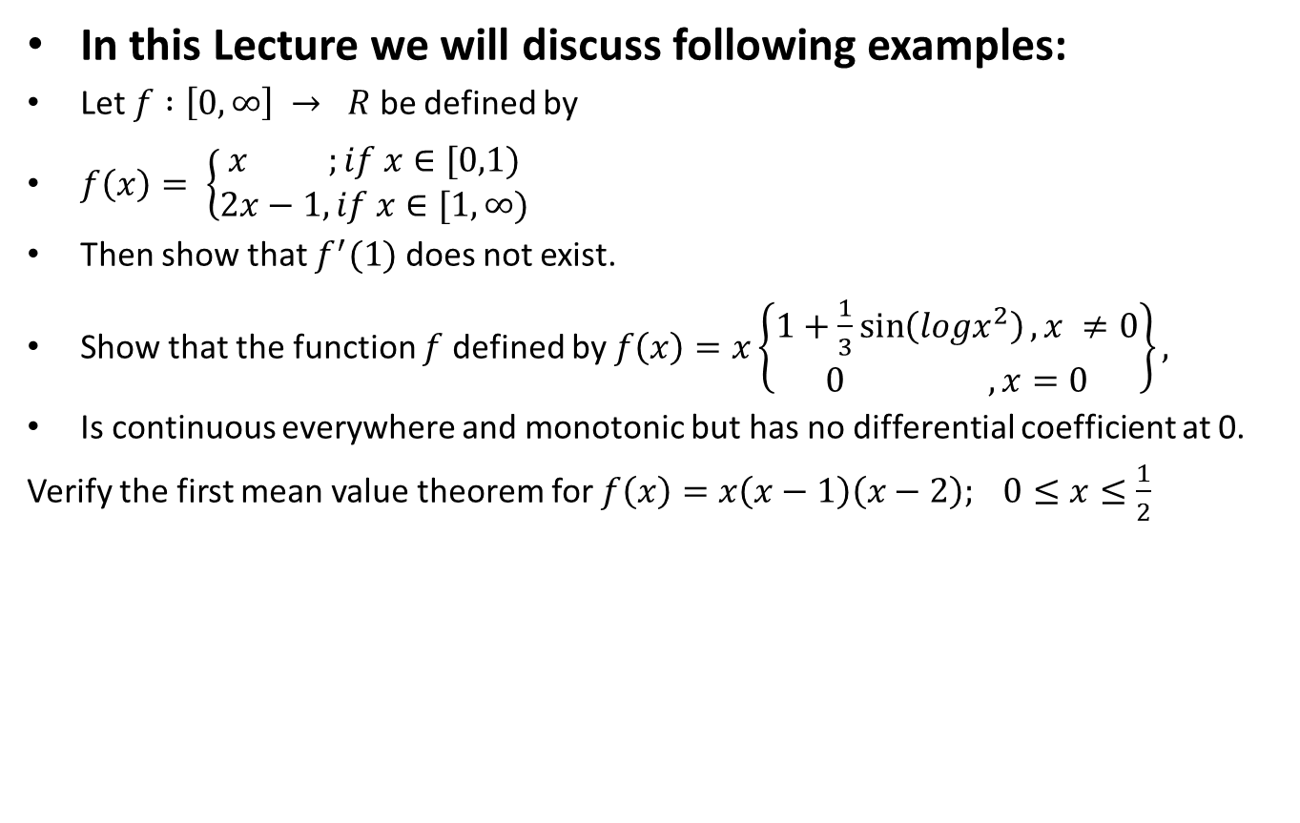
Lecture Outline
In this Lecture we will discuss following examples:
Let $f :\left[0,∞\right] → R$ be defined by
$f\left(x\right)= \left\{\begin{aligned}x ;if x∈[0,1) \\ 2x−1, if x∈[1,∞)\end{aligned}\right.$
Then show that $f^{′}(1)$ does not exist.
Show that the function $f$ defined by $f\left(x\right)=x\left\{\begin{aligned}1+\frac{1}{3}\sin\left(logx^{2}\right), x ≠0 \\ 0 , x=0\end{aligned}\right\},$
Is continuous everywhere and monotonic but has no differential coefficient at 0.
Verify the first mean value theorem for $f\left(x\right)=x\left(x−1\right)\left(x−2\right); 0≤x≤\frac{1}{2}$

Slide 7
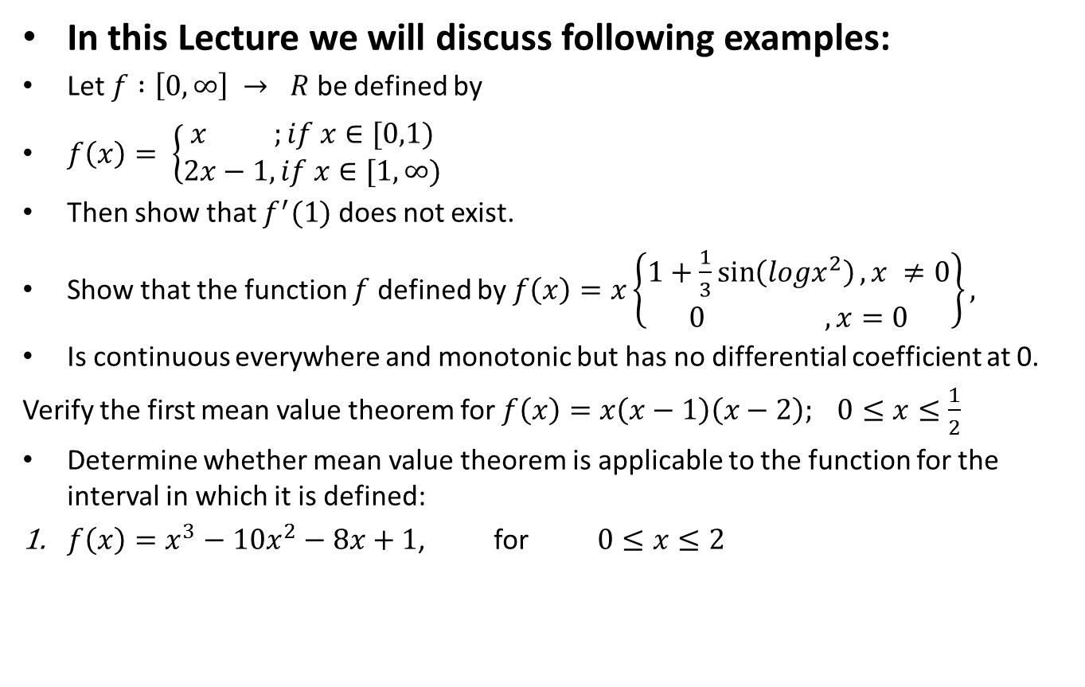
Lecture Outline
In this Lecture we will discuss following examples:
Let $f :\left[0,∞\right] → R$ be defined by
$f\left(x\right)= \left\{\begin{aligned}x ;if x∈[0,1) \\ 2x−1, if x∈[1,∞)\end{aligned}\right.$
Then show that $f^{′}(1)$ does not exist.
Show that the function $f$ defined by $f\left(x\right)=x\left\{\begin{aligned}1+\frac{1}{3}\sin\left(logx^{2}\right), x ≠0 \\ 0 , x=0\end{aligned}\right\},$
Is continuous everywhere and monotonic but has no differential coefficient at 0.
Verify the first mean value theorem for $f\left(x\right)=x\left(x−1\right)\left(x−2\right); 0≤x≤\frac{1}{2}$
Determine whether mean value theorem is applicable to the function for the interval in which it is defined:
$f\left(x\right)=x^{3}−10x^{2}−8x+1$, for $0≤x≤2$

Slide 8
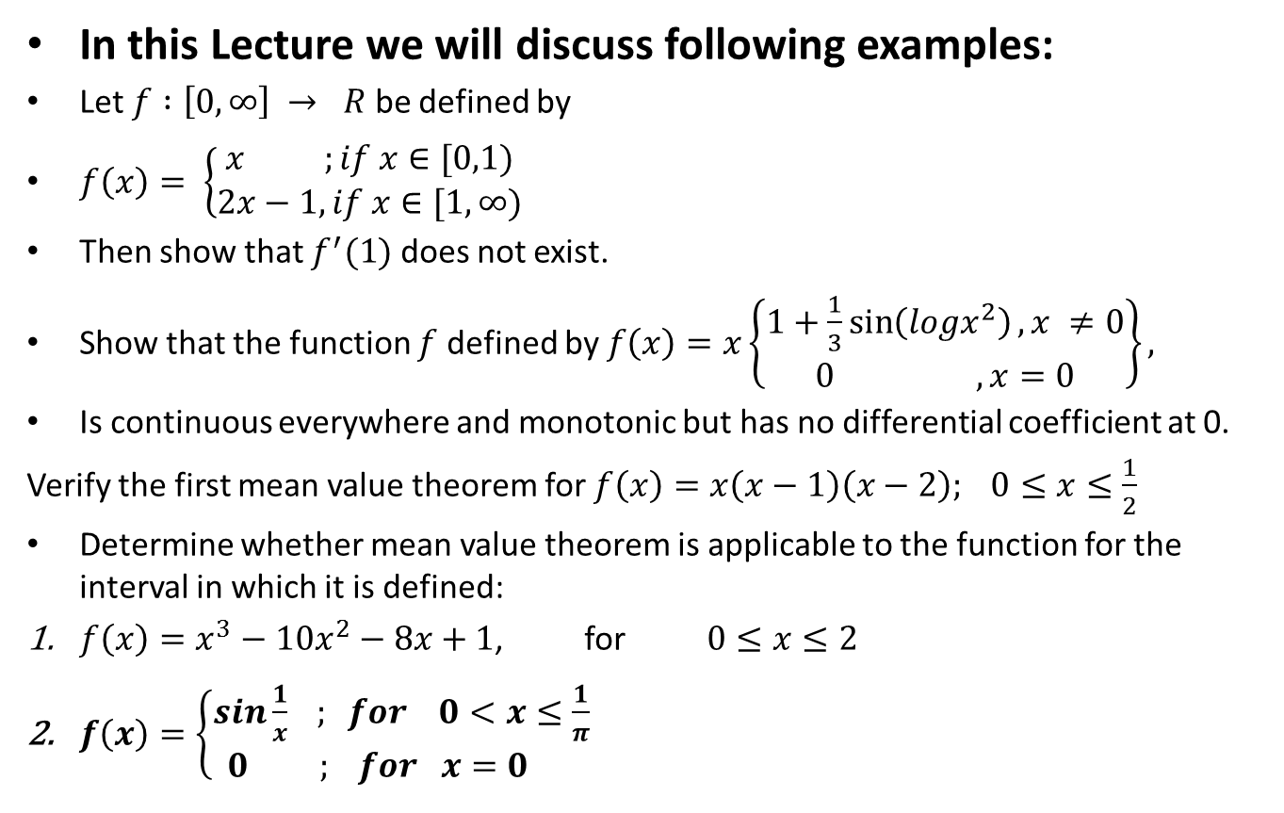
Lecture Outline
In this Lecture we will discuss following examples:
Let $f :\left[0,∞\right] → R$ be defined by
$f\left(x\right)= \left\{\begin{aligned}x ;if x∈[0,1) \\ 2x−1, if x∈[1,∞)\end{aligned}\right.$
Then show that $f^{′}(1)$ does not exist.
Show that the function $f$ defined by $f\left(x\right)=x\left\{\begin{aligned}1+\frac{1}{3}\sin\left(logx^{2}\right), x ≠0 \\ 0 , x=0\end{aligned}\right\},$
Is continuous everywhere and monotonic but has no differential coefficient at 0.
Verify the first mean value theorem for $f\left(x\right)=x\left(x−1\right)\left(x−2\right); 0≤x≤\frac{1}{2}$
Determine whether mean value theorem is applicable to the function for the interval in which it is defined:
$f\left(x\right)=x^{3}−10x^{2}−8x+1$, for $0≤x≤2$
$f\left(x\right)=\left\{\begin{aligned}sin\frac{1}{x} ; for 0<x≤\frac{1}{π} \\ 0 ; for x=0 \end{aligned}\right.$

Slide 9

Example.
Let $f :\left[0,∞\right] → R$ be defined by
$f\left(x\right)= \left\{\begin{aligned}x ;if x∈[0,1) \\ 2x−1, if x∈[1,∞)\end{aligned}\right.$
Then show that $f^{′}(1)$ does not exist.

Slide 12

Example.
Show that the function $f$ defined by $f\left(x\right)=\left\{\begin{aligned}x\{1+\frac{1}{3}\sin\left(logx^{2}\right)\}, x ≠0 \\ 0 , x=0\end{aligned}\right\},$
is continuous every where and monotonic but has no differential coefficient at 0.

Slide 19

Example.
Verify the first mean value theorem for $f\left(x\right)=x\left(x−1\right)\left(x−2\right); 0≤x≤\frac{1}{2}$

Slide 22

Example.
Determine whether mean value theorem is applicable to the function for the interval in which it is defined:
$f\left(x\right)=x^{3}−10x^{2}−8x+1$, for $0≤x≤2$

Slide 24

Example.
Determine whether mean value theorem is applicable to the function for the interval in which it is defined:
$f\left(x\right)=\left\{\begin{aligned}sin\frac{1}{x} ; for 0<x≤\frac{1}{π} \\ 0 ; for x=0 \end{aligned}\right.$

Slide 27
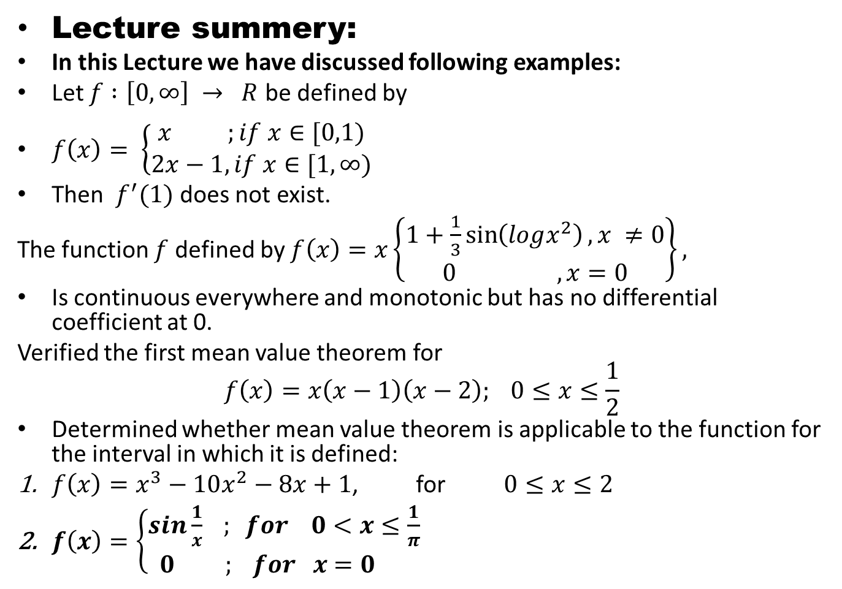
Lecture summery:
In this Lecture we have discussed following examples:
Let $f :\left[0,∞\right] → R$ be defined by
$f\left(x\right)= \left\{\begin{aligned}x ;if x∈[0,1) \\ 2x−1, if x∈[1,∞)\end{aligned}\right.$
Then $f^{′}(1)$ does not exist.
The function $f$ defined by $f\left(x\right)=x\left\{\begin{aligned}1+\frac{1}{3}\sin\left(logx^{2}\right), x ≠0 \\ 0 , x=0\end{aligned}\right\},$
Is continuous everywhere and monotonic but has no differential coefficient at 0.
Verified the first mean value theorem for
$$f\left(x\right)=x\left(x−1\right)\left(x−2\right); 0≤x≤\frac{1}{2}$$
Determined whether mean value theorem is applicable to the function for the interval in which it is defined:
$f\left(x\right)=x^{3}−10x^{2}−8x+1$, for $0≤x≤2$
$f\left(x\right)=\left\{\begin{aligned}sin\frac{1}{x} ; for 0<x≤\frac{1}{π} \\ 0 ; for x=0 \end{aligned}\right.$

Slide 28
THANK YOU

