Slide 1
Real Analysis I
Course Code MTH 321
By
Dr. Moiz ud Din khan
Professor of Mathematics

Slide 2
Lecture # 26

Slide 3
Lecture Outline
In this Lecture we will Riemann Integration

Slide 4
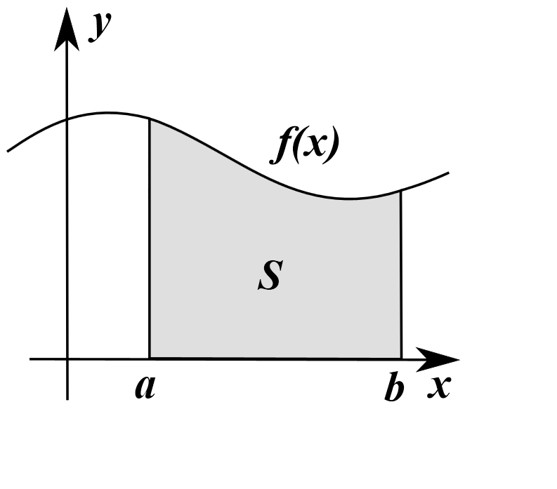
Riemann Integration
The integral as the area of a region under a curve.

Slide 5
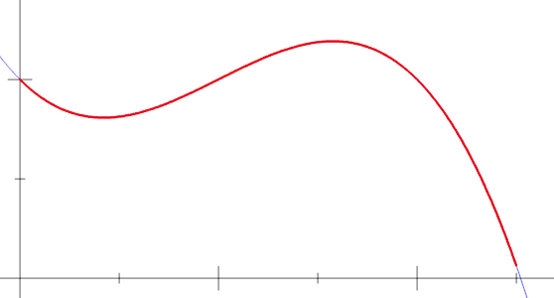

Slide 6
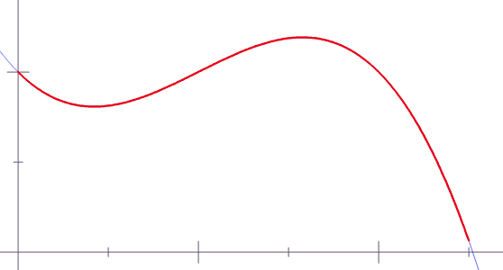

Slide 7
Definition. Let $\left[a,b\right]$be a given interval. By a partition $P$ of $[a,b]$we mean a finite set of points $x_{0},x_{1},…,x_{n,}$ where $a=x_{0}≤x_{1}≤…≤x_{n+1}≤x_{b}=b.$
We write
$∆x_{i}=x_{i}−x_{i−1}$ ($i=(1,…,n)$

Slide 8
Now suppose $f$ is a bounded real function defined on $\left[a,b\right]$. Corresponding to each partition $P$ of $\left[a,b\right]$ we put
$M_{i}=$sup $f(x)$$\left(x_{i−1}≤x≤x_{i}\right),$
$m_{i}=$inf$f(x)$$\left(x_{i−1}≤x≤x_{i}\right),$

Slide 11
$U\left(P,f\right)=\sum_{i=1}^{n}{M_{i}∆x_{i}}$
$L\left(P,f\right)=\sum_{i=1}^{n}{m_{i}∆x_{i}}$
And finally
$\int_{a}^{−b}{fdx=}$inf$U(P,f)$,
$\int_{a}^{−b}{fdx=}$ sup $L(P,f)$,

Slide 12
If the upper and lower integrals are equal, we say that $f$ is Riemann integral on $\left[a,b\right],$we write $f∈ℛ$ (that is, $ℛ$ denote the set of Riemann integrable functions), and we denote the common value of (1) and (2) by
$\int_{a}^{b}{fdx,}$
Or by
$\int_{a}^{b}{f\left(x\right)dx.}$
This is the Riemann integral of $f$over $\left[a,b\right]$

Slide 13
Since $f$ is bounded, there exist two numbers, $m$ and $M,$ such that
$m≤f(x)≤M$$\left(a≤x≤b\right).$
Hence, for every $partition P,$
$m\left(b−a\right)≤L\left(P,f\right)≤U\left(P,f\right)≤M\left(b−a\right)$

Slide 20
Lecture summery:
In this Lecture we have discussed Riemann Integration

Slide 21
THANK YOU

