Slide 1
Real Analysis I
Course Code MTH 321
By
Dr. Moiz ud Din khan
Professor of Mathematics

Slide 2
Lecture # 27

Slide 3
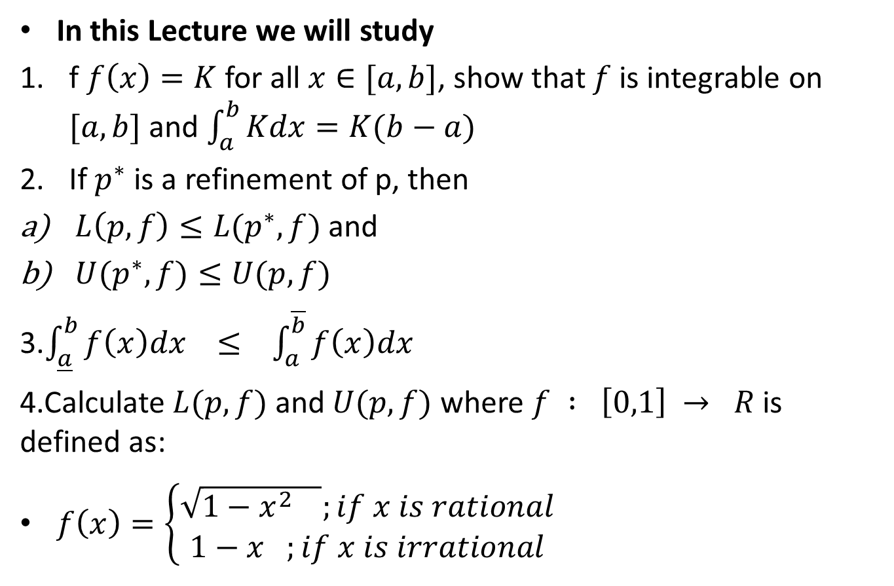
Lecture Outline
In this Lecture we will study
f $f\left(x\right)=K$ for all $x∈[a,b]$, show that $f$ is integrable on $[a,b]$ and $\int_{a}^{b}{Kdx}=K(b−a)$
If $p^{∗}$ is a refinement of p, then
$L\left(p,f\right)≤L(p^{∗},f)$ and
$U(p^{∗},f)≤U(p,f)$
3.$\int_{\underline{a}}^{b}{f\left(x\right)dx} ≤ \int_{a}^{\overline{b}}{f\left(x\right)dx}$
4.Calculate $L(p,f)$ and $U(p,f)$ where $f : \left[0,1\right] → R$ is defined as:
$f\left(x\right)=\left\{\begin{aligned}\sqrt{1−x^{2} };if x is rational \\ 1−x ;if x is irrational\end{aligned}\right.$

Slide 8

Example.
If $f\left(x\right)=K$ for all $x∈[a,b]$, show that $f$ is integrable on $[a,b]$ and $\int_{a}^{b}{Kdx}=K(b−a)$

Slide 11
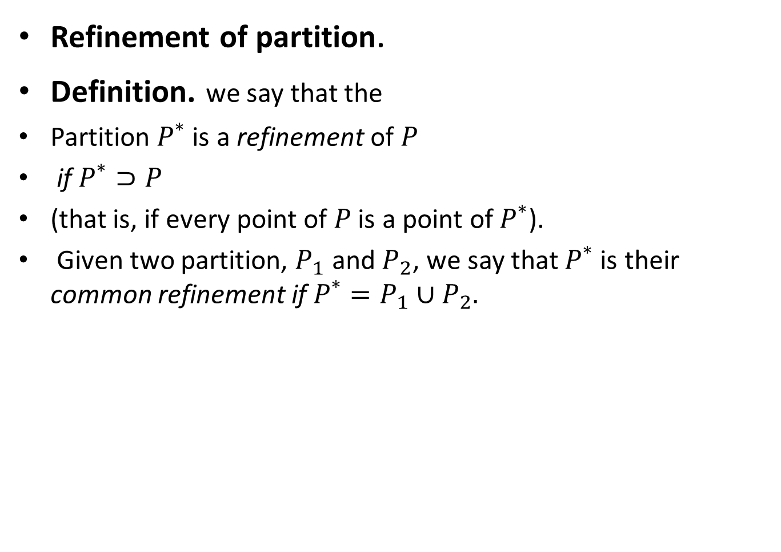
Refinement of partition.
Definition.we say that the
Partition $P^{∗}$ is a refinement of $P$
if $P^{∗}⊃P$
(that is, if every point of $P$ is a point of $P^{∗}$).
Given two partition, $P_{1}$ and $P_{2}$, we say that $P^{∗}$ is their common refinement if $P^{∗}=P_{1}∪P_{2}.$

Slide 12

Theorem.
If $p^{∗}$ is a refinement of p, then
$L\left(p,f\right)≤L(p^{∗},f)$ and
$U(p^{∗},f)≤U(p,f)$

Slide 18

Theorem.
$\int_{\underline{a}}^{b}{f\left(x\right)dx} ≤ \int_{a}^{\overline{b}}{f\left(x\right)dx}$

Slide 20
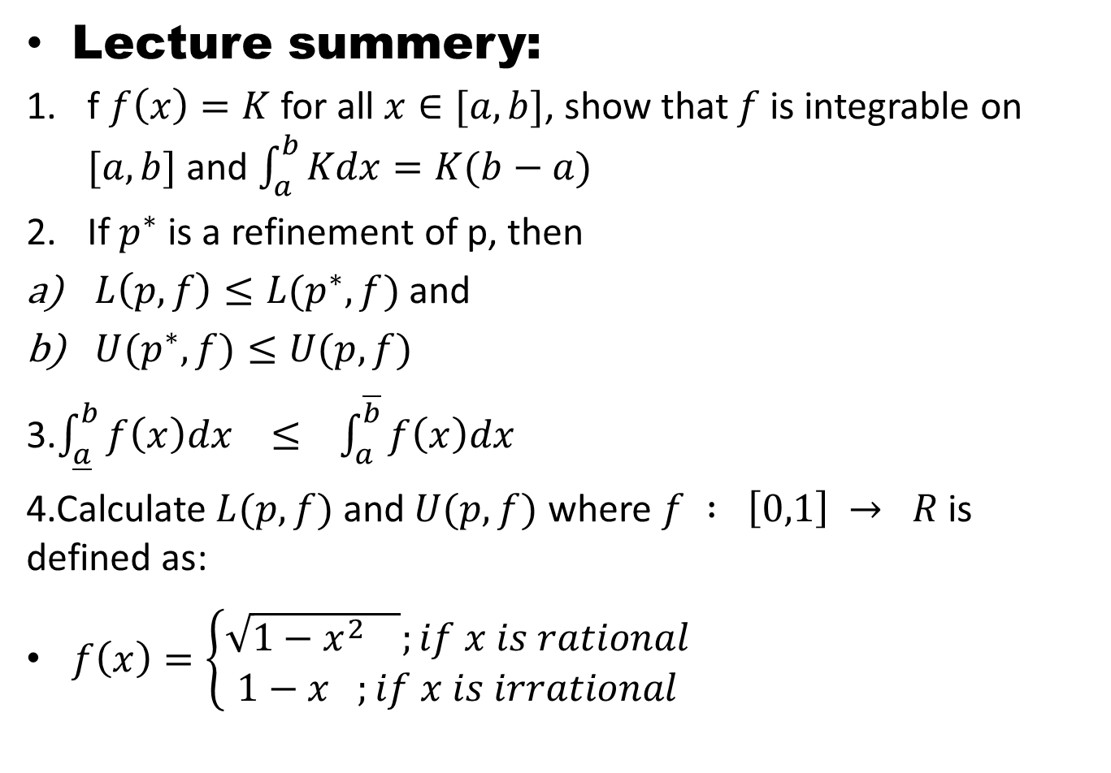
Lecture summery:
f $f\left(x\right)=K$ for all $x∈[a,b]$, show that $f$ is integrable on $[a,b]$ and $\int_{a}^{b}{Kdx}=K(b−a)$
If $p^{∗}$ is a refinement of p, then
$L\left(p,f\right)≤L(p^{∗},f)$ and
$U(p^{∗},f)≤U(p,f)$
3.$\int_{\underline{a}}^{b}{f\left(x\right)dx} ≤ \int_{a}^{\overline{b}}{f\left(x\right)dx}$
4.Calculate $L(p,f)$ and $U(p,f)$ where $f : \left[0,1\right] → R$ is defined as:
$f\left(x\right)=\left\{\begin{aligned}\sqrt{1−x^{2} };if x is rational \\ 1−x ;if x is irrational\end{aligned}\right.$

Slide 21
THANK YOU

