Slide 1
Real Analysis I
Course Code MTH 321
By
Dr. Moiz ud Din khan
Professor of Mathematics

Slide 2
Lecture # 28

Slide 3

Lecture Outline
In this Lecture we will discuss following examples
Calculate $L(p,f)$ and $U(p,f)$ where $f : \left[0,1\right] → R$ is defined as:
$f\left(x\right)=\left\{\begin{aligned}\sqrt{1−x^{2} };if x is rational \\ 1−x ;if x is irrational\end{aligned}\right.$

Slide 4

Lecture Outline
In this Lecture we will discuss following examples
Calculate $L(p,f)$ and $U(p,f)$ where $f : \left[0,1\right] → R$ is defined as:
$f\left(x\right)=\left\{\begin{aligned}\sqrt{1−x^{2} };if x is rational \\ 1−x ;if x is irrational\end{aligned}\right.$
2. $\left\{\begin{aligned}sin\frac{1}{x} ;for irrational x ∈[0,1] \\ 0 ;for r rational x ∈[0,1]\end{aligned}\right.$
Then show that f is not Riemann integrable on [0,1].

Slide 5
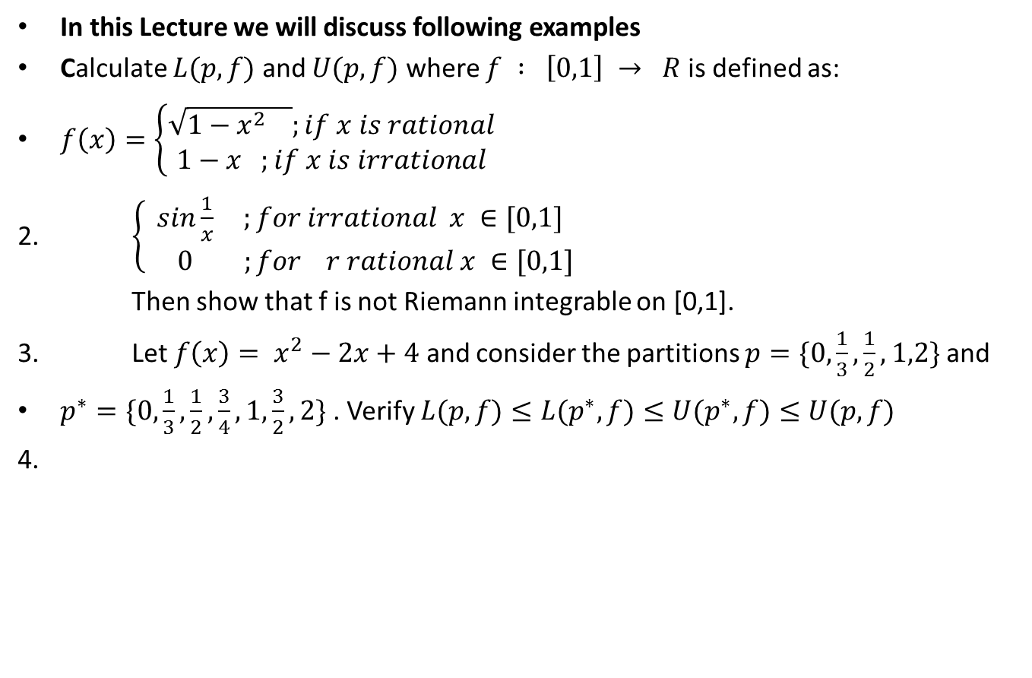
Lecture Outline
In this Lecture we will discuss following examples
Calculate $L(p,f)$ and $U(p,f)$ where $f : \left[0,1\right] → R$ is defined as:
$f\left(x\right)=\left\{\begin{aligned}\sqrt{1−x^{2} };if x is rational \\ 1−x ;if x is irrational\end{aligned}\right.$
2. $\left\{\begin{aligned}sin\frac{1}{x} ;for irrational x ∈[0,1] \\ 0 ;for r rational x ∈[0,1]\end{aligned}\right.$
Then show that f is not Riemann integrable on [0,1].
3. Let $f\left(x\right)= x^{2}−2x+4$ and consider the partitions $p=\{0,\frac{1}{3}, \frac{1}{2}, 1,2\}$ and
$p^{∗}=\{0,\frac{1}{3}, \frac{1}{2}, \frac{3}{4},1, \frac{3}{2},2\}$ . Verify $L(p,f)≤L(p^{∗},f)≤U(p^{∗},f)≤U(p,f)$
4.

Slide 6
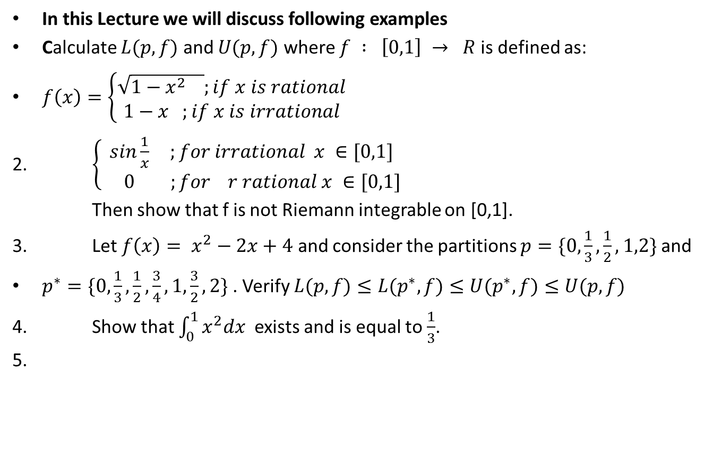
Lecture Outline
In this Lecture we will discuss following examples
Calculate $L(p,f)$ and $U(p,f)$ where $f : \left[0,1\right] → R$ is defined as:
$f\left(x\right)=\left\{\begin{aligned}\sqrt{1−x^{2} };if x is rational \\ 1−x ;if x is irrational\end{aligned}\right.$
2. $\left\{\begin{aligned}sin\frac{1}{x} ;for irrational x ∈[0,1] \\ 0 ;for r rational x ∈[0,1]\end{aligned}\right.$
Then show that f is not Riemann integrable on [0,1].
3. Let $f\left(x\right)= x^{2}−2x+4$ and consider the partitions $p=\{0,\frac{1}{3}, \frac{1}{2}, 1,2\}$ and
$p^{∗}=\{0,\frac{1}{3}, \frac{1}{2}, \frac{3}{4},1, \frac{3}{2},2\}$ . Verify $L(p,f)≤L(p^{∗},f)≤U(p^{∗},f)≤U(p,f)$
4. Show that $\int_{0}^{1}{x^{2}dx}$ exists and is equal to $\frac{1}{3}$.
5.

Slide 7
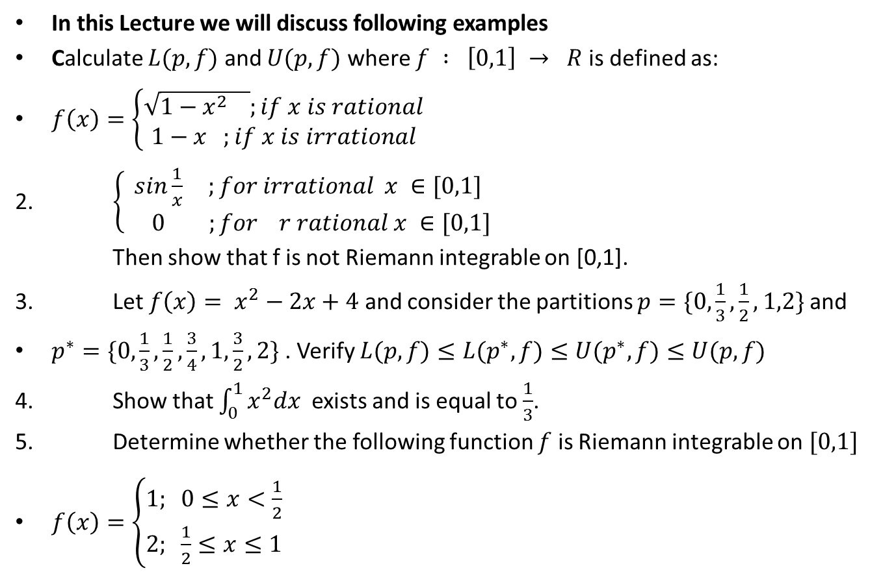
Lecture Outline
In this Lecture we will discuss following examples
Calculate $L(p,f)$ and $U(p,f)$ where $f : \left[0,1\right] → R$ is defined as:
$f\left(x\right)=\left\{\begin{aligned}\sqrt{1−x^{2} };if x is rational \\ 1−x ;if x is irrational\end{aligned}\right.$
2. $\left\{\begin{aligned}sin\frac{1}{x} ;for irrational x ∈[0,1] \\ 0 ;for r rational x ∈[0,1]\end{aligned}\right.$
Then show that f is not Riemann integrable on [0,1].
3. Let $f\left(x\right)= x^{2}−2x+4$ and consider the partitions $p=\{0,\frac{1}{3}, \frac{1}{2}, 1,2\}$ and
$p^{∗}=\{0,\frac{1}{3}, \frac{1}{2}, \frac{3}{4},1, \frac{3}{2},2\}$ . Verify $L(p,f)≤L(p^{∗},f)≤U(p^{∗},f)≤U(p,f)$
4. Show that $\int_{0}^{1}{x^{2}dx}$ exists and is equal to $\frac{1}{3}$.
5. Determine whether the following function $f$ is Riemann integrable on $[0,1]$
$f\left(x\right)=\left\{\begin{aligned}1; 0≤x<\frac{1}{2} \\ 2; \frac{1}{2}≤x≤1\end{aligned}\right.$

Slide 8
Short Revision.

Slide 10

Example.
Calculate $L(p,f)$ and $U(p,f)$ where $f : \left[0,1\right] → R$ is defined as:
$f\left(x\right)=\left\{\begin{aligned}\sqrt{1−x^{2} };if x is rational \\ 1−x ;if x is irrational\end{aligned}\right.$

Slide 12

Example.
If $\left\{\begin{aligned}sin\frac{1}{x} ;for irrational x ∈[0,1] \\ 0 ;for r rational x ∈[0,1]\end{aligned}\right.$
Then show that f is not Riemann integrable on [0,1].

Slide 15

Example.
Let $f\left(x\right)= x^{2}−2x+4$ and consider the partitions $p=\{0,\frac{1}{3}, \frac{1}{2}, 1,2\}$ and
$p^{∗}=\{0,\frac{1}{3}, \frac{1}{2}, \frac{3}{4},1, \frac{3}{2},2\}$ . Verify
$L(p,f)≤L(p^{∗},f)≤U(p^{∗},f)≤U(p,f)$

Slide 19

Example.
Show that $\int_{0}^{1}{x^{2}dx}$ exists and is equal to $\frac{1}{3}$.

Slide 23

Example.
Determine whether the following function $f$ is Rieman integrable on $[0,1]$
$f\left(x\right)=\left\{\begin{aligned}1; 0≤x<\frac{1}{2} \\ 2; \frac{1}{2}≤x≤1\end{aligned}\right.$

Slide 24
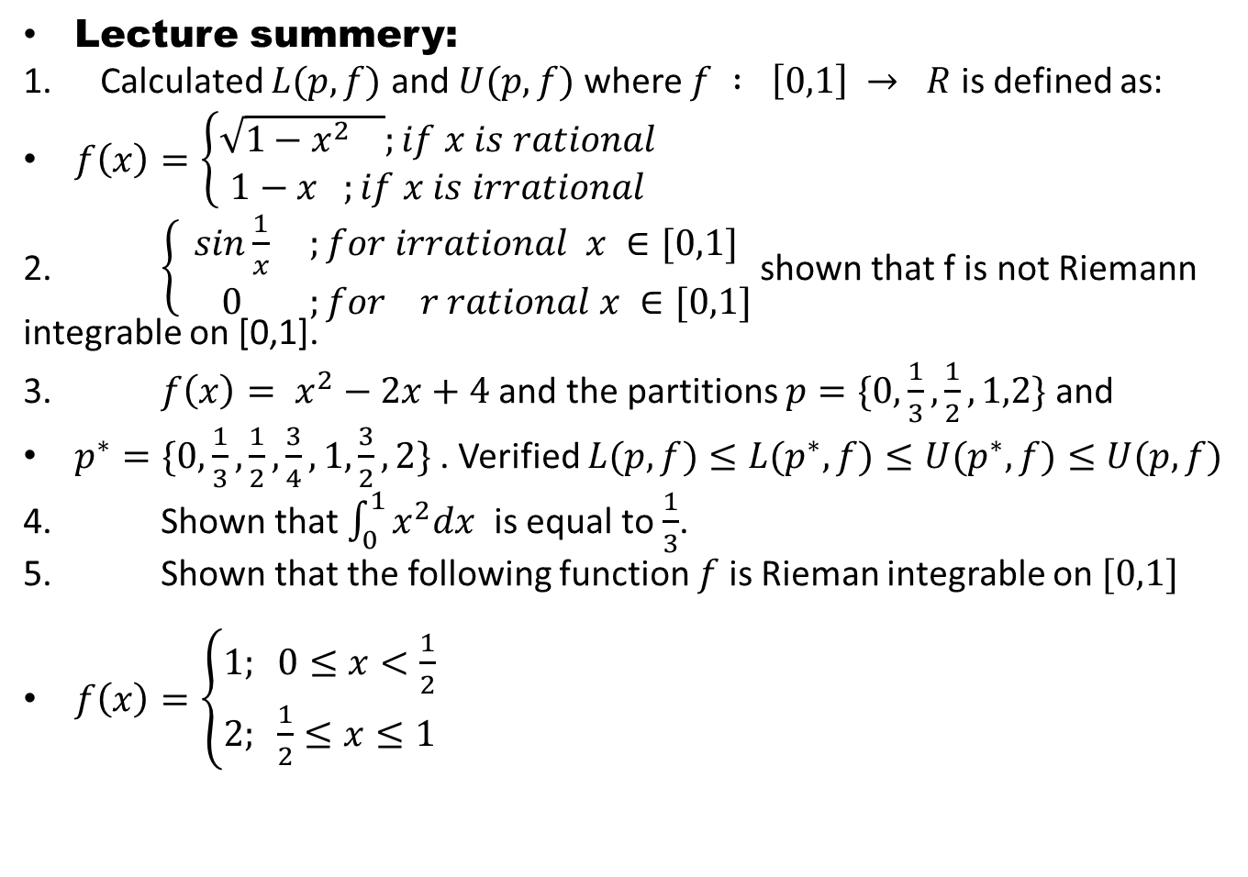
Lecture summery:
Calculated $L(p,f)$ and $U(p,f)$ where $f : \left[0,1\right] → R$ is defined as:
$f\left(x\right)=\left\{\begin{aligned}\sqrt{1−x^{2} };if x is rational \\ 1−x ;if x is irrational\end{aligned}\right.$
2. $\left\{\begin{aligned}sin\frac{1}{x} ;for irrational x ∈[0,1] \\ 0 ;for r rational x ∈[0,1]\end{aligned}\right.$ shown that f is not Riemann integrable on [0,1].
3. $f\left(x\right)= x^{2}−2x+4$ and the partitions $p=\{0,\frac{1}{3}, \frac{1}{2}, 1,2\}$ and
$p^{∗}=\{0,\frac{1}{3}, \frac{1}{2}, \frac{3}{4},1, \frac{3}{2},2\}$ . Verified $L(p,f)≤L(p^{∗},f)≤U(p^{∗},f)≤U(p,f)$
4. Shown that $\int_{0}^{1}{x^{2}dx}$is equal to $\frac{1}{3}$.
5. Shown that the following function $f$ is Rieman integrable on $[0,1]$
$f\left(x\right)=\left\{\begin{aligned}1; 0≤x<\frac{1}{2} \\ 2; \frac{1}{2}≤x≤1\end{aligned}\right.$

Slide 25
THANK YOU

