Slide 1
Real Analysis I
Course Code MTH 321
By
Dr. Moiz ud Din khan
Professor of Mathematics

Slide 2
Lecture # 29

Slide 3

Lecture Outline
In this Lecture we will state and prove
A bounded function $f$ on $[a,b]$ is integrable over $[a,b]$ if and only if, for each $∈>0$, there is a partition p of $[a,b]$ such that
  $$U\left(p,f\right)−L(p,f)<∈$$

Slide 4

Lecture Outline
In this Lecture we will state and prove
A bounded function $f$ on $[a,b]$ is integrable over $[a,b]$ if and only if, for each $∈>0$, there is a partition p of $[a,b]$ such that
  $$U\left(p,f\right)−L(p,f)<∈$$
Prove that the bracket function is integrable on $[a,b]$

Slide 5
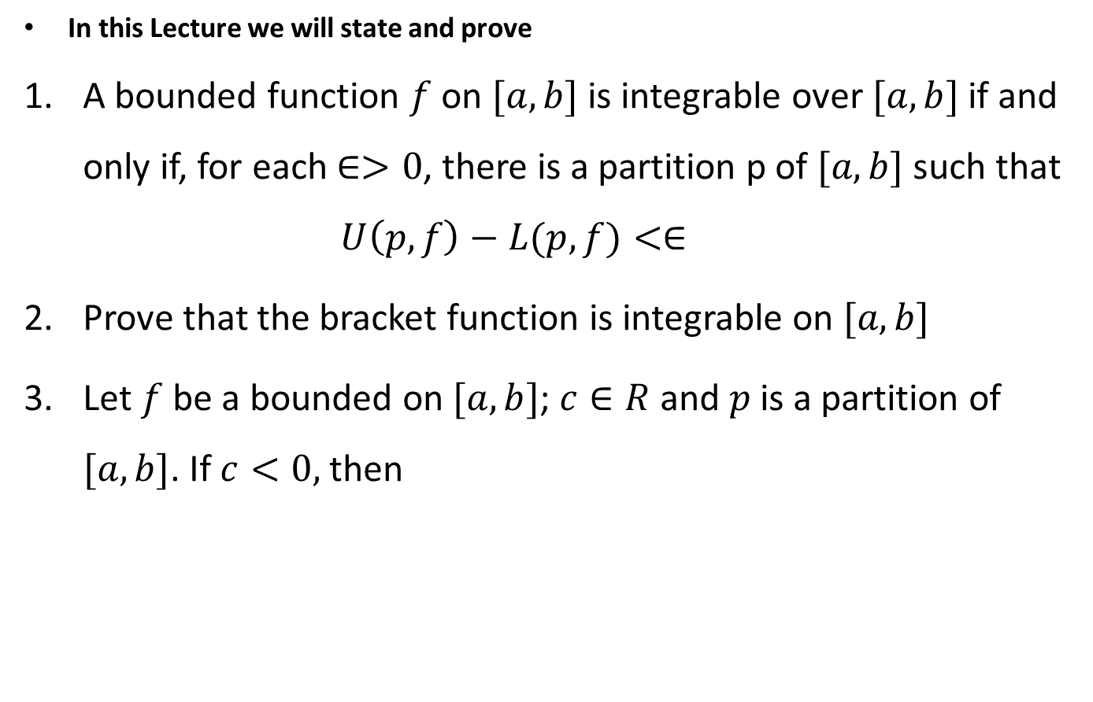
Lecture Outline
In this Lecture we will state and prove
A bounded function $f$ on $[a,b]$ is integrable over $[a,b]$ if and only if, for each $∈>0$, there is a partition p of $[a,b]$ such that
  $$U\left(p,f\right)−L(p,f)<∈$$
Prove that the bracket function is integrable on $[a,b]$
Let $f$ be a bounded on $[a,b]$; $c∈R$ and $p$ is a partition of $[a,b]$. If $c<0,$ then

Slide 6
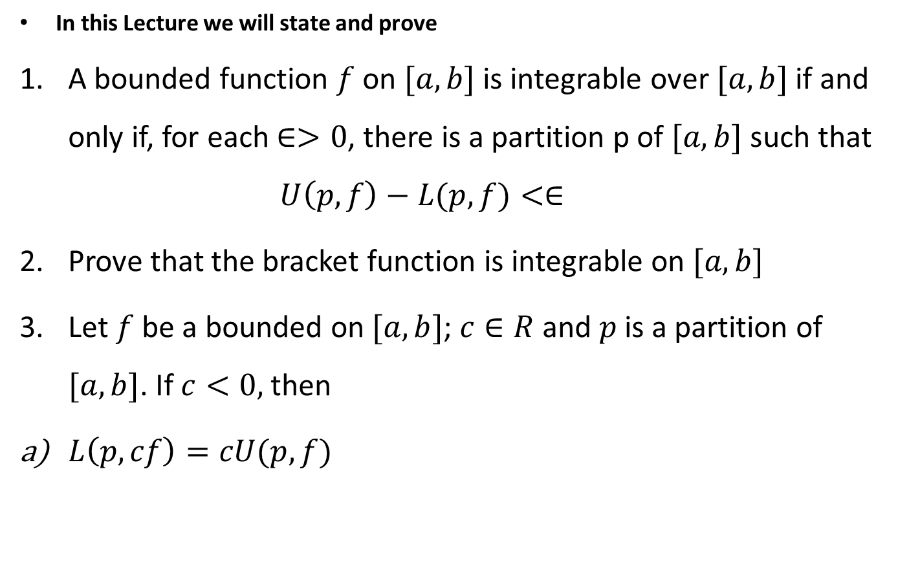
Lecture Outline
In this Lecture we will state and prove
A bounded function $f$ on $[a,b]$ is integrable over $[a,b]$ if and only if, for each $∈>0$, there is a partition p of $[a,b]$ such that
  $$U\left(p,f\right)−L(p,f)<∈$$
Prove that the bracket function is integrable on $[a,b]$
Let $f$ be a bounded on $[a,b]$; $c∈R$ and $p$ is a partition of $[a,b]$. If $c<0,$ then
$L\left(p,cf\right)=cU(p,f)$

Slide 7
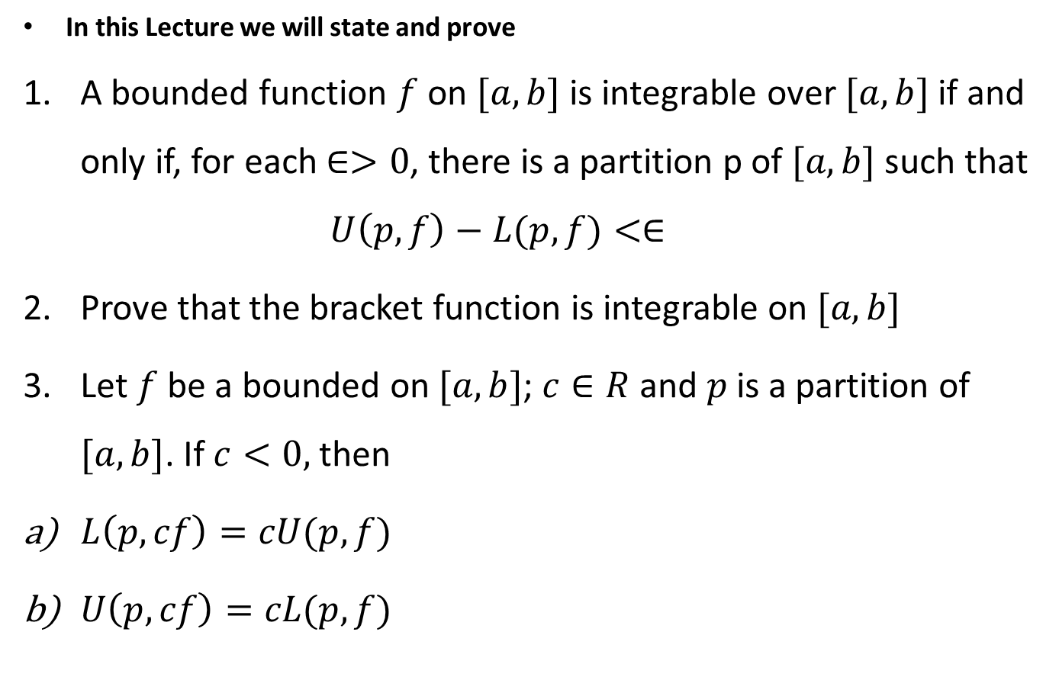
Lecture Outline
In this Lecture we will state and prove
A bounded function $f$ on $[a,b]$ is integrable over $[a,b]$ if and only if, for each $∈>0$, there is a partition p of $[a,b]$ such that
  $$U\left(p,f\right)−L(p,f)<∈$$
Prove that the bracket function is integrable on $[a,b]$
Let $f$ be a bounded on $[a,b]$; $c∈R$ and $p$ is a partition of $[a,b]$. If $c<0,$ then
$L\left(p,cf\right)=cU(p,f)$
$U\left(p,cf\right)=cL(p,f)$

Slide 8
Short Recall

Slide 10

Theorem.
A bounded function $f$ on $[a,b]$ is integrable over $[a,b]$ if and only if, for each $∈>0$, there is a partition p of $[a,b]$such that
  $$U\left(p,f\right)−L(p,f)<∈$$

Slide 15

Example.
Prove that the bracket function is integrable on $[3,6]$

Slide 20

Theorem.
Let $f$ be a bounded function on $[a,b]$; $c∈R$ and $p$ is a partition of $[a,b]$. If $c<0,$ then
$L\left(p,cf\right)=cU(p,f)$
$U\left(p,cf\right)=cL(p,f)$

Slide 25
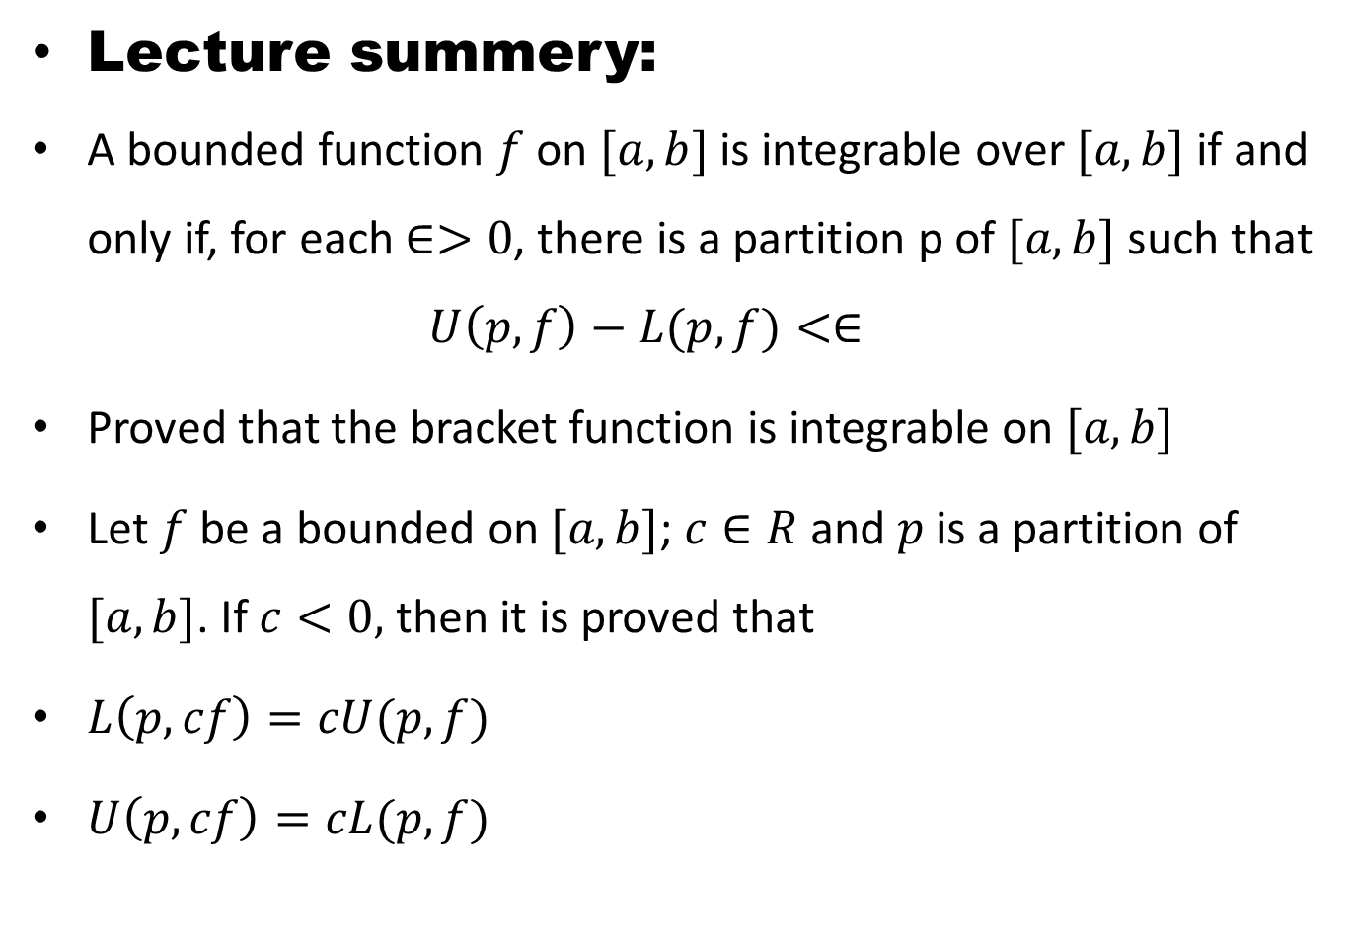
Lecture summery:
A bounded function $f$ on $[a,b]$ is integrable over $[a,b]$ if and only if, for each $∈>0$, there is a partition p of $[a,b]$ such that
  $$U\left(p,f\right)−L(p,f)<∈$$
Proved that the bracket function is integrable on $[a,b]$
Let $f$ be a bounded on $[a,b]$; $c∈R$ and $p$ is a partition of $[a,b]$. If $c<0,$ then it is proved that
$L\left(p,cf\right)=cU(p,f)$
$U\left(p,cf\right)=cL(p,f)$

Slide 26
THANK YOU

