Slide 1
Real Analysis I
Course Code MTH 321
By
Dr. Moiz ud Din khan
Professor of Mathematics

Slide 2
Lecture # 03

Slide 3
Lecture Outline
In this Lecture we will prove and Define:

Slide 4

Lecture Outline
In this Lecture we will prove and Define:
There is no rational number p for which $p^{2}=2$

Slide 5

Lecture Outline
In this Lecture we will prove and Define:
There is no rational number p for which $p^{2}=2$
Let $A=\{p/{{p∈Q;p>0 and p}^{2}} <2\}$ , show that A contains no largest member.

Slide 6

Lecture Outline
In this Lecture we will prove and Define:
There is no rational number p for which $p^{2}=2$
Let $A=\{p/{{p∈Q;p>0 and p}^{2}} <2\}$ , show that A contains no largest member.
Show that between any two rational numbers there exists an other rational number.

Slide 7
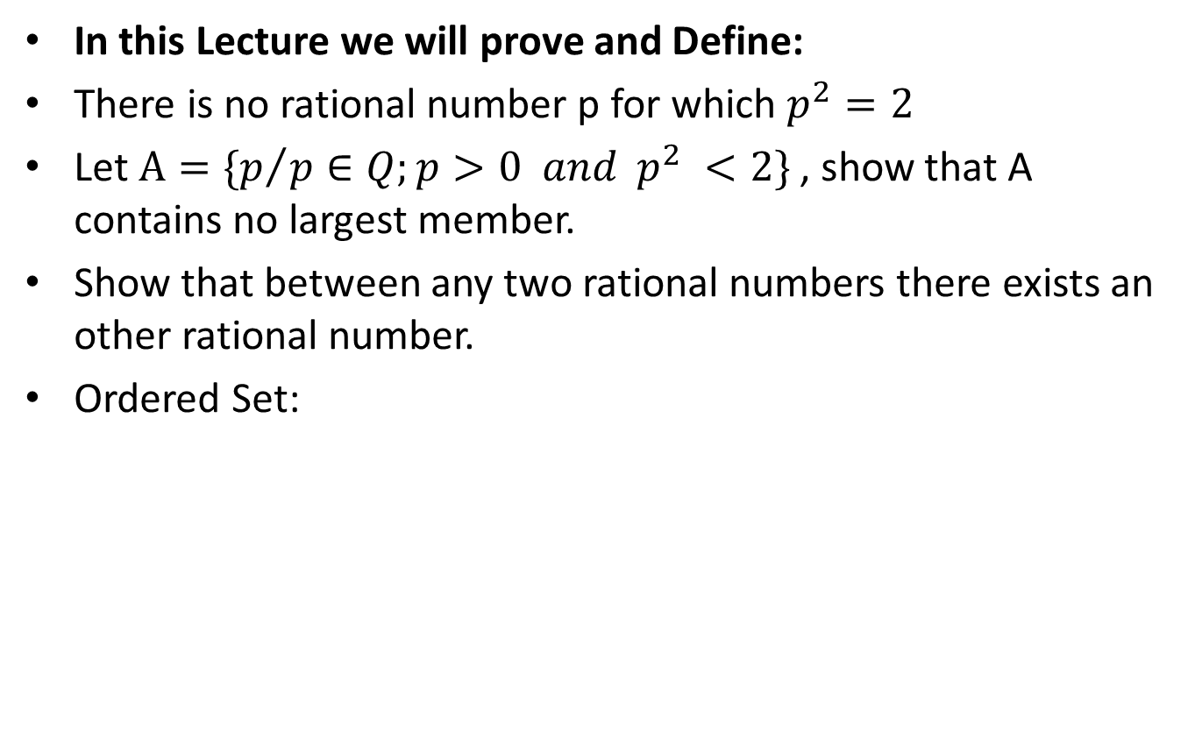
Lecture Outline
In this Lecture we will prove and Define:
There is no rational number p for which $p^{2}=2$
Let $A=\{p/{{p∈Q;p>0 and p}^{2}} <2\}$ , show that A contains no largest member.
Show that between any two rational numbers there exists an other rational number.
Ordered Set:

Slide 8
Revision: Rational Numbers

Slide 10

Theorem.
Prove that there is no rational number p for which $p^{2}=2$
Proof.

Slide 15

Theorem.Let $A=\{p/{{p∈Q;p>0 and p}^{2}} <2\}$ , show that A contains no largest member.
Proof.

Slide 21
Problem. Show that between any two rational numbers there exists an other rational number.
Solution.

Slide 23
Ordered Set:
Definition:

Slide 24

Ordered Set:
Definition: Let S be a set. An order on S is a relation, denoted by $"<“$ with the following two properties:

Slide 25
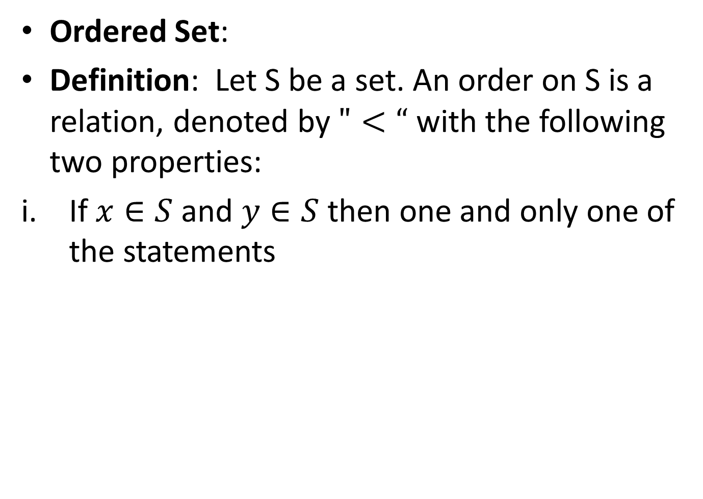
Ordered Set:
Definition: Let S be a set. An order on S is a relation, denoted by $"<“$ with the following two properties:
If $x∈S$ and $y∈S$ then one and only one of the statements

Slide 26
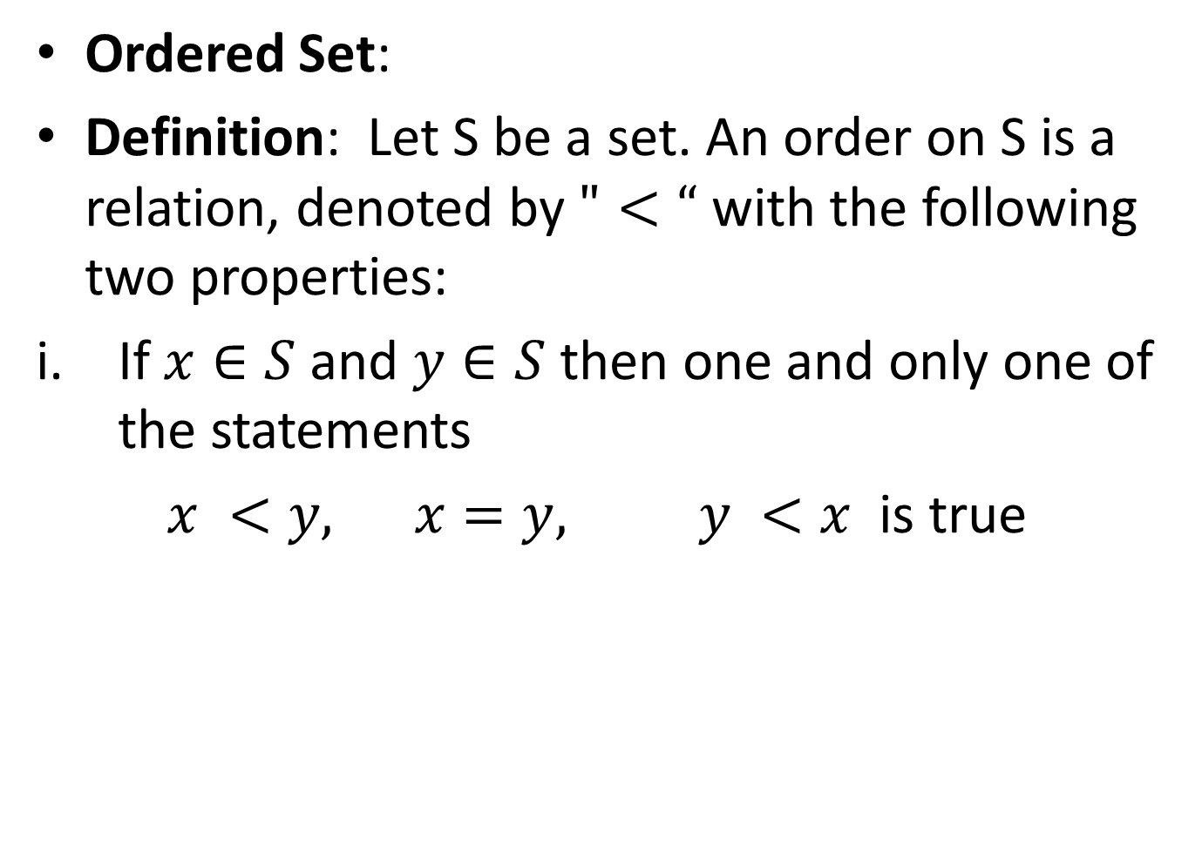
Ordered Set:
Definition: Let S be a set. An order on S is a relation, denoted by $"<“$ with the following two properties:
If $x∈S$ and $y∈S$ then one and only one of the statements
$x <y, x=y, y <x$ is true

Slide 27
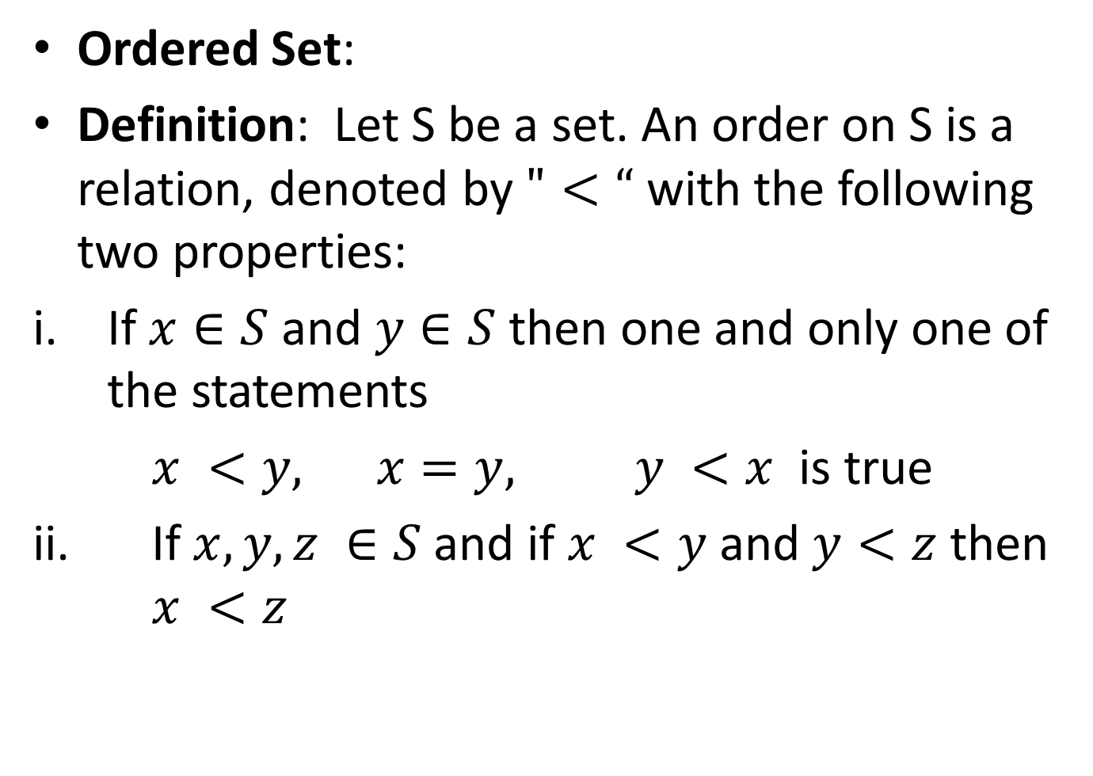
Ordered Set:
Definition: Let S be a set. An order on S is a relation, denoted by $"<“$ with the following two properties:
If $x∈S$ and $y∈S$ then one and only one of the statements
$x <y, x=y, y <x$ is true
ii. If $x, y, z ∈S$ and if $x <y$ and $y<z$ then $x <z$

Slide 28
Note That:

Slide 29
Note That:
An ordered set is a set S in which an order is defined.

Slide 30
Note That:
An ordered set is a set S in which an order is defined.
Q is an ordered set.

Slide 31
Note That:
An ordered set is a set S in which an order is defined.
Q is an ordered set.
Every ordered set with least upper bound property also has greatest lower bound property.

Slide 32
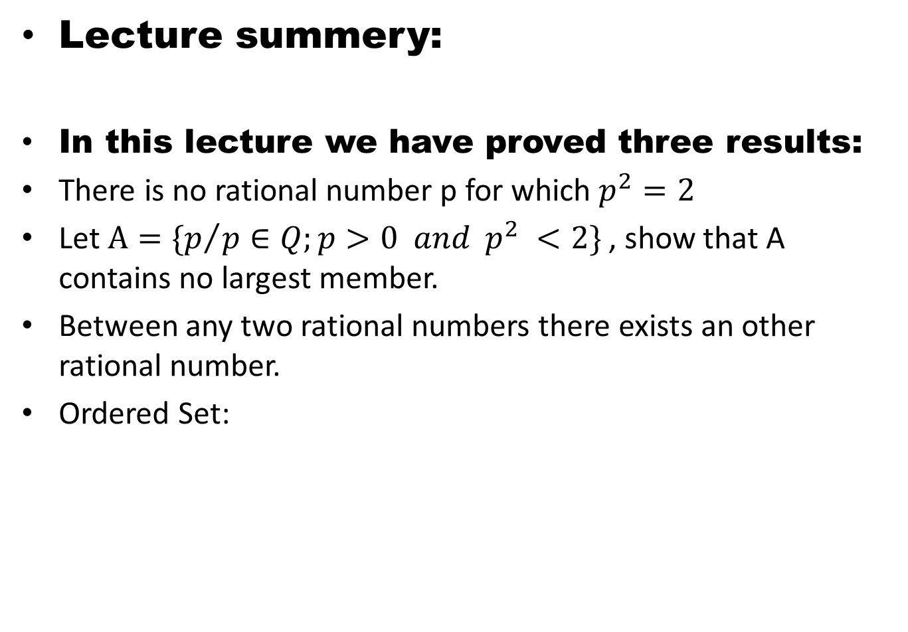
Lecture summery:
In this lecture we have proved three results:
There is no rational number p for which $p^{2}=2$
Let $A=\{p/{{p∈Q;p>0 and p}^{2}} <2\}$ , show that A contains no largest member.
Between any two rational numbers there exists an other rational number.
Ordered Set:

Slide 33
THANK YOU

