Slide 1
Real Analysis I
Course Code MTH 321
By
Dr. Moiz ud Din khan
Professor of Mathematics

Slide 2
Lecture # 04

Slide 3
Lecture Outline
In this Lecture we will prove two theorems:

Slide 4
Lecture Outline
In this Lecture we will prove two theorems:
The set of Rational numbers Q does not have least upper bound property.

Slide 5
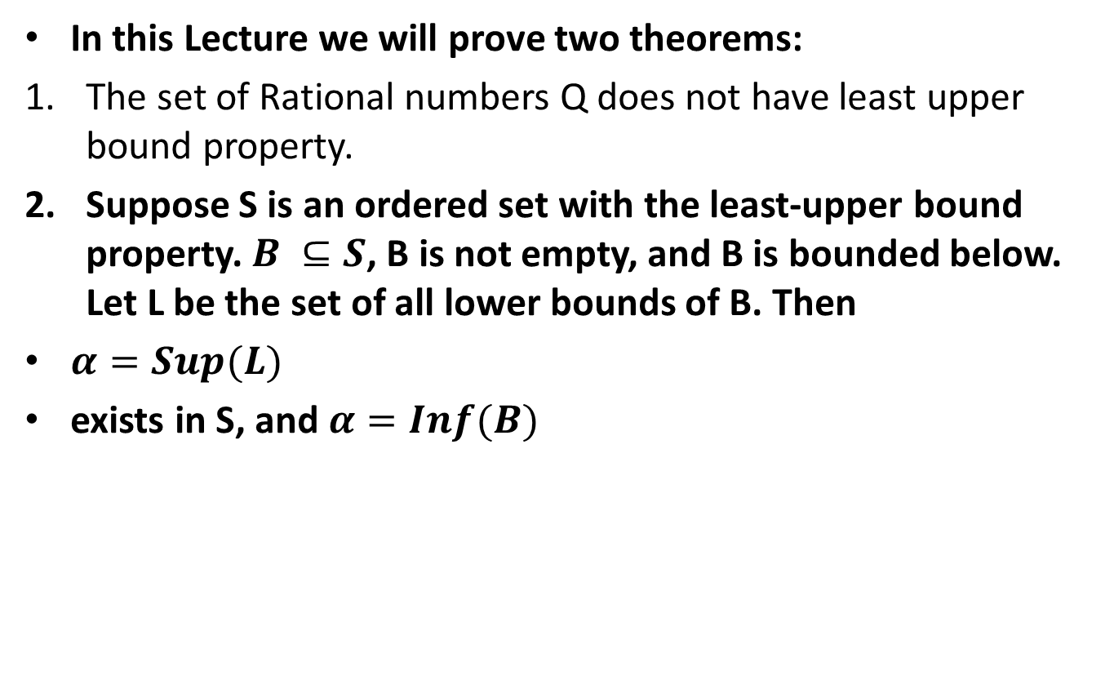
Lecture Outline
In this Lecture we will prove two theorems:
The set of Rational numbers Q does not have least upper bound property.
Suppose S is an ordered set with the least-upper bound property. $B ⊆S$, B is not empty, and B is bounded below. Let L be the set of all lower bounds of B. Then
$α=Sup(L)$
exists in S, and $α=Inf(B)$

Slide 6

Proposition: The set of Rational numbers $ℚ$does not have least upper bound property.
Proof.

Slide 12

Theorem. Suppose S is an ordered set with the least-upper bound property. $B ⊆S$, B is not empty, and B is bounded below. Let L be the set of all lower bounds of B. Then
$α=Sup\left(L\right)$exists in S, and $α=Inf(B)$
Proof.

Slide 19
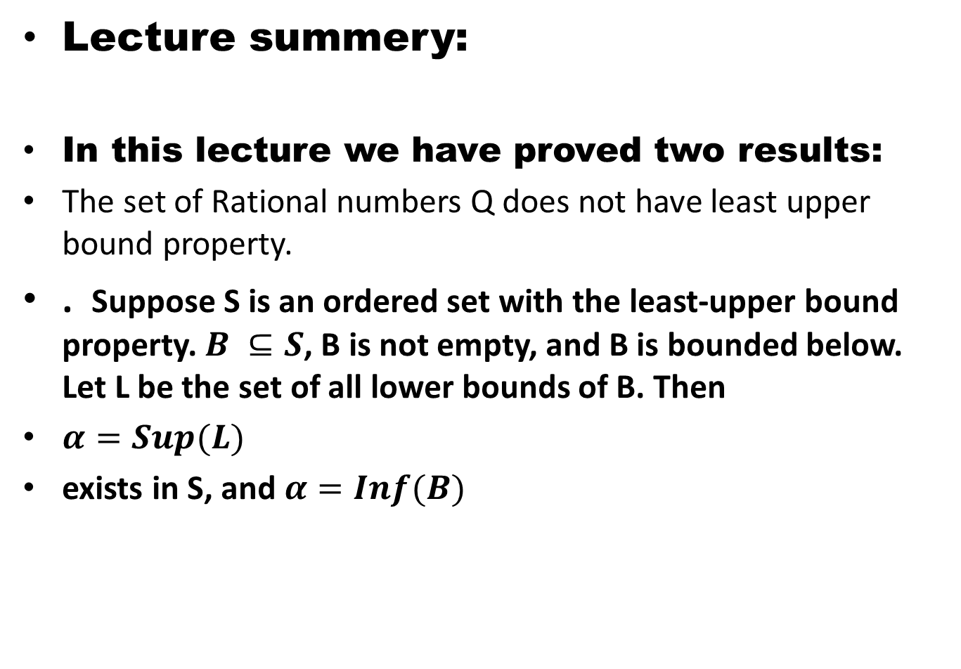
Lecture summery:
In this lecture we have proved two results:
The set of Rational numbers Q does not have least upper bound property.
. Suppose S is an ordered set with the least-upper bound property. $B ⊆S$, B is not empty, and B is bounded below. Let L be the set of all lower bounds of B. Then
$α=Sup(L)$
exists in S, and $α=Inf(B)$

Slide 20
THANK YOU

