Slide 1
Real Analysis I
Course Code MTH 321
By
Dr. Moiz ud Din khan
Professor of Mathematics

Slide 2
Lecture # 05

Slide 3
Lecture Outline
In this Lecture we will prove two theorems:

Slide 4

Lecture Outline
In this Lecture we will prove two theorems:
If $x ∈R, y∈R, and x>0,$ then there is a positive integer n such that $nx >y.$

Slide 5

Lecture Outline
In this Lecture we will prove two theorems:
If $x ∈R, y∈R, and x>0,$ then there is a positive integer n such that $nx >y.$
If $x ∈R, y∈R, and x<y,$then there exists a $p∈Q$such that $x<p<y$

Slide 6

Lecture Outline
In this Lecture we will prove two theorems:
If $x ∈R, y∈R, and x>0,$ then there is a positive integer n such that $nx >y.$
If $x ∈R, y∈R, and x<y,$then there exists a $p∈Q$such that $x<p<y$
We will define some notions

Slide 7
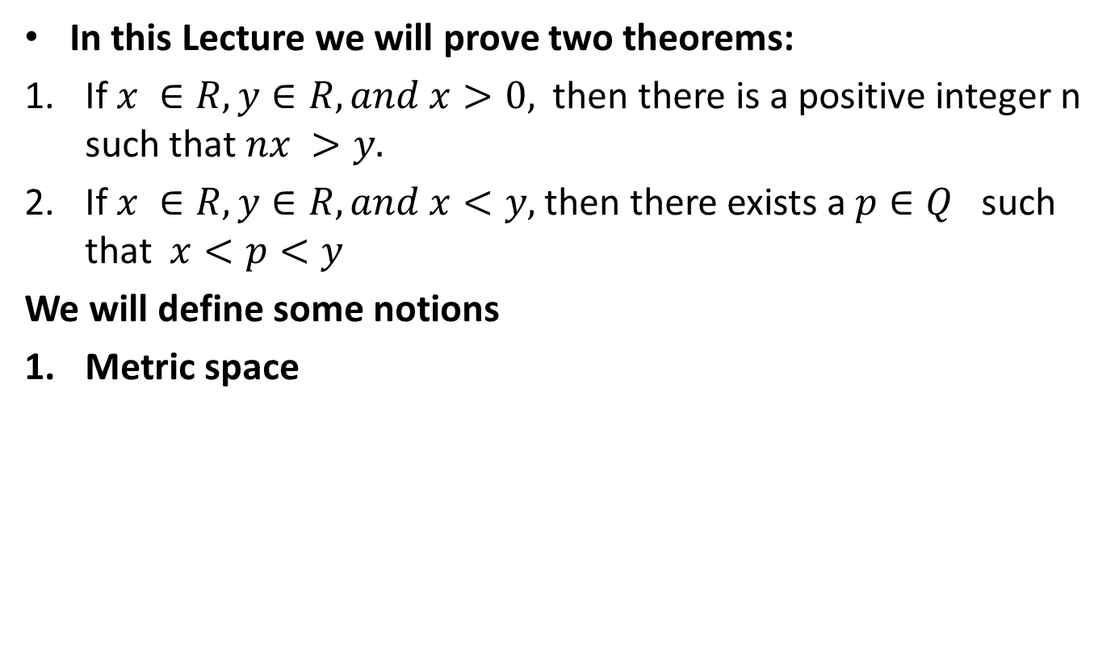
Lecture Outline
In this Lecture we will prove two theorems:
If $x ∈R, y∈R, and x>0,$ then there is a positive integer n such that $nx >y.$
If $x ∈R, y∈R, and x<y,$then there exists a $p∈Q$such that $x<p<y$
We will define some notions
Metric space

Slide 8
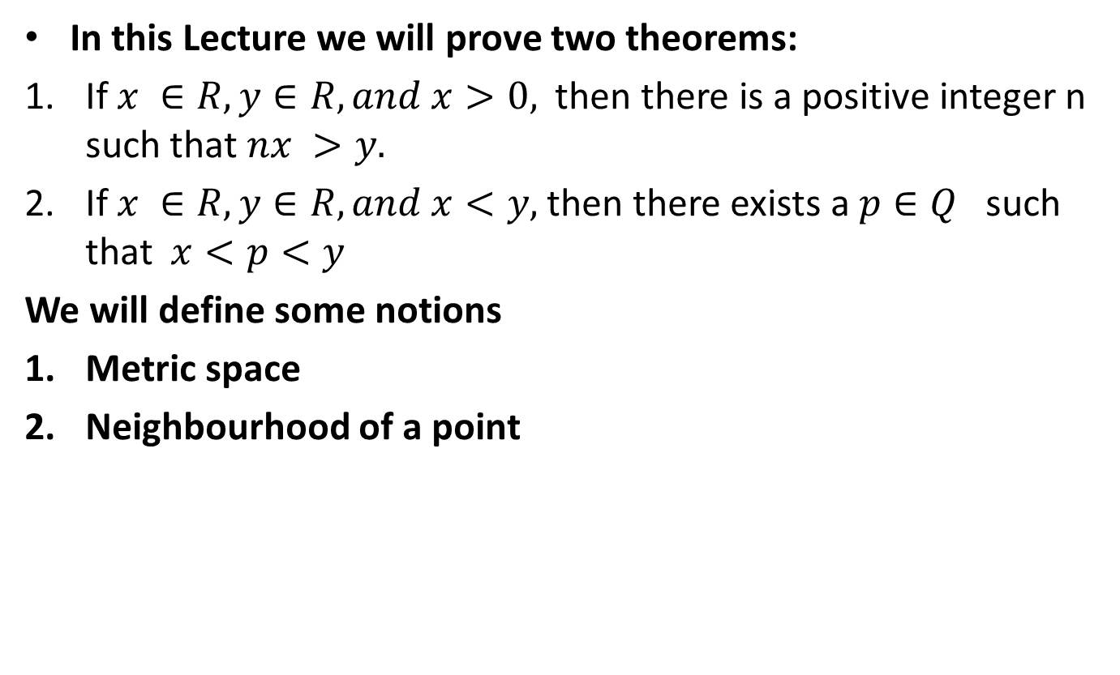
Lecture Outline
In this Lecture we will prove two theorems:
If $x ∈R, y∈R, and x>0,$ then there is a positive integer n such that $nx >y.$
If $x ∈R, y∈R, and x<y,$then there exists a $p∈Q$such that $x<p<y$
We will define some notions
Metric space
Neighbourhood of a point

Slide 9
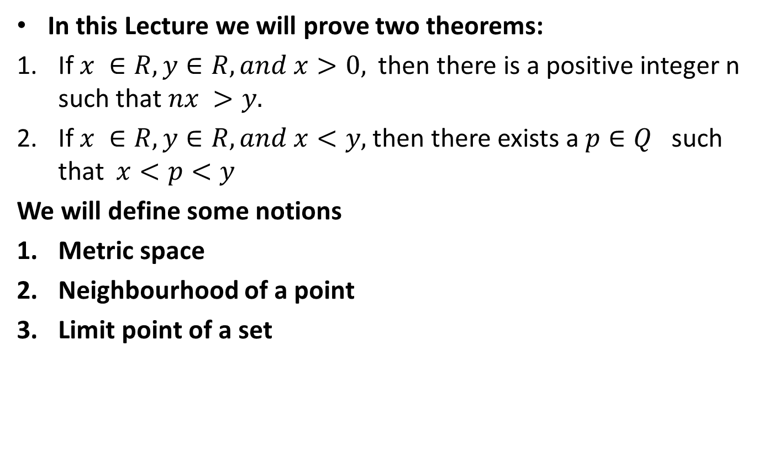
Lecture Outline
In this Lecture we will prove two theorems:
If $x ∈R, y∈R, and x>0,$ then there is a positive integer n such that $nx >y.$
If $x ∈R, y∈R, and x<y,$then there exists a $p∈Q$such that $x<p<y$
We will define some notions
Metric space
Neighbourhood of a point
Limit point of a set

Slide 10

Theorem.If $x ∈R, y∈R, and x>0,$ then there is a positive integer n such that $nx >y.$
Proof.

Slide 14

Theorem.If $x ∈R, y∈R, and x<y,$then there exists a $p∈Q such that x<p<y.$
Proof.

Slide 18
Metric Space:

Slide 21

Definition. Let$(X,d)$ be a metric space. $A neighborhood$ of a point $p$ is a set $N_{r}(p)$ consisting of all points $q$ such that $d\left(p, q\right)<r.$ The number $r$ is called the radius of $N_{r}(p)$.
.

Slide 23

Note that in $R^{1}$,neighborhoods are segments, whereas in $R^{2}$, neighborhoods are interiors of circles.

Slide 25
Definition. Let$(X,d)$ be a metric space. A point $p$ is a limit $point$ of the set $E⊆X$ if every neighborhood of $p$ contains a point $q≠p$ such that $q∈E.$

Slide 27

Definition. Let$(X,d)$ be a metric space. If $p ∈E and p$ is not a limit point of $E,$ then $p$ is called an$isolated point of E.$

Slide 29
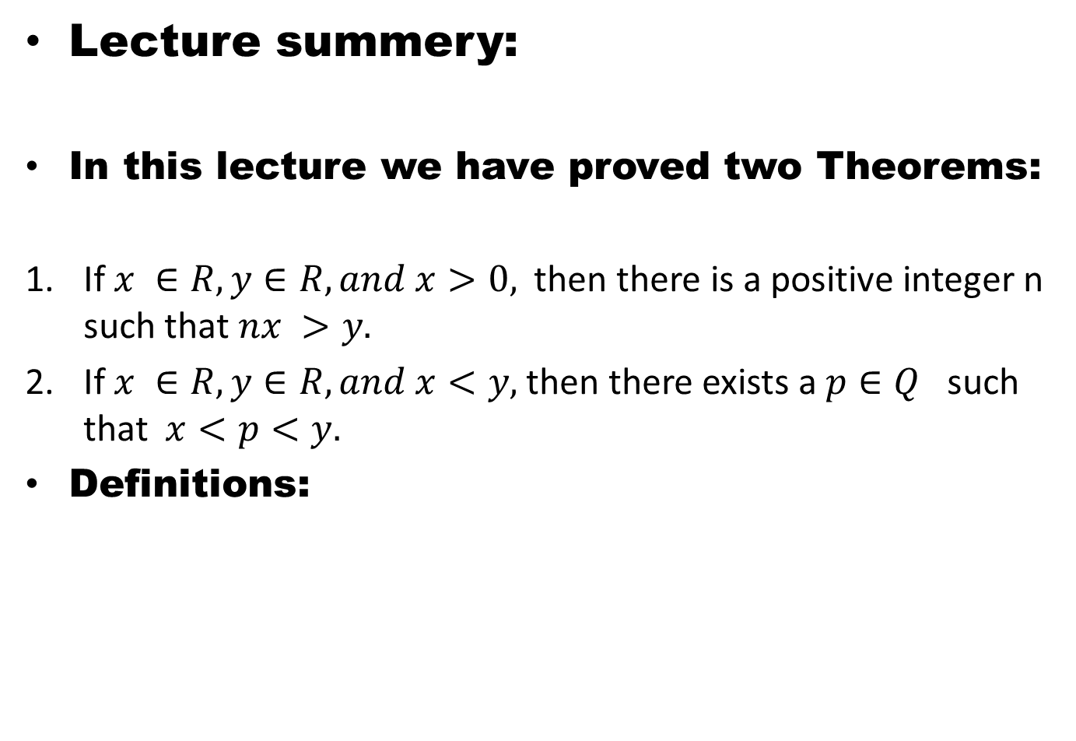
Lecture summery:
In this lecture we have proved two Theorems:
If $x ∈R, y∈R, and x>0,$ then there is a positive integer n such that $nx >y.$
If $x ∈R, y∈R, and x<y,$then there exists a $p∈Q$such that $x<p<y.$
Definitions:

Slide 30
THANK YOU

