Slide 1
Real Analysis I
Course Code MTH 321
By
Dr. Moiz ud Din khan
Professor of Mathematics

Slide 2
Lecture # 06

Slide 3
Lecture Outline
In this Lecture we recall:
Few Definitions
Closed set

Slide 4
Lecture Outline
In this Lecture we recall:
Few Definitions
Closed set
Interior of a set

Slide 5
Lecture Outline
In this Lecture we recall:
Few Definitions
Closed set
Interior of a set
Open set

Slide 6
Lecture Outline
In this Lecture we recall:
Few Definitions
Closed set
Interior of a set
Open set
Perfect set

Slide 7
Lecture Outline
In this Lecture we recall:
Few Definitions
Closed set
Interior of a set
Open set
Perfect set
Prove two theorems:

Slide 8
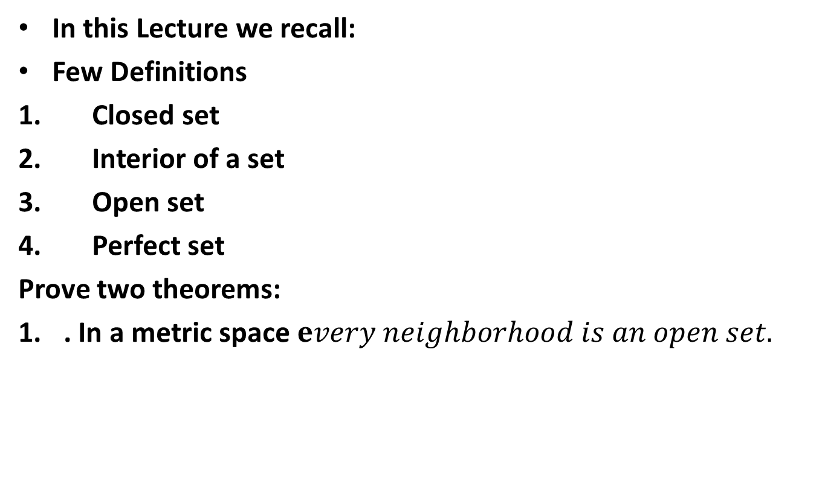
Lecture Outline
In this Lecture we recall:
Few Definitions
Closed set
Interior of a set
Open set
Perfect set
Prove two theorems:
. In a metric space $every neighborhood is an open set.$

Slide 9
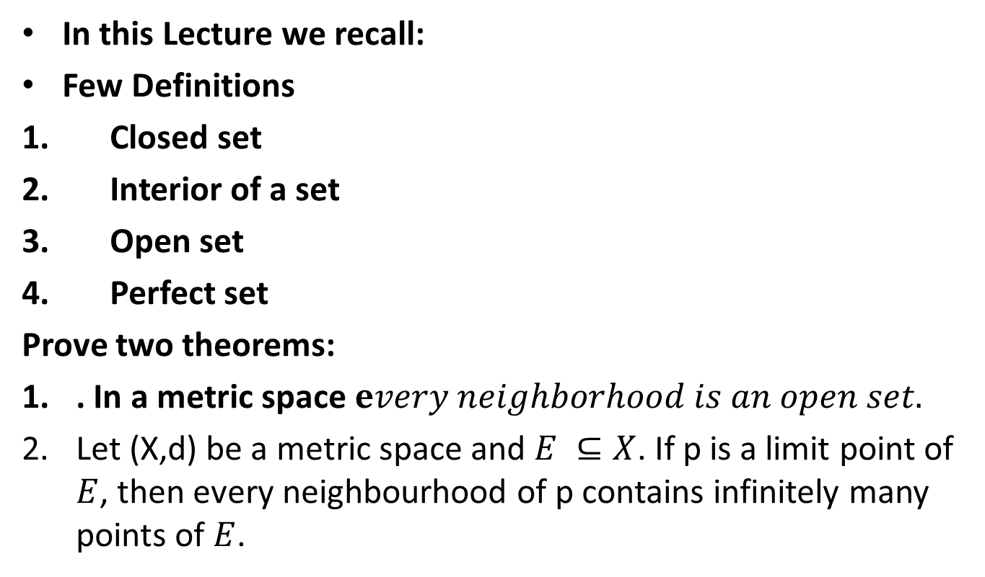
Lecture Outline
In this Lecture we recall:
Few Definitions
Closed set
Interior of a set
Open set
Perfect set
Prove two theorems:
. In a metric space $every neighborhood is an open set.$
Let (X,d) be a metric space and $E ⊆X$. If p is a limit point of $E$, then every neighbourhood of p contains infinitely many points of $E$.

Slide 10

Definition. Let$(X,d)$ be a metric space. A point $p$ is an interior point of $E$ if there is a neighborhood $N$ of $p$ such that $N⊂$$E$.

Slide 11

Definition. Let$(X,d)$ be a metric space. $E$ is open if every point of $E$ is an interior point of $E.$
The complement of $E$(denoted by $E^{c})$ is the set of all points $p∈X$ such that $p∉E.$

Slide 12

Definition. Let$(X,d)$ be a metric space. $E$ is Perfect if $E$ is closed and if every point of $E$ is a limit point of $E.$

Slide 13

Definition. Let$(X,d)$ be a metric space. $E$ is bounded if there is a real number $M$ and a point $q ∈X$ such that $d\left(p,q\right)<M$ for all $p∈E.$

Slide 14

Definition. Let$(X,d)$ be a metric space. E is dense in $X$ if every point of $X$ is a point of $E,$ or a limit point of $E($or both).

Slide 15
Theorem. In a metric space, prove that every neighbourhood is an open set.
Proof.

Slide 19

Theorem. Let (X,d) be a metric space and $E ⊆X$. If p is a limit point of $E$, then every neighbourhood of p contains infinitely many points of $E$.
Proof.

Slide 25
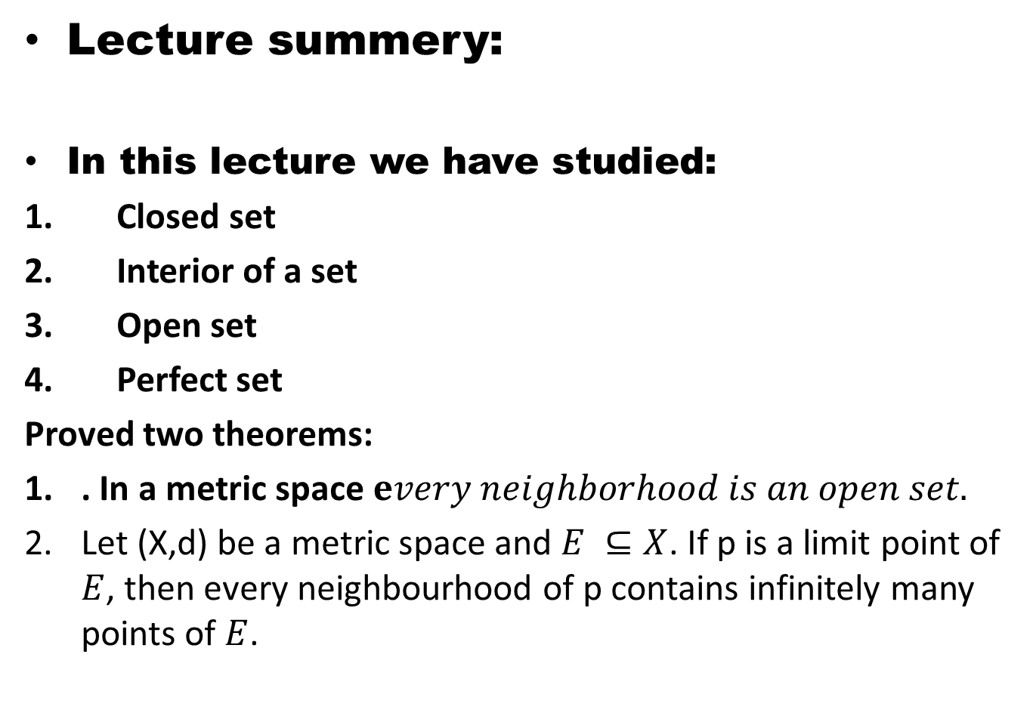
Lecture summery:
In this lecture we have studied:
Closed set
Interior of a set
Open set
Perfect set
Proved two theorems:
. In a metric space $every neighborhood is an open set.$
Let (X,d) be a metric space and $E ⊆X$. If p is a limit point of $E$, then every neighbourhood of p contains infinitely many points of $E$.

Slide 26
THANK YOU

