Slide 1
Real Analysis I
Course Code MTH 321

Slide 2
Real Analysis I
Course Code MTH 321
By
Dr. Moiz ud Din khan
Professor of Mathematics

Slide 3
Lecture # 07

Slide 4
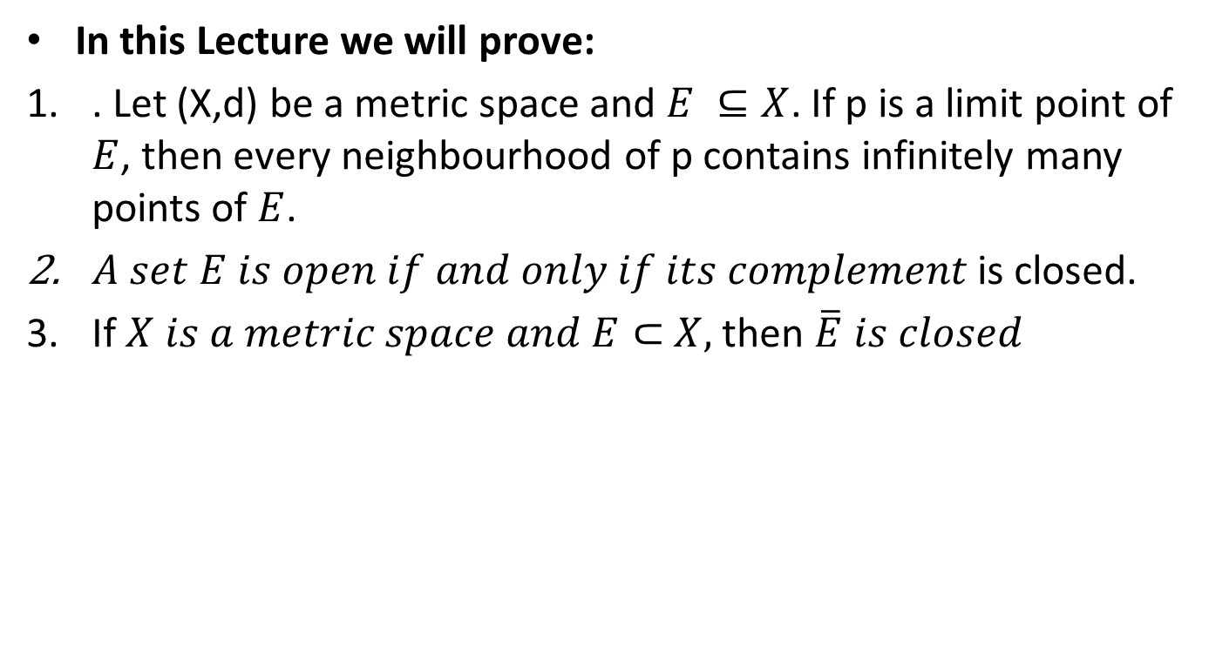
Lecture Outline
In this Lecture we will prove:
. Let (X,d) be a metric space and $E ⊆X$. If p is a limit point of $E$, then every neighbourhood of p contains infinitely many points of $E$.
$A set E is open if and only if its complement$is closed.
If $X is a metric space and E⊂$$X,$then $\overline{E} is closed$

Slide 5

Theorem. Let (X,d) be a metric space and $E ⊆X$. If p is a limit point of $E$, then every neighbourhood of p contains infinitely many points of $E$.
Proof.

Slide 11

Corollary $A finite point set has no limit points.$

Slide 12
Theorem. In a metric space (X, d) , a set E is open if and only if its complement is closed.
Proof.

Slide 17

Corollary $A set F is closed if and only if its complement is open.$

Slide 18

Theorem. Let $(X,d)$be a metric space and $E⊆X,$then prove that $\overline{E} is closed$ subset of X.
Proof.

Slide 27
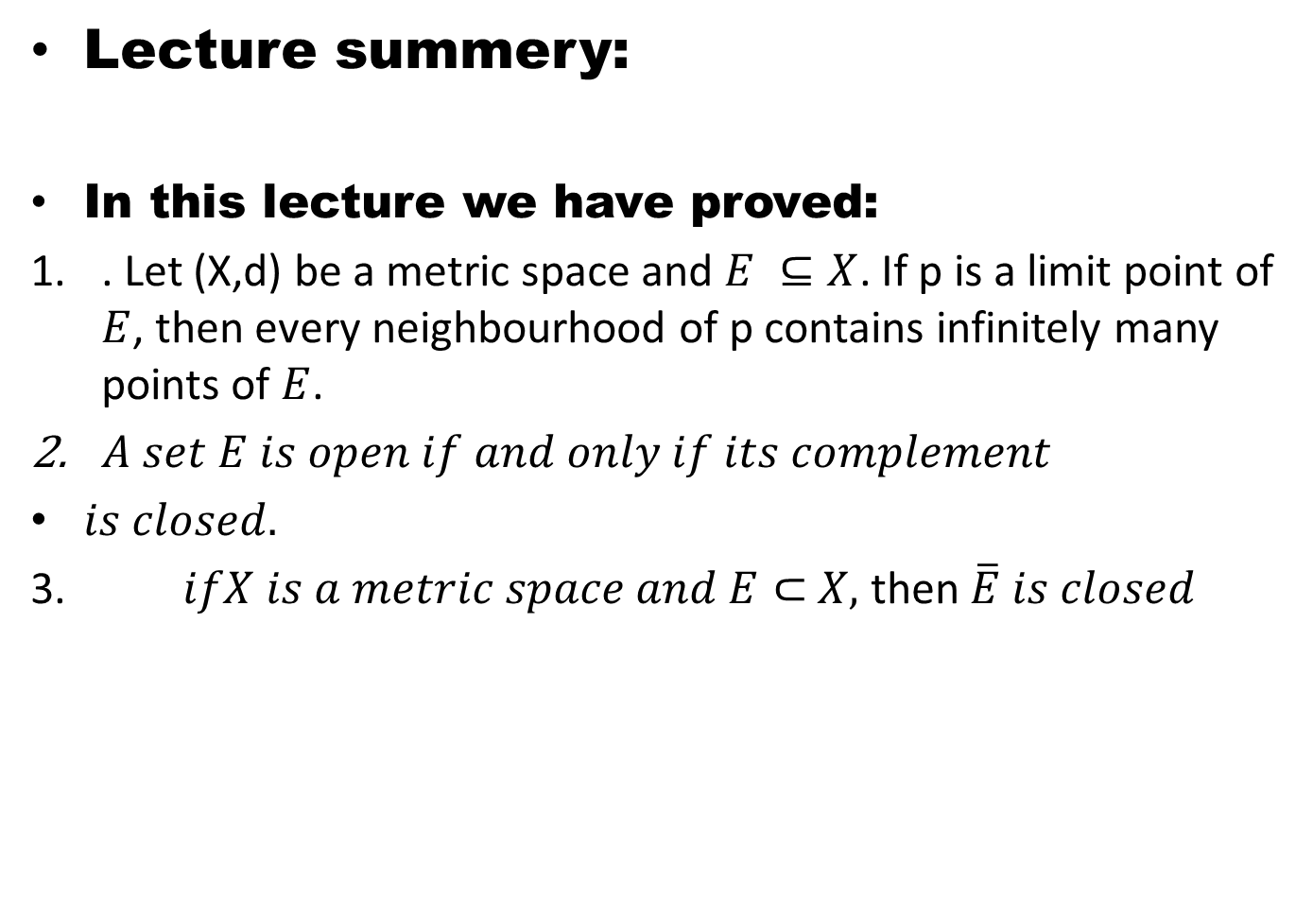
Lecture summery:
In this lecture we have proved:
. Let (X,d) be a metric space and $E ⊆X$. If p is a limit point of $E$, then every neighbourhood of p contains infinitely many points of $E$.
$A set E is open if and only if its complement$
$is closed.$
3. $ifX is a metric space and E⊂$$X,$then $\overline{E} is closed$

Slide 28
THANK YOU

