Slide 1
Real Analysis I
Course Code MTH 321

Slide 2
Real Analysis I
Course Code MTH 321
By
Dr. Moiz ud Din khan
Professor of Mathematics

Slide 3
Lecture # 08

Slide 4
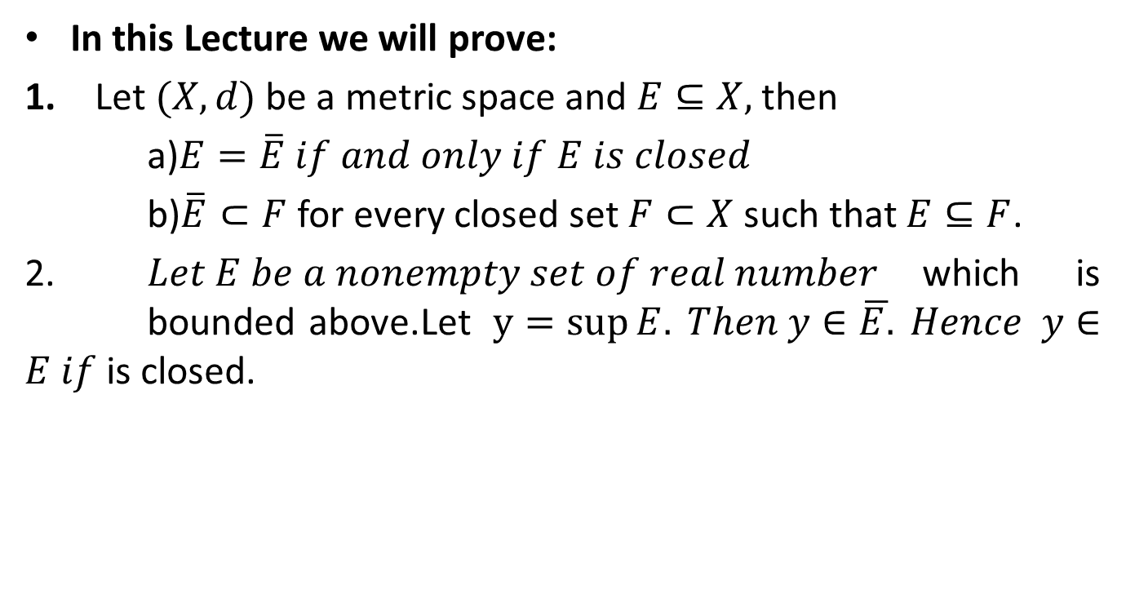
Lecture Outline
In this Lecture we will prove:
Let $(X,d)$be a metric space and $E⊆X,$then
a)$E=\overline{E} if and only if E is closed$
b)$\overline{E}⊂F$for every closed set $F⊂X$such that $E⊆F$.
2. $Let E be a nonempty set of real number$which is bounded above.Let$y=\sup{E.} Then y∈\overline{E.} Hence y∈E if$ is closed.

Slide 5

Theorem.Let $(X,d)$be a metric space and $E⊆X,$then$E=\overline{E} if and only if E is closed$

Slide 11

Theorem. Let $(X,d)$be a metric space and $E⊆X,$then $\overline{E}⊂F$for every closed set $F⊂X$such that $E⊆F$.

Slide 16

Theorem. Let (X, d ) be a metric space and E be a nonempty set of real numbers which is bounded above. Let $y=\operatorname{Sup}{(E).}$Then $y∈\overline{E.} Hence y∈E if$E is closed.
Proof.

Slide 21
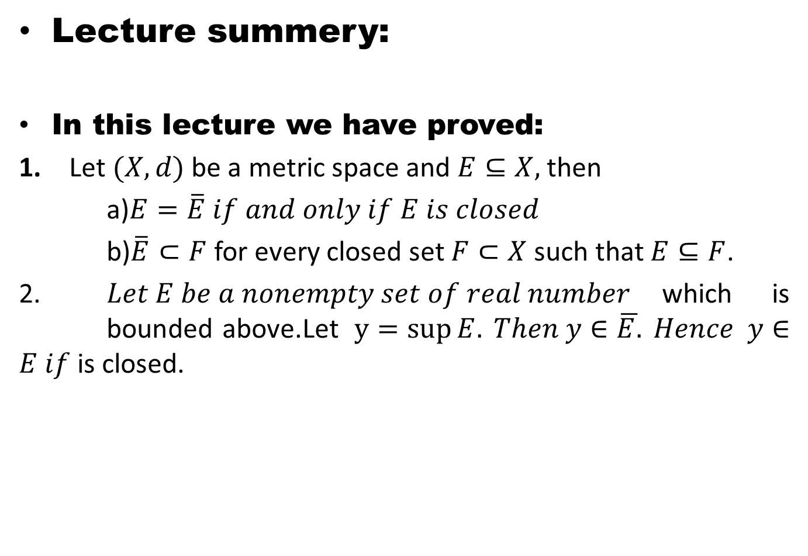
Lecture summery:
In this lecture we have proved:
Let $(X,d)$be a metric space and $E⊆X,$ then
a)$E=\overline{E} if and only if E is closed$
b)$\overline{E}⊂F$ for every closed set $F⊂X$such that $E⊆F$.
2. $Let E be a nonempty set of real number$which is bounded above.Let$y=\sup{E.} Then y∈\overline{E.} Hence y∈E if$ is closed.

Slide 22
THANK YOU

