Slide 1
Psycholinguistics
LECTURE# 10

Slide 2
Psycholinguistics
Productivity
This is an important characteristic of human language allowing us to continuously create new utterances, combining the ‘building bricks’ of language in ever new ways, whether these be sounds, words or sentences. Human languages are therefore continually evolving.

Slide 3
Psycholinguistics
Cultural Transmission
This refers to how languages are acquired by our children. The assumption is that there is no genetic component (although Noam Chomsky challenges this with his theory of Universal Grammar) which would enable a child to simply start speaking e.g. English at a certain age, but rather that children need to be exposed to a language (and culture) in order to acquire it.
This means, for example, that a child born in Korea to Korean parents but then adopted by French parents in France will tend to grow up speaking French as his/her first language and not Korean (unless the French parents make sure the child is also exposed to Korean).
Many animals, however, do seem to pass the ability to communicate on to their offspring genetically e.g. dogs will bark even if they have never heard another dog.

Slide 4
Psycholinguistics
Duality
Duality (or ‘double articulation’) refers to two separate layers of language working together to provide us with a pool of sounds which we can combine to communicate with one another.
On the one hand, we have a limited number of discrete sounds which in isolation have no inherent meaning e.g. b, i, or n.
On the other hand, we have a virtually unlimited number of distinct meanings which we can create by combining these sounds in certain ways e.g. bin, or nib. Various other combinations such as *bni are not meaningful in English, but could possibly be in other languages.

Slide 5
Psycholinguistics
Other features of human language
A further feature of human language is reflexiveness, which means that we are able to use the language to talk about language – which is typically what linguists do. Discreteness is also something that is said to distinguish human languages from other forms of animal communication. It means that the sounds of a language differ sufficiently from one another for a (native) speaker to distinguish them and thereby know which sign with which meaning is being used at any one time.

Slide 6
Psycholinguistics
Language and the brain
Language is a cognitive skill and one therefore whose roots are situated in the evolution of the brain. We do not know exactly when our ancestors began to speak (estimates vary from 30,000 – 100,000 years ago), or even what triggered them to do so, but once they started,
there was no stopping them. From such humble beginnings the 5,000 – 6,000 languages we assume to exist today have evolved.

Slide 7
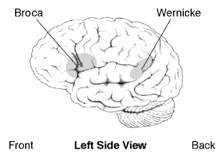
Psycholinguistics
Research mainly on language aphasia has been able to show that there are two major areas of the brain specialized in language processing, production and comprehension: Broca’s and Wernicke’s areas, situated in the left hemisphere and named after the two physicians who first discovered them in the 19th century.

Slide 8
Psycholinguistics
What is linguistics?
Linguistics is the science of language(s). It is generally a descriptive discipline rather than a prescriptive one, which means that linguists do not lay down hard and fast rules about how to use a certain language, but rather concentrate on describing the rules which (especially native) speakers seem to have internalized.
Apart from this, there are various different ways of ‘doing’ linguistics. For example, we can concentrate on language as used at a certain point of time e.g. in 1989; this is called synchronic linguistics.

Slide 9
Psycholinguistics
Alternatively, we can look at language from a diachronic point of view, which involves analyzing the development of a language during a certain period of time e.g. during Middle English, or in the 1950s etc.
Linguistics is a science which can either be studied in a theoretical or a more applied way.
For example, someone may be interested in finding out exactly how questions are formed in English (= theoretical).
Once this is known the knowledge could be applied e.g. to language teaching, thereby (hopefully) enabling teachers and pupils to learn the language more effectively.

Slide 10
Psycholinguistics
Phonetics and Phonology
The two primary linguistic disciplines concerned with speech sounds - those sounds that are used by humans to communicate - are phonetics and phonology.
Both areas are mutually dependent. Phonetics describes the concrete, physical form of sounds (how they are produced, heard and how they can be described), while phonology is concerned with the function of sounds, that is with their status and inventory in any given language.

Slide 11
Psycholinguistics
Phones and Phonetics
The two basic tasks of phonetics are the transcription and the classification of sounds, also called phones in this context. The phone is therefore the basic unit of phonetics and it refers to the concrete sound substance as such. In the area of articulatory phonetics this substance is described on the basis of the articulatory properties. These refer to the human vocal tract (or to the speech organs), illustrated below, and are used to describe and classify sounds. By contrast, acoustic and auditory phonetics deal with the characteristics of sound waves and how they are perceived by the human ear.

Slide 12
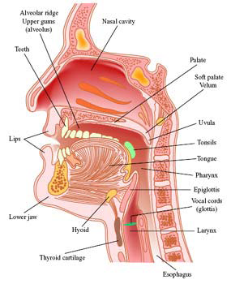
Psycholinguistics

Slide 13
Psycholinguistics
Phones are represented by placing brackets around the transcription ([da:ns]/[dæns] for dance in British and American English)).
The usefulness of a transcription system (a phonetic alphabet) is particularly plausible in a language such as English, where pronunciation and spelling often diverge substantially (cp. see – sea on the one hand, and through and though, on the other).
There are various transcription models, such as the IPA (International Phonetic Alphabet); for the transcription of English, several, slightly differing systems have evolved, all of them following in some way the original model of the phonetician Daniel Jones.

Slide 14
Psycholinguistics
Classification of sounds
Traditionally, sounds are classified into consonants and vowels.
Consonants are sounds that are produced with a major obstruction in the mouth cavity.
For example, in the case of [t] (Fig. 1), there is direct contact between the tip of the tongue (active articulator) and the alveolar ridge (passive articulator), so that the airflow coming from the lungs can leave the mouth cavity only when the obstruction is removed:

Slide 15
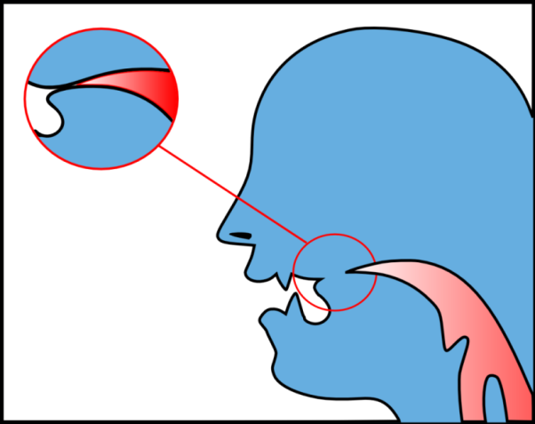
Psycholinguistics
Fig. 1. consonant [t]

Slide 16
Psycholinguistics
Vowels are sounds that are produced without such obstruction.
For example, in the case of [i:] (Fig. 2), there is a gap within the mouth that is determined by the position of the tongue, and the airflow can escape relatively freely:

Slide 17
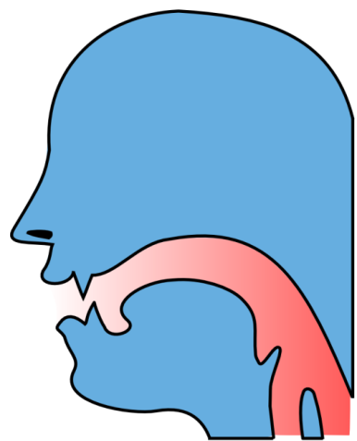
Psycholinguistics
Fig. 2. vowel [i:]

Slide 18
Psycholinguistics
Another difference between consonants and vowels is that vowels are generally voiced, i.e. the vocal cords are set vibrating by the outgoing airflow. Consonants, by contrast, can be voiced or voiceless:
The vocal cords are either far apart and do not vibrate, as in fan, or they are relatively closed and vibrate as in van (Fig. 3).

Slide 19
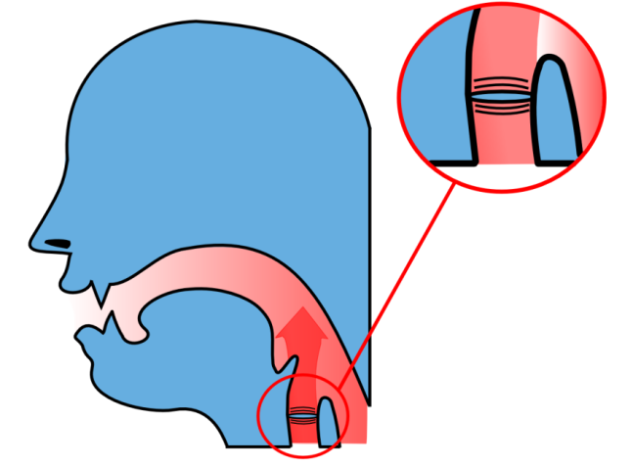
Psycholinguistics
Fig. 3. Voiceless and voiced sounds

Slide 20
Psycholinguistics
Classification of consonants
Factors relevant for the classification of consonants include the manner of articulation, the place of articulation, and voicing.
With regard to the manner of articulation, English consonants can be classified into plosives, fricatives, affricates, nasals, liquids, and semi-vowels.

Slide 21
Psycholinguistics
Plosives are consonants that are made up by completely blocking the airflow.
The production of plosives involves three stages:
1) a direct contact between the active and the passive articulator forming a complete obstruction to the airflow;
2) the compression of air behind the obstruction; and
3) the release of the compressed air in the form of an “explosion” (hence the term plosive).
There are six plosives in English: bilabial [p] and [b], alveolar [t] and [d], and velar [k] and [g].

Slide 22
Psycholinguistics
Bilabial plosives [p] and [b] are produced with both lips pressed together.
The active articulator is the lower lip; the passive articulator is the upper lip.
The soft palate is raised and the air coming into the mouth stops for some time and then breaks the obstruction with a slight explosion.
In the case of [b], the vocal cords are vibrating:

Slide 23
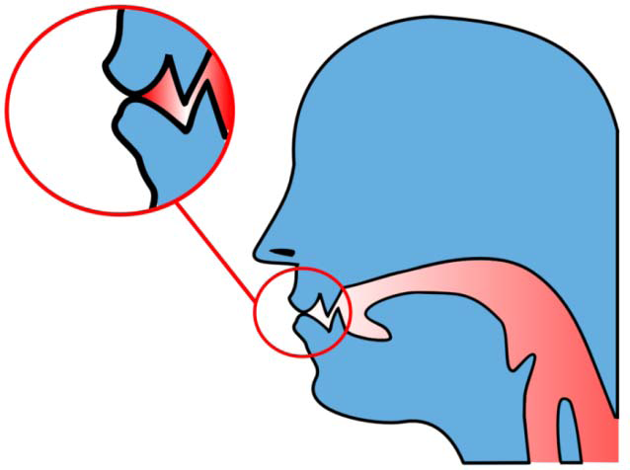
Psycholinguistics
Fig. 4. bilabial plosives [p] and [b]

Slide 24
Psycholinguistics
Alveolar plosives [t] and [d] are produced with the tip of the tongue firmly pressed against the (middle part of the) alveolar ridge.
The active articulator is the tip of the tongue; the passive articulator is the alveolar ridge. The tip of the tongue makes firm contact with the 8 alveolar ridge.
The air is trapped for a short time and then breaks the obstruction with a slight explosion. In the case of [d], the vocal cords are vibrating:

Slide 25
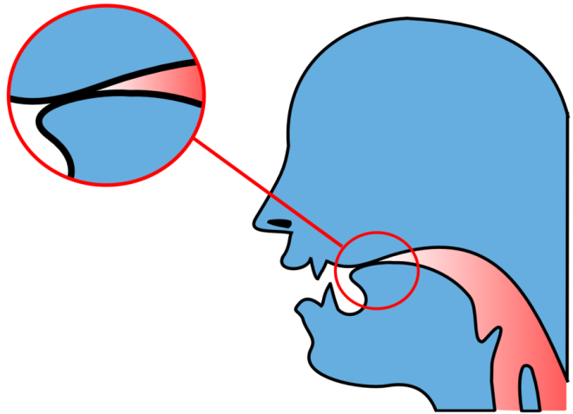
Psycholinguistics
Fig. 5. alveolar plosives [t] and [d]

Slide 26
Psycholinguistics
Velar plosives [k] and [g] are articulated with the back of the tongue against the soft palate.
The active articulator is the back of the tongue; the passive articulator is the soft palate.
The back of the tongue makes firm contact with the soft palate.
The air is trapped for a short time and then breaks the obstruction with a slight explosion.
In the case of [g], the vocal cords are vibrating:

Slide 27
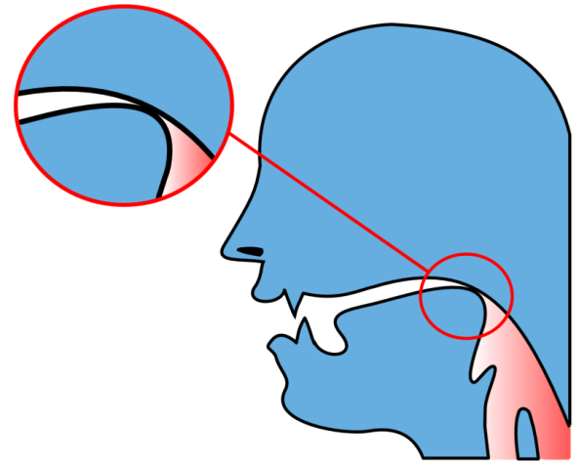
Psycholinguistics
Fig. 6. velar plosives [k] and [g]

Slide 28
Psycholinguistics
Fricatives are consonants that are produced by impeding, but not completely blocking the airflow,
i.e., there is a narrow gap between the active and the passive articulator along which the airflow can leave the oral cavity.
There are nine fricatives in English: labio-dental [f] and [v], interdental [θ] and [ð], alveolar [s] and [z], palate-alveolar [ʃ] and [ʒ], and glottal [h].

Slide 29
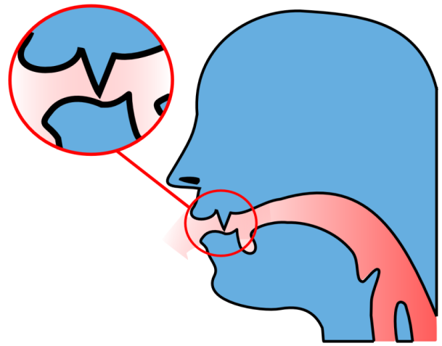
Psycholinguistics
Fig. 7. labio-dental fricatives [f] and [v]

Slide 30
Psycholinguistics
The lower lip is very close to the edge of the upper front teeth, thus forming an incomplete obstruction.
When the air goes through the narrowing it causes slight friction (hence the term fricative).
For [f] the vocal cords do not vibrate; there may be some vibration accompanying [v] when it occurs in word initial position as in e.g. vast or between vowels as in e.g. never.

Slide 31
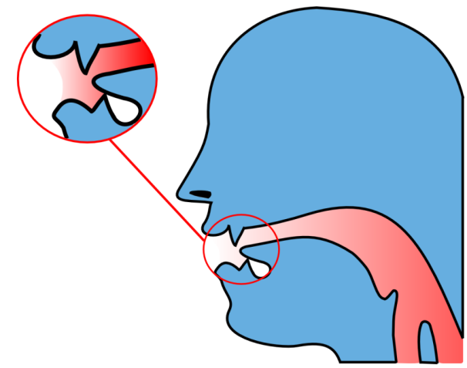
Psycholinguistics
Fig. 8. interdental fricatives [θ] and [ð]

Slide 32
Psycholinguistics
The tip of the tongue is either close to the edge of the upper teeth or slightly projected between the teeth.
For [θ] the friction is as strong as for [f], for [ð] it is gentler.
For [θ] the vocal cords do not vibrate; they vibrate for [ð] when it occurs in word initial position, before a vowel or in intervocalic positions. E.g. that, rather, etc.

Slide 33
Psycholinguistics
Other fricatives are produced with different places of articulation:
For the alveolar fricatives [s] and [z], the tip of the tongue is close to the alveolar ridge. The teeth are very close together.
The friction for [s] is strong, even stronger than for [θ]. For [s] the vocal cords do not vibrate; they vibrate for [z] when it occurs before vowels or in intervocalic positions. E.g. zone, easy, etc.

Slide 34
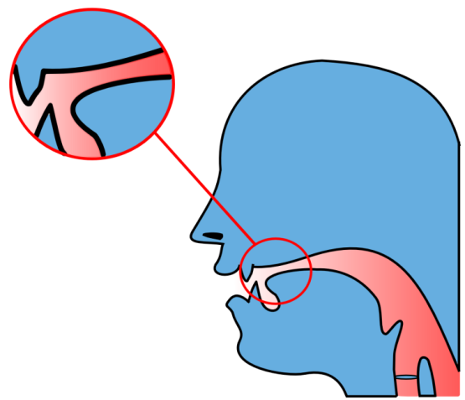
Psycholinguistics
Fig. 9. alveolar and palate-alveolar fricatives [s], [z], [ʃ] and [ʒ]

Slide 35
Psycholinguistics
For [ʃ] and [ʒ], the tip of the tongue is close to the back part of the alveolar ridge forming a flat narrowing.
The front part of the tongue is raised towards the hard palate forming the front secondary focus.
The friction for [ʃ] is strong, stronger than for [f] and [θ].
For [ʃ] the vocal cords do not vibrate; they vibrate for [ʒ] when it occurs before vowels. E.g. pleasure, etc.
It is produced with the voiceless expulsion of air from the lungs with the mouth and tongue already in position for the following vowel.

Slide 36
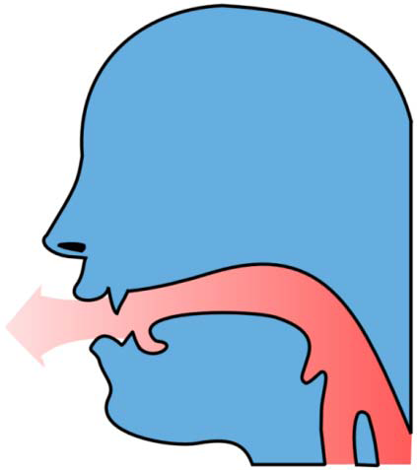
Psycholinguistics
Fig. 10. glottal fricative [h]

Slide 37
Psycholinguistics
Affricates are sounds that are similar to both plosives and fricatives:
The tip of the tongue touches the back part of the teeth ridge, the front part of the tongue is raised towards the hard palate.
The air is trapped for a short time because of a complete obstruction between the tip of the tongue and the teeth ridge, then the obstruction is released slowly and the friction is heard.
The voiceless affricate is [tʃ] as in chain, whereas [dʒ], as in jelly, is voiced.

Slide 38
Psycholinguistics
Nasals are consonants which, like plosives, are produced by completely blocking the airstream. But there is an important difference:
The airflow escapes through the nasal cavity (hence the term nasals).
There are three nasal consonants in English: bilabial [m], alveolar [n], and velar [ŋ]:

Slide 39
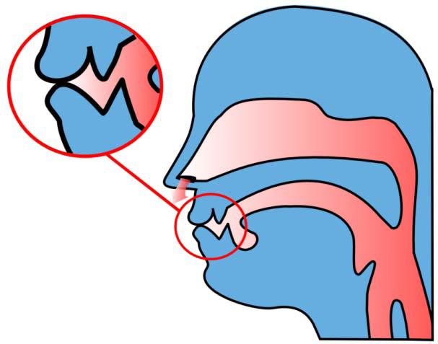
Psycholinguistics
Fig. 11. bilabial nasal [m]

Slide 40
Psycholinguistics
The lips are firmly kept together forming the complete obstruction.
The active articulator is the lower lip; the passive articulator is the upper lip.
The soft palate is lowered and the air escapes through the nasal cavity.
The vocal cords are vibrating.

Slide 41
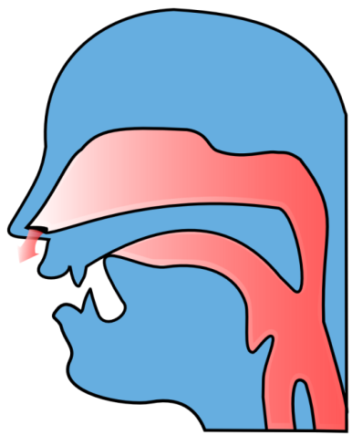
Psycholinguistics
Fig. 12. alveolar nasal [n]

Slide 42
Psycholinguistics
The tip of the tongue is pressed against the alveolar ridge forming the complete obstruction.
The active articulator is the tip of the tongue, and the passive articulator is the alveolar ridge.
The soft palate is lowered and the air escapes through the nasal cavity.
The vocal cords are vibrating.

Slide 43
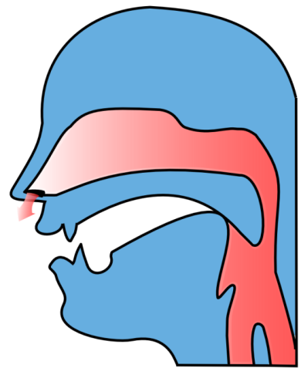
Psycholinguistics
Fig. 13. velar nasal [ŋ]

Slide 44
Psycholinguistics
The back of the tongue is pressed to the soft palate forming the complete obstruction.
The active articulator is the back of the tongue, and the passive articulator is the soft palate.
The soft palate is lowered and the air escapes through the nasal cavity.
The vocal cords are vibrating.
Liquids include alveolar [l] and post-alveolar [r].

Slide 45
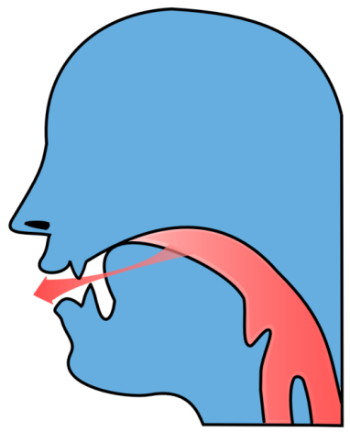
Psycholinguistics
Fig. 14. alveolar [l]

Slide 46
Psycholinguistics
The tip of the tongue is in firm contact with the alveolar ridge forming the complete obstruction.
The active articulator is the tip of the tongue, and the passive articulator is the alveolar ridge.
The sides of the tongue are lowered and the air can pass between them.
The vocal cords are brought together and are vibrating.

Slide 47
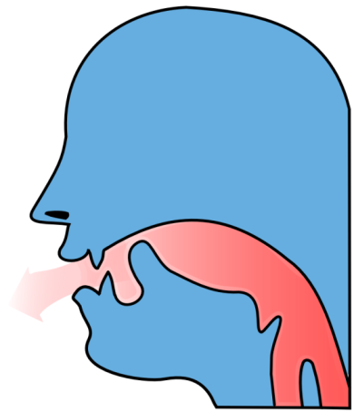
Psycholinguistics
Fig. 15. post-alveolar [r]

Slide 48
Psycholinguistics
The tip of the tongue is held in a position near to but not touching the back part of the alveolar ridge.
The soft palate is raised and the air flows quietly between the tip of the tongue and the hard palate.
The front part of the tongue is low and the back is rather high so that the tongue has a curved shape.
The vocal cords are vibrating.

Slide 49
Psycholinguistics
Semi-glides or glides include bilabial [w] and palatal [j]: [w], as in why, starts out with the lips firmly rounded, these articulators then moving away (= gliding) from the narrowing in the mouth.
When articulating [j], as in you, the front part of the tongue is first raised towards the hard palate, then the soft palate is raised and the air goes along the central part of the tongue.
The vocal cords are kept together and are vibrating.

Slide 50
Psycholinguistics
The reason why these sounds are called semi-vowels is thus their manner of articulation:
Like true vowels, semi-vowels are produced without a major obstruction, i.e., there is a wide gap between the active and the passive articulator, so that the airflow can escape relatively freely from the mouth.
However, unlike true vowels, semi-vowels never form the nucleus of a syllable (e.g., week, yellow) and are therefore usually considered consonants.

Slide 51
Psycholinguistics
Classification of vowels
Depending on the height of the tongue, vowels can be classified into high, low, and mid vowels:
1) When the front or the back of the tongue is raised towards the roof of the mouth, the vowel is called high, this is the case, e.g., in pill, meet, look, or soon.
2) When the front or the back of the tongue is as low as possible, the vowel is called low, as, e.g., in land, star, or dog.
3) When the tongue occupies the position intermediate between the high and the low one, the vowel is called mid, e.g. in get, or the unstressed [ə] in about.

Slide 52
Psycholinguistics
Depending on the part of the tongue that is raised most vowels are classified into front, back, and central vowels:
1) When the front part of the tongue is raised towards the hard palate, the vowel is called front, e.g. in meet, get, or land.
2) When the back part of the tongue is raised towards the soft palate, the vowel is called back, as in star, dog, law, or soon.
3) When the front part of the tongue is raised towards the back part of the hard palate, the vowel is called central, e.g. in about, much, or nurse.

Slide 53
Psycholinguistics
These high-low and front-back dimensions of vowel articulation are also referred to as vowel quality.
To illustrate how the articulatory properties of vowels relate to each other, a vowel chart is commonly used as a reference system.
The chart below (adapted from Kortmann (2006: 68)) describes the basic vowel qualities of most standard varieties of English together with their phonetic transcription.
As can be seen from this chart, some vowels do not only differ qualitatively, but also quantitatively (as indicated by the colon as the diacritic for length). Long as opposed to short vowels also differ by being tense as opposed to lax:

Slide 54
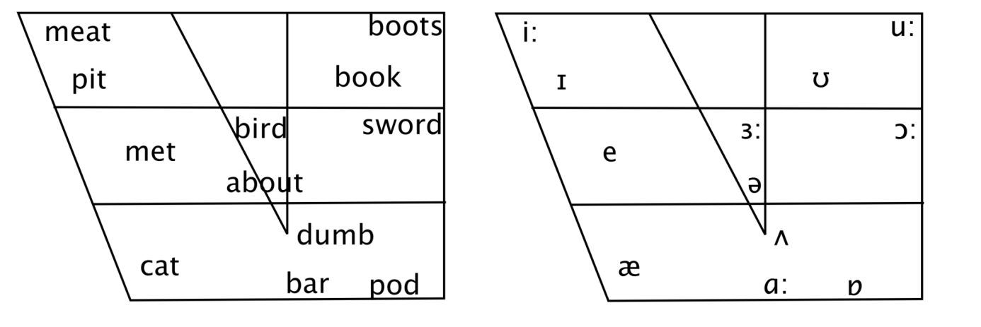
Psycholinguistics

Slide 55
Psycholinguistics
1) Tense vowels are produced with a deliberate, accurate, maximally distinct gesture that involves considerable muscular effort.
Tense vowels are either long vowels (e.g. [i:] in meet) or diphthongs (e.g. [eI] in say).
2) Non-tense (or lax) vowels are produced rapidly and are therefore short (e.g. [I] in pill).

Slide 56
Psycholinguistics
Diphthongs
The vowels described so far have all been monophthongs, in contrast to the diphthongs (or gliding vowels), where the tongue moves from one position to another. Examples can be found in day, fight, oil, so, and now for the so-called closing diphthongs, while centring diphthongs occur, for example, in bare, beer, and sure.

Slide 57
Psycholinguistics
Phonemes and phonology
Phonemes, in contrast to phones, are defined by their function within the language system (langue).
This function is basically one of meaning differentiation, although other functions of phonic means, such as an expressive function of vowel lengthening (That was coooooool), are also possible.
All sounds, however, which have a meaning-differentiating function within a given language are considered phonemes within that language system; these are abstract, idealized units within our minds or parts of our model of a language that we design; in language use (parole) phonemes are always realized as phones.

Slide 58
Psycholinguistics
The test for these smallest distinctive units of a given language system is the minimal pair test, i.e. when a difference in sound structure also causes a shift in meaning.
An example is [k] in cable and [t] in table, which therefore constitute phonemes of English, indicated by the notation /k/ and /t/.
Note, however, that we are dealing with the actual sound structure here, not with spelling, so tea/he are a minimal pair, while see/sea are not.
Also, minimal pairs are only pairings that differ in exactly one segment; so, pin and tin, or tin and ten, are minimal pairs, while pin and ten would be not.

Slide 59
Psycholinguistics
Allophones
Some sound differences do not differentiate meaning, as in the pronunciation of /l/ in the words lip and pill.
While the difference may be only slight (you may try to keep track of where you place the tip of your tongue), from a phonetic point of view the two realizations of /l/ have to be considered two phones, but not two phonemes.
They are called clear and dark /l/ and are two allophones of the phoneme /l/ in English.

Slide 60
Psycholinguistics
Distribution of allophones
In contrast to phonemes, allophones do not occur in minimal pairs, which means they either never occur in the same environment (complementary distribution), as in the case of clear and dark /l/, or they occur in free variation.
For example, voiceless plosives at the end of a syllable or word are sometimes aspirated (if deep is pronounced [di:ph]), but they may just as well not be (if deep is pronounced [di:p]).
The decisive difference between phonemes and their allophones is that the variants of a phoneme do not differentiate meaning, and therefore the sound difference does not constitute a relevant phonetic feature.

Slide 61
Psycholinguistics
Phonological systems
The phonology of a language is also the inventory of its phonemes, i.e. the sum of all those sounds that show distinctive (i.e. meaning-differentiating) phonetic differences. RP as the standard (British) English sound system, for example, has
24 consonants,
16
12 vowels, and
8 diphthongs
but it has many more allophones (such as clear and dark /l/, or the aspirated plosives).

Slide 62
Psycholinguistics
By contrast, this table shows the phoneme inventory of Standard Mandarin, the official language of China:
As can be seen, one major difference to English is that Standard Mandarin lacks the voiced bilabial, alveolar and velar plosives /b/, /d/ and /g/, while it has the aspirated versions of the consonants pʰ, tʰ, kʰ as distinct phonemes.
In other words, a difference (aspiration) that does not distinguish meaning in English and is thus a redundant articulatory feature constitutes a distinctive feature in Mandarin Chinese,
while another one (the voicing of plosives) is distinctive in English (i.e. it distinguishes meaning), but not in Chinese.

Slide 63
Psycholinguistics
Syllables
Phonology does not only describe a system of sounds in isolation, but it also deals with the rules and restrictions that hold for their combinations.
This branch of phonology is called phonotactics. Phones combine into the syllable, which is essentially a vowel with optional consonants clustered around it.
The vowel forms the nucleus of a syllable, with the onset in front of it and the coda behind it. Depending on whether there is a coda or not, a syllable can be described as either closed or open.
The basic form of the English syllable is (CCC) V (CCCC), i.e. I, spray, or texts are all examples of one syllable but of different complexity.

Slide 64
Psycholinguistics
Prosody
Prosody belongs to the domain of suprasegmental phonology in that it describes phenomena extending over more than one phoneme.
The phenomena that belong here are stress, rhythm, and intonation.
While stress can be word or sentence stress, rhythm and intonation occur in phrases and sentences. Intonation is described by reference to pitch (tones); different levels of pitch are used to express a wide range of meanings:
for example, we use the difference between a falling and a rising pitch pattern in statements and questions.

Slide 65
Psycholinguistics
Connected Speech
The phonological changes that occur when language is used in natural utterances are described as features of connected speech.
The most important ones are:
assimilation, i.e. when neighbouring sounds become more alike (as in im-possible, in contrast to in-decent) elision,
i.e. the loss of sounds (as in Chris(t)mas or san(d)wich) intrusion and linking (as in law(r) and order).

Slide 66
Psycholinguistics
The most important feature of connected speech, however, is the occurrence of weak forms, which is the result of the occurrence of stress in connected speech.
English has the property of being a stress-timed language, which means there is a tendency for stressed syllables to occur at fairly equal intervals.
As a result, in unstressed syllables vowel quality tends to be weakened, mostly to the schwa [ə], but the total omission of vowels (as it frequently happens in contractions, such as isn’t, she’s) is also possible, particularly in the case of function words (auxiliaries, pronouns, prepositions, conjunctions).

