Slide 1
Statistics and Probability Theory
Lecture 03
Fasih ur Rehman

Slide 2
Last Class
Data Representation
Histogram
Center and Spread of Data
Quartiles
Box and Whisker Plot

Slide 4
Today’s Agenda
Median of a grouped data
Outlier
Mean
Mode
Weighted Mean

Slide 5
Median of Grouped Data
Median of grouped data is found by
Cumulative frequency distribution be constructed
Decide which class has median (i.e. the class with value at least n/2)
Median is then found by the relation
L_{m} is the lower limit of the class that contains median
n = Σf_{i}
f_{m} is frequency of the median class
F Cumulative frequency before the class
i is the class width

Slide 6
Example
We constructed cumulative distribution
Third class contains median
Using relation
Group | Abs. Freq | Cum. Freq
75 - 79 | 1 | 1
80 - 84 | 3 | 4
85 - 89 | 7 | 11
90 - 94 | 2 | 13
94 - 99 | 1 | 14

Slide 7
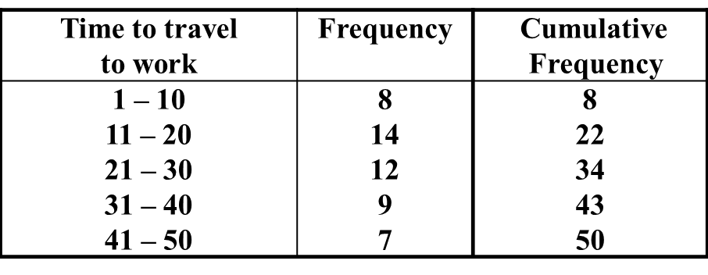
Example
Here n/2 = 25 so median is in third class
F = 22; L_{m} = 20.5; i = 10

Slide 8
Outliers
An Outlier is a value that appears to be uniquely different from rest of the data set.
This might indicate that something has gone wrong with data collection process
One way of finding outlier is using IQR
Outlier is conventionally defined as a value more than a distance of 1.5 * IQR from either end of box
In the example of last class

Slide 9
Mean, Average or Expected Value
Mean is found by
Mean = (Σ X_{j})/n
89 84 87 81 89 86 91 90 78 89 87 99 83 89
Σ X_{j} = 1222
Mean = 1222/14 = 87.3

Slide 10
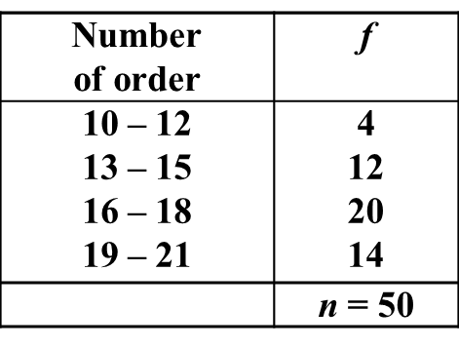
Mean for Grouped Data

Slide 11
Example
Group | Abs. Freq | Cum. Freq
75 - 79 | 1 | 1
80 - 84 | 3 | 4
85 - 89 | 7 | 11
90 - 94 | 2 | 13
94 - 99 | 1 | 14

Slide 12
Summary
Median of a grouped data
Outlier
Mean

Slide 13
References
1: Advanced Engineering Mathematics by E Kreyszig 8th edition

