Slide 1
Statistics and Probability Theory
Lecture 04
Fasih ur Rehman

Slide 2
Last Class
Median of a grouped data
Outlier
Mean

Slide 3
Today’s Agenda
Weighted Mean
Mode
Percentile
Variance and Standard Deviation

Slide 4
Weighted Mean
In weighted mean, data points don’t contribute equally i.e. some points contribute more than others.

Slide 5
Mode
Mode is the value that appears the most in the data.
For grouped data, it’s mid point of the class containing largest number of element (i.e. class with highest frequency.

Slide 6
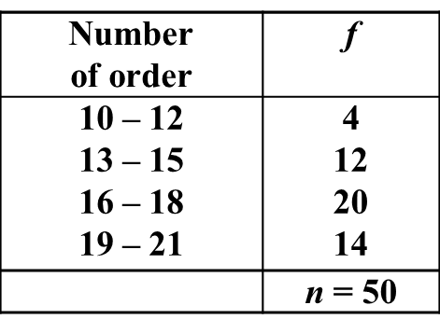
Example (Mode)
89 84 87 81 89 86 91 90 78 89 87 99 83 89

Slide 7
How Mean Median and Mode are Related
Mode = mean - 3 [mean - median]

Slide 8
Percentile
The sample p^{th} percentile is a value such that at least 100p % of the observations are at least at or below this value and at least 100(1 – p)% are at or above this value.
Percentiles are calculated as
Sort the sample (n - observations) in ascending order
Determine the product ‘np’ (round up ‘np’ if needed) this gives order of the p^{th} percentile in the data
If ‘np’ is integer (say = k) calculate mean of the k^{th} and (k + 1)^{st} order observation.

Slide 9
Variance
Spread and variability of the data values can be measure in a more refined way by standard deviation and variance.
Variance is defined as mean of the squared deviations from the mean.
For population
For Sample

Slide 10
Standard Deviation
Standard Deviation measures variation of the scores about the mean. Mathematically, it is calculated by taking square root of the variance.

Slide 11
Summary
Weighted Mean
Mode
Variance and Standard Deviation

Slide 12
References
1: Advanced Engineering Mathematics by E Kreyszig 8th edition

