Slide 1
Statistics and Probability Theory
Lecture 13
Fasih ur Rehman

Slide 2
Last Class
Introduction to Probability
Random Variables
Probability Distribution
Continuous and discrete probability distribution functions
Probability Bar chart and Probability Histogram
Examples

Slide 3
Today’s Agenda
Probability Distribution Functions(continued)

Slide 4
Continuous Probability Distribution
Continuous probability distribution cannot be written in tabular form but it can be stated as a formula. Such a formula would necessarily be a function of the numerical values of the continuous random variable X and as such will be represented by the functional notation f(x). The function f(x) usually called probability density function or density function of X.

Slide 5
Continuous PDF
The function f(x) is probability density function for a continuous random variable X, defined over set of real numbers, if
$$f\left(x\right)≥0 for all x∈R$$
$$\int_{−∞}^{∞}{f\left(x\right)dx=1}$$
$$and P\left(a<x<b\right)= \int_{a}^{b}{f\left(x\right)dx}$$

Slide 6
Examples / Explanation

Slide 7
Example
Suppose that the error in the reaction temperature, in °C, for a controlled laboratory experiment is a continuous random variable X having the probability density function. Verify f(x) is PDF and find P(0<x<1)
$f\left(x\right)=\left\{\begin{aligned}\frac{x^{2} }{3} \\ 0\end{aligned}\right.$ for (-1 < x < 2)

Slide 8
Example
$f\left(x\right)=0.75(1−x2)$ if -1 ≤ x ≤ 1 and$f\left(x\right)=0$otherwise; find distribution, P(-0.5 ≤ x ≤ 0.5), P(0.25 ≤ x ≤ 2) and x such that P( X ≤ x) = 0.95

Slide 9
Example

Slide 10
Cumulative Distribution Function
The Cumulative Distribution Function F(x) of a continuous random variable X with density function f(x) is
$F\left(x\right)=P\left(X≤x\right)= \int_{−∞}^{x}{f\left(t\right)dt, for −∞<x< ∞}$
This definition leads to
$$P\left(a<x<b\right)=F\left(b\right)−F(a)$$
and
$$f\left(x\right)= \frac{dF(x)}{dx}$$
if the derivative exists

Slide 11
Example
Find CDF for $f\left(x\right)=\left\{\begin{aligned}\frac{x^{2} }{3} \\ 0\end{aligned}\right.$ for (-1 < x < 2)
divide the interval -$∞$ to $∞$ in three parts

Slide 12
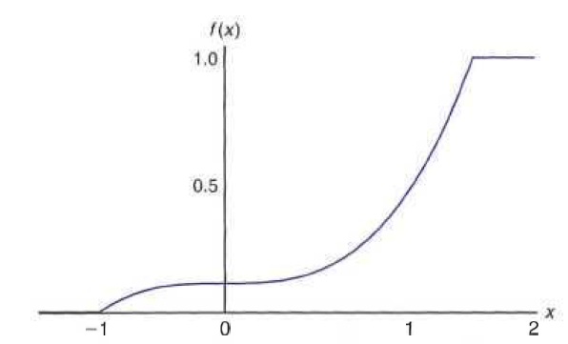
Example cont.

Slide 13
Example
The Department of Energy (DOE) puts projects out. on bid and generally estimates what a reasonable bid should be. Call the estimate b. The DOE has determined that the density function of the winning (low) bid is
$f\left(y\right)=\left\{\begin{aligned}\frac{5 }{8b} \\ 0\end{aligned}\right.$ for (-2b/5 <y <2b)
Find F(y) and use it to determine the probability that the winning bid is less than the DOE's preliminary estimate b.

Slide 14
Joint Probability Distribution
The function f(x, y) is a joint probability distribution or probability mass function of the discrete random variable x and y if
$$f\left(x, y\right)≥0 for all (x, y)$$
$$f(x, y)=1$$
$$P\left(X=x;Y=y\right)=f(x, y)$$
for any region A in the xy plane,
$$P\left[\left(x, y\right)∈A\right]= ΣΣf(x, y)$$

Slide 15
Example
Two ballpoint pen are selected at random from a box that contains 3 blue pens, 2 red pens, and 3 green pens. If X is the number of blue pens and Y is the number of red pens selected, find the joint probability f(x, y) and $P\left[\left(x, y\right)∈A\right]$ where A is the region {(x, y)| x + y ≤ 1}

Slide 16
Example

Slide 17
Summary
Continuous Distribution

Slide 18
References
Probability and Statistics for Engineers and Scientists by Walpole
Schaum outline series in Probability and Statistics

