Slide 1
Statistics and Probability Theory
Lecture 14
Fasih ur Rehman

Slide 2
Last Class
Continuous PDF
Joint PDF
Examples

Slide 3
Today’s Agenda
Probability Distribution Functions(continued)

Slide 4
Example
Simultaneous flip of two coins as joint PDF

Slide 5
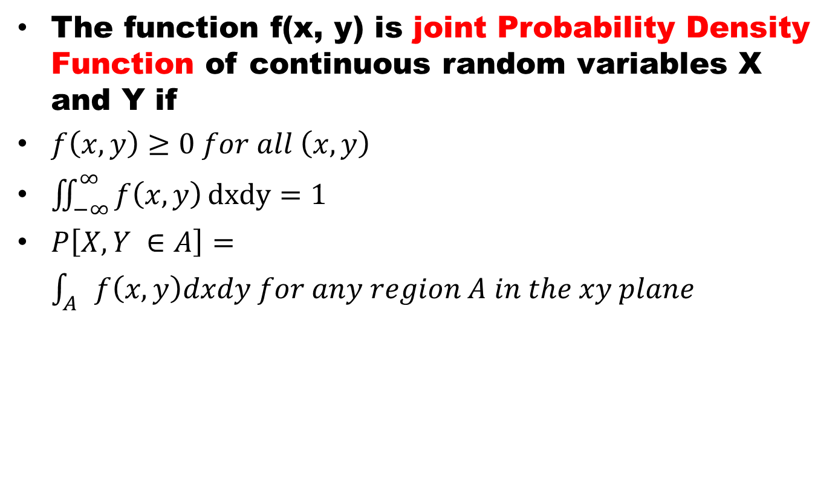
Continuous Joint PDF
The function f(x, y) is joint Probability Density Function of continuous random variables X and Y if
$f\left(x, y\right)≥0 for all \left(x, y\right)$
$\iint_{−∞}^{∞}{f\left(x, y\right)}dxdy=1$
$P\left[X, Y ∈A\right]=\int_{A}{f\left(x,y\right)dxdy for any region A in the xy plane}$

Slide 6
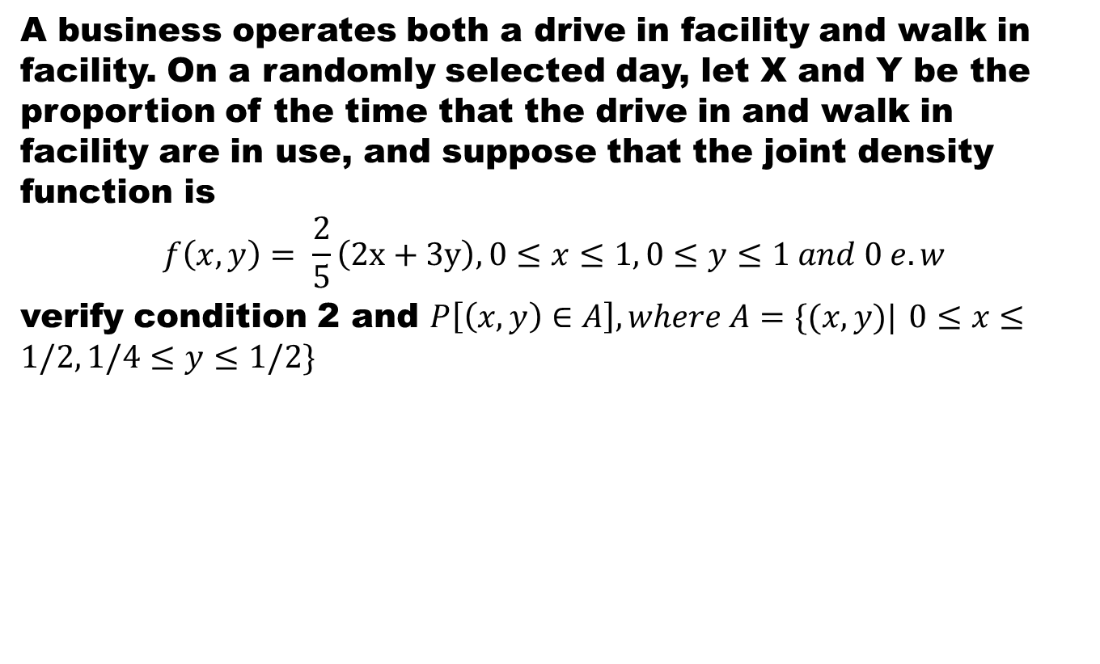
Example
A business operates both a drive in facility and walk in facility. On a randomly selected day, let X and Y be the proportion of the time that the drive in and walk in facility are in use, and suppose that the joint density function is
$$f\left(x,y\right)= \frac{2}{5}\left(2x+3y\right), 0≤x≤1, 0≤y≤1 and 0 e.w$$
verify condition 2 and $P\left[\left(x,y\right)∈A\right], where A=\{(x,y)|0≤x≤1/2, 1/4≤y≤1/2\}$

Slide 7
Example (cont)

Slide 8
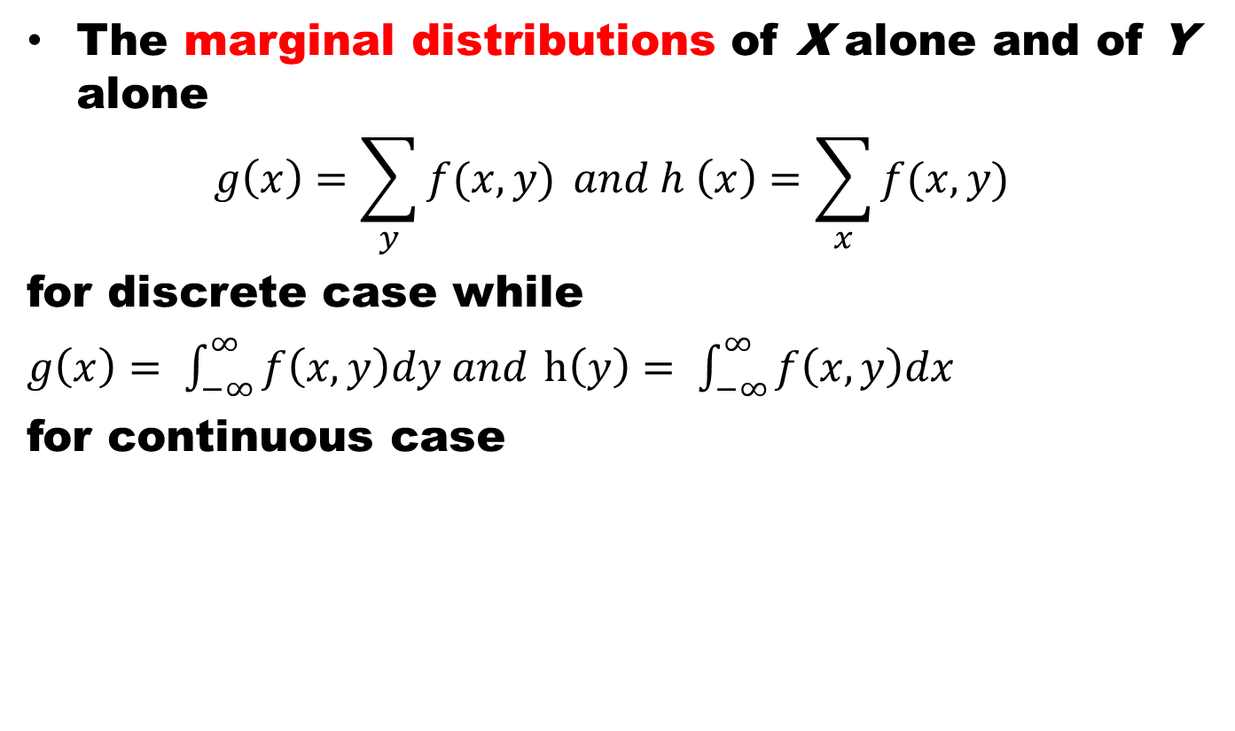
Marginal Distribution
The marginal distributions of X alone and of Y alone
$$g\left(x\right)=\sum_{y}{f(x,y)} and h \left(x\right)=\sum_{x}{f(x,y)}$$
for discrete case while
$g\left(x\right)= \int_{−∞}^{∞}{f\left(x,y\right)dy and}$ $h\left(y\right)= \int_{−∞}^{∞}{f\left(x,y\right)dx}$
for continuous case

Slide 9
Summary
Continuous Distribution

Slide 10
References
Probability and Statistics for Engineers and Scientists by Walpole
Schaum outline series in Probability and Statistics

