Slide 1
Statistics and Probability Theory
Lecture 18
Fasih ur Rehman

Slide 2
Last Class
Variance of a distribution
Mean of a joint distribution

Slide 3
Today’s Agenda
Covariance
Correlation
Discrete Distributions
Uniform Distribution

Slide 4
Covariance
Let X and Y be random variables with joint probability distribution f(x, y). The covarianceof X and Y is
$$μ_{xy}=E\left[\left(X−μ_{x}), (Y−μ_{y}\right)\right]=\sum_{x}{\sum_{y}{(x−μ_{x})(x−μ_{y})f\left(x,y\right)}}$$
if X and Y are discrete and
$$μ_{xy}=E\left[\left(X−μ_{x}), (Y−μ_{y}\right)\right]=\iint_{−∞}^{∞}{(x−μ_{x})(x−μ_{y})f\left(x,y\right)}dxdy$$
if X and Y are continuous.

Slide 5
Theorem
The covariance of two random variables X and Y with means $μ_{x} and μ_{y}$ respectively is given by
$$σ_{xy}=E\left(XY\right)−μ_{x}μ_{y}$$
Proof:

Slide 6
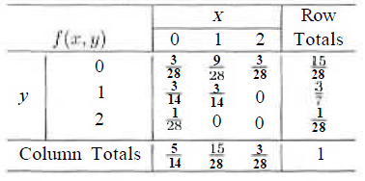
Example
Find covariance of JPDF.

Slide 7
Example
The fraction X of male runners and the fraction Y of female runners who compete in marathon races are described by the joint density function
$$f\left(x,y\right)=8xy for 0≤y≤x≤1 and f\left(x,y\right)=0 e.w.$$

Slide 8
Example (Cont.)

Slide 9
Correlation
Let X and Y be random variables with covariance σ_{xy} and standard deviations σ_{x} and σ_{y} respectively. The correlation coefficient of X and Y
$$ρ_{xy}=\frac{σ_{xy}}{σ_{x}σ_{y}}$$

Slide 10
Example
Find correlation coefficient of the last 2 examples

Slide 11
Example (cont)

Slide 12
Discrete Probability Distributions

Slide 13
Summary
Covariance
Correlation
Discrete Distributions
Uniform Distribution

Slide 14
References
Probability and Statistics for Engineers and Scientists by Walpole
Schaum outline series in Probability and Statistics

